Slide 1
Products—Innovations

Slide 2
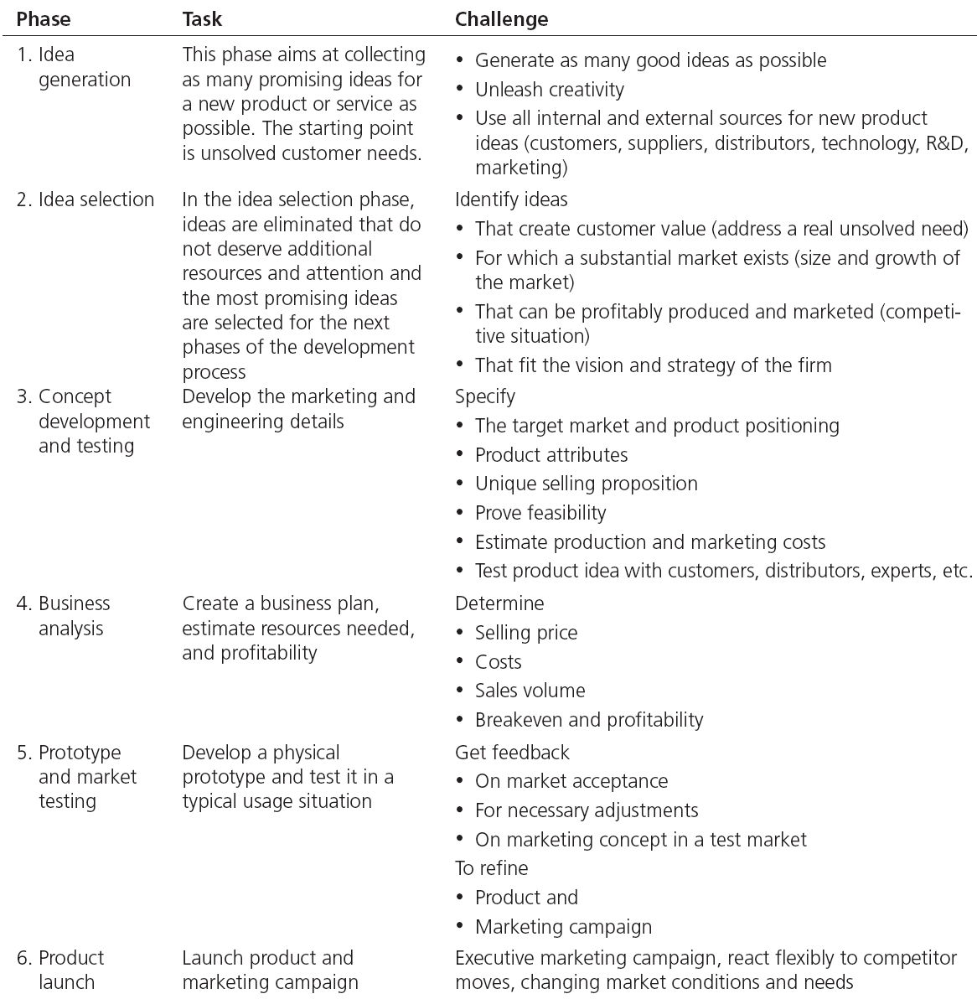
Table Note 30-1 - Phases in the New Product Development Process

Slide 3
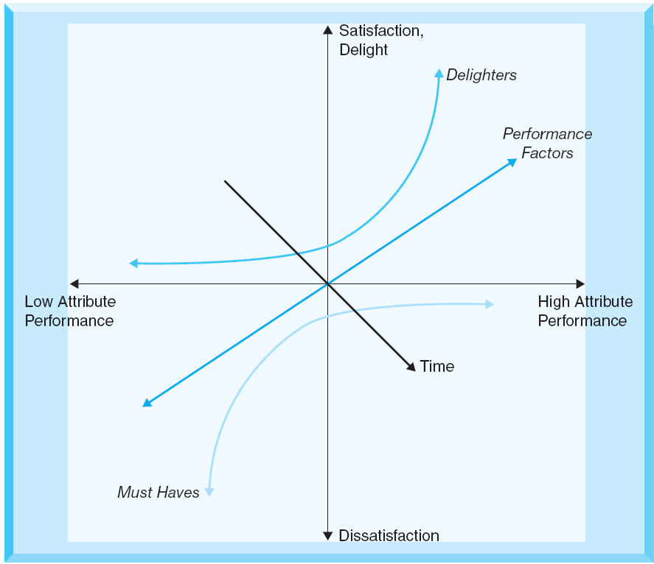
Figure Note 30-1 - The Kano Model
The Kano-model of customer satisfaction can help to identify promising ideas.
It distinguishes three types of product attributes:
Basic factors (must haves)
Excitement factors (delighters)
Performance factors (the more the better)

Slide 4
Figure Note 30-2 - Research versus Development as a Continuum
Research refers to more basic explorations.
Development refers to more applied and incremental and tactical new product development and design.
The most important aspect of integrating this continuum from basic theoretical research to applied incremental development is to have an understanding of exactly
what the investments are meant to contribute to the strategy and to then shape the activities to conform to that purpose.

Slide 5
Design
It recognizes the essential process of integrating nonfunctional or aesthetic elements of the product with the functional elements to create enhanced customer experiences and customer value
Design or “product design” as a process is a broad, holistic, and integrative set of activities linking the new product development process to the customers and to the firm’s strategy from the onset

Slide 6
“innovation”
In marketing strategy, innovations refer to discontinuous innovations—products that are truly “new to the world” and that change the way a customer need is met
An “innovation” is defined by the degree of change in consumer behavior or “consumption patterns” required to adopt it, consume it, and meet a need with it.

Slide 7
Figure Note 31-1 - Degrees of New Product Innovation
Consumption patterns include the actual behaviors required to use the product as well as the knowledge required and the ancillary equipment and installations required.
Discontinuous innovations require substantial changes in consumption patterns.
Continuous innovations” offer incremental value without major or sometimes even noticeable changes in consumption patterns.
Dynamically discontinuous innovations change consumption behaviors and change the way the need is met, but only to a limited degree.

Slide 8
Customer Value and Product Innovation
Value is defined as what the customers get adjusted for what the customers give
Relative performance adjusted for relative price

Slide 9
The Diffusion of Innovations
Refers to the speed at which a truly new product or an idea spreads through or “diffuses” into a market.
The adoption process of an innovation includes stages that a consumer moves through on their way from unaware of a new product to eventual adoption and loyalty.

Slide 10
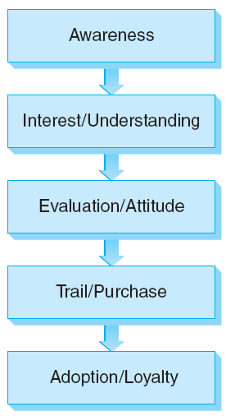
Figure Note 31-3 - The Adoption Process

Slide 11
Attributes of the Product/Innovation
Relative advantage
Trialability
Complexity/Ease of use
Observability
Compatibility
Risk
Network effects

Slide 12
Note 33 Pricing Strategies

Slide 13
Introduction
Four steps central to effectively developing pricing strategies and tactics:
Define price objectives
Analyze key elements of pricing situation
Define the pricing strategy
Set the price and the pricing tactics

Slide 14
Price Objectives
Pricing objectives are derived from the marketing strategy and the positioning decisions the firm has made
Pricing decisions can have short-term or long-term objectives
Short-term objectives:
Survival
Maximum current profit

Slide 15
Price Objectives
Long-term objectives:
Building and protecting market share
Market skimming
Market penetration
Product positioning

Slide 16
Elements of Pricing Decisions
The firm’s costs and cost structure
The firm’s customers
The firm’s competition
Legal and ethical implications of the decision and strategy

Slide 17
Define the Pricing Strategy
Important concepts that can shape the pricing strategy:
The value map
Skimming versus penetration strategies
Razorblade pricing
Price promotions versus brand building
Premium/prestige pricing

Slide 18
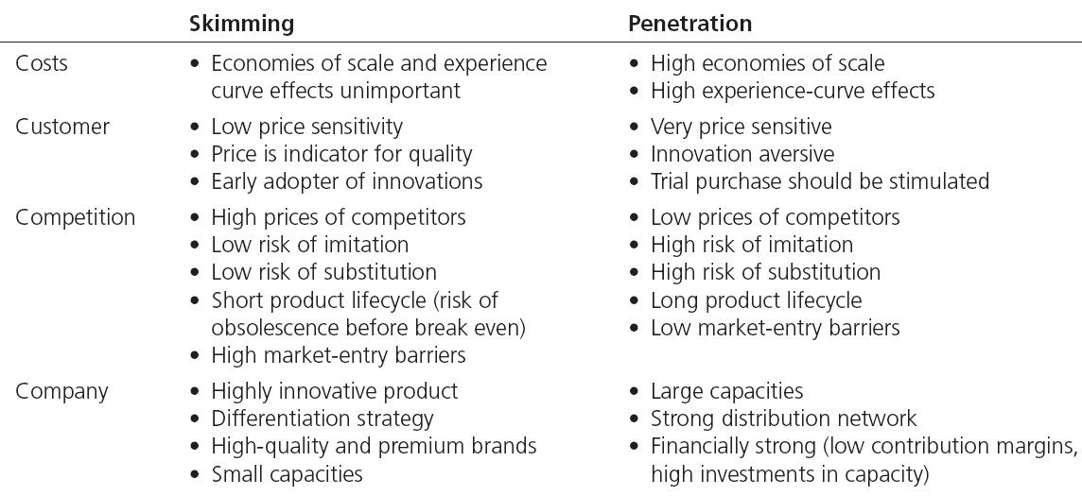
Table Note 33-3 - Skimming versus Penetration Strategy

Slide 19
Setting and Adjusting the Price
The final price must be consistent with the core strategy and with the pricing objectives
Tactics that can be used to respond to pricing challenges
Price discounts and allowances
Promotional pricing
Price differentiation
Price bundling and complementary pricing
Yield management

Slide 20
Note 34 Promotion and People— Integrated Marketing Communications

Slide 21
The Communications Management Process
Specifying the target market and segments
Type of market
Target market concentration and addressability
Order size/cost
Type of product
The stage in the product lifecycle
Available commercial infrastructure and cultural differences

Slide 22
The Communications Management Process
Determining customers’ current relationships with the product/brand
Setting objectives
Setting the budget
Implementing the program
Evaluating the communications effort

Slide 23
Note 35 Place—Distribution

Slide 24
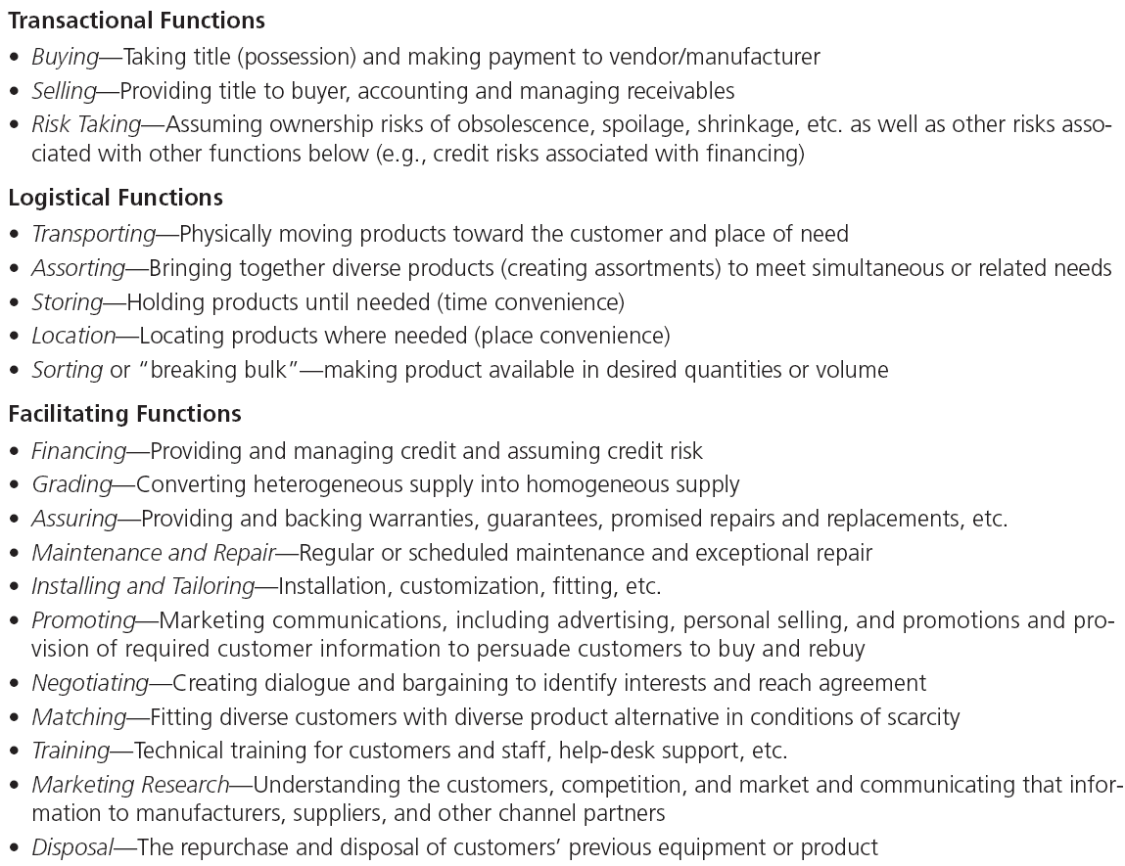
Table Note 35-1 - Functions Performed by Channels of Distribution and Channel Entities

Slide 25
Distribution Dynamics
Changes in the competitive environment have caused channel structures to change and some channel members have become obsolete or redundant
Channel structures continue to evolve due to technological and competitive forces

Slide 26
Distribution Dynamics
The creative marketing strategist may find opportunities as well as hazards in the changing dynamics of marketing channels
Three related forces underlie channel dynamics and distribution outcomes for firms:
Channel power
Channel control
Channel conflict

Slide 27
Strategic Channel Considerations
Issues to be considered in establishing and managing channels of distribution:
Customer needs and behaviors
Brand positioning
Costs and margin structures

Slide 28
Strategic Channel Alternatives
Distribution Intensity
Multiple Channels
Hybrid Channels
Channel Structure/Ownership

Slide 29
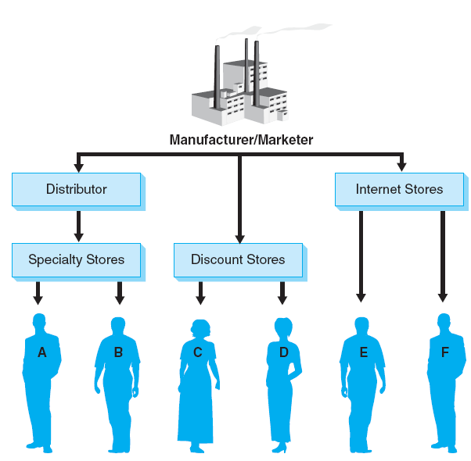
Figure Note 35-1 - Multiple Channels of Distribution

Slide 30
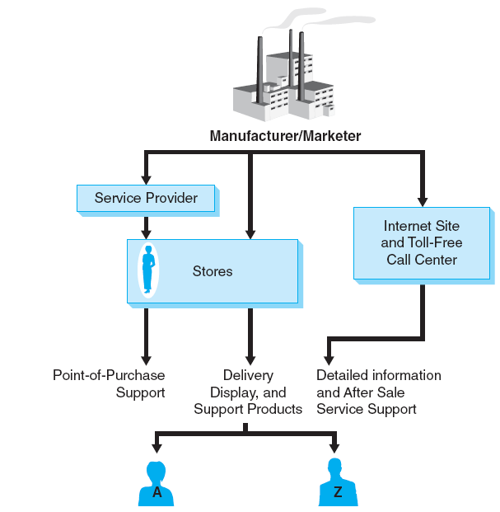
Figure Note 35-2 - Hybrid Channels of Distribution

Slide 31
Strategic Distribution Decisions
Analyzing customers needs and wants from the product’s distribution system:
Describe the firm’s target segments with regard to their channel-function needs
Benchmark both the firm’s and its competitors’ capabilities at delivering those salient customer needs
Generate alternatives
Various and numerous alternatives should be analyzed against their expected costs and benefits
Notes:
Decisions can be made based on those “costed-out” analyses.
This process should facilitate informed and systematic choices across feasible distribution alternatives and should lead to systems that optimally meet customers’ real needs for the values created by channel functions.

