Slide 1
Methods of tablet manufacturing

Slide 2
Dry methods
Direct compression
Dry granulation
Wet methods
Wet granulation

Slide 3
Advantages - Economy - Machine: fewer manufacturing steps and pieces of equipment - Labor: reduce labor costs - Less process validation - Lower consumption of power
Direct compression
Tablets are compressed directly from powder blends of the active ingredient and suitable excipients
No pretreatment of the powder blends by wet or dry granulation procedures is necessary

Slide 4
- Elimination of granulation process
Heat (wet granulation)
Moisture (wet granulation)
High pressure (dry granulation)
Processing without the need for moisture and heat which is inherent in most wet granulation procedures
Avoidance of high compaction pressures involves in producing tablets by slugging or roll compaction
- Elimination of variabilities in wet granulation processing
Binders (temp, viscous, age)
Viscosity of the granulating solution (depend on its temp),
How long it has been prepared,

Slide 5
Direct compression
Tablets are compressed directly from powder blends of the active ingredient and suitable excipients
- No pretreatment of the powder blends by wet or dry granulation procedures is necessary
Some granular chemicals like potassium chloride possess free flowing as well as cohesive properties that enable them to be compressed directly in a tablet machine with out need of either wet or dry granulation .
- In the direct compression method the tablet excipients used must be materials with properties of fluidity and compressibility .

Slide 11
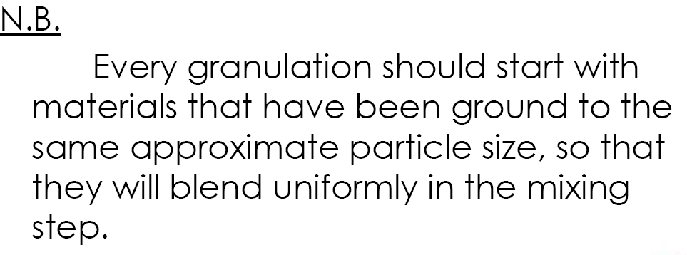

Slide 12
Granulation
Reasons for Granulation
1. Render the material free flowing to ensure that tablets with a low and acceptable tablet weight variation can be prepared .
2. Densify the material (to increase the bulk density of powder mixture so the required volume of powder can be filled into the die) .
3. Prepare uniform mixtures that do not separate to improve mixing homogeneity and reduce segregation.
4. Improve the compression characteristics of the drug .
5. Control the rate of the drug release .
6. Reduce dust .
7. Improve the appearance of the tablet .

Slide 13
Dry Granulation
When tablet ingredients are sensitive to moisture or are unable to withstand elevated temperatures during drying, and when the tablet ingredients have sufficient inherent binding or cohesive properties, slugging may be used to form granules.
This method is referred to as dry granulation, pre compression or double-compression. It eliminates a number of steps but still includes weighing, mixing, slugging, dry screening, lubrication and compression.

Slide 14
The active ingredient, diluent (if one is required) and part of the lubricant are blended. One of the constituents, either the active ingredient or the diluent, must have cohesive properties. Powdered material contains a considerable amount of air; under pressure this air is expelled and a fairly dense piece is formed. The more time allowed for this air to escape, the better the tablet or slug
The compressed slugs are comminuted through the desirable mesh screen either by hand, or for larger quantities through the comminuting mill.
The lubricant remaining is added to the granulation, blended gently and the material is compressed into tablets.
Aspirin is a good example where slugging is satisfactory.

Slide 15
Tablet Produced by Compression Granulation (Dry Granulation):
• Advantage:
(1) Avoid exposure of the powder to moisture and heat.
(2) Used for powders of very low bulk density to ↑ their bulk density.
• Disadvantages:
– Tablet disintegration and dissolution may be retarded due to double lubrication and compaction

Slide 16
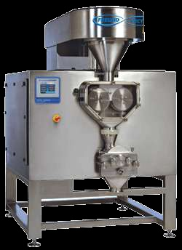
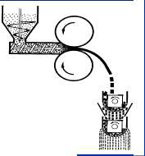
Steps of Dry Granulation:
• The blend of finely divided powders is forced into the dies of a large capacity tablet press.
• Then, compacted by means of flat faced punches (Compacted masses are called slugs and the process is slugging) or roll compactor to produce sticks or sheets.
• Slugs or sheets are then milled/screened to produce granules (flow more than the original powder mixture).
Roller compactor

Slide 17
WET GRANULATION
• It involves massing of a mix of dry primary powder particles using a granulating fluid.
• The fluid contain a solvent that must be volatile and non-toxic e.g water,ethanol.
• The granulating solvent may contain a binding agent to ensure particle adhesion after drying.
Tablet Production via Wet Granulation:
Process description:
• Agitation of a powder by convection in the presence of a liquid.
• It forms the granules by binding the powders together with an adhesive.
• Once the granulating liquid has been added,mixing continues until uniform dispersion is attained (15 min. to an hour).

Slide 18
The mass should merely (just) become moist rather than wet or pasty (there is a limit to the amount of solvent that may be
employed).
- Overly wet material would block the screens & prolong the drying processing.
• End point is tested by pressing
a portion of the mass in the palm, if it crumbles (passed) under moderate pressure then, the mixture is ready for wet screening.
The moist mass is broken up into coarse, granular aggregates (using screens with large
perforations).
• The purpose is to increase surface area to facilitate removal of moisture.
• Sreening the dry granules
• Mixing with other tablet excipients (lubricant, glidant, remaining of
disintegrant) and then compaction.

Slide 19
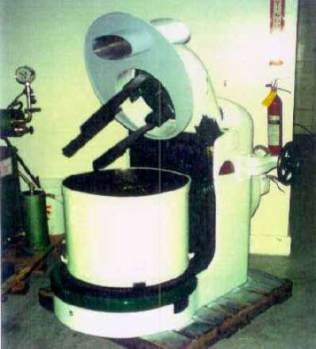
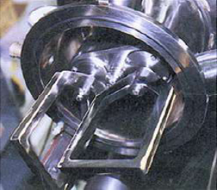
Mixers and Blender
Planetary Mixer
• Good horizontal mixing
• Cross contamination risk
• Poor vertical mixing

Slide 20
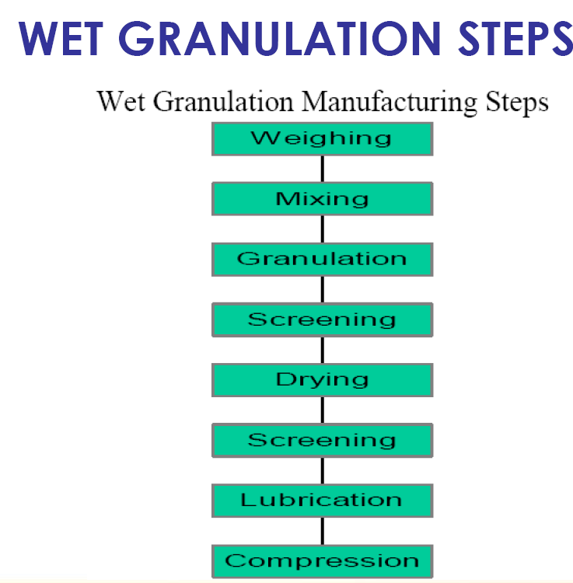

Slide 21
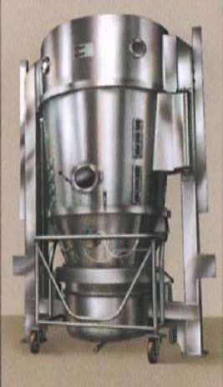
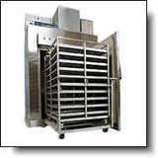
Drying process
• A process of evaporating the liquid contained within aggregates produced by a wet granulation process to a predetermined moisture content
• Accomplished via direct (tray dryer) or indirect (fluidized bed dryer) contact of the product with the heating medium
Fluid bed dryer
Tray dryer

Slide 28
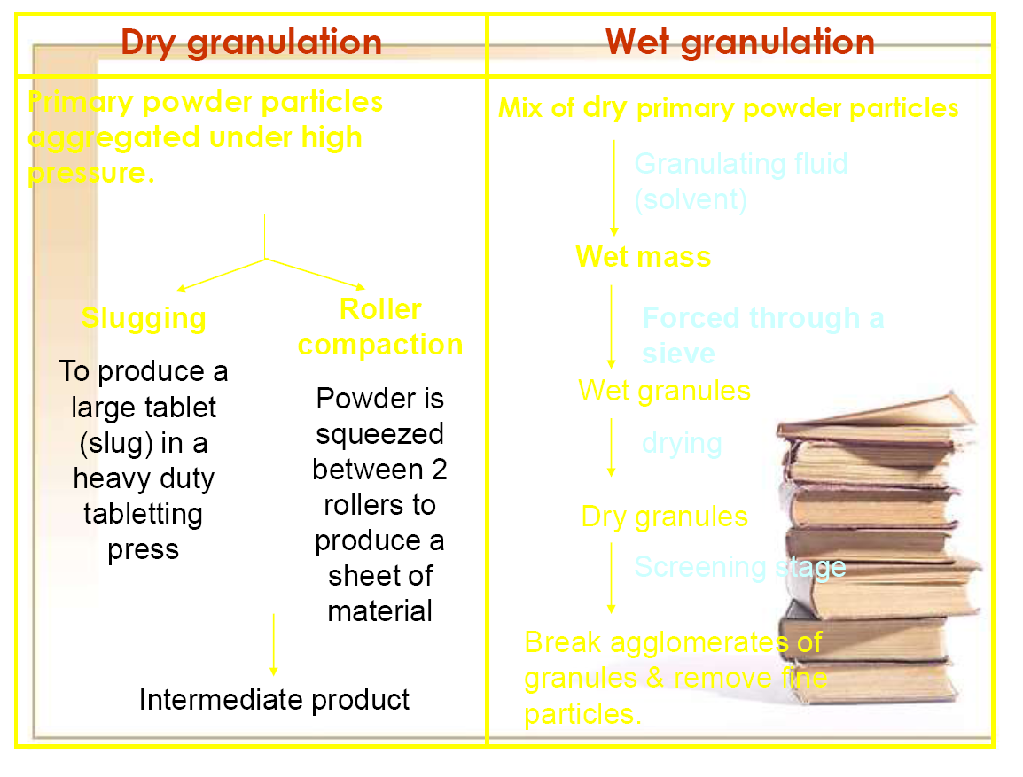
Primary powder particles aggregated under high pressure
Mix of dry primary powder particles
Granulating fluid (solvent)
Wet mass
Slugging
Roller compaction
Forced through a sieve
Wet granules
drying
Dry granules
Screening stage
Break agglomerates of granules and remove the particles

Slide 29
Intermediate product
Typical liquids include:
Water
Ethanol, isopropanol or combination (organic solvents)

Slide 30
1. Binding:
It is the adhesion of the granules to the die wall
and this cause the resistance of the tablet to
eject from the die, it is usually due to insufficient
lubrication, which produce tablets with rough
and vertical score marks on the edges.
• Solution:
•
•
1. Increasing lubrication.
2. Improve lubricant distribution.
3. Increasing the moisture content
of the granulation.

Slide 31
2. Sticking, Picking & Filming:
Adhesion of the material to the punch faces.
• Sticking : (whole adhesion)
Is usually due to improperly(incorrectly) dried or
lubricated granulation causing the whole tablet
surface to stick to the punch faces → dull,
scratched, or rough tablet faces.
• Picking : (localized adhesion)
Is a form of sticking in which a small
portion of granulation sticks to
the punch face & a portion of the
tablet surface is missed.

Slide 32
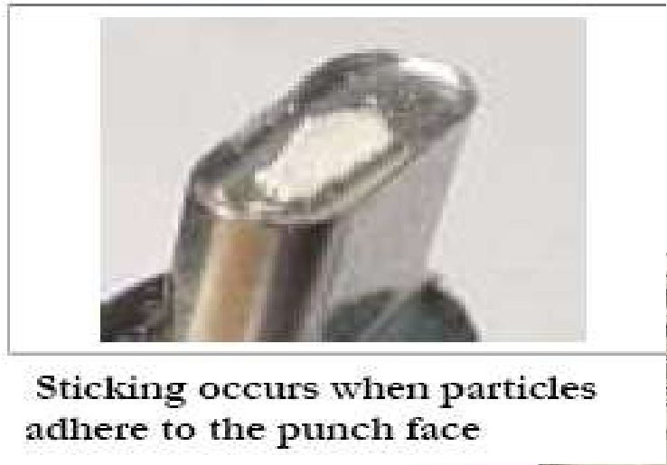

Slide 33
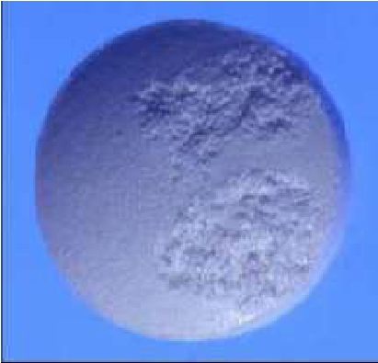
picking

Slide 34
Filming: is a slow form of sticking and is largely
due to excess moisture in the granulation.

Slide 35
3. Capping & Laminating:
Capping occurs when the upper
segment of the tablet separates from the
main portion of the tablet & comes off as
a cap.
• It is usually due to air entrapped
in the granulation which is
compressed in the die during the
compression & then expands
when the pressure is released.

Slide 37
• Reasons of capping : 1. large amount of fines in
the granulation &/or the lack of sufficient
clearance between the punch and the die wall.
2. In new punches and dies that are tight fitting.
3. Too much or too little lubricant or excessive
moisture.
Lamination is due to the same
causes as capping except that
the tablet splits at the sides into
two or more parts.
If tablets laminate only at certain
stations, the tooling is usually the cause.

Slide 38
• Solutions for capping & laminating:
1. Increasing the binder.
2. Adding dry binder such as gum acacia ,
PVP or powdered sugar.
3. Decreasing the upper punch
diameter.

Slide 39
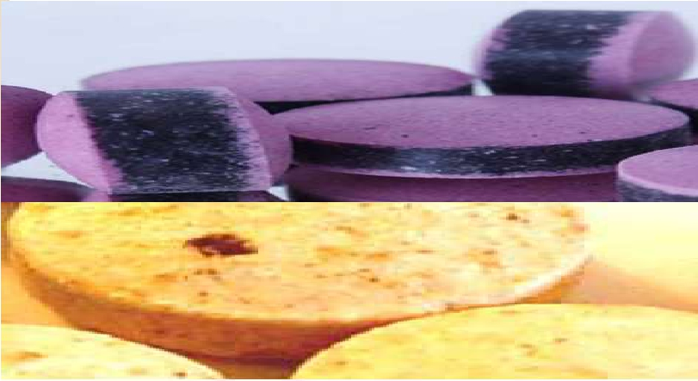
4. Mottling:
It is an unequal distribution of color on the surface
of the tablet.

Slide 40
• Cause : 1. A drug that differs in color from its
excipients or whose degradation products
are highly colored.
2. Migration of a dye during drying
of a granulation (change the solvent
system, reduce the drying temperature,
or grind to a smaller particle size).

