Slide 1
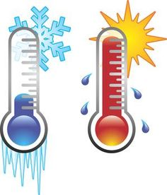
The effect of temperature on the rate of an enzyme catalyzed reaction

Slide 2
In this experiment, we will continue to study acid phosphatase kinetics.
Acid phosphatase kinetics
Time
Enzyme concentration
Substrate concentration
Effect of pH
Effect of inhibitor
Effect of temperature

Slide 3
Objectives
To establish the relationship between temperature and the rate of an enzyme catalyzed reaction
To determine the optimum temperature for such a reaction

Slide 4
The effect of Temperature on Enzyme
The rate of an enzyme catalyzed reaction is affected by changes in temperature
Each enzyme has a temperature that it works optimally in called (Optimum Temperature)
For most enzymes, the optimum temperature is at or above the temperature of the cells in which the enzyme is found in vivo.

Slide 5
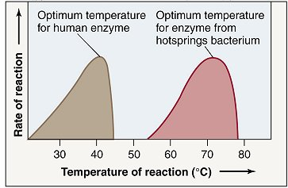
Optimum Temperature
Each enzyme has a temperature that it works optimally in, which in humans is around 37 degrees Celsius the normal body temperature for humans.
However, some enzymes work really well at lower temperatures like 4 degrees Celsius
and some work really well in higher temperatures like 95 degrees Celsius.

Slide 6
What is the effect of temperature on the activity of most enzymes?
The rate of an enzyme catalyzed reaction increase with temperature up to maximum called optimum temperature
1-At suboptimal temperature, increasing temperature increase the kinetics energy of the reactant. As they move faster, they move likely to collide and interact with each other and the enzyme.
2-The rate continues to rise until reaches a peak at the optimum temperature
1 2 3

Slide 7
What is the effect of temperature on the activity of most enzymes?
3-Above this temperature, the rate usually falls dramatically. This is because the increase energy cause bonds that maintain the enzymes shape to break, and the enzyme becomes denatured.(three dimensional structure will change)
The changed shape means that the substrate can no longer fit into the active site, and enzyme activity is lost.
1 2 3

Slide 8
Method:
You will perform a series of 5-minutes assays, in which different temperature will be used
In order to detect the effect of temperature you must fix all the component except the temperature
Time ( 5 minutes ) | constant
Enzyme concentration | constant
Temperature | Variable
pH (5.7) | constant

Slide 9
Method:
The effect of the following temperature will be studied on Acid phosphatase:
Desired temperature (˚C) | Method of preparation
4˚C | Ice plus tap water in an ice bucket
20˚C | Thermos tatted water bath
37˚C | Thermos tatted water bath
60˚C | Thermos tatted water bath
80˚C | Thermos tatted water bath
100˚C | Thermos tatted water bath

Slide 10
Method
Label 12 assay tubes as the following:
Each should have its own Blank
Blank-4Cº | Test-4 Cº
Blank-20 Cº | Test-20 Cº
Blank -37 Cº | Test-37 Cº
Blank-60 Cº | Test-60 Cº
Blank-80 Cº | Test-80 Cº
Blank-100 Cº | Test-100 Cº

Slide 11
Method
You must prepare the following for each tube:
Chemical | Volume
1.0M sodium acetate buffer (pH 5.7) | 0.5 ml
0.1M MgCl2 | 0.5 ml
p-nitrophenyl phosphate | 0.5 ml
Water | 5 ml
Place the tubes in the labeled temperature and let the temperature equilibrate for 2 min.

Slide 12
Method
Add 0.5 ml of enzyme extract to TEST and allow the reaction to proceed for 5 min.
Stop the reaction by the addition of 0.5ml of KOH . (for blank do not forget to add KOH before adding 0.5 ml of enzyme)
Repeat steps using all the water bath temperatures described in the previous table. When all of the reaction mixtures have returned to room temperature, determine the absorbance at 405 nm of each experimental tube against its own blank.

Slide 13
Results :
Velocity (µmole of PNP/min) | Absorbance 405 nm | Temperature
 |  | 0
 |  | 20
 |  | 37
 |  | 50
 |  | 80
 |  | 100
Plot a graph illustrating the effect of different temperatures on the rate of the reaction.

Slide 14
Calculations:
Velocity (V) = (A x 10⁶) /(E x time)= µmole of PNP/min
A= absorbance
E= extension coefficient=18.8 x 10³
Time = 5 min

Slide 15
The Effect of Temperature on the Rate of an Enzyme Catalyzed Reaction.
Optimum Temp
Velocity
(µmole of PNP/min)
Temperature (°C)

Slide 16
Discussion
An introductory statement (In this experiment, we studied the effect of different temperatures on the rate of acid phosphatase catalyzed reaction.)
Principle
From the curve, explain and discuss the relationship between the activity of acid phosphatase and temperature.
Define the optimum temperature and determine it from the curve.

