Slide 1
Western Blot
Lab# 5
BCH 462[practical]

Slide 2
What are Antigens [Ag]:
What are Antibody [Ab]:
Immunoassay is : a test that uses antibody and antigen complexes[immuno-complexes]
as a means of generating measurable results.

Slide 3
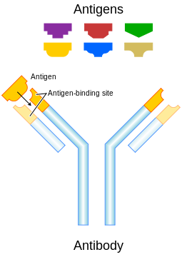

Slide 4
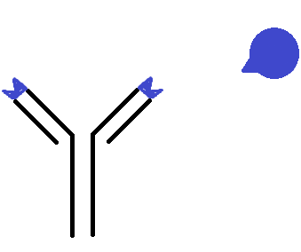
epitope
antigen
antibody

Slide 5
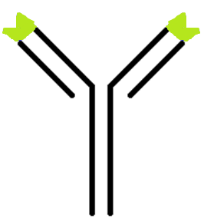
Enzyme
Primary antibody
“antibody specified to specific antigen”
Secondary antibody
“antibody specified to Primary antibody”
The enzyme linked: will convert colorless substrate to colored product,
Indicate the presence of the antibody - antigen [Ab-Ag] binding complex.

Slide 6
Objective:
-Western blotting of proteins from SDS-PAGE.
- For the lab we will Electroblotting the pre-stained maker only.

Slide 7
Western blot:
-Is used to identify specific proteins [antigens] in a sample of tissue homogenate or extract, based on their ability[the antigens] to bind to antibodies resulting in color indicate the presence of this specific protein.
-Immunoblot
- Western blot is a widely used immunoassay technique, used to identify proteins.
Principle:
It is an analytical method where in a protein sample is electrophoresed on an SDS-PAGE then electro-transferred onto nitrocellulose membrane. The transferred protein is detected using specific primary antibody [1ry-antibody],secondary antibody labeled with an enzyme, and substrate which in the end you will get colored product. The color indicate the presence of the protein of interest.

Slide 8
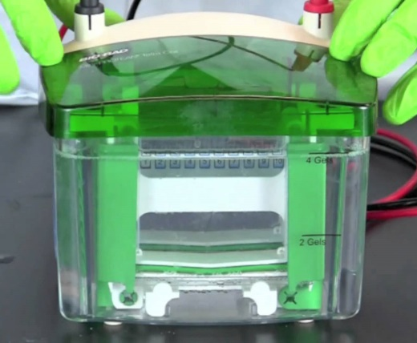
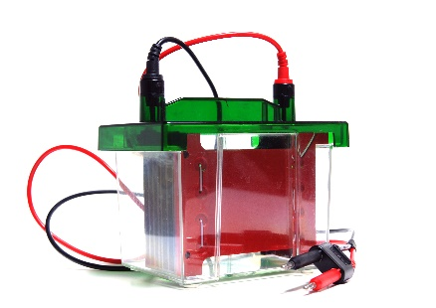
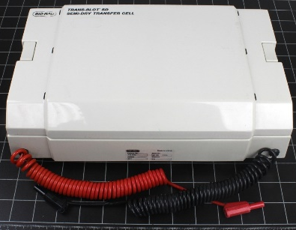
The technique uses three elements to accomplish this task
1. Separating the sample mixture using SDS-PAGE.
2. Transfer step [Electroblotting], transfer the proteins bands from the gel to the membrane.
3. Marking target protein using a proper primary and secondary antibody to visualize.

Slide 9
1st Phase: SDS-PAGE.

Slide 10
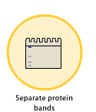
Steps of detection of specific protein using Western bolt
1. A protein sample is subjected to polyacrylamide gel electrophoresis.
Protein sample
SDS-PAGE
To confirm the separation of the sample use:
1-Replica of the gel and stain it as usual [with Coomassie brilliant blue R-250] .
2-prestained marker.
3-Ponceau S.

Slide 11
prestained marker
Figure: Protein Ladder is a mixture of nine (9) blue-, orange- and green-stained proteins (10 to 250kDa) for use as size standards in protein electrophoresis (SDS-PAGE) and Western blotting.

Slide 12
Prestained marker

Slide 13
2nd Phase: Electroblotting.

Slide 14
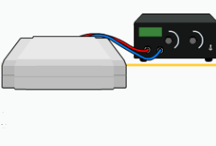
2. After that the gel is placed over a sheet of nitrocellulose , the protein in the gel is electrophoretically transferred to the nitrocellulose. “transfer step [Electroblotting]”
Membrane
[with transferred proteins]
Transfer can be done by:
1- wet method.
2-semi-wet method.

Slide 15
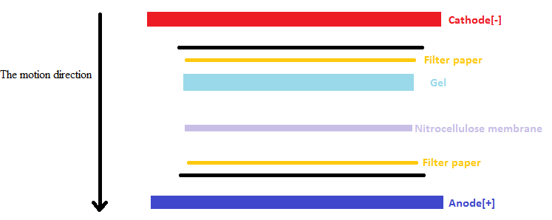
Because the samples in the gel are [–ev] charged , the applied electric current will facilitate their transferring to nitrocellulose membrane, the samples will move toward the Anode[+].
Also the capillary action has its effect in the movement of the samples from the gel to the nitrocellulose membrane.
Note that: [the filter papers, gel and nitrocellulose membrane will soaked in transfer buffer].

Slide 16
3rd Phase: Marking target protein to visualize.

Slide 17
3.The nitrocellulose is then soaked in blocking buffer.
Blocking buffer:
To block the nonspecific
Binding of proteins.
Membrane
[with transferred proteins]
4.The nitrocellulose is then incubated with the specific primary antibody for the protein of interest.
Membrane
[with transferred proteins]
Specific 1ry antibody
[specific for antigen of interest]

Slide 18
5.The nitrocellulose is then incubated with a second antibody, which is specific for the first antibody[1ry –antibody].
Membrane
[with transferred proteins
+1ry antibody]
2ry antibody
[Specific for 1ry antibody]
Note that The enzyme linked: will convert colorless substrate to colored product.
The color produced indicate the presence of the antibody - antigen [Ab-Ag] binding complex.

Slide 19
6.The second antibody will typically have a covalently attached enzyme which, when provided with a chromogenic substrate, will cause a color reaction. “detection step”.
-Alkaline phosphatase (AP) and horseradish peroxidase (HRP) are the two enzymes used most extensively as labels for protein detection.
-Several substrates can be converted to colored precipitate “product” by (AP) and (HRP) enzymes. As the precipitate accumulate on the membrane, a visible band develops.
[S]
[P]
Substrate
Colored product
[E]
2ry antibody
[Specific for 1ry antibody and linked to an enzyme]

Slide 20
Detection of specific protein using Western bolt
[P]
[S]
Colored product
Substrate
[E]
2ry antibody
[Specific for 1ry antibody]
Primary antibody
“antibody specified
to specific antigen”
Antigen of interest

Slide 21
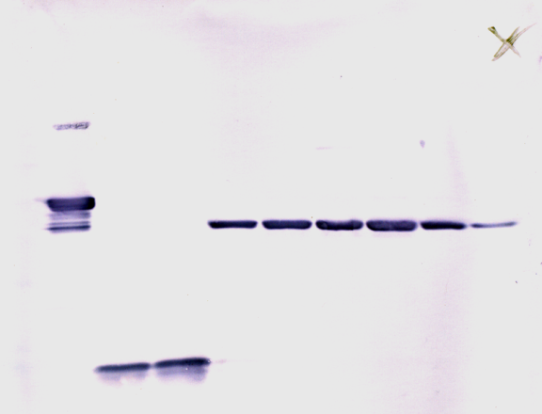
7.Thus the molecular weight and amount of the desired protein can be characterized from a complex mixture of proteins by western blotting.
http://www.youtube.com/watch?v=VgAuZ6dBOfs

Slide 22
Ponceau S Staining:
http://www.youtube.com/watch?v=Jj_37cDsO7o
Western Blot:
https://www.youtube.com/watch?v=VgAuZ6dBOfs

