Slide 1
Thermodynamic of polymers in solution

Slide 2
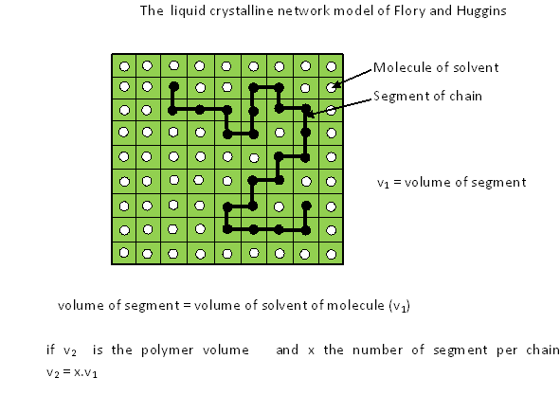
Flory - Huggins theory Athermal macromolecular solutions

Slide 3
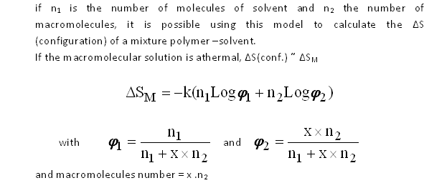

Slide 4
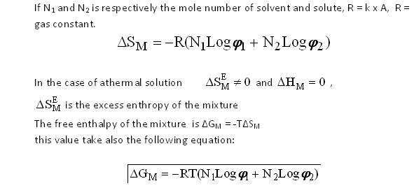

Slide 5
1-2. The regular macromolecular solutions
A regular solution is characterized by a small value of enthalpy of mixture (ΔH_{M}) compared with the thermal agitation energy which is alone responsible of the molecular repartition in the liquid network.
So, the mixture entropy of regular solution (polymer -solvent) has the same value that attributed to athermal macromolecular solution. This constitutes the ideal model of the real polymer solutions.

Slide 6
1-2.1. Heat of mixtures, Interaction parameter χ _{1,2}
In the Flory –Huggins theory, the calculation of the mixture heat ΔH_{M} is exactly the same that those evaluated for the mixture enthalpy of the regular simple solution. The segment macromolecular notion drive to the consideration of the elementary interactions solvent-solvent, solvent-segment and segment-segment respectively characterized by the energies ε₁₁,ε₁₂ and ε₂₂.

Slide 7
If z is the adjacent cells to the segment number in the liquid crystalline network model of Flory.

Slide 8
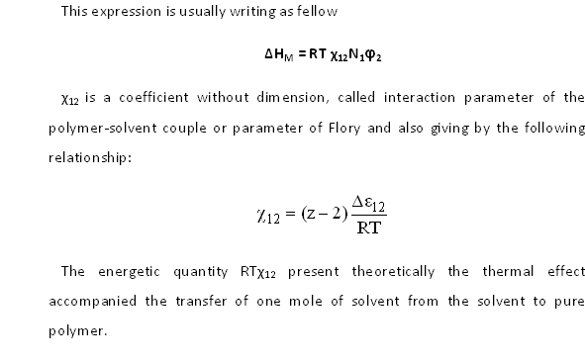

Slide 9
The free enthalpy of mixture (ΔG_{M}) of the regular macromolecular solution, which indicates practically the case of a real solution at weak thermal effect, is:
ΔG_{M}= RT(N₁Logφ₁ + N₂Logφ₂ +χ₁₂N₁φ₂)

Slide 10
1-2.2. Notion of good solvent and mediocre solvent
The dissolution phenomenon of solute (2) in solvent (1) is effective when the free enthalpy of mixture (ΔG_{M}) take a negative value.
As the entropy of mixture is always positive, the dissolution is conditioned essentially by the sign and the heat intensity of the this mixture ΔH_{M}.
Therefore, the interaction parameter χ₁₂ is measures the quality of a solvent towards a determined polymer.

Slide 11
By analogy with the theory of the simple regular solutions, the expression of the heat of mixture ΔH_{M} calculated from the Flory –Huggins theory is affected by a positive sign (endothermic mixture). This is practically true for the majority of macromolecular solutions.
Some time, we observe some exceptions when the constituents(solvent and polymer) have a polar structures.
Example: the dissolution of the poly(methylmethacrylate) in trichloroethylene give a negative value for ΔH_{M}.

Slide 12
The endothermic macromolecular solutions, which represent the major part of the real cases, are in opposite, characterized by the positive values of the interaction parameters χ₁₂.

Slide 13
For a endothermic mixture realized at temperature T, the complete dissolution of the macromolecular solute is the best with the weak interaction parameters.
“The solvents with the weak interaction parameters is designed by good solvents for the polymer considered”.
In this way, by example, the natural rubber-carbon tetrachloride, poly(vinyl-tetrahydrofuran chloride) and cellulose nitrate are respectively characterized by χ₁₂ = 0.28, 0.14 and 0.27.

Slide 14
On opposite,
“the solvents with the χ₁₂ near 0.5 is designed by the mediocre solvents for the polymer considered”.
By example, the polyisobutylene is dissolved easily at ordinary temperature in the cyclohexane (χ₁₂= 0.44) than in benzene (χ₁₂ = 0.5). The good solvent and the bad solvent are closely lied to the temperature.

Slide 15
1-3. Real macromolecular solutions
In general, in the case of a real macromolecular solution, which the heat of mixture ΔH_{M} take an notable value or which the constitutes of the mixture are more polar, the regular macromolecular solution concept is not applicable. In this fact, for this type of solutions it is impossible to identify the entropy of configuration ΔS_{conf.} with its entropy of mixture ΔS_{M}. Because the disposition of the macromolecular segments in solution do not only governed by the statistical considerations, and if ΔH_{M} is positive, the segments of macromolecules tempt to withdraw into oneself to favorite the segment-segment interactions.

Slide 17
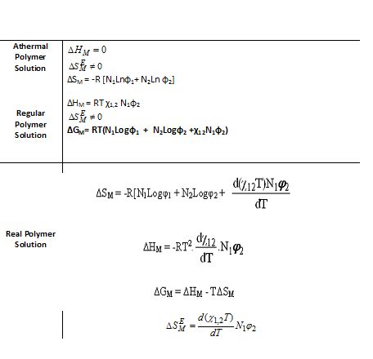
Now its possible to resume the definition of the different categories of macromolecular solution

Slide 18
2.Macromolecular diluted solutions
In general, we admit that the macromolecular chains in solution has practically a homogeny repartition when the fraction volume of solute are superior to 0.04. Before this limit, the effective volumes occupied by the chains can be more or less separated and the Flory-Huggins do not experimentally verified. In particular, the partial molar entropy of solvent take clearly the weak values than the deducted by the calculation. For the such as diluted solutions, the partial molar entropy of solvent can write as fellow.

Slide 20
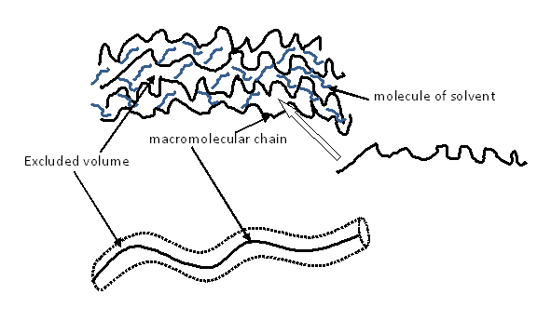
2.1 Notion of the excluded volume

Slide 21
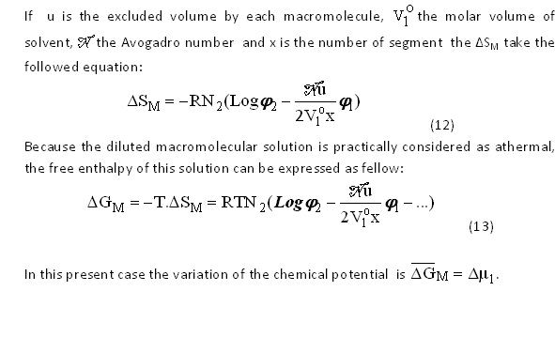

Slide 22
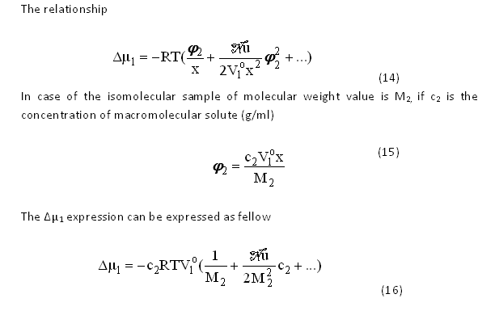

Slide 23
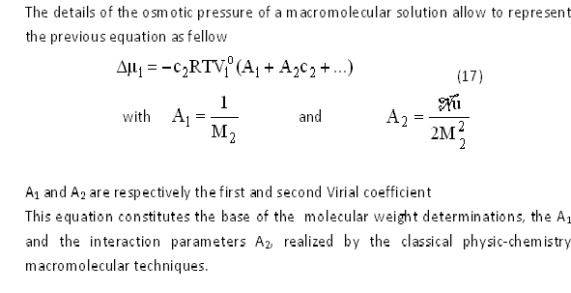

Slide 24
2.2 Flory and Krigbaum Theory
The spherical and stick forms of macromolecules proposed by Zimm and Huggins are in reality two models very simplified. This proposition constitutes two cases diametrically opposed of macromolecules in solution which depended to the solvatation of the solvent.
Flory and Krigbaum have calculated the general expressions of the excluded volume u and the second virial coefficient (A₂) which characterize the macromolecules gifted by a good flexibility. In the case of a very diluted macromolecular solution , each isolated macromolecule can be definite by a radial function of segments distribution since the mass center of the molecule.

Slide 25
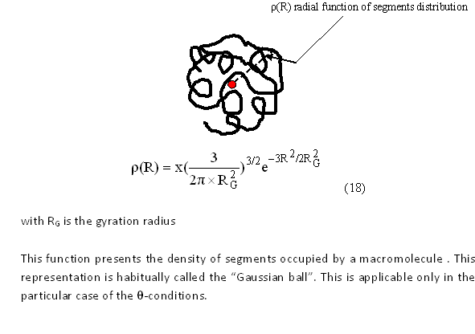

Slide 26
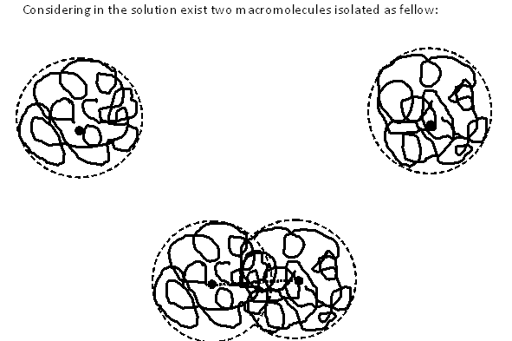
2.2.1 Volume excluded by a flexible macromolecular chain

Slide 27
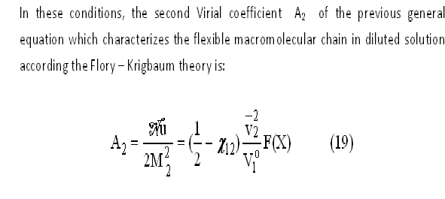

Slide 28
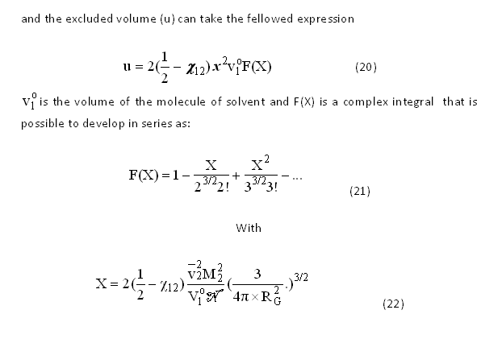

Slide 30
2.1.2 θ-Solvent and θ-temperature
One of the principal consequences of the Flory –Krigbaum theory is that the excluded volume (u) and the second virial coefficient (A₂) are both functions of the interaction parameter χ₁₂.
When χ₁₂ is negative, the case of certain exceptional couples polymer-solvent, the quantity (1/2- χ₁₂) is always positive and the excluded volume (u) and the second coefficient of Virial (A₂) increase with the absolute value of χ₁₂. In this fact, the segment-solvent intermolecular interactions are energetically more favored than the segment-segment intramolecular interactions, this fact induce a strong deployment of each macromolecular ball.

Slide 31
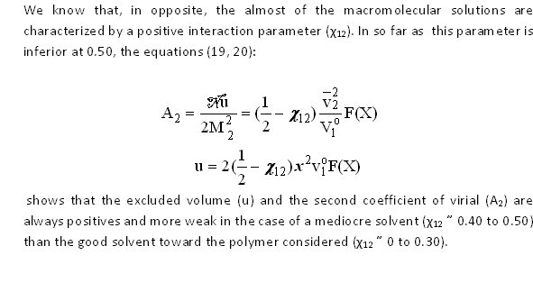

Slide 32
When the interaction parameter is exactly 0.5, the relation (20) shows that the excluded volume is nil. The absolute temperature to which the value of the interaction parameter is 0.5 is called θ-temperature or Flory temperature. A Such as solvent necessary a mediocre solvent for this polymer taking in the same conditions of temperature is designed as θ-solvent. θ-solvent can be a pure liquid or a mixture of liquid.
Other definition, the θ-temperature can be defined more rigourosely as the temperature of the macromolecular solution which the second coefficient of Virial A₂ is nil.

Slide 33
Example of experimental determination of interaction parameters
Inverse gas chromatography
Employed in it inverse state, this technique leads to several parameters as ΔHa ( heat of absorption), ΔHd( heat of dissolution), Tg ( glass transition temperature) and the solvent –polymer, non solvent polymer and polymer-polymer interaction parameters of Flory.

Slide 34
Inverse state means the injection of a known substance called probe and study of the stationary phase ( polymer).

Slide 35
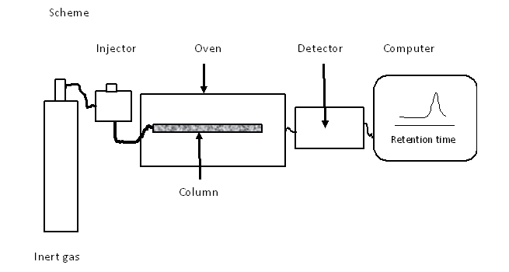

Slide 36
The principal element in the inverse gas chromatography is the column.
The column is treated and loaded by a inert support impregnate by the polymer.
The infinite quantity (some μl) of molecule probe ( solute) is injected in the column loaded.
The retention time of the solvute is taking at the summit of the peak.
The retention volume Vg is calculate according to the following equation:

Slide 38
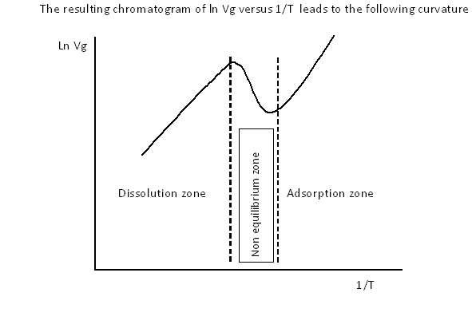

Slide 39
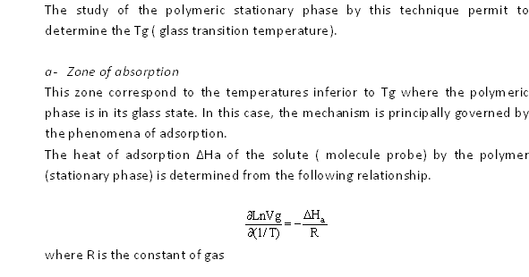

Slide 40
Zone of non equilibrium
In this zone the retention mechanism is generally complex, the stationary polymeric phase is in the chromatographic non equilibrium due to the the physic state transition of this phase.

Slide 42
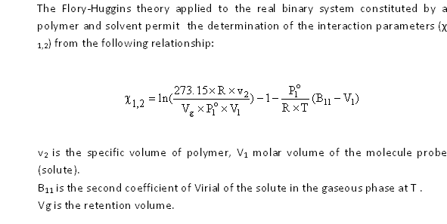
The interactions polymer-solvent

Slide 43
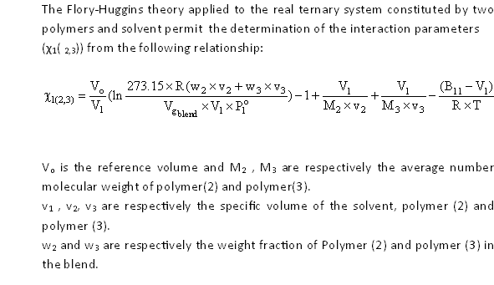
The interaction solvent/Polymer-Polymer

Slide 44
Here, χ _{1(2,3)} is related to other binary interaction parameters as shown in the following expression:
χ _{1(2,3) =} φ₂ x χ₁₂ + φ₃ x χ₁₃ + φ₂ x φ₃ x χ₁₃

Slide 45
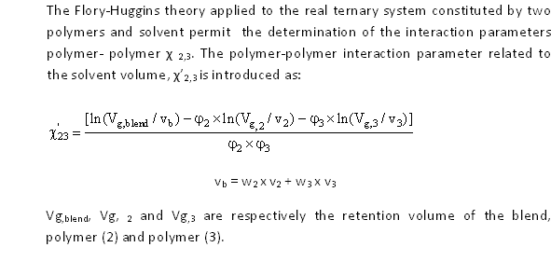
The interaction Polymer-Polymer

Slide 46
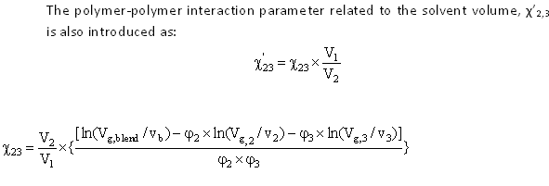

Slide 47
3. Osmotic pressure of diluted macromolecular in solution The osmotic phenomena trough a membrane “ semi-permeable” is widely employed in the physical chemistry macromolecular.

Slide 48
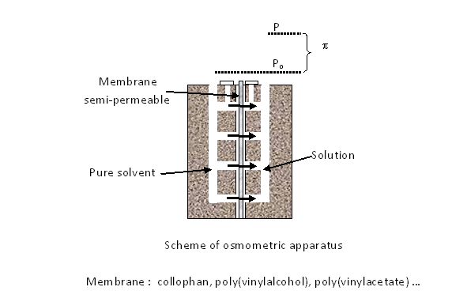

Slide 49
The difference between P and P_{o} is called osmometric pressure = P - P_{o}

Slide 50
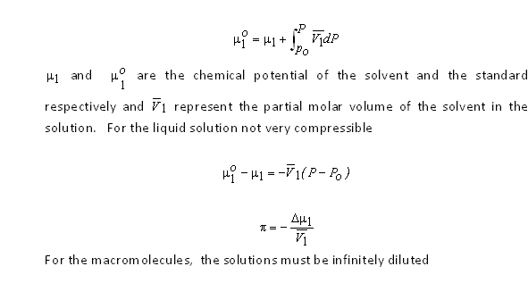
4.1 Thermodynamique expression of the osmotic pressure

Slide 51
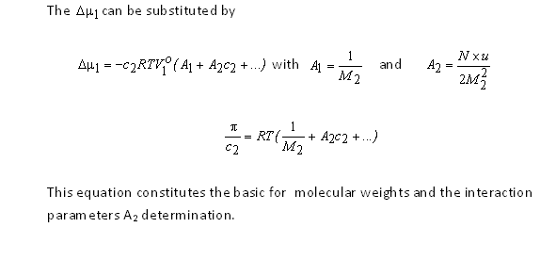

Slide 52
4.2 Determination of average number molecular weights

Slide 53
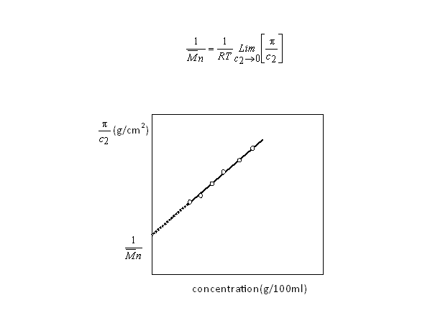

Slide 54
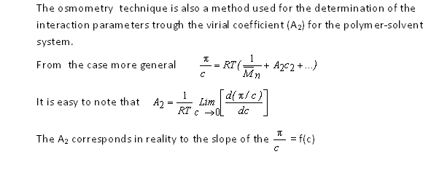
3.3 Determination of interaction parameters

Slide 55
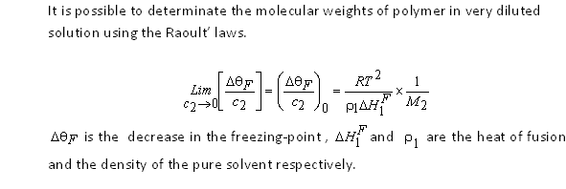
3.4 Thermodynamic methods study based on the Raoult’s laws

Slide 56
Boiling method

Slide 57
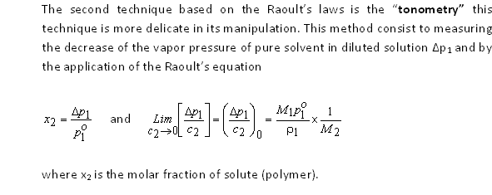
Tonometry method

Slide 58
4. Solubility of polymers 4.1 Hildebrand Solubility parameters
Hidebrand has defined a solubility parameter (δ ) charactering each molecule of the same type as
where is the associated energy of the same type of molecule and z, the coordination number of the liquid network ( the number of the immediate molecules neighbor), the partial molar volume of the solvent.
This parameter can be reach experimentally from the vaporization energy of liquids.

Slide 59
The enthalpy of mixture take definitively this form
It well know that the solubility solute /solvent is possible when
ΔG_{M} =ΔH_{M}-TΔS_{M} < 0 ΔS_{M} is always positive
for a good solubility ΔH_{M} take the weak positive value
The necessary condition for obtain a solution is
ΔH_{M} ≈ 0 or δ₁ ≈ δ₂

Slide 60
4. The phases separation in the systems at weak interactions
4.1 The binary systems
Systems containing a polymer and solvent
4.1.1 Athermic solutions
According to the hypotheses that the dissolution of the flexible macromolecular chains are occurs neither variation of volume and nor energy transfer during the mixing. The variation of energy take the following equation:

Slide 61
x is the ratio of the molar volume of solute /molar volume of solvent. x is proportional to the polymerirization degree.

Slide 62
1.1.2 Regular solutions
In the regular solutions model, Flory supposes that if the mixture occurs with energy transfer, the enthalpy effect is very weak. In this case, the enthalpy of mixture take this form
where χ is the interaction parameter solute-solvent.

Slide 63
The partial molar enthalpy of solvent take this expression
the variation of the free enthalpy of mixture can be write as fellow
and the variation of the chemical potential of solvent and solute can be expressed as
(6)
and

Slide 64
1.1.3 The phases separation
The equation ( 6) can be rewrite only with the volume fraction of solute φ₂ :

Slide 65
4.2 The ternary systems
4.2.1 Ternary systems with a macromolecular component
The general problem was treated by Scott. Scott proposes two different approximations for simplified the calculation:

Slide 66
a) In case of the single liquid approximation (the composition of the solvent is the same in the two phases ) . The mixture is equivalent to a binary system which the Flory interaction parameter is:
The variation of the chemical potential of the polymer is:
with x₁ = x₂ = 1 and x₃=x

Slide 67
b) The second approximation is the case of the complete immiscibility, the polymer and the solvent are supposed to be completely immiscible ( one phase containing the two solvents and other phase containing the swelled polymer).

Slide 68
4.2.1.1 Polymer – solvent – non solvent systems
The more simple case is those of Tompa. Tompa considers that the
interaction constant between the polymer and one of the liquids is equal to
the relative constant of the two liquids
χ12 = χ13 = χ (11)
The solvent is designed by (2), the non solvent by (1) and the polymer by (3)
Tompa considers also that the interaction parameters of the solvent and polymer is nil:
χ₂₃ = 0 where χ₂ = χ₃ = 0 and χ₁ = χ and from the a) supposition of Scott x₁ = x₂ = 1 and x₃ = x

Slide 69
With the negligence of the entropic term of χ, the variation of the chemical potentials are:

Slide 70
4.2.1.2 Polymer –Solvent (1) – Solvent (2) systems (Scott)
The conditions x₁ = x₂ and x = x₃ are always applicable and χ₁₃ and χ₂₃ are
inferior to 0.5 while χ₁₂ is inferior to 2. The three components are in
principle miscible in all proportions.
According to Peterson et al. if the binary mixture of the two solvents is
assimilated to a unique solvent, the interaction between the polymer(A)
and the solvent (S) is according to Scott take the following equation:
χ_{AS} = x₁χ_{A1} + x₂χ_{A2} - x₁x₂χ₁₂ (15)
where x₁ and x₂ are the molar fraction of the solvent 1 and solvent 2 and
χ_{A1} and χ_{A2} are the interaction parameters between the polymer and each
solvent.

Slide 71
4.2.1.3 Polymer – non solvent (1) – non solvent (2) Systems
A polymer insoluble in the solvent (1) and insoluble in
solvent (2)separately but it can be soluble in their mixture.

Slide 72
4.3 The Polydispersed macromolecular systems
4.3.1. The average molecular seizes
a) The average number molecular weight
N_{i} : number of molecules and M_{i} is the molecule weight of molecule i
b) The average weight molecular weight
c) The average molecular weight “Z”
d) The average viscosimetric molecular weight
a is the coefficient of viscosimetri equation: [η]=kMª

Slide 73
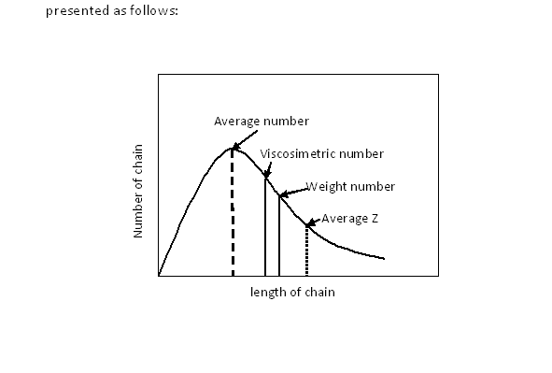
Mn, Mw, Mz and Mv

Slide 74
5. Experimental realization of fractionally
5.1 The fractioned precipitation
This operation is realized by three different ways
The addition of a non solvent (precipitant) into the solution
The evaporation of solvent
The variation of temperature

Slide 75
5.1.1 Method by addition of a non solvent
The polymer dissolved in an adequate solvent
then is added progressively to a non solvent and
the polymer precipitates immediately.
The polymer is then recuperates by filtration.

Slide 76
5.1.2 Method by evaporation of solvent
The Principe of this operation is based on the concentration of the polymeric solution. This solvent is evaporated by air up to the total evaporation of solvent.

Slide 77
5.1.3 Method by variation of the temperature
Some solvents are mediocre or bad, the cooling operation can be used for recuperate the polymer by decantation.

