Slide 1
Boolean Algebra and Digital Logic

Slide 2
Combinational Circuits – Basic concepts
Combinational Circuits
Combinational logic is used to build circuits that contain basic Boolean operators, inputs, and outputs.
The output of a combinational circuit is a function of its inputs at any given moment.
Combinational logic has no memory.
A combinational circuit may have several outputs. If so, each output represents a different Boolean function.

Slide 3
Combinational Circuits – Basic concepts
Combinational Circuits
Combinational logic is used to build circuits that contain basic Boolean operators, inputs, and outputs.
The output of a combinational circuit is a function of its inputs at any given moment.
Combinational logic has no memory.
A combinational circuit may have several outputs. If so, each output represents a different Boolean function.

Slide 4
Typical Combinational Circuits – A Half Adder (1/2)
Combinational Circuits
A half-adder is a simple combinational circuit.
Consider the problem of adding two binary digits together, three cases are possible:
0 + 0 = 0
1 + 0 = 0 + 1 = 1
1 + 1 = 1 0 (the result is “0” with a carry of “1”)
We have two inputs (the bits to add) and two outputs (the “sum” and the “carry”).
Drawing the truth table leads us to the Boolean function of a half-adder.
Note that each output has a Boolean function.

Slide 5
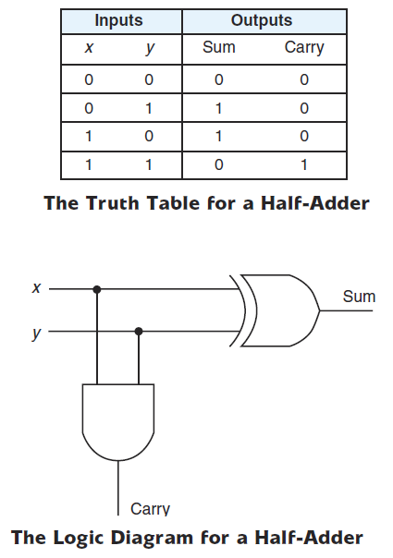
Typical Combinational Circuits – A Half Adder (2/2)
Combinational Circuits
The sum is “1” when only one of the inputs (x, y) is equal to “1”
This is the job of an XOR
Sum = $x⊕y$
The carry is “1” when only both inputs (x and y) are “1”
This is the job of an AND
Carry = xy

Slide 6
Typical Combinational Circuits – A Full Adder (1/2)
Combinational Circuits
A half adder could be extended to a circuit that allows the addition of larger binary numbers: Full adder
Remember how we added binary numbers?
We add each column without forgetting the carry from the nearest right column
A full adder has three inputs:
The two bits to add (x and y)
The carry from the nearest right column (carry-in)
A full adder has two outputs (the “sum” and the “carry”)

Slide 7
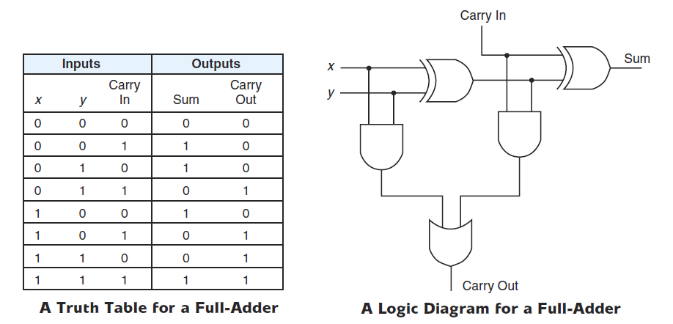
Typical Combinational Circuits – A Full Adder (2/2)
Combinational Circuits
Think of how this logic diagram is obtained.
Note that a full-adder is composed of two half-adders and an OR gate.

Slide 8
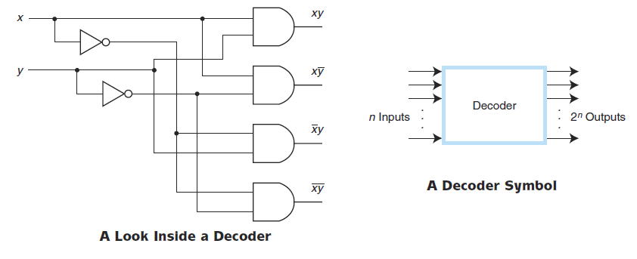
Typical Combinational Circuits – A Decoder (1/3)
Combinational Circuits
A decoder decodes binary information of a set of n inputs to a maximum of 2^{n} outputs.
A decoder uses the inputs and their respective values to select one specific output line
For a given input combination, only one output is set to “1” and all others are set to “0”

Slide 9
Typical Combinational Circuits – A Decoder (2/3)
Combinational Circuits

Slide 10
Typical Combinational Circuits – A Decoder (3/3)
Combinational Circuits
Memory Chip 4
Memory Chip 5
Memory Chip 6
Memory Chip 0
Memory Chip 7
Memory Chip 1
Memory Chip 2
Memory Chip 3
CS
CS
CS
CS
CS
CS
CS
CS
0
0
1
0
0
0
0
0
0
1
2
3
4
5
6
7
Decoder
13
0
1
0
0 | 1 | 0 | 1 | 0 | 0 | 0 | 1 | 0 | 0 | 1 | 1
Notes:
For tutors only:
We have 16 bits for address: The memory size is 2¹⁶ = 64 Kwords = 64 Kbytes (supposing a word size of 1byte)
Each memory chip has a size of : 64Kbytes/8 = 8Kbytes
All memory 1 addresses begin with: 000xxxxxxxxxxxxx
All memory 2 Addresses begin with: 001xxxxxxxxxxxxx
All memory 3 Addresses begin with: 011xxxxxxxxxxxxx
And so on until memory 7, its addresses begin with: 111xxxxxxxxxxxxx

Slide 11
Decoder Examples
1-to-2-Line Decoder
2-to-4-Line Decoder
Note that the 2-4-line made up of 2 1-to-2- line decoders and 4 AND gates.

Slide 12
Decoder Expansion - Example 1
3-to-8-line decoder
Number of output ANDs = 8
Number of inputs to decoders driving output ANDs = 3
Closest possible split to equal
2-to-4-line decoder
1-to-2-line decoder
2-to-4-line decoder
Number of output ANDs = 4
Number of inputs to decoders driving output ANDs = 2
Closest possible split to equal
Two 1-to-2-line decoders
See next slide for result

Slide 13
Decoder Expansion - Example 1
Result

Slide 14
Decoder Expansion - Example 2
7-to-128-line decoder
Number of output ANDs = 128
Number of inputs to decoders driving output ANDs = 7
Closest possible split to equal
4-to-16-line decoder
3-to-8-line decoder
4-to-16-line decoder
Number of output ANDs = 16
Number of inputs to decoders driving output ANDs = 2
Closest possible split to equal
2 2-to-4-line decoders
Complete using known 3-8 and 2-to-4 line decoders

Slide 15
Decoder with Enable
In general, attach m-enabling circuits to the outputs
See truth table below for function
Note use of X’s to denote both 0 and 1
Combination containing two X’s represent four binary combinations
Alternatively, can be viewed as distributing value of signal EN to 1 of 4 outputs
In this case, called a demultiplexer

Slide 16
Encoding
Encoding - the opposite of decoding - the conversion of an m-bit input code to a n-bit output code with n ≤ m ≤ 2^{n} such that each valid code word produces a unique output code
Circuits that perform encoding are called encoders
An encoder has 2^{n} (or fewer) input lines and n output lines which generate the binary code corresponding to the input values
Typically, an encoder converts a code containing exactly one bit that is 1 to a binary code corres-ponding to the position in which the 1 appears.

Slide 17
Encoder Example
A decimal-to-BCD encoder
Inputs: 10 bits corresponding to decimal digits 0 through 9, (D₀, …, D₉)
Outputs: 4 bits with BCD codes
Function: If input bit D_{i} is a 1, then the output (A₃, A₂, A₁, A₀) is the BCD code for i,
The truth table could be formed, but alternatively, the equations for each of the four outputs can be obtained directly.

Slide 18
Encoder Example (continued)
Input D_{i} is a term in equation A_{j} if bit A_{j} is 1 in the binary value for i.
Equations:
A₃ = D₈ + D₉
A₂ = D₄ + D₅ + D₆ + D₇
A₁ = D₂ + D₃ + D₆ + D₇
A₀ = D₁ + D₃ + D₅ + D₇ + D₉
F₁ = D₆ + D₇ can be extracted from A₂ and A₁ Is there any cost saving?
Notes:
No. The total gate input cost remains the same.

