Slide 1
Sialography
MEAAD AL-MUSINED

Slide 2
Definition
Radiographic examination of the salivary ducts and associated parenchymal tissue of salivary glands after injection of a contrast medium

Slide 3
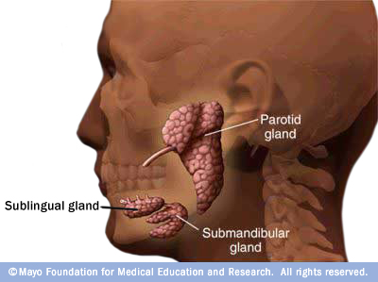
Anatomy
Parotid (near the ears).
Submandibular (below the mandible).
Sublingual (below the tongue)

Slide 4
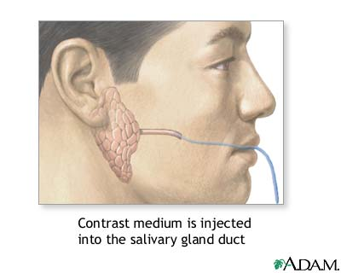
Technique
It usually involves the injection of a small amount of contrast medium into the salivary ducts, followed by routine X-ray projections.

Slide 5
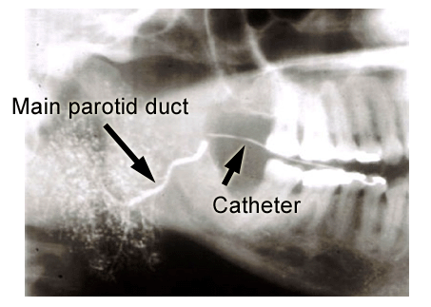
LT Lateral

Slide 6
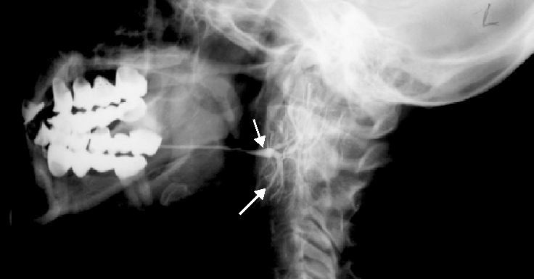
RT Lateral

Slide 7
Thank you

