Slide 1
King Saud University College of Engineering IE – 341: “Human Factors Engineering” Fall – 2017 (1st Sem. 1438-9H)
Visual Displays of Dynamic Information
(Chapter 5) – part 2: Qualitative Visual Displays
Prepared by: Ahmed M. El-Sherbeeny, PhD

Slide 2
Lesson Overview
Uses of Dynamic Information
Quantitative Visual Displays (part 1)
Qualitative Visual Displays (part 2)

Slide 3
Uses of Dynamic Information
Dynamic information: i.e. changing info; e.g:
Natural phenomena (e.g. temperature, pressure)
Vehicle speed
Traffic lights
Frequency, intensity of sounds, etc.
Dynamic displays:
Displays used to display dynamic information
Types of dynamic displays, type of info. presented:
Quantitative: precise numeric value of some variable (e.g. “pressure is 125 psi”)
Qualitative: approximate value/rate of change/change in direction (e.g. “pressure is increasing”)
Status/check: determines if readings are normal (e.g. “pressure is normal”)
Representational: situation awareness; e.g. radar display predicts where plane will be in 5 or 10 minutes

Slide 4
Qualitative Visual Displays

Slide 5
Qualitative Visual Displays
Objective of displays used for qualitative info:
Approx. value of continuously changing variable
e.g. pressure, temperature, speed, etc.
Rate of change/change in direction of variable
Quantitative basis of Qualitative Reading
Determining status/condition of variable in terms of specific predetermined range(s)
e.g. gauge of engine: cold, normal, or hot
Maintain a desirable range of approximate values
e.g. speed range between 50-55 mph (80-88 kmh)
Observing trends/rates of change
e.g. airplane ascending or descending; or N, S, E, W

Slide 6
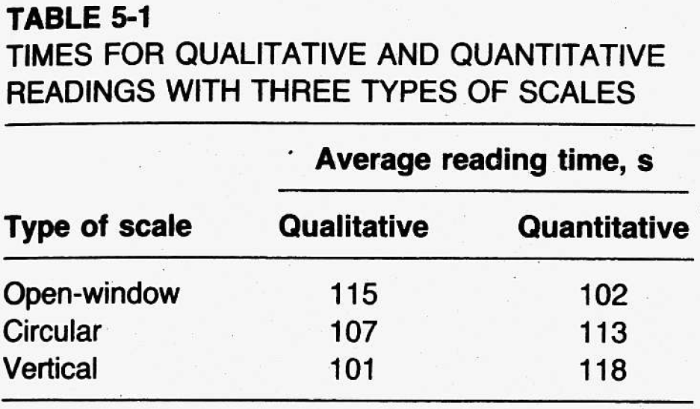
Cont. Qualitative Visual Displays
Cont. Quant. Basis of Qualitative Reading
Note, scales best applicable for quant. task not necessarily best applicable for qualit. task (below)
Can you analyze table below?

Slide 7
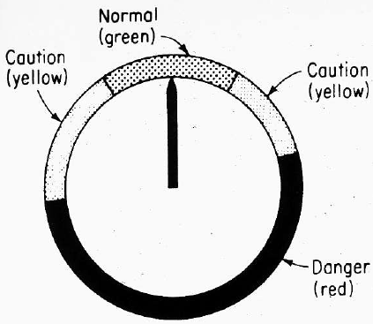
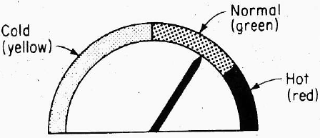
Cont. Qualitative Visual Displays
Design of Qualitative Scales
Values: sliced into limited number of ranges
Coding for ranges/readings on qualit. scales:
Color codes for ranges (right)
Shape coding for specific ranges of values
advise: take advantage of natural compatible associations people have bet. coding features and intended meanings

Slide 8
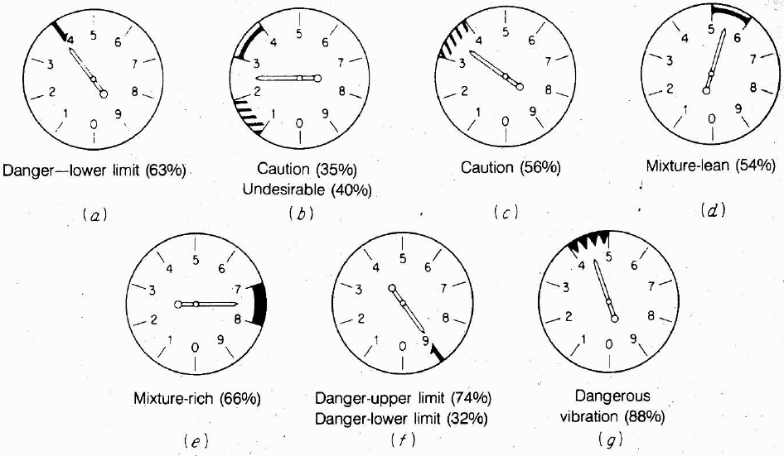
Cont. Qualitative Visual Displays
Cont. Design of Qualitative Scales
Cont. Shape coding
Experiment conducted:
Purpose: determine best association between shapes and meaning of different military plane readings
140 subjects
7 shapes vs. 7 meanings
%ge correct responses shown in ( )

Slide 9
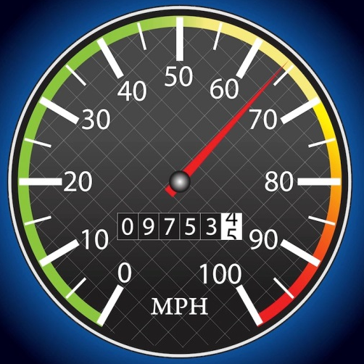
Cont. Qualitative Visual Displays
Cont. Design of Qualitative Scales
Use of strictly Quantitative displays:
involves identifying quantitative value, and
involves assigning value read to one of possible ranges of values that represent the categories
Use of strictly Qualitative displays
directly conveys meaning of display indicator
Use of Quantitative + Qualitative displays:
Indicate trend, direction, rate of change (i.e. qualitative)
Indicate also: quant. reading (if values included)
Examples:
Last slide
Car speed gauge (numbers + indication at 120 kmh)
Other examples?

Slide 10
Cont. Qualitative Visual Displays
Check Reading
instrument that checks if reading is normal
this is achieved using quant. scale
normal condition is represented by an exact or very narrow values (not range)
e.g. to determine if voltage is ~110V or ~220V
requires caution to display normal reading clearly
research suggests normal reading should be aligned (for circular scales) at:
9 o’clock position (see right)
12 o’clock position (also acceptable)

Slide 11
Cont. Qualitative Visual Displays
Cont. Check Reading
when several check reading devices used ⇒ deviant device should stand out (see below)
“gestalt”: human tendency to perceive complex configuration as complete entity
⇒ odd entity becomes immediately clear
e.g. below: lines between dials adds to “gestalt”
lower configuration also acceptable (less clear)

Slide 12
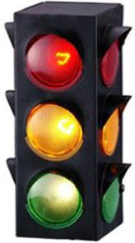
Cont. Qualitative Visual Displays
Status Indicators
Qualitative info. can indicate status of system
e.g. check reading: normal or abnormal
e.g. automobile thermometer: cold/normal/hot
status indicators: show –only– separate, discrete conditions (comp. to check reading)
e.g. on/off
e.g. traffic lights: stop/caution/go
Note, scales that show only check reading can be converted to status indicators
Common uses:
light indicators (varying color, position)
e.g. traffic lights: red (top), yellow (middle), green (bot.)
also used with stove controls (on/off)

Slide 13
Cont. Qualitative Visual Displays
Signal and Warning Lights
Flashing/steady state lights used for:
Warning (e.g. highways)
Identification (e.g. aircrafts at night)
Navigation aids, beacons
Attracting attention (e.g. on instrument panel)
Factors affecting detectability of lights
Size, Luminance, and Exposure time
Color of Lights
Flash Rate of Lights

Slide 14
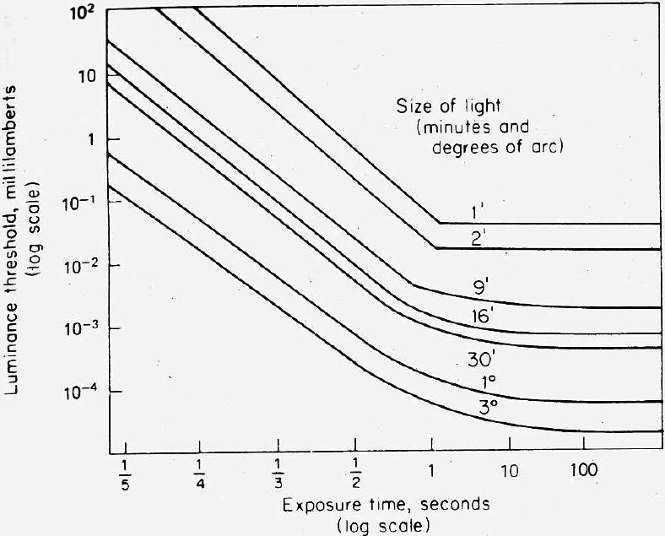
Cont. Qualitative Visual Displays
Cont. Signal and Warning Lights
Size, Luminance, and Exposure Time
Detecting flashing light depends on combin^{on}: size, luminance, exposure time
as size of light ↑ and/or as exposure time ↑ ⇒ luminance required to just detect light ↓
“just detect”: can be detected 50% of the time (i.e. luminance threshold)
for operational use:
luminance should be at least double these to be detected 99% of the time

Slide 15
Cont. Qualitative Visual Displays
Cont. Signal and Warning Lights
Color of Lights
background color + ambient illumination ⇒
influence ability of people to detect and respond to lights of different colors
With good signal brightness contrast + dark background
color has minimal importance in attracting attention
With low signal-to-background brightness contrast:
red signal is recommended,
followed by green, yellow, and white

Slide 16
Cont. Qualitative Visual Displays
Cont. Signal and Warning Lights
Flash Rate of Lights
flash rate should be « 30 times/sec
≥ 30 ⇒ light appears steady ⇒ “flicker-fusion”
Recommended to attract attention:
flash rates of about 3-10 per second (4 is best)
duration of at least 0.05 s
lights should subtend at least 1° of visual angle
Recommended for highways and flyways, use:
60-120 flashes per minute (1-2 per second)
Varying flashing lights
mostly: single/fixed flashing light used
some applications: lights with different flash rates
e.g. tail lights showing rate of deceleration: car brakes
Keep in mind: humans can differentiate -maximum of- three different flash rates clearly (remember: JND ?)

Slide 17
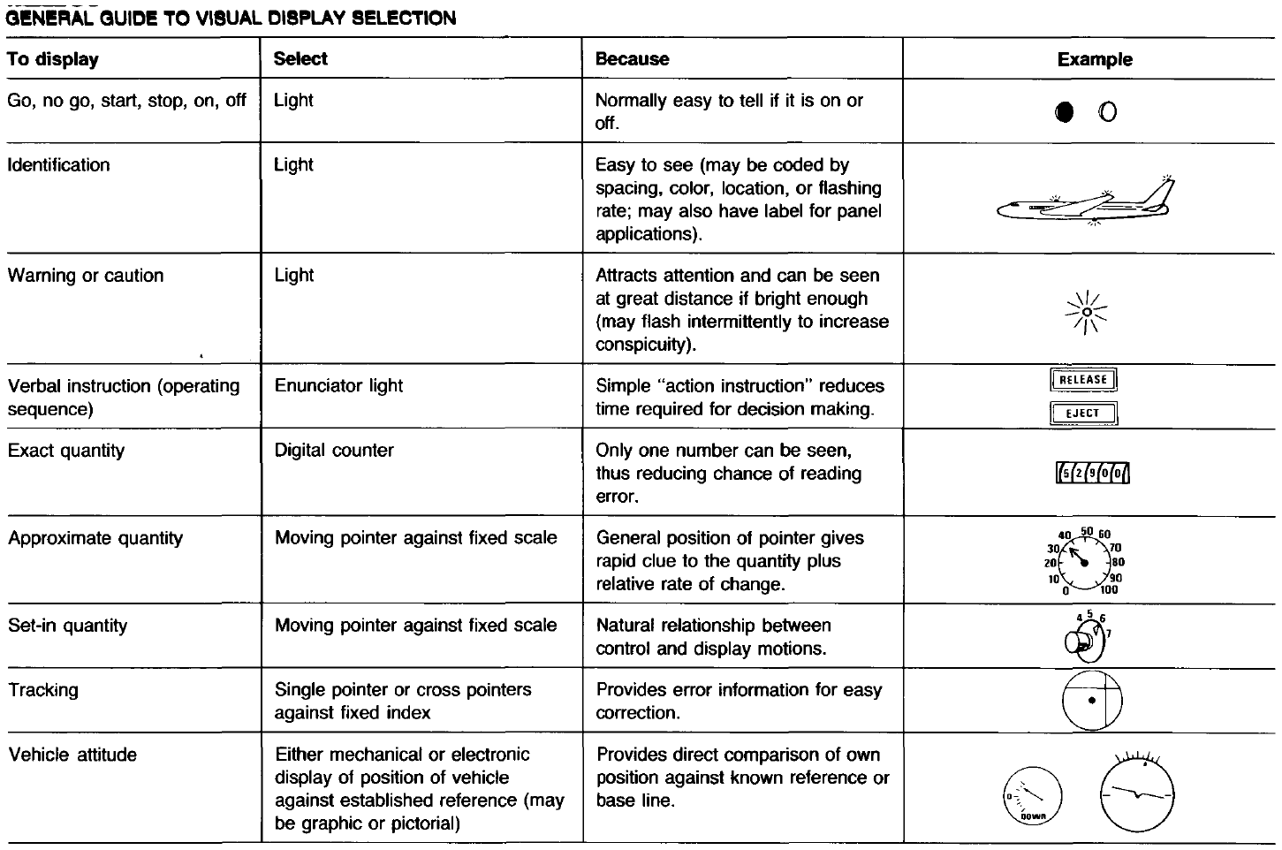
Summary

Slide 18
References
Human Factors in Engineering and Design. Mark S. Sanders, Ernest J. McCormick. 7th Ed. McGraw: New York, 1993. ISBN: 0-07-112826-3.

