Slide 1
King Saud University
College of Engineering
IE – 341: “Human Factors Engineering”
Fall – 2015 (1st Sem. 1436-7H)
Human Capabilities
Part – B. Hearing (Chapter 6)
Prepared by: Ahmed M. El-Sherbeeny, PhD

Slide 2
Lesson Overview
Hearing
  Ear Anatomy
  Nature and Measurement of Sounds
    Frequency of Sound Waves
    Intensity of Sound
    Complex Sounds
  Masking
Auditory Displays
  Detection of Signals
  Relative Discrimination of Auditory Signals
  Absolute Identification of Auditory Signals
  Sound Localization
Noise

Slide 3
Hearing

Slide 4
Ear Anatomy
Complex process
  Pneumatic (i.e. filed with air) pressure waves
  Hydraulic waves
  Mechanical vibrations
  Electrical impulses
Notes:
Q: can you (later) name where each of these processes occur?

Slide 5
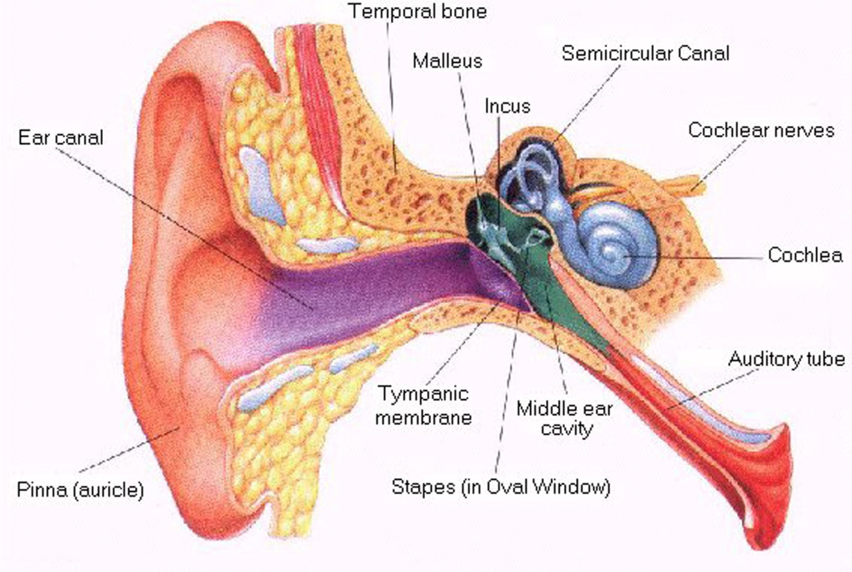
Cont. Ear Anatomy

Slide 6
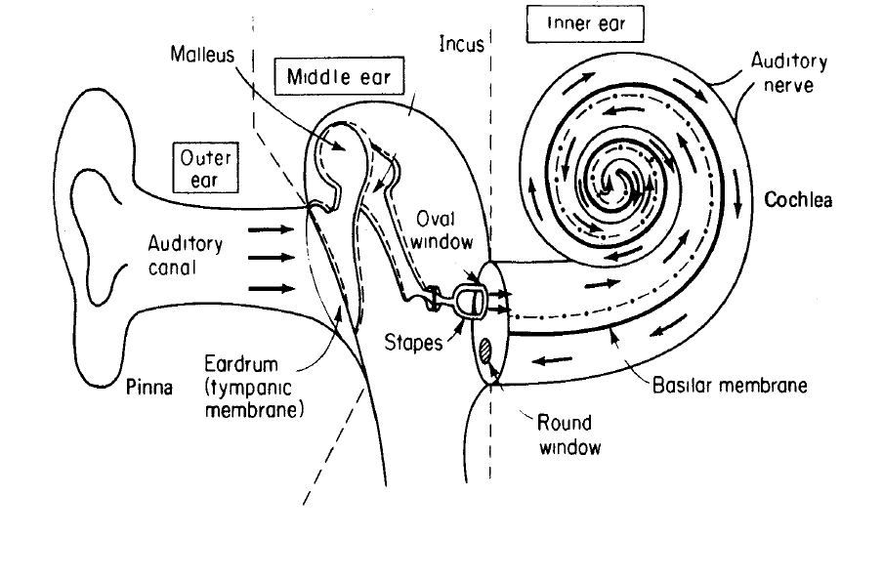
Cont. Ear Anatomy

Slide 7
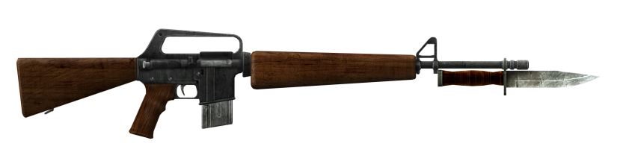
Cont. Ear Anatomy: Outer Ear
Collects sound energy
External part: pinna or conchae
Auditory canal (meatus)
  Bayonet shape
  1״ long
  Resonant property
    Sensitivity to frequencies: 2 – 5 kHz
    Enhances SPL by as much as 12 dB (see slide 17)
Eardrum (tympanic membrane)

Slide 8
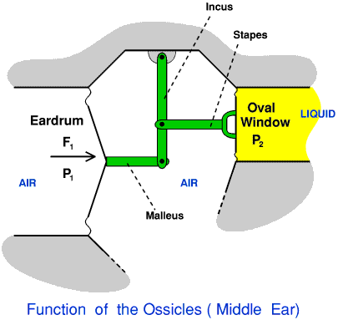
Cont. Ear Anatomy: Middle Ear
Chain of 3 small bones (ossicles)
  Malleus
  Incus
  Stapes
Transmit vibrations
  eardrum to oval window
  Stapes acts like a piston on oval window
Eardrum surface area
+
Lever action of ossicles
Sound pressure to fluid of inner ear
Pressure of stapes against oval window is amplified 22 times

Slide 9
Cont. Ear Anatomy: Cont. Middle Ear
Two muscles
  Tensor tympani muscle (to malleus)
  Stapedius muscle (to stapes)
      Acoustic (aural) Reflex of Muscles:
Tighten in response to loud noise
  Q: can you compare this with pupil action?
Protection against intense sounds
  Reduces sound transmission
  Occurs when sound is 80 db above threshold level
  Up to 20 db attenuation (i.e. reduction of severity)
More responsive to
  Broadband sounds (i.e. wide range of frequencies) than to pure tones
  Lower frequencies than to higher frequencies
Muscles remain flexed (i.e. contracted)
  up to 15 min in intense steady-state noise

Slide 10
Cont. Ear Anatomy: Cont. Middle Ear
Intense impulse noise:
  Muscle contraction delay (Latency: 35 – 150 ms)
  Not much protection against initial impulse
  Protection against subsequent impulses; interval less than one second

Slide 11
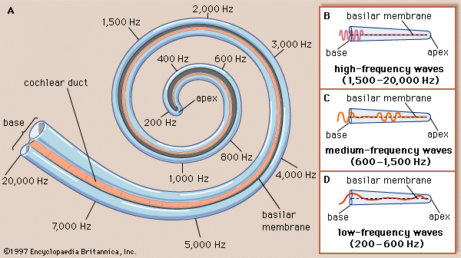
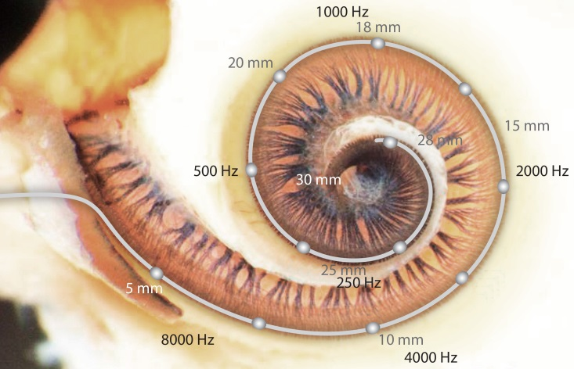
Cont. Ear Anatomy: Inner Ear – cochlea
Spiral (Snail)
30 mm long (uncoiled)
Filled with fluid
Stapes ➔ Piston
➔ fluid back & forth in response to pressure
Fluid movement ➔ basilar membrane
➔ vibration to organ of Corti
Organ of Corti
  Hair cells & nerve endings
  Sensitive to changes in pressure
  Transmits sound to brain via auditory nerve

Slide 12
Cont. Ear Anatomy:
Conversion of Sound Waves to Sensations
Place (resonance) theories
  Fibers of basilar membrane like piano strings
  Different fibers are sensitive differently to different frequencies
Temporal theories
  Pitch is related to time pattern of neural impulses emitted by the fibers
Current understanding:
  Place theory: high tones
  Temporal theory: low tones
  Combination of both (i.e. complementary): middle tones

Slide 13
Nature and Measurement of Sounds
Direct vs. Indirect hearing:
  Direct hearing: e.g. baby’s natural cry
  Indirect hearing: e.g. doorbell ⇒ someone at door
  Indirect stimulus can be more effective than direct
    e.g. fire alarm (100% detectable) vs. heat/smoke (75%)
Nature and Measurement of Sounds
  Sound is created by vibrations from a source and is transmitted through a medium (such as atmosphere) to the ear
  Two primary attributes of sound:
    Frequency
    Intensity (or amplitude)

Slide 14
Cont. Nature and Measurement of Sounds
Frequency of Sound Waves :
  When sound is generated,
    vibration ⇒ air molecules to move back and forth
    this alternation ⇒ ↑ and ↓ in air pressure
  Vibration forms sinusoidal (sine) waves
    height of wave above and below the midline represents the amount of above-normal and below-normal air pressure respectively
    The waveform above the midline is the image of the waveform below the midline in a sine wave.
    The waveform repeats itself again and again in a sine wave
    frequency of sound:
      “number of cycles per second”
      expressed in: hertz (Hz) ; 1 Hz ≡ 1cycle / 1 second

Slide 15
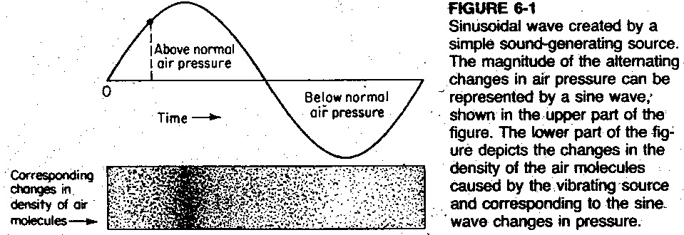
Cont. Nature and Measurement of Sounds
Cont. Frequency of Sound Waves :
  Sinusoidal wave created by a simple sound-generating source

Slide 16
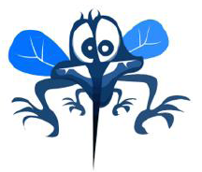
Cont. Nature and Measurement of Sounds
Cont. Frequency of Sound Waves :
  The human ear is sensitive to frequencies
    20 to 20,000 Hz
    highest sensitivity: between 1,000 to 3,000 Hz
  Ear is not equally sensitive to all frequencies
  People differ in their relative sensitivities to various frequencies
  See what frequencies you can/can’t hear at the following Web Site: The Mosquito Ringtone (http://www.freemosquitoringtone.org/)
Pitch
  Highness or lowness of a tone
  High frequencies ➔ high pitched tones
  Low frequencies ➔ low pitched tones

Slide 17
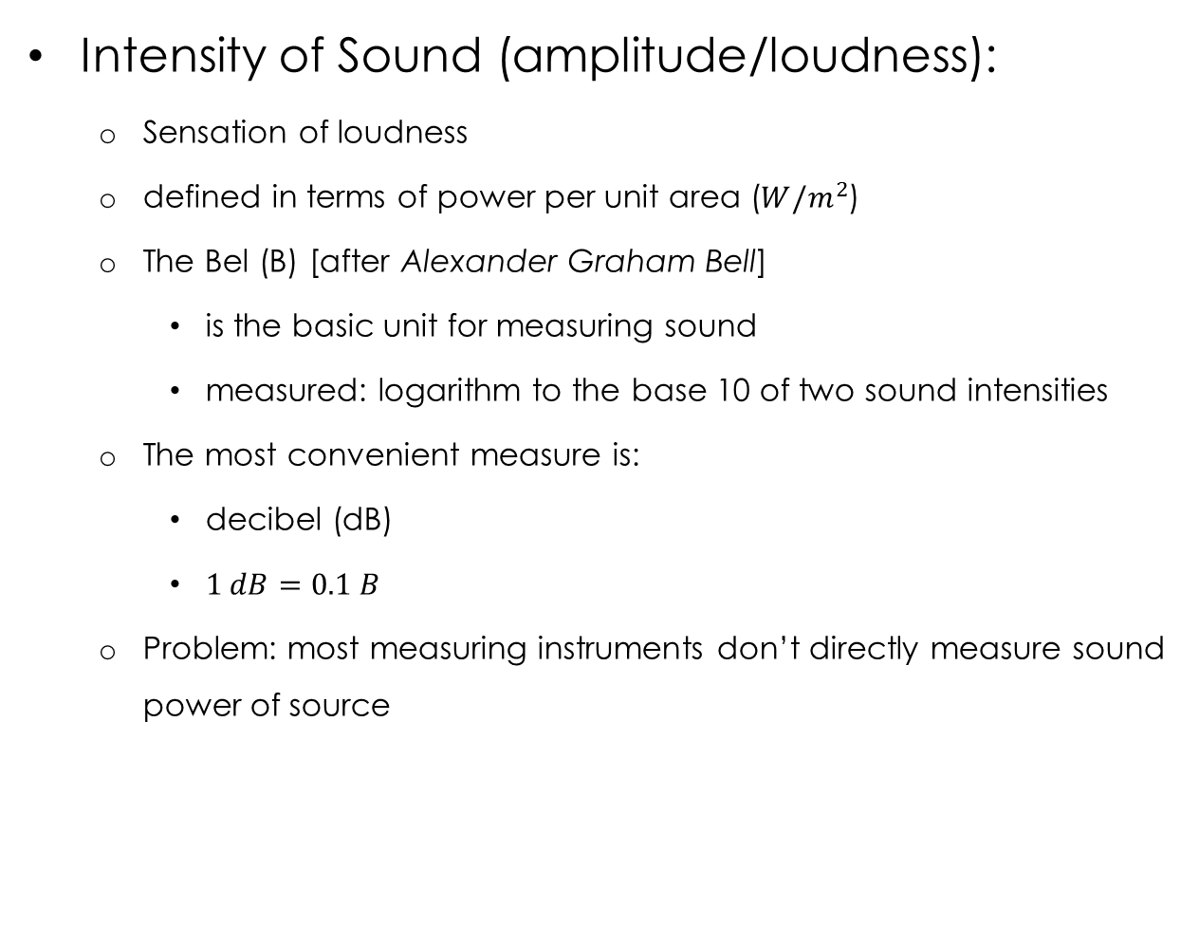
Cont. Nature and Measurement of Sounds
Intensity of Sound (amplitude/loudness):
  Sensation of loudness
  defined in terms of power per unit area ($W/m^{2}$)
  The Bel (B) [after Alexander Graham Bell]
    is the basic unit for measuring sound
    measured: logarithm to the base 10 of two sound intensities
  The most convenient measure is:
    decibel (dB)
    $1 dB=0.1 B$
  Problem: most measuring instruments don’t directly measure sound power of source

Slide 18
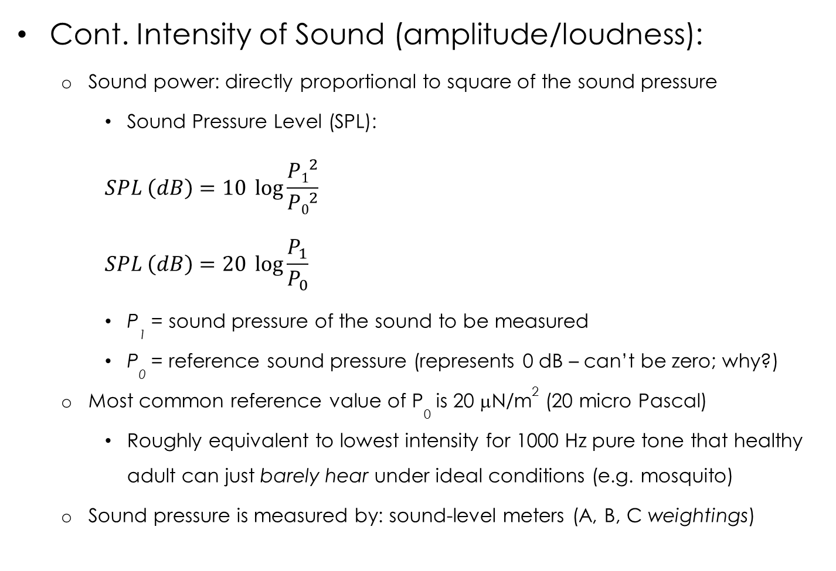
Cont. Nature and Measurement of Sounds
Cont. Intensity of Sound (amplitude/loudness):
  Sound power: directly proportional to square of the sound pressure
    Sound Pressure Level (SPL):
    $$SPL \left(dB\right)=10 \log{\frac{{P1}^{2}}{{P0}^{2}}}$$
    $$SPL \left(dB\right)=20 \log{\frac{P_{1}}{P_{0}}}$$
    P₁ = sound pressure of the sound to be measured
    P₀ = reference sound pressure (represents 0 dB – can’t be zero; why?)
  Most common reference value of P₀ is 20 μN/m² (20 micro Pascal)
    Roughly equivalent to lowest intensity for 1000 Hz pure tone that healthy adult can just barely hear under ideal conditions (e.g. mosquito)
  Sound pressure is measured by: sound-level meters (A, B, C weightings)
Notes:
Q: can SPL be less than 0 dB? A: yes, which means sound pressure < 20 μιχρο−πασχαλσ, ι.ε. Π₁ < Π₀; Θ2: ωηατ ισ Π₁ = Π₀, Α2: ΣΠΛ = 20 λογ(1) = 0 δΒ (ι.ε. τηισ ισ ρεφερενχε ϖαλυε)

Slide 19
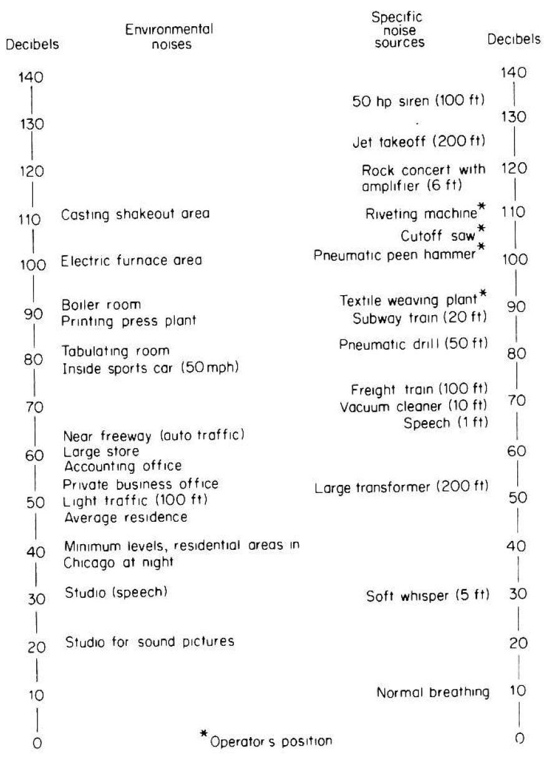
Cont. Nature and Measurement of Sounds
Cont.
Intensity of Sound
  Figure 6-2:
  Decibel levels for
  various sounds (0-150 dB)
  Note ↑ 10 dB ⇒
  ↑ 10 fold sound power ⇒
  ↑ 100-fold sound pressure (why?)
  Signal-to-Noise Ratio
  (SNR): difference bet.
  meaningful signal,
  & background noise
    e.g. 90 dB signal,
    70 dB noise ⇒
    SNR = +20 dB
Notes:
A: remember that power is related to square of pressure

Slide 20
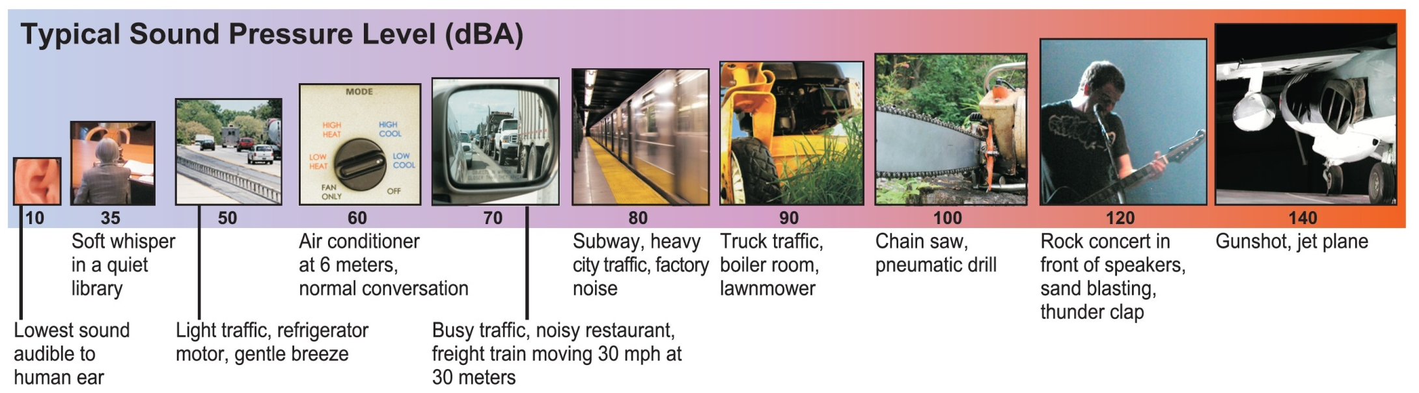
Cont. Nature and Measurement of Sounds:
Ranges of Typical Sound Levels for Common Sounds
Notes:
A: remember that power is related to square of pressure

Slide 21
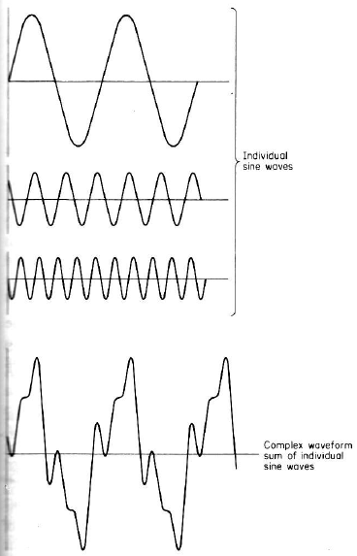
Cont. Nature and Measurement of Sounds
Complex Sounds:
  Very few sounds are pure
  Most complex sounds are
  non-harmonic
  Figure 6-3: waveform depiction of
  a complex sound formed
  by 3 individual sine waves
  Q: what is different is individual waves:
  frequency or amplitude?
Notes:
A: both; Note how complex sound has same amplitude as highest sound amplitude , and same frequency as lowest sound frequency

Slide 22
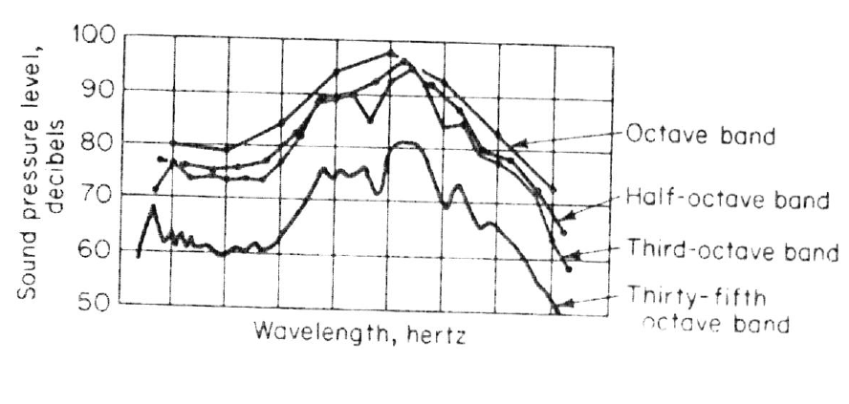
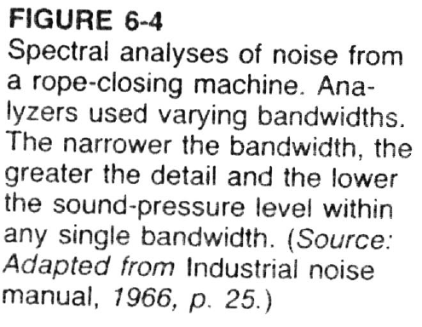
Cont. Nature and Measurement of Sounds
Cont. Complex Sounds:
  Method 2 of depiction: Sound Spectrum
  Divide sound into frequency bands,
  Measure intensity of sound in each band
  Achieved using “frequency-band analyzer”
  Narrower bandwidth ➔
    greater detail of the spectrum
    lower sound level within each bandwidth

Slide 23
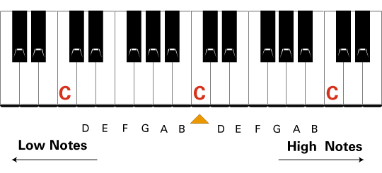
Cont. Nature and Measurement of Sounds
Cont. Complex Sounds:
  Methods of dividing the sound spectrum:
  Method 1: Octaves
    1 octave has double the frequency of the one below it
    E.g. “Middle C” has a frequency of 256 Hz
    one octave above “middle C” has a frequency of 512 Hz
    i.e. octave is Interval between one pitch and another with half or double its frequency
  Method 2: bands (ANSI)
    divide audible range into 10 bands
    center frequencies @:
    31.5, 63, 125, 250, 500, 1000, 2000, 4000, 8000, 16000 Hz

Slide 24
Cont. Nature and Measurement of Sounds
Masking (defined):
  Condition when one component of the sound environment reduces the sensitivity of the ear to another component
  It is amount that the “threshold of audibility” of a sound (the masked sound) is raised by the presence of another (masking) sound
  Experimentally:
    1: get absolute threshold (i.e. minimum audible level) of sound to be masked (by itself)
    2: repeat this in the presence of masking sound
  Masking must be considered when considering noise in auditory displays
  Q: Can you a give an example of “masked” and “masking” sounds from our everyday lives?
  Q: difference between masked and complex sounds?

Slide 25
Auditory Displays

Slide 26
Auditory Displays
Chapter 3: auditory vs. visual modality (e.g. auditory preferred: message is short, simple)
4 types of human functions/tasks involved in the reception of auditory signals:
Detection (i.e. whether a signal is present)
Relative discrimination (differentiating bet. ≥2 signals presented together)
Absolute identification (only 1 signal is present)
Localization (knowing the direction that the signal is coming from)

Slide 27
Cont. Auditory Displays
Detection of signals
  Signals can occur in “peaceful” surroundings or noisy surroundings
  The signal plus noise (SN) should be distinct from the noise (N) itself
  Otherwise, signal cannot always be detected in the presence of noise
    i.e. signal (masked sound) + noise (masking sound) ⇒ threshold of detectability is elevated
    ⇒ signal must be > threshold to detect signal
  Using filters ⇒ noise removed ⇒ ↑ detectability, SNR ⇒ more audible sound

Slide 28
Cont. Auditory Displays
Relative Discrimination of Auditory Signals
  Relative discrimination of signals on basis of
    intensity
    frequency
  A common measure of discriminability:
  just-noticeable difference (JND):
    JND: “the smallest difference or change along a stimulus dimension (frequency, intensity) that can just be detected 50% of the time by people.”
    The smaller the JND, the easier it is for people to detect differences on the dimension being changed.
      Small JND ⇒ subjects could detect small changes
      Large JND ⇒ large change necessary before noticing change

Slide 29
Cont. Auditory Displays
Absolute Identification
  This is used when it is necessary to make an absolute identification of an individual stimulus (by itself)
  e.g. identify
    someone’s pitch/frequency
    specific animal/bird
    certain car siren/honk tone
    Sound durations
  Number of levels along a continuum (range or scale) that can identified usually is quiet small
  It is better to use more dimensions with fewer steps or levels of each dimension, than to use fewer dimensions and more levels of each

Slide 30
Cont. Auditory Displays
Localization
  Stereophony: “the ability to localize (guess/predict) the direction from which the sound is emanating (coming from)”
  Primary factors/cues used to determine direction
    intensity of sound
    phase (lag) of sound
    e.g. if sound reaches directly one side of head first, sound reaches the nearer ear approx. 0.8 ms before other ear ⇒ localizing sounds below 1500 Hz
    For frequencies > 3000 Hz, intensity is used to localize sound (e.g. try to gradually increase volume in one speaker and decrease volume in opposite speaker)
    Sounds between 1500-3000 Hz: hard to localize

Slide 31
Cont. Auditory Displays
Special purpose auditory displays:
  Warning and alarm signals
    Each signal having preferred frequency, intensity
    Each causing certain “attention-getting” and “noise-penetration” ability
  Aids for the blind
    Mobility aids (go-no-go safety signals at certain distance)
    Environmental sensors (information about surrounding, e.g. surface characteristics, directional information, distance)

Slide 32
Noise

Slide 33
Noise
Noise
  “Unwanted sound”
  Information theory: “auditory stimulus of stimuli bearing no informational relationship to the presence or completion of the immediate task”
  Causes: startle response, annoyance
  Interferes with speech, sounds (i.e. masking)
  Decreases “complex” task performance
    But actually may increase “simple” task performance!
Effects of noise
  Hearing loss (e.g. occupational hearing loss)
  Temporary loss, permanent loss
  Physiological effects
  Psychological effects

Slide 34
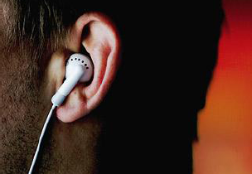
Cont. Noise
Hearing loss
  Long term exposure → hearing loss
    ↑ with ↑ in frequency and ↑ in duration
    First signs appear in range: 4-6 kHz
    Risk of damage ↑ in frequency range: 2400-4800 Hz
    Effect: damage to hair cells (i.e. nerve damage)
  Conductive hearing loss
    Damage to eardrum and middle ear
    Measured with “audiometer”: bone vs. air conduction tests
  Age-related hearing loss
    30% of people > 65 have significant hearing loss
    Natural damage occurs to hair cells (higher freq.: 4-6 kHz)
    Aging brain cannot filter background noise (can cause “tinnitus” )
Notes:
Tinnitus = طنين

Slide 35
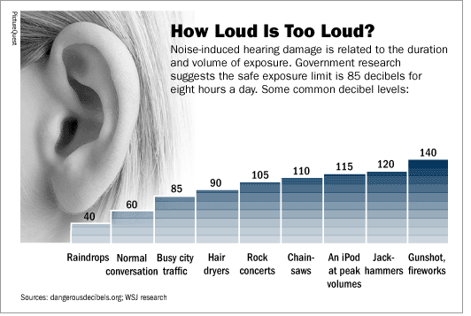
Cont. Noise
Notes:
Tinnitus = طنين

Slide 36
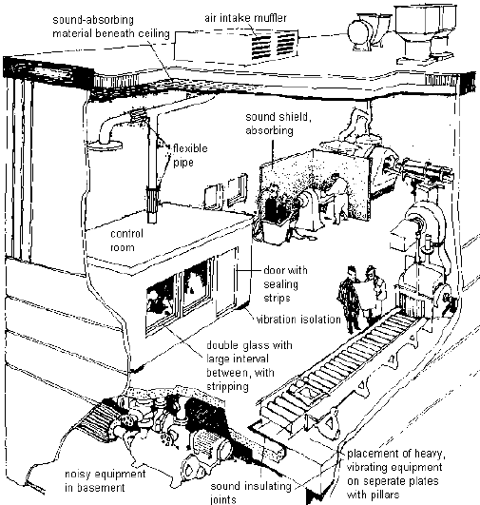
Cont. Noise: Occupational Noise Control

Slide 37
References
Human Capabilities - Hearing
  Human Factors in Engineering and Design. Mark S. Sanders, Ernest J. McCormick. 7th Ed. McGraw: New York, 1993. ISBN: 0-07-112826-3.
  Slides by: Dr. Khaled Al-Saleh; online at:
  http://faculty.ksu.edu.sa/alsaleh/default.aspx
  Slides by: Dr. Tamer Khalaf
  Slides by: Prof. Mohammed Z. Ramadan
  See what frequencies you can/can’t hear at the following Web Site:
  The Mosquito Ringtone

