Slide 1
Chapter 5
New-Product Development and Product Life-Cycle Strategies

Slide 2
New-Product Development and Product Life-Cycle Strategies
Topic Outline
New-Product Development Strategy
New-Product Development Process
Managing New-Product Development
Product Life-Cycle Strategies
Additional Product and Service Considerations

Slide 3
New-Product Development Strategy
Two ways to obtain new products
Acquisition refers to the buying of a whole company, a patent, or a license to produce someone else’s product
New product development refers to original products, product improvements, product modifications, and new brands developed from the firm’s own research and development
Notes:
Note to Instructor
New products are important—to both customers and the marketers who serve them. For companies, new products are a key source of growth. For customers, they bring new solutions and variety to their lives. Yet, innovation can be very expensive and very risky. New products face tough odds. According to one estimate, 90 percent of all new products in America fail. Each year, companies lose an estimated $20 billion to $30 billion on failed food products alone.

Slide 4
New-Product Development Process
Major Stages in New-Product Development
Notes:
New-product development starts with
good new-product ideas—lots of
them. For example, Cisco’s recent
I-Prize “crowdsourcing” challenge
attracted 1,200 ideas from 2,500
innovators in 104 countries.
The remaining steps reduce the
number of ideas and develop
only the best ones into
profitable products. Of the 1,200
ideas from Cisco’s I-Prize
challenge, only a handful were
developed.

Slide 5
New-Product Development Process
Marketing Strategy Development
When firms test market
New product with large investment
Uncertainty about product or marketing program
When firms may not test market
Simple line extension
Copy of competitor product
Low costs
Management confidence
Notes:
Note to Instructor
This Web link takes you to Decision Insight—a company involved with online market testing. You can click at many examples they offer of clients as well as their virtual shopping testing products.

Slide 6
New-Product Development Process
Marketing Strategy Development
Commercialization is the introduction
of the new product
When to launch
Where to launch
Planned market
rollout

Slide 7
Managing New-Product Development
Successful new-product development should be:
Customer centered
Team-based
Systematic

Slide 8
Managing New-Product Development
New-Product Development Strategies
Customer-centered new product development new ways to solve customer problems and create more customer satisfying experiences

Slide 9
Managing New-Product Development
New-Product Development Strategies
Team-based new-product development Company departments work closely together in cross-functional teams, overlapping in the product-development process to save time and increase effectiveness

Slide 10
Managing New-Product Development
New-Product Development Strategies
Systematic new-product development
innovative development approach that collects, reviews, evaluates, and manages new-product ideas
Creates an innovation-oriented culture
Yields a large number of new-product ideas

Slide 11
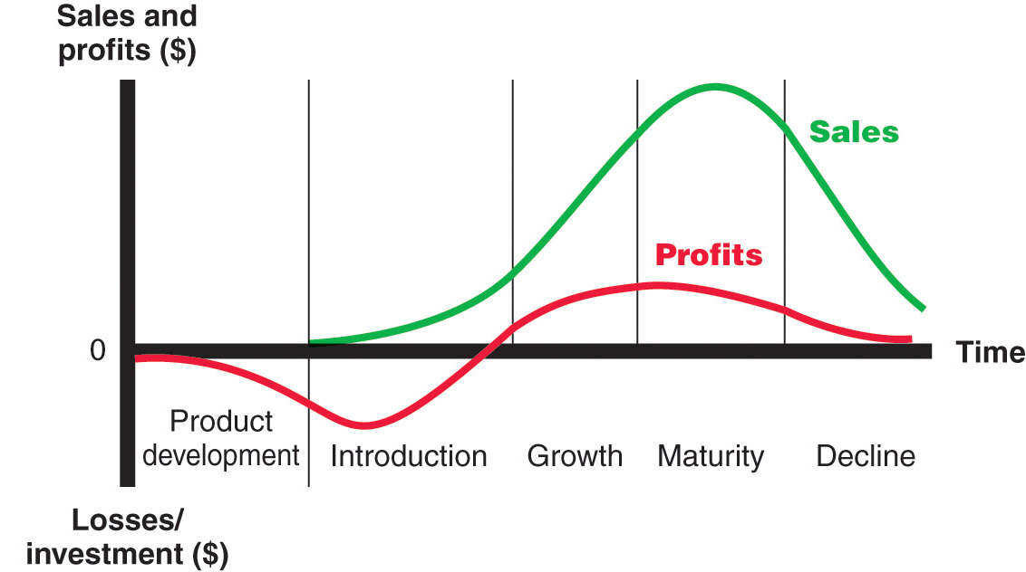
Product Life-Cycle Strategies
Product Life Cycle
Notes:
Note to Instructor
Product life cycle (PLC)
The course of a product’s sales and profits
over its lifetime. It involves five distinct
stages: product development,
introduction, growth, maturity, and
decline.
Discussion Question
Name a product at each stage of the PLC.
This concept is very new to students. See if they can identify products or product categories that are in each stage of the model. Introduction might include online movie viewing software, growth might include MP3 players, maturity might include bottled water, and decline could include soda (actually in a decline) or videotape players.

Slide 12
Product Life-Cycle Strategies
Product development
Sales are zero and investment costs mount
Introduction
Slow sales growth and profits are nonexistent
Growth
Rapid market acceptance and increasing profits.
Maturity
Slowdown in sales growth and profits level off or decline
Decline
Sales fall off and profits drop

Slide 13
Product Life-Cycle Strategies
Notes:
Note to Instructor
Style is a basic and distinctive mode of expression.
Fashion is a currently accepted popular style in a given field.

Slide 14
Product Life-Cycle Strategies
Introduction Stage
Slow sales growth
Little or no profit
High distribution and promotion expense

Slide 15
Product Life-Cycle Strategies
Growth Stage
Sales increase
New competitors enter the market
Price stability or decline to increase volume
Consumer education
Profits increase
Promotion and manufacturing costs gain economies of scale

Slide 16
Product Life-Cycle Strategies
Maturity Stage
Slowdown in sales
Many suppliers
Substitute products
Overcapacity leads to competition
Increased promotion and R&D to support sales and profits

Slide 17
Product Life-Cycle Strategies
Decline Stage
Maintain the product
Harvest the product
Drop the product
Notes:
maintain its brand, repositioning or reinvigorating it in
hopes of moving it back into the growth stage of the PLC.
harvest the product,
which means reducing various costs (plant and equipment, maintenance, R&D, advertising,
sales force), hoping that sales hold up.
drop the product from its line. It can sell it to another
firm or simply liquidate it at salvage value.

Slide 18
Additional Product and Service Considerations
Product Decisions and Social Responsibility
Public policy and regulations regarding developing and dropping products, patents, quality, and safety

Slide 19
Additional Product and Service Considerations
International Product and
Service Marketing—Challenges
Determining what products and services to introduce in which countries
Standardization versus customization
Packaging and labeling
Customs, values, laws

Slide 20
All rights reserved. No part of this publication may be reproduced, stored in a retrieval system, or transmitted, in any form or by any means, electronic, mechanical, photocopying, recording, or otherwise, without the prior written permission of the publisher. Printed in the United States of America.
Copyright © 2012 Pearson Education, Inc.
Publishing as Prentice Hall

