Slide 1
Enzyme-Linked Immunosorbent Assay [ELISA]
Lab# 6
BCH 462[practical]

Slide 2
Antigens [Ag]:
A substance that when introduced into the body stimulates the production of an antibody. Antigens include toxins, bacteria, foreign blood cells, and the cells of transplanted organs.
Antibody [Ab]:
Antibodies are large Y-shaped glycoproteins. They are produced by the immune system to identify and neutralize foreign objects like bacteria and viruses or antigens in general.
-The antibody recognizes a unique foreign target, called an antigen[ not normally found in the body] .
So, each antibody recognize specific antigen.
Immunoassay is : a test that uses antibody and antigen complexes[immuno-complexes]
as a means of generating measurable results.

Slide 3
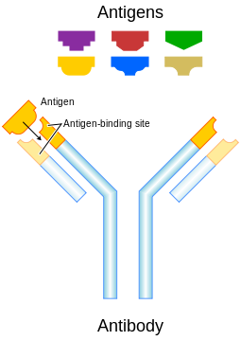

Slide 4
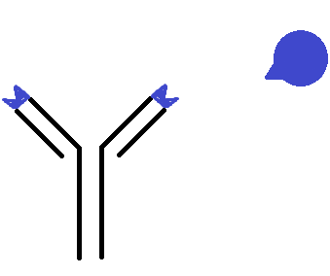
epitope
antigen
antibody

Slide 5
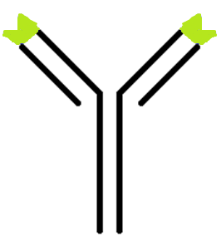
enzyme
Primary antibody
“antibody specified to specific antigen”
Secondary antibody
“antibody specified to Primary antibody”
The enzyme linked: will convert colorless substrate to colored product,
Indicate the presence of the antibody - antigen [Ab-Ag] binding complex.

Slide 6
ELISA: method used in immunology and other scientific field, designed for detecting and quantitating substances such as:
peptides, proteins, hormones “antigens in general” .
antibodies.
Principle:
The basic principle of ELISA is, to detect a specific antibody- antigen reaction by using an enzyme which can convert a colorless substrate to a color product indicating the presence of the antibody - antigen [Ab-Ag] binding.

Slide 7
Propose of ELISA:
-To determine the presence and the concentration of a particular Ag or Ab in a sample. Thus it can be run in a qualitative and quantitative format.
-In qualitative ELISA, results provide a positive or negative result for a sample.
-In quantitative ELISA, the optical density or florescent units of the sample is interpolated into a standard curve (obtained from serial dilutions of a standard).

Slide 8
Application of ELISA:
ELISA can be used in the field of medicine, food industry and in toxicology labs to evaluate the presence of a specific Ag or Ab in a sample.
They can be used for:
-Screening donated blood for evidence of viral contamination.
-Measuring hormones level.
-It can measure autoantibody in autoimmune disease Such as rheumatoid arthritis.

Slide 9
Types of ELISA:
Direct ELISA .
Indirect ELISA.
Sandwich ELISA.
Competitive ELISA.

Slide 10
Polystyrene Microtiter Plate

Slide 11
Direct ELISA:
-It is used to detect the presence and the concentration of specific antigen in the sample.
-Test which is considered to be the simplest type of ELISA.
Principle:
-The antigen “of interest” is adsorbed or fixed to a microtiter plate , an “enzyme is linked to an antibody” applied to the antigen. The enzyme-antibody, will bound to antigen of interest.
By adding, the enzyme's substrate, the enzyme will convert colorless substrate to colored product. The color produced is proportional the amount of the antigen of interest.
-The name “direct ELISA” due to, that (the antibody linked to the enzyme) is directly bind to the protein of interest “antigen”.

Slide 12
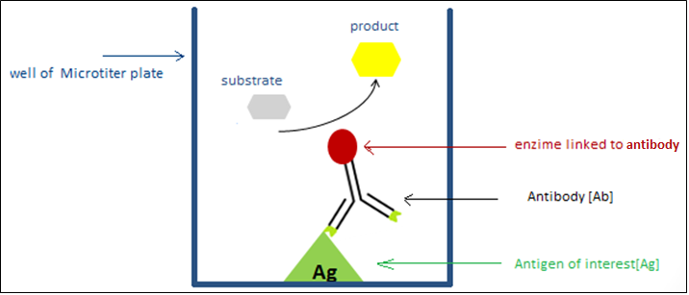
Direct ELISA

Slide 13
Direct ELISA:
Adding the sample and incubate for 1 or 2 hr.
microtitre plate
solid support used to immobilized antigen or antibody
of interest.

Slide 14
Ag
Note that we should add the blocking buffer, which contains a non –reactive protein, To block all unbound sites in the well to prevent false positive results or non specific binding.
directly enzyme linked antibodies added to react with target antigens (fixed to microtiter plate).
The substrate is added.
The color or the signal produced as a result of the reaction between
the substrate and the enzyme conjugated with the antibody.
the color produced is proportional to antigen of intrest in the sample.
Antigen under investigation
Ag
Ag
Untargeted antigen.
Ag
Ag
Ag

Slide 15
Indirect ELISA:
-Is used to detect the presence and the concentration of specific antibody.
Principle:
This method differs than direct ELISA, in that one more labeled secondary antibody is added in the reaction. The primary antibody added to the fixed antigen. Then labeled secondary antibody added that recognizes the primary antibody. The color or the signal produced as a result of addition of substrate is proportional to antibodies in the sample.
“antibody of interest “in the sample.
Do not forget:
1. The primary antibody [1ry antibody]: is not linked to an enzyme. And it is the antibody of interest in this case. it is specific to the antigen.
2. The secondary antibody [2ry antibody]: is conjugated with an enzyme , and it is specific to 1ry antibody.

Slide 16
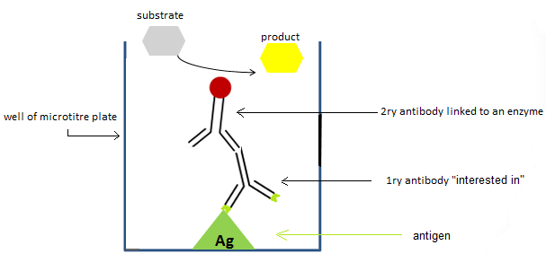
Indirect ELISA
The name Indirect ELISA, is due to that 2ry antibody bind indirectly to the antigen.

Slide 17
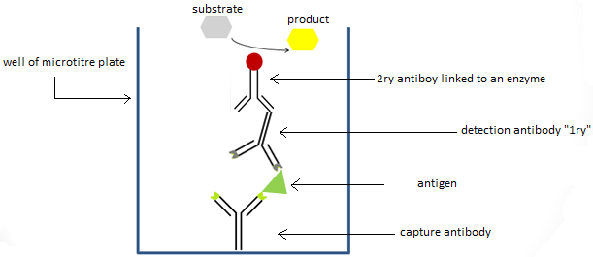
Sandwich ELISA:
-Is used to detect the presence and the concentration of specific antigen.
Principle:
The sandwich ELISA quantify antigens between two layers of antibodies (i.e. capture and detection antibody just like a sandwich). The antigen to be measured must contain at least two antigenic epitope since at least two antibodies bind to antigen. The color or the signal produced as a result of addition of substrate is proportional to antigen concentration.

Slide 18
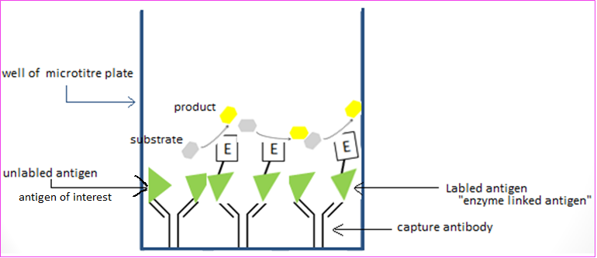
Competitive ELISA:
It measures the amount of antigen in a sample. In this type of ELISA, another version of your antigen of interest is labeled instead of the antibody. Unlabeled antigen “your interest” and the “labeled antigen” compete for binding to the capture antibody. The color or the signal produced as a result of addition of substrate is inversely proportional to antigens of interest in the sample.
For example, the absence of the antigen of interest in the sample will result in a dark color because the “labeled antigens” are bound to the capture antibody, whereas the presence of the antigen of interest will result in a light color or no color as the concentration of the antigen increases.

