Slide 1
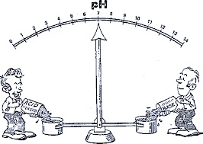
The effect of pH on the rate of an enzyme catalyzed reaction
322 BCH
Exp (6)

Slide 2
In this experiment, we will continue to study acid phosphatase kinetics.
Acid phosphatase kinetics
Time
Enzyme concentration
pH
Substrate concentration
Inhibitor
Temperature

Slide 3
Objectives
To establish the relationship between pH and the rate of an enzyme catalyzed reaction.
To determine the optimum pH for such a reaction.

Slide 4
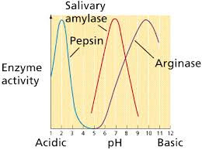
The Effect of pH on Enzymes
The rate of enzymatic reaction depends on pH of the medium.
Each enzyme has an optimum pH, where the rate of enzymatic reaction is maximum.
At higher or lower pH, the rate of an enzymatic reaction decreases.
For most enzymes, the optimum pH lies in the range from pH 5 to pH 9.
With some exceptions, pepsin’s optimum pH is extremely acidic.
And arginase’s optimum pH is extremely basic.

Slide 5
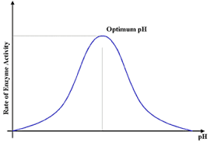
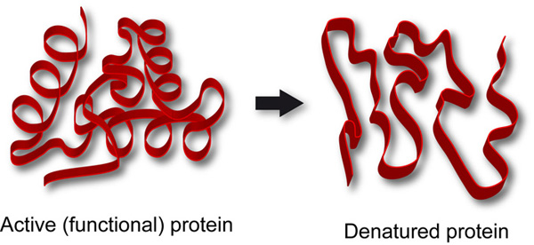
The relationship between the rate of an enzymatic reaction and pH takes form of a bell-shape.
Change in pH effects the charged state of the substrate or amino acid residues in the active site of the enzyme, hence affecting the rate of the reaction
Enzyme denaturation at extremely high or low pH
Bell-Shaped curve

Slide 6
Principal
Its concentration can be measured at 405 nm.
1.
2.
ACP

Slide 7
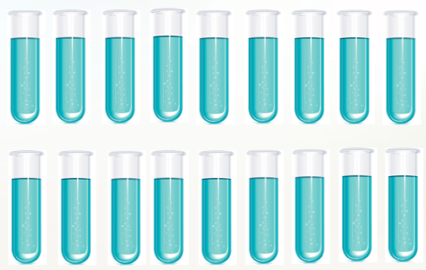
Method:
Place in a water bath maintained at 37 ºC for 5 minutes.
T₃
T₄
T_{4.5}
T₅
T_{5.5}
T₆
T₇
T₈
T₉
9 tubes (Test)
Add to each tube (Test and Blank):
0.5 ml of Corresponding pH buffer
0.5 ml of pNPP
0.5 ml MgCl₂
5 ml water
B₃
B₄
B_{4.5}
B₅
B_{5.5}
B₆
B₇
B₈
B₉
9 tubes (Blank)
All the factors that affect enzyme kinetics are constant except pH where it varies in each tube
Time = 5 min Temp= 37 ºC [S] = 0.05M

Slide 8
To start the reaction add add 0.5ml of enzyme
To stop the reaction → add 0.5ml of KOH
Keep in a water bath maintained at 37 ºC for other 5 minutes.
Start at | 0 | 2 | 4 | 6 | 8 | 10 | 12 | 14 | 16
Stop at | 5 | 7 | 9 | 11 | 13 | 15 | 17 | 19 | 21
For Blank tubes: Add KOH ((FIRST)) then E, to prevent the reaction from happening.
After all the reactions have been terminated, determine the absorbance at 405 nm for each sample against blank.

Slide 9
Results
Velocity (µmole of PNP/min) | Absorbance 405 nm | pH
 |  | 3
 |  | 4
 |  | 4.5
 |  | 5
 |  | 5.5
 |  | 6
 |  | 7
 |  | 8
 |  | 9
Plot a graph illustrating the effect of different pHs on the rate of the reaction.

Slide 10
Calculations:
Velocity (V) = (A x 10⁶) /(E x time)= µmole of PNP/min
A= absorbance
E= extension coefficient=18.8 x 10³
Time = 5 min

Slide 11
The Effect of pH on the Rate of an Enzyme Catalyzed Reaction.
Velocity
(µmole of PNP/min)
Optimum pH
pH
Bell- shape curve

Slide 12
Discussion
An introductory statement (In this experiment, we studied the effect of different pH on the rate of acid phosphatase catalyzed reaction.)
Principle
From the curve, explain and discuss the relationship between the activity of acid phosphatase and pH.
Define the optimum pH and determine which buffer is the best from the curve.

