Slide 1
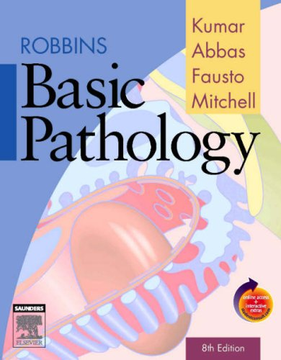
CLS 223
Reem Alkhamis
Email: ralkhamis@ksu.edu.sa
3rd floor/ office # 125

Slide 2
Lecture # 6
Non- Adaptive
Immune Response

Slide 3
The Immune system sometimes:
Over responds → Hypersensitivity reaction
Fails to respond → Immunodeficiency state
Turns against the body → Autoimmune disease.

Slide 4
Hypersensitivity reaction
Excessive undesirable reaction produced by the immune system.
Require a pre-sensitized state of the host (previous exposure to the same Ag)
Hypersensitivity reactions can be divided into 4 types:
1) Type 1
2) Type 2
3) Type 3
4) Type 4
Notes:
Pre-sensitized state (previous exposure to the same Ag)

Slide 5
1) Type 1 hypersensitivity reaction:
Also known as Immediate or anaphylactic hypersensitivity.
Reaction occurs within minutes after the interaction of the Ag
Ag: pollen, cat fur, insects.. (environmental Ag)
With the Ab: IgE that is bound to the surface of mast cells in a sensitized host.
The Ag-Ab reaction liberates histamine and other chemical mediators from mast cells, resulting in vascular, smooth muscle reactions, and inflammation.
The reaction may involve:
-Nasopharynx (allergic rhinitis ).
Bronchopulmonary tissue (allergic asthma)
-eyes( conjunctivitis)
-systemic (anaphylactic sock)
Notes:
Manifestations: redness, hotness, swelling, runny nose,
anaphylactic sock: massive drop in blood pressure due to introduction of Ag by ingestion or injection (severe and systemic)
Allergic rhinitis (runny nose)
Ag (inhaled, ingested, in contact with skin or eyes, injected)

Slide 6
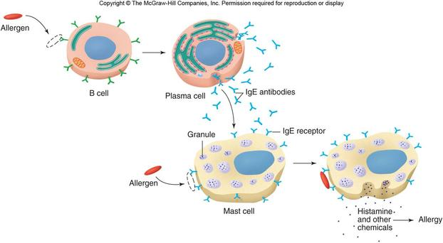
Notes:
First exposure to the Ag (allergen, becouse it triggers allergy) stimulate B lymphocytes to produce plasma cells→ Ab production (IgE), IgE will then bind to mast cells or basophils.
Second exposure to the same allergen, Allergen binds to igE connected to mast cells or basophils will activate the mast cells to release it’s component.
Treatment: Antihistamin, avoid allergen

Slide 7
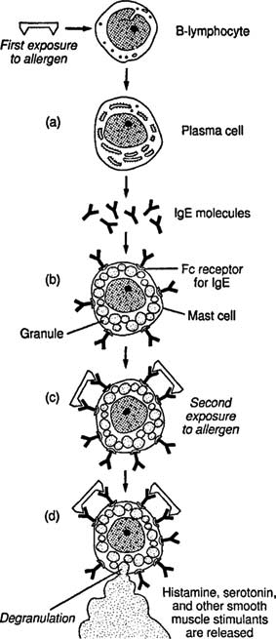

Slide 8
2) Type 2 hypersensitivity reaction
Also known as Cytotoxic hypersensitivity.
the Ab produced by the immune response bind to Ag on the patient's own cell surfaces. The affected cells undergo lyses.
Ab: IgM and IgG
Ag: may be normal molecules intrinsic to cell membranes or they may be adsorbed extrinsic antigens (e.g. a drug).
E.g.: incompatible blood transfusion, hemolytic disease of the new born,
type 2 drug reaction
Notes:
drugs are normally haptens that can’t generate immune response by themselves so by attaching to RBC or platelets they will be immunogenic

Slide 9
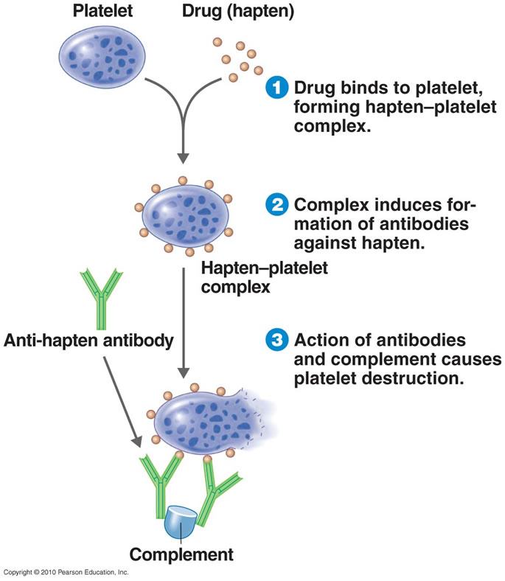
Type 2 drug reaction
An example of type II hypersensitivity is the reaction to penicillin where the drug can bind to RBCs, causing them to be recognized as different; B cell proliferation will take place and Ab against the drug are produced. IgG and IgM bind to these Ag to form complexes resulting in cell lysis
This drug binds to platelets

Slide 10
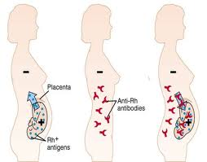
Hemolytic disease of the new born
Baby’s RBCs destroyed
Mother Rh-
First baby Rh+
Second baby Rh+
Notes:
Ab here is IgG!!!!

Slide 11
3) Type 3 hypersensitivity reaction
Also called immune complex reaction.
caused by reaction between Ag and Ab forming large amounts of immune complexes that deposit and accumulate in organs giving rise to inflammatory response.
Ab: Mostly IgG, IgM may be involved.
The reaction may be local or systemic.
Local: when complexes form at the site where Ag has been planted. E.g.: (Arthus reaction): the reaction occurs after vaccination against diphtheria and tetanus → necrosis, ulcer, hemorrhage at the site of injection.
Systemic: when complexes are formed in the circulation and deposited in blood vessels. E.g.: (serum sickness): The reaction occurs following injection of Antiserum intravenously. the human immune system can mistake the proteins present as harmful antigens. Causes fever, arthritis, skin rash.
Notes:
Diphtheria and tetanus vaccine is a toxoid (from last lecture) given intra dermal (local)
Antiserum: blood serum containing polyclonal antibodies and is used to pass on passive immunity to many diseases

Slide 12
4)Type 4 hypersensitivity reaction
Also called cell mediated or delayed type of hypersensitivity reaction.
Slow response, take 2 to 3 days to develop. It is a reaction between Ag and stimulated T lymphocytes causing tissue injury by inducing inflammation.
E.g.:
-old tuberculin test: intradermal injection of protein extracted from tubercle bacilli → localized inflammatory reaction 24 hours later and continue for some week.( the patient is sensitized against tuberculin before the test either by infection or vaccine).
- Contact dermatitis
Notes:
Contact dermatitis: red rash or blisters

Slide 13
Immunodeficiency
It is a state in which the immune system’s ability to fight is reduced or entirely absent.
It has two types:
Selective:
B lymphocytes deficiency
T lymphocytes deficiency
2) combined:
B+T lymphocyte deficiency. It is also called severe combined immunodeficiency disease (SCID)

Slide 14
Also this immunodeficiency may be:
Primary:
Defect in the organs producing the B and the T lymphocytes (stem cell and thymus).
Secondary
Decrease in the synthesis of Igs. E.g.: lymphomas, hypogamma-globulinaemia.
Increase loss of Igs. E.g.: nephrotic syndrome.
Production of defective Igs. E.g.: multiple myeloma.

Slide 15
Autoimmune disease
Normally the immune system has the ability to differentiate between self and non-self antigens.
Thus, there is no immune response against self antigens (self-tolerance).
If a breakdown in self-tolerance occurs, this will result in production of immune response against self antigen. This immune response is called autoimmune response.
In other words, it is the failure of the body to recognize its own parts as SELF, which allows an immune response against its own cells and tissues.

Slide 16
Mechanism of loss of self-tolerance Mechanism of autoimmune disorders
Predisposing factors:
1) Genetic predisposition.
2) Sex: more in females
3) Environmental factors: chemical agents, drugs, smoking, microbial agents.

Slide 17
Direct factors:
1) Molecular mimicry: exogenous Ag share structural similarities with certain host Ag. Ab produced against this Ag ( which mimics the self Ag) can also bind to host Ag. This is called cross reaction seen in Rheumatic fever (the Ag of a bacteria known as streptococcus is similar to cardiac Ag. Once infection by streptococcus occurs, immune response of the body release Ab which is reacted to cardiac Ag and streptococcus Ag).
2) Exposure of hidden Ag. E.g.: cornea, testicles, brain.
3) Neoantigens: self Ag that have been modified by extrinsic factors (by drugs, infections.)

Slide 18
There are two types of autoimmune disorders
Organ specific: the disease is specific to a certain organ, as in thyrotoxicosis which is an autoimmune disease affecting only the thyroid gland.
Non organ specific: the disease produces symptoms in different organs of the body, however, there are particular organs which show more symptoms.
E.g.: Systemic lupus erythematosis (SLE) affect the whole body, but the kidney is markedly affected.

