Slide 1
Chapter 6
Pricing:
Understanding and Capturing Customer Value

Slide 2
Pricing: Understanding and Capturing Customer Value
Topic Outline
What Is a Price?
Major Pricing Strategies
Other Internal and External Considerations Affecting Price Decisions

Slide 3
What Is a Price?
Price is the amount of money charged for a product or service. It is the sum of all the values that consumers give up in order to gain the benefits of having or using a product or service.
Notes:
Note to Instructor
Discussion Question
How does a company like Starbuck’s price their products?
This will lead to a good overview of the chapter as students will most likely focus on customers, costs and competitors.

Slide 4
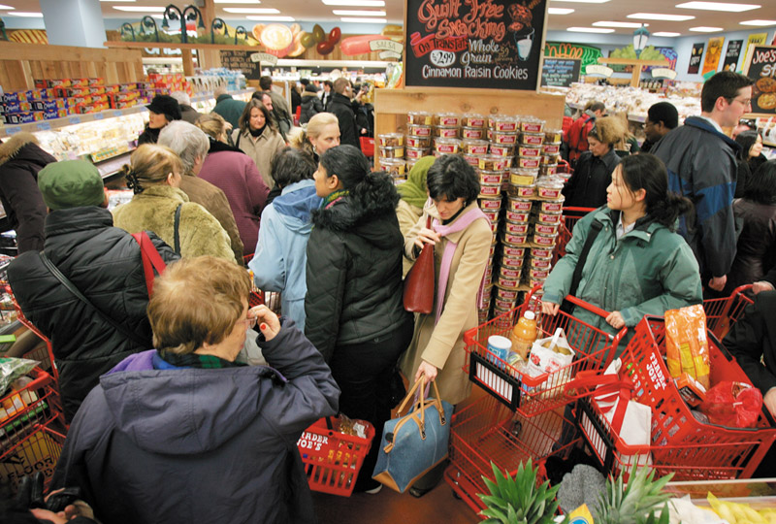
Major Pricing Strategies
Customer Value-Based Pricing
Understanding how much value consumers place on the benefits they receive from the product and setting a price that captures that value

Slide 5
Major Pricing Strategies
Customer Value-Based Pricing

Slide 6
Major Pricing Strategies
Customer Value-Based Pricing
Value-based pricing uses the buyers’ perceptions of value, not the sellers cost, as the key to pricing. Price is considered before the marketing program is set.
Value-based pricing is customer driven
Cost-based pricing is product driven
Notes:
Note to Instructor
Students often confuse value with low price. You might want to bring up a product that some of them will value even at a high price. You can bring up the latest iPhone product or a luxury car. Some students will feel that the price for these products is too high, however, others will see the value these products offer to the consumer.

Slide 7
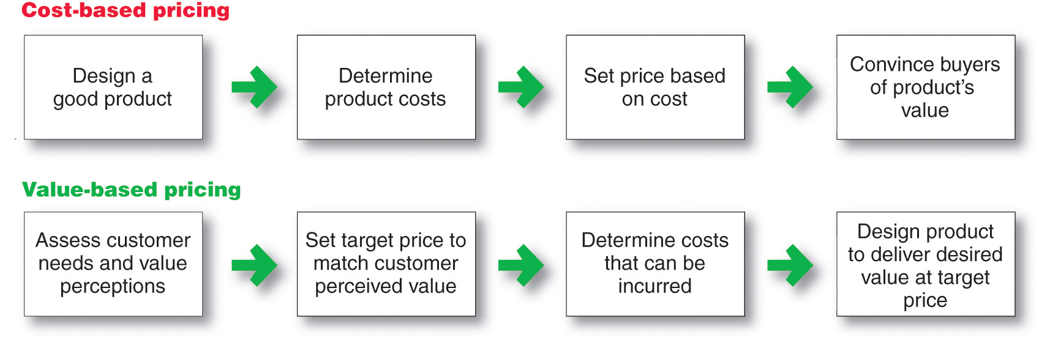
Major Pricing Strategies
Customer Value-Based Pricing

Slide 8
Major Pricing Strategies
Customer Value-Based Pricing
Good-value pricing
offers the right combination of quality and good service at a fair price
Notes:
Note to Instructor
Existing brands are being redesigned to offer more quality for a given price or the same quality for less price.
In many cases good-value pricing includes less expensive items.

Slide 9
Major Pricing Strategies
Customer Value-Based Pricing
Everyday low pricing (EDLP) charging a constant everyday low price with few or no temporary price discounts
Notes:
Note to Instructor
This link is for Wal-Mart’s homepage. It is interesting to compare this to kohls.com, which does NOT practice EDLP but focuses on special promotions and deals.

Slide 10
Major Pricing Strategies
Customer Value-Based Pricing
High-low pricing charging higher prices on an everyday basis but running frequent promotions to lower prices temporarily on selected items
Notes:
Note to Instructor

Slide 11
Major Pricing Strategies
Customer Value-Based Pricing
Value-added pricing attaches value-added features and services to differentiate offers, support higher prices, and build pricing power

Slide 12
Major Pricing Strategies
Cost-Based Pricing
Cost-based pricing setting prices based on the costs for producing, distributing, and selling the product plus a fair rate of return for effort and risk

Slide 13
Major Pricing Strategies
Cost-Based Pricing
Types of costs
Fixed costs
Variable costs
Total costs

Slide 14
Major Pricing Strategies
Cost-Based Pricing
Fixed costs are the costs that do not vary with production or sales level
Rent
Heat
Interest
Executive salaries

Slide 15
Major Pricing Strategies
Cost-Based Pricing
Variable costs are the costs that vary with the level of production
Packaging
Raw materials
Notes:
Note to Instructor
This link is to steelonthenet.com that shows current prices for the raw materials used to make steel including coal, iron oar, natural gas, steel scrap, and electricity. This site tracks the prices over time so students can see how these change.

Slide 16
Major Pricing Strategies
Cost-Based Pricing
Total costs are the sum of the fixed and variable costs for any given level of production

Slide 17
Considerations in Setting Price

Slide 18
Other Internal and External Considerations Affecting Price Decisions
Target costing starts with an ideal selling price based on consumer value considerations and then targets costs that will ensure that the price is met

Slide 19
Other Internal and External Considerations Affecting Price Decisions
Organizational considerations include:
Who should set the price
Who can influence the prices

Slide 20
Other Internal and External Considerations Affecting Price Decisions
The Market and Demand
Before setting prices, the marketer must understand the relationship between price and demand for its products

Slide 21
Other Internal and External Considerations Affecting Price Decisions
Price elasticity of demand illustrates the response of demand to a change in price
Inelastic demand occurs when demand hardly changes when there is a small change in price
Elastic demand occurs when demand changes greatly for a small change in price
Notes:
Note to Instructor
Factors that affect price elasticity of demand include:
Unique product
Quality
Prestige
Substitute products
Cost relative to income

Slide 22
All rights reserved. No part of this publication may be reproduced, stored in a retrieval system, or transmitted, in any form or by any means, electronic, mechanical, photocopying, recording, or otherwise, without the prior written permission of the publisher. Printed in the United States of America.
Copyright © 2012 Pearson Education, Inc.
Publishing as Prentice Hall

