Slide 1
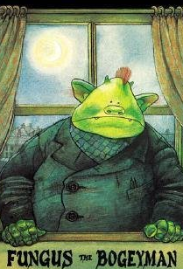
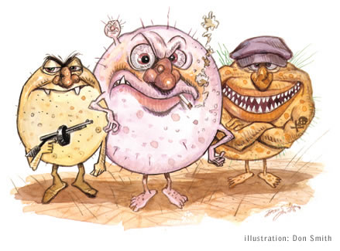
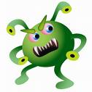
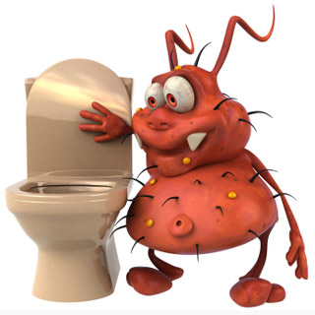
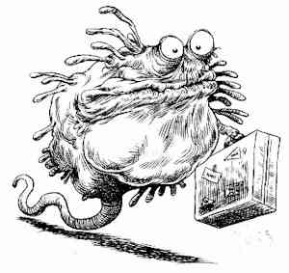
Inhibiting Microbial Growth in vitro
CLS 212: Medical Microbiology

Slide 2
Microbicidal or Microbistatic?
Microbicidal
Microbicidal is the process or an agent that kills the microorganism.
The suffix -cidal or –cide means ''killing''.
Microbistatic
Microbistatic is the process or an agent that inhibits the growth and reproduction of the microorganism.
The suffix -static or –state means ''inhibiting or stopping''.

Slide 3
Sterilization or Disinfection?
Sterilization
Sterilization is the complete destruction of all forms of microbial life including bacteria, viruses, fungi, parasites, and spores.
Disinfection
Disinfection is reducing or eliminating the number of pathogenic microorganisms to the point where they no longer cause disease. But this method does not affect spores.

Slide 4
Pasteurization and Sanitization
Pasteurization
Is a disinfecting method used to eliminate pathogens from liquids e.g. milk, juice,..
Sanitization
Sanitization is the use of chemical agents on food-handling equipment to meet public health standards and minimize chances of disease transmission e.g. use of hot water & soap in cleaning restaurants.

Slide 5
STERILIZATION AND DISINFECTION METHODS
Methods used to destroy or inhibit microorganisms are either physical or chemical, and sometimes both types are used.

Slide 6
Physical Methods

Slide 7
Physical Methods
They are commonly used in hospitals, clinics, and laboratories. Physical methods include:
Heat.
Cold.
Desiccation.
Radiation.
Ultrasonic waves.
Filtration.
Gaseous atmosphere.

Slide 8
I- HEAT
Heat is considered the most common method for sterilization because it is practical, efficient, and inexpensive.
Heat kills microorganisms by denaturing their enzymes and other proteins.
There are three methods of sterilization or disinfection by heat:
dry heat
moist heat
autoclave.

Slide 9
I- HEAT 1. Dry Heat
An effective way to sterilize metals, glassware, some powders, oils, and waxes.
Hot Air Oven:
It is done in a 160-165°C oven for 2hours or in 170-180°C oven for 1hour.
Burning (incineration):
Is used to destroy contaminated disposable materials.
Direct Flame:
Bunsen burner or electrical heating device is used to sterile wire loops and forceps used in the laboratory.

Slide 10
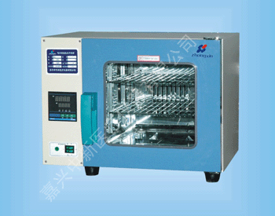
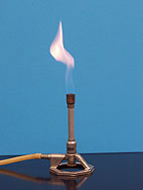
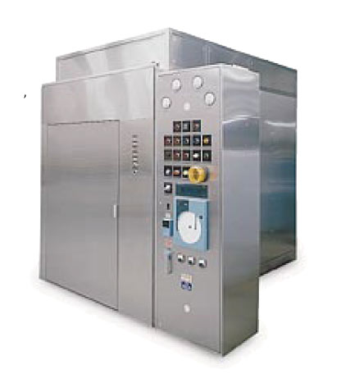
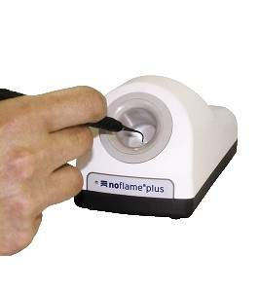
I- HEAT
Dry heat Oven
Bunsen Burner
Electric Bunsen

Slide 11
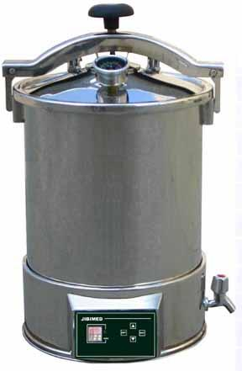
I- HEAT 2. Moist Heat
Is used to disinfect syringes, needles, and simple instruments by boiling (100°C) for 30 minutes.
Boiling is not always effective as
spores, like Mycobacteria, and
some viruses are not affected.

Slide 12
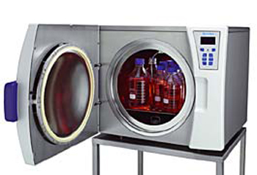
I- HEAT 3. Autoclave
An autoclave is a large
metal chamber that uses
steam under pressure for
sterilization (like the
pressure cooker).
Autoclaving is done at 121.5°C and 15psi pressure for 20 minutes.
An autoclave tape or strip (commercially available) is used to ensure proper functioning.

Slide 14
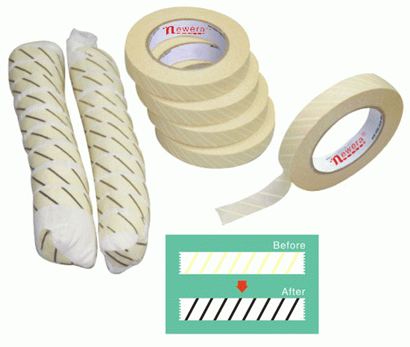
Autoclave Tapes

Slide 15
II- Cold
Freezing (below zero)
Freezing will greatly slow the metabolic activities of microorganisms leading to inhibition of their growth.
2. Refrigeration (4°C)
Refrigeration will slightly affect the metabolic activities of most microorganisms but it would not completely inhibit growth.

Slide 16
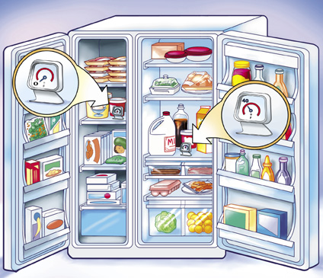
Slow Freezing is the most effective way as ice crystals that forms may rapture the cell membrane and cell wall of microbes.
CAUSION:
Thawing and refreezing of
food will allow the bacteria
and its spores to resume
growing.

Slide 17
III- Desiccation (Drying)
Many microorganisms stay viable even after drying but they cannot reproduce i.e. desiccation will inhibit the growth of microorganisms.
When suitable moist and nutrient rich environment is available, the microorganism will grow rapidly.
It is a method mainly used for food preservation.

Slide 18
IV- Radiation
There are three different types of radiation that can be used to control microorganisms:
Ionizing radiation.
Ultraviolet radiation.
Microwave radiation.

Slide 19
Electromagnetic spectrum

Slide 20
A portion of the electromagnetic spectrum. Wavelength is given in micrometres, μm: 1 μm = 10⁻⁶ m. Note that the wavelength changes by a factor of 10 for each division along the top scale, so this is a logarithmic scale.

Slide 21
IV- Radiation 1. Ionizing Radiation
Gamma rays, X-rays, and Beta rays from radioactive materials have short wavelengths (less than 1 nanometer).
Cause death or mutations in microorganisms as they damage the DNA and proteins.
Used to sterilize pharmaceuticals, disposable medical supplies, heat-sensitive surgical equipment.
Food industry is interested in using ionizing radiation e.g. chicken.
Disadvantages: Penetrates human tissues and may cause genetic mutations in humans and cancer.

Slide 22
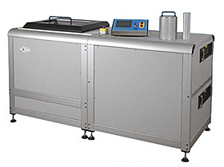
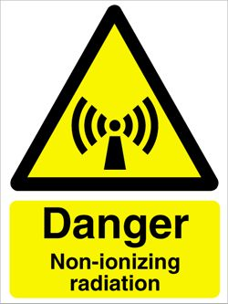

Slide 24
2. Ultraviolet light (Non-ionizing Radiation)
Wavelength is longer than 1 nanometer.
Damages DNA which cause mutations or death.
Most commonly used as UV-lamps that sterilize operating rooms, nurseries, cafeterias,..
Disadvantages: Damages skin, eyes and does not penetrate paper, glass, and cloth.

Slide 25
UV-Lamps

Slide 26
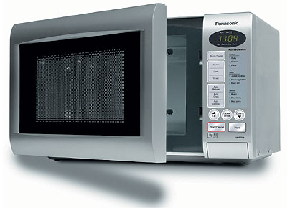
IV- Radiation 3. Microwave Radiation
Wavelength ranges from 1mm to 1m.
May kill microbial cells in moist foods but not spores.

Slide 27
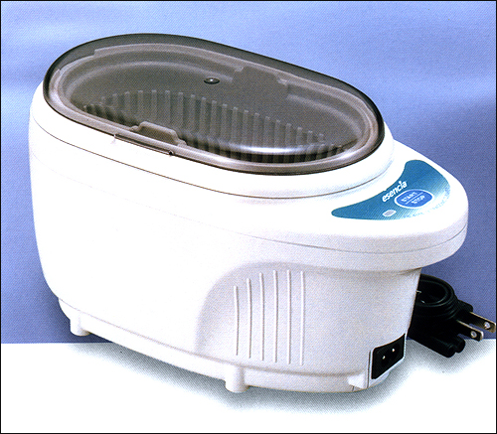
V- Ultrasonic Waves
Used for cleaning and sterilizing delicate equipments.
Ultrasonic cleaners consist of water tanks, were short sound waves pass
through, removing organic
debris from equipments.

Slide 28
VI- Filtration
Filtration is the removal of microbes by passage of a liquid or gas through a screen like material with small pores.
Filters of various pore sizes can be used.
Used to sterilize heat sensitive materials like vaccines, enzymes, antibiotics, and some culture media.
High Efficiency Particulate Air Filters (HEPA): Used in operating rooms and burn units to remove bacteria from air.

Slide 29
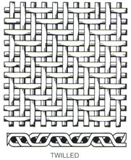
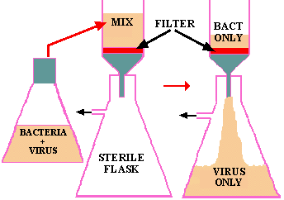

Slide 30
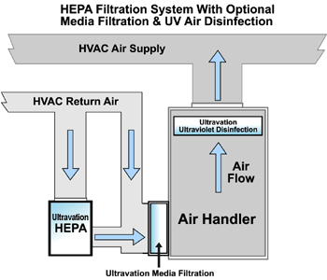
VI- Filtration HEPA

Slide 31
VII- Gaseous Atmosphere
In rare cases, changing the atmosphere can be used as a way to inhibit the growth of microorganisms.
Aerobes and microaerophiles can be killed by placing them in oxygen-free atmosphere. Whereas, anaerobes can be killed by placing them in oxygen atmosphere.

Slide 32
Chemical Methods

Slide 33
Chemical Methods
Disinfectants
A disinfectant is a chemical agent that is used to inhibit microbial growth on inanimate objects, surfaces, and floors.
Antiseptics
An antiseptic is a chemical agent that is used to inhibit microbial growth on human skin and mucous membranes.

Slide 34
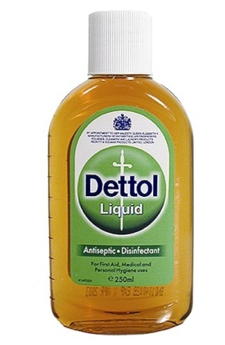
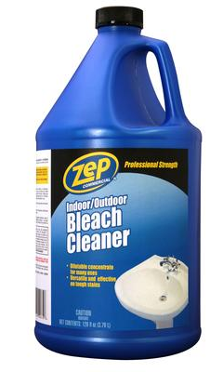
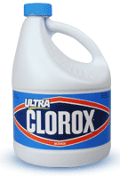
Most commonly used Disinfectants
Soaps and detergents, alcohols, and
phenolic compounds: destroy
microbial cell membranes e.g. Dettol.
Formaldehydes, hydrogen peroxide, halogens, and salts of heavy metals:
destroy enzymes and structural
proteins e.g. Bleach, Clorox.
Chlorine, ozone, iodine:
attach nucleic acids.

Slide 35
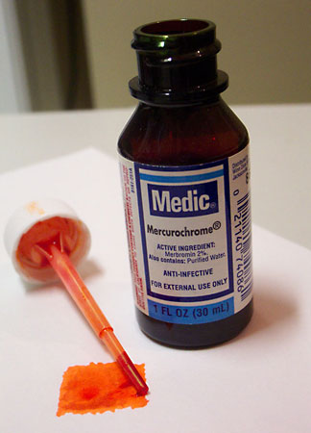
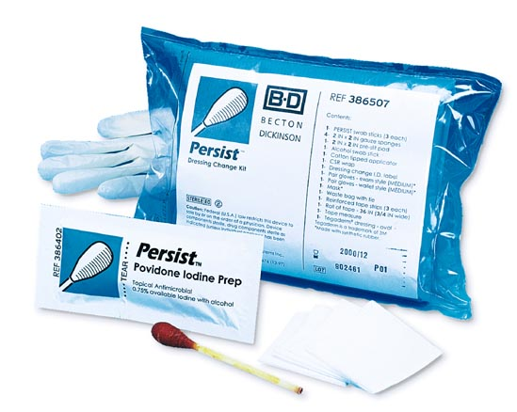
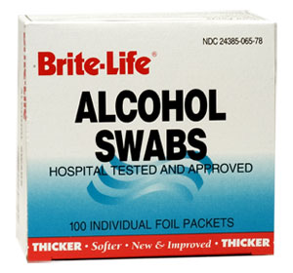
Most commonly used Antiseptics
Iodophor: used as skin antiseptic in surgery.
Alcohol: used on skin before needle pricking.
Mercurochrome: used to disinfect skin wounds.

Slide 36
