Slide 1
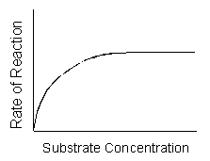
The effect of substrate concentration on the rate of an enzyme catalyzed reaction
322 BCH
Exp (7)

Slide 2
In this experiment, we will continue to study acid phosphatase kinetics.
Acid phosphatase kinetics
Time
Enzyme concentration
pH
Substrate concentration
Inhibitor
Temperature

Slide 3
Objectives
To establish the relationship between substrate concentration and the rate of an enzyme catalyzed reaction.
To determine the Km and Vmax of the enzyme for a particular substrate.

Slide 4
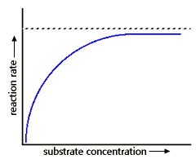
The effect of substrate concentration
One of the important parameters affecting the rate of a reaction catalyzed by an enzyme is the substrate concentration, [S].
During enzyme substrate reaction, the initial velocity V₀ gradually increases with increasing concentration of the substrate. Finally a point is reached, beyond which the increase in V₀ will not depend on the [S].

Slide 5
The effect of substrate concentration
At relatively low concentration of substrate, the rate of reaction increase linearly with an increase in substrate concentration.
→The catalytic site of the enzyme is empty, waiting for substrate to bind, for much of the time, and the rate at which product can be formed is limited by the concentration of substrate which is available.

Slide 6
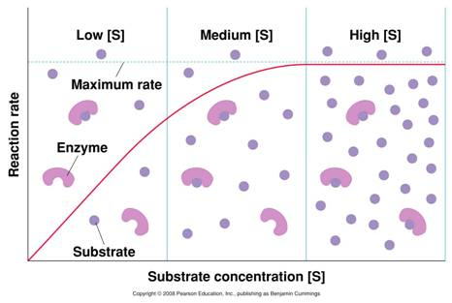
The effect of substrate concentration
At higher substrate concentration, the rate of reaction increases by smaller and smaller amounts in response to increase in substrate concentration.

Slide 7
The effect of substrate concentration
However beyond a particular substrate concentration, the velocity remains constant without any further increase. This plateau is called the maximum velocity, Vmax
This is because as the concentration of substrate increases, the enzyme becomes saturated with substrate.
So there is usually a hyperbolic relationship between the rate of reaction and the concentration of substrate

Slide 8
Animation

Slide 9
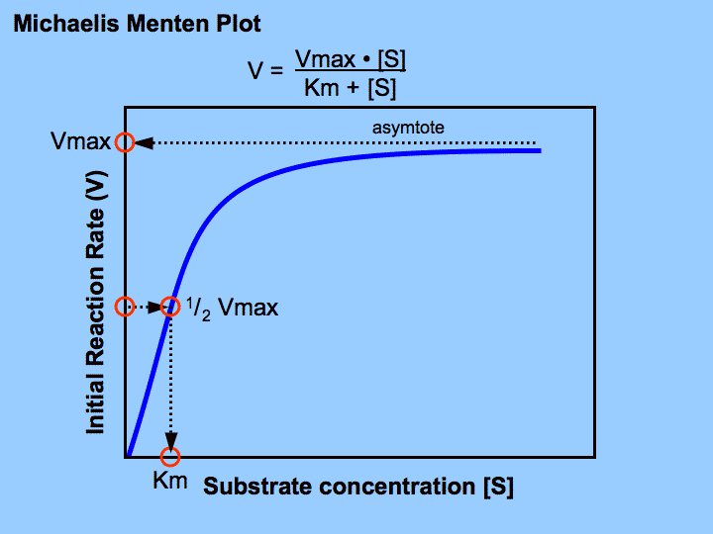
Michaelis–Menten equation
Michaelis-Menten equation give the relationship between [S] and velocity of enzymatic reaction.
The hyperbolic shape of this curve can be expressed algebraically by the Michaelis – Menten equation:
Vi= intial velocity
V max= maxiumm velocity
[S] = substrate concentration
Km= Michaelis constant

Slide 10
Michaelis constant (Km)
Km is the substrate concentration at half V max.
The relationship between rate of reaction and concentration of substrate depends on the affinity of the enzyme for its substrate. This is usually expressed as the Km of the enzyme, an inverse measure of affinity
The larger the km, the weaker the binding and the larger the [S] needed to reach the half the maximum rate
The Km can vary greatly from enzyme to enzyme, and even for different substrates of the same enzyme

Slide 11
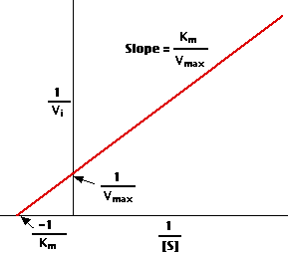
Lineweaver – Burk equation
The Michaelis -Menten equation can be algebraically transformed into forms that are useful in the practical determination of Km an V max.
One common transformation is derived simply by taking the reciprocal of both sides of the Michaelis -Menten equation to give Lineweaver – Burk equation:
By plotting 1/v against 1/ [S] a straight line plot, Lineweaver – Burk plot is obtained.
Both V max and Km can be obtained accurately from intercepts of the straight line with the y – axis and x-axis

Slide 12
Principal
Its concentration can be measured at 405 nm.
1.
2.
ACP

Slide 13
Method:
Place in a water bath maintained at 37 ºC for 5 minutes.
[S] mM
2.5
5
10
25
50
0
0.5
1
Add to each tube
0.5 ml Corresponding pNPP
Add to each tube
0.5 ml of buffer
0.5 ml MgCl₂
5 ml water
B
C
D
E
A (Blank)
F
G
H
All the factors that affect enzyme kinetics are constant [S] where it varies in each tube
Time = 5 min Temp= 37 ºC pH= 5.7

Slide 14
Method:
To start the reaction add add 0.5ml of enzyme
To stop the reaction → add 0.5ml of KOH
Start at | 0 | 0 | 2 | 4 | 6 | 8 | 10 | 12
Stop at | 0 | 5 | 7 | 9 | 11 | 13 | 15 | 17
For Blank: Add KOH ((FIRST)) then E, to prevent the reaction from happening.
After all the reactions have been terminated, determine the absorbance at 405 nm for each sample against blank.

Slide 15
Tube | A | B | C | D | E | F | G
Start at | 0 | 2 | 4 | 6 | 8 | 10 | 12
Stop at | 5 | 7 | 9 | 11 | 13 | 15 | 17
To convert the time table to an easier way try the following

Slide 16
Results
Record the absorbance and calculate the velocity:
In order to draw using Lineweaver – Burk: calculate the following:

Slide 17
Calculations
Velocity (V) = (A x 10⁶) /(E x time)= µmole of PNP/min
A= absorbance
E= extension coefficient=18.8 x 10³
Time = 5 min

Slide 18
Results
Draw the curve using Michaelis -Menten and determine Vmax and Km for acid phosphatase.
Prepare the double –reciprocal plot of Lineweaver and Burk and determine the Km and V max from the x and y intercepts.

Slide 19
discussion
Describe the curve of the effect of substate concentration on the enzymatic activity
Comment on the value of Vmax and km and define each of them

