Slide 1
Single Radial Immunodiffusion and Immunoelectrophoresis
Lab# 7
BCH 462 [Practical]

Slide 2
Objective:
-To get familiar with radial immunodiffusion. And how it used to determine the concentration of specific antigen.
- To learn the technique of immunoelectrophoresis.

Slide 3
These Tests include:
Precipitation.
Agglutination.
Immunofluorescence.
Radioimmunoassay (RIA).
Enzyme-Linked Immuno sorbent Assay (ELISA)
Western Blotting.

Slide 4
Precipitation Reactions:
-This describes the reaction between soluble antibody and soluble antigen in which an insoluble product results, the precipitate. (Figure).
-These reactions depend on the formation of lattices (cross-links) when antigen and antibody exist in optimal proportions. [it is known as zone of equivalence and appears to us as precipitation].
-Excess of either component reduces lattice formation and subsequent precipitation.

Slide 5
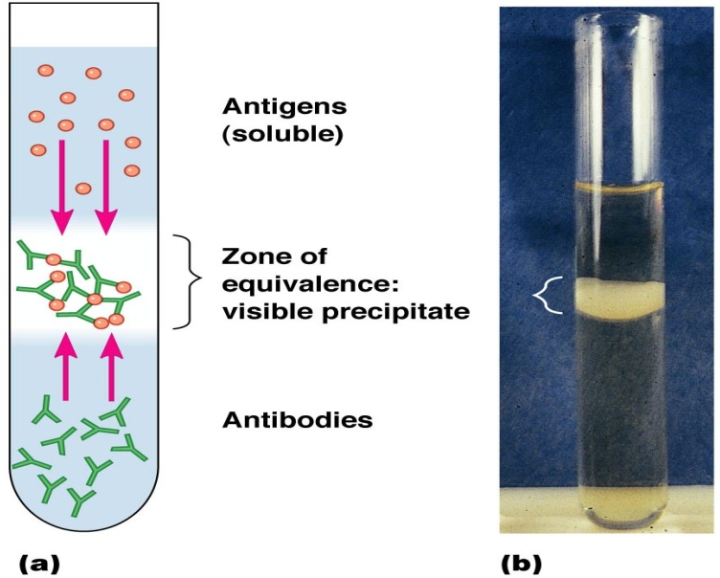

Slide 6
Precipitation reactions (Immunology}
Simple Immunodiffusion (ID)
1.Single Radial ID (RID) (Mancini)
2.Double ID (Ouchterlony)
Electro-Immnodiffusion
1. Immunoelectrophoresis (IEP)
2. Immunofixation
3. Rocket Electroimmunodiffusion (EID)
4. Counterimmunoelectrophoresis (CIEP)

Slide 7
What is Immunodiffusion technique:
Any technique involving diffusion of antigen or antibody through a semi-solid medium, usually agar or agarose gel, resulting in a precipitin reaction.

Slide 8
Single Radial Immunodiffusion

Slide 9
What is Single Radial Immunodiffusion assay” Mancini method”?
-Is an immunodiffusion technique, used in immunology to determine the quantity ”concentration” of an antigen.
Principle:
Is an immunodiffusion technique used in immunology to determine the quantity of an antigen by measuring the diameters of circles of precipitin complexes surrounding samples of the antigen that mark the boundary between the antigen and an antibody fixed in a medium, such as an agar or agarose gel. As the antigen diffuses into the medium [which containing the fixed antibody], reacts with the antibody, and forms insoluble precipitin complexes, when the antigen and antibody reach the zone of equivalence.
-It is suitable for routine use in the diagnostic laboratories.

Slide 10
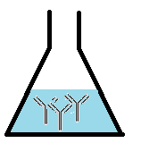
Determination of antigen concentration using radial immunodiffusion:
1. Incorporate of antiserum “antibodies” specific for the antigen of interest, into molten agarose. Then pour the mixture in Petri dish.
Petri dish containing the uniformly distributed antiserum in the agarose gel.
Agarose + antiserum [antibody]

Slide 11
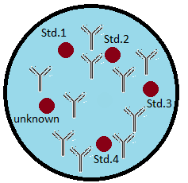
2- Cut the wells using a gel puncher. Then apply your standard antigen and sample antigen to the wells.

Slide 12
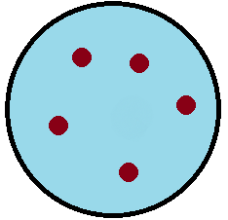
After the antigen is added:
- Initially, as the antigen diffuses through the well, its concentration is relatively high
[So, no precipitation will occur].
-However, as antigen diffuses farther and farther from the well, its concentration decrease.
-when its concentration becomes equivalent to that of the antibody fixed in the gel,
A ring of antigen-antibody precipitate [precipitin] is formed. [zone of equivalence]
-The greater the initial concentration of antigen in the well, the greater the diameter of the precipitin ring.
Antigen diffusion through the well radially.

Slide 13
Figure: Radial immunodiffusion test, antigen is filled in the well, antigen start diffusing radially in the gel that contain specific antibody.

Slide 14
3. After 24 to 48 hour, the diameter of circular precipitates formed around the wells then they are measured.
-By measuring the diameters of the precipitin rings formed by known antigen concentrations “standard antigens concentrations”, a standard curve can be constructed.
-The unknown antigen concentration, can then be found by simple interpolation having measured the diameters of the respective precipitin rings.
Figure: The precipitin ring is formed around the wells of the samples.
Note that: the diameters of precipitin rings are directly proportional to antigen concentration.

Slide 15
4. A plot of precipitation ring diameters versus concentrations is made for the samples
with known antigen concentrations.
1 2 3 4
Figure: wells (1-4), contain known standard concentrations of protein under study ”antigen”.
The graph shows the resulting calibration curve from which, an unknown concentration of the antigen can be determent.

Slide 19
Immunoelectrophoresis

Slide 20
Immunoelectrophoresis:
-Technique based on the principles of electrophoresis of antigens and immunodiffusion of the electrophoresed antigens with a specific antiserum to form precipitin bands.
-It is used to detect the presence of antibodies.
- Used mainly to determine the blood levels of three major immunoglobulins: immunoglobulin M (IgM), immunoglobulin G (IgG), and immunoglobulin A (IgA).

Slide 21
Immunoelectrophoresis:
A gel is prepared with a well to add the antigen in it.
1.The antigen mixture, is first electrophoresed to separate its components by charge.
2.Troughs are then cut into the agar gel parallel to the direction of the electric field.
3.Antiserum is added to the troughs.
4.Antibody and antigen then diffuse toward each other.
5.Lines of precipitation [arcs], will be produced where they meet in appropriate proportions [at the zone of equivalence].
6.The precipitin line indicate the presence of the antigen- antibody complex. While the absence of precipitin line indicates the absence of antigen- antibody complex.

Slide 22
Figure:
Immunoelectrophoresis of an antigen mixture.
-An antigen preparation (orange) is first electrophoresed, which separates the component antigens on the basis of charge.
-Antiserum (blue), is then added to troughs on one or both sides of the separated antigens and allowed to diffuse.
-In time, lines of precipitation (colored arcs) form where specific antibody and antigen interact.

Slide 25
During:
Electrophoresis, molecules placed in an electric field acquire a charge and move towards appropriate electrode. Mobility of the molecule is dependent on a number of factors:
-Size of molecules to be separated.
-Concentration of agarose gel.
-Voltage applied.
-The buffer used for electrophoresis.
Immunodiffusion: Antigens resolved by electrophoresis are subjected to immunodiffusion with antiserum added in a trough cut in the agarose gel. Antigen-antibody complex precipitates at the zone of equivalence to form an opaque arc shaped line in the gel.

Slide 26
Applications:
-Immunoelectrophoresis, is used in clinical laboratories to detect the presence or absence of proteins in the serum.
- This technique is useful in determining whether a patient produces abnormally low amounts of one or more isotypes of Ig , characteristic of certain immunodeficiency diseases.
-It can also show whether a patient overproduces some serum protein, such as albumin, immunoglobulin, or transferrin.

Slide 27
Antigen [Ag] molecules each have a set of antigenic determinants or epitopes.

Slide 28
Monoclonal Antibody | Polyclonal Antibody
Consists of one antibody class/subclass which is selective for a single epitope on the antigen | Contains a mixture of antibodies (mainly IgGs), often recognizing multiple epitopes on the antigen
Because of their specificity, they are less likely to cross-react with other proteins, giving lower background than polyclonal antibodies | May contain non-specific antibodies resulting in background staining
Specificity makes them ideal as the primary antibody in an assay, for detecting antigens in tissue, or for affinity purification of antigens | Useful as secondary antibodies or for immunoprecipitation, as they target multiple epitopes providing a more robust detection

Slide 29
Precipitation Reactions in general:
Formation of an Ag-Ab lattice depends on the valency of both the antibody and antigen:
-The antibody, must be bivalent; a precipitate will not form with monovalent Fab fragments.
-The antigen, must be either bivalent or polyvalent; that is, it must have at least two copies of the same epitope, or have different epitopes that react with different antibodies present in polyclonal antisera.

Slide 30
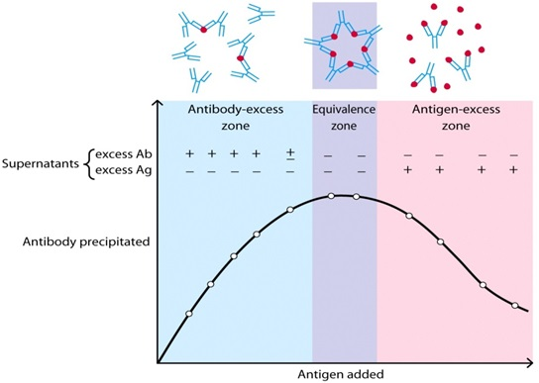
Figure: precipitation curve.

