Slide 1
King Saud University College of Engineering IE – 341: “Human Factors Engineering” Fall – 2016 (1st Sem. 1437-8H)
Human Capabilities
Part – B. Hearing (Chapter 6)
Prepared by: Ahmed M. El-Sherbeeny, PhD

Slide 2
Lesson Overview
Hearing
Ear Anatomy
Nature and Measurement of Sounds
Frequency of Sound Waves
Intensity of Sound
Complex Sounds
Masking
Auditory Displays
Detection of Signals
Relative Discrimination of Auditory Signals
Absolute Identification of Auditory Signals
Sound Localization
Noise

Slide 3
Hearing

Slide 4
Ear Anatomy
Complex process
Pneumatic (i.e. filled with air) pressure waves
Hydraulic waves
Mechanical vibrations
Electrical impulses
More information about hearing:
https://youtu.be/0NJ_EAQjR3c (excellent short video)
Notes:
Q: can you (later) name where each of these processes occur?

Slide 5
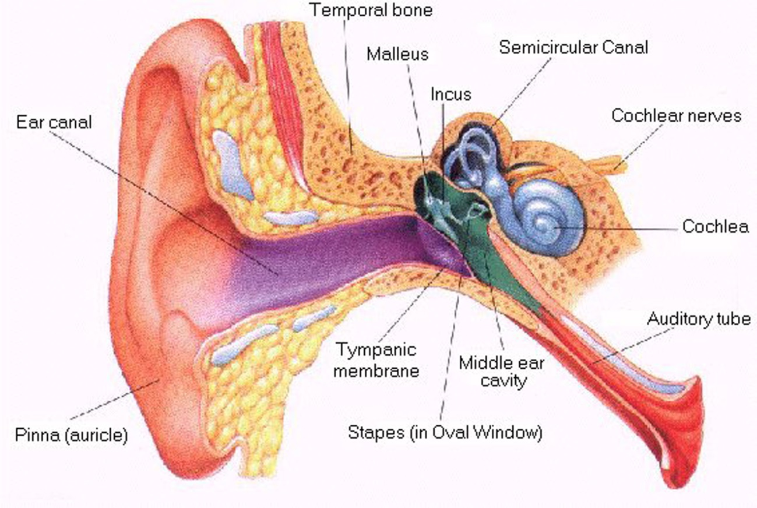
Cont. Ear Anatomy

Slide 6
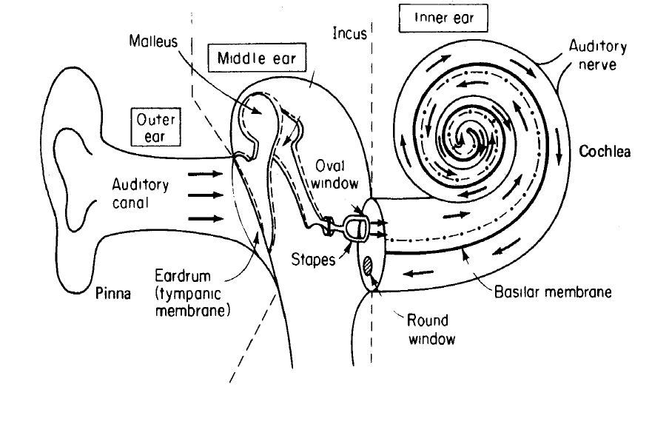
Cont. Ear Anatomy

Slide 7
Cont. Ear Anatomy: Outer Ear
Collects sound energy
External part: pinna or conchae
Auditory canal (meatus)
Bayonet shape
1״ long
Resonant property
Sensitivity to frequencies: 2 – 5 kHz
Enhances SPL by as much as 12 dB (see slide 17)
Eardrum (tympanic membrane)

Slide 8
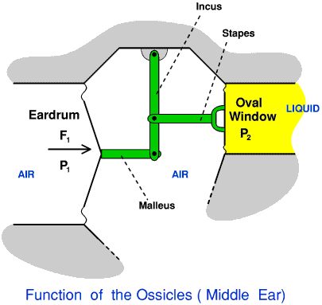
Cont. Ear Anatomy: Middle Ear
Chain of 3 small bones (ossicles)
Malleus
Incus
Stapes
Transmit vibrations
eardrum to oval window
Stapes acts like a piston on oval window
Eardrum surface area
+
Lever action of ossicles
Sound pressure to fluid of inner ear
Pressure of stapes against oval window is amplified 22 times

Slide 9
Cont. Ear Anatomy: Cont. Middle Ear
Two muscles
Tensor tympani muscle (to malleus)
Stapedius muscle (to stapes)
Acoustic (aural) Reflex of Muscles:
Tighten in response to loud noise
Q: can you compare this with pupil action?
Protection against intense sounds
Reduces sound transmission
Occurs when sound is 80 db above threshold level
Up to 20 db attenuation (i.e. reduction of severity)
More responsive to
Broadband sounds (i.e. wide range of frequencies) than to pure tones
Lower frequencies than to higher frequencies
Muscles remain flexed (i.e. contracted)
up to 15 min in intense steady-state noise

Slide 10
Cont. Ear Anatomy: Cont. Middle Ear
Intense impulse noise:
Muscle contraction delay (Latency: 35 – 150 ms)
Not much protection against initial impulse
Protection against subsequent impulses; interval less than one second
Another movie: transmission of sound in the ear:
https://youtu.be/flIAxGsV1q0
Notes:
Another longer movie: https://youtu.be/Ie2j7GpC4JU

Slide 11
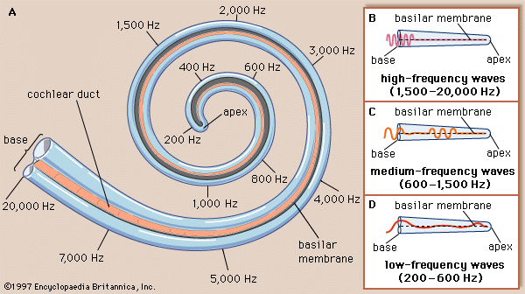
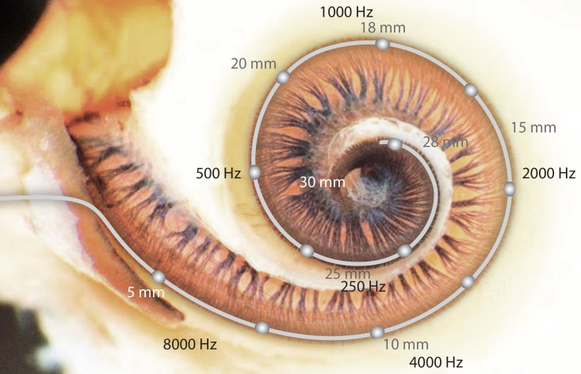
Cont. Ear Anatomy: Inner Ear – cochlea
Spiral (Snail)
30 mm long (uncoiled)
Filled with fluid
Stapes ➔ Piston ➔ fluid back & forth in response to pressure
Fluid movement ➔ basilar membrane ➔ vibration to organ of Corti
Organ of Corti
Hair cells & nerve endings
Sensitive to changes in pressure
Transmits sound to brain via auditory nerve

Slide 12
Cont. Ear Anatomy: Conversion of Sound Waves to Sensations
Place (resonance) theories
Fibers of basilar membrane like piano strings
Different fibers are sensitive differently to different frequencies
Temporal theories
Pitch is related to time pattern of neural impulses emitted by the fibers
Current understanding:
Place theory: high tones
Temporal theory: low tones
Combination of both (i.e. complementary): middle tones

Slide 13
Nature and Measurement of Sounds
Direct vs. Indirect hearing:
Direct hearing: e.g. baby’s natural cry
Indirect hearing: e.g. doorbell ⇒ someone at door
Indirect stimulus can be more effective than direct
e.g. fire alarm (100% detectable) vs. heat/smoke (75%)
Nature and Measurement of Sounds
Sound is created by vibrations from a source and is transmitted through a medium (such as atmosphere) to the ear watch video: https://youtu.be/nGKffdaI4Pg
Two primary attributes of sound:
Frequency
Intensity (or amplitude)

Slide 14
Cont. Nature and Measurement of Sounds
Frequency of Sound Waves :
When sound is generated,
vibration ⇒ air molecules to move back and forth
this alternation ⇒ ↑ and ↓ in air pressure
Vibration forms sinusoidal (sine) waves
height of wave above and below the midline represents the amount of above-normal and below-normal air pressure respectively
The waveform above the midline is the image of the waveform below the midline in a sine wave.
The waveform repeats itself again and again in a sine wave
frequency of sound:
“number of cycles per second”
expressed in: hertz (Hz) ; 1 Hz ≡ 1 cycle / 1 second
Notes:
Production of Sound: https://youtu.be/nGKffdaI4Pg

Slide 15
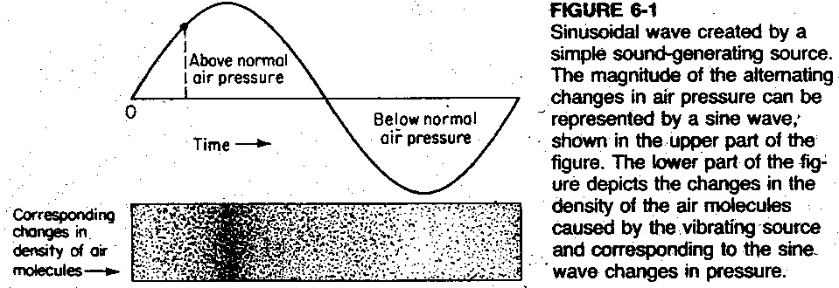
Cont. Nature and Measurement of Sounds
Cont. Frequency of Sound Waves :
Sinusoidal wave created by a simple sound-generating source

Slide 16
Cont. Nature and Measurement of Sounds
Cont. Frequency of Sound Waves :
The human ear is sensitive to frequencies
20 to 20,000 Hz
highest sensitivity: between 1,000 to 3,000 Hz
Ear is not equally sensitive to all frequencies
People differ in their relative sensitivities to various frequencies
See what frequencies you can/can’t hear at the following Web Site: The Mosquito Ringtone (http://www.freemosquitoringtone.org/)
Pitch
Highness or lowness of a tone
High frequencies ➔ high pitched tones
Low frequencies ➔ low pitched tones

Slide 17
Cont. Nature and Measurement of Sounds
Intensity of Sound (amplitude/loudness):
Sensation of loudness
Defined in terms of power per unit area ($W/m^{2}$)
The Bel (B) [after Alexander Graham Bell]
is the basic unit for measuring sound
measured: logarithm to the base 10 of two sound intensities
The most convenient measure is:
decibel (dB)
$1 dB=0.1 B$
Problem: most measuring instruments don’t directly measure sound power of source

Slide 18
Cont. Nature and Measurement of Sounds
Cont. Intensity of Sound (amplitude/loudness):
Sound power: directly proportional to square of the sound pressure
Sound Pressure Level (SPL):
$$SPL \left(dB\right)=10 \log{\frac{{P1}^{2}}{{P0}^{2}}}$$
$$SPL \left(dB\right)=20 \log{\frac{P_{1}}{P_{0}}}$$
P₁ = sound pressure of the sound to be measured
P₀ = reference sound pressure (represents 0 dB – can’t be zero; why?)
Most common reference value of P₀ is 20 μN/m² (20 micro Pascal)
Roughly equivalent to lowest intensity for 1000 Hz pure tone that healthy adult can just barely hear under ideal conditions (e.g. mosquito)
Sound pressure is measured by: sound-level meters (A, B, C weightings)
Notes:
Q: can SPL be less than 0 dB? A: yes, which means sound pressure < 20 μιχρο−πασχαλσ, ι.ε. Π₁ < Π₀; Θ2: ωηατ ισ Π₁ = Π₀, Α2: ΣΠΛ = 20 λογ(1) = 0 δΒ (ι.ε. τηισ ισ ρεφερενχε ϖαλυε)

Slide 19
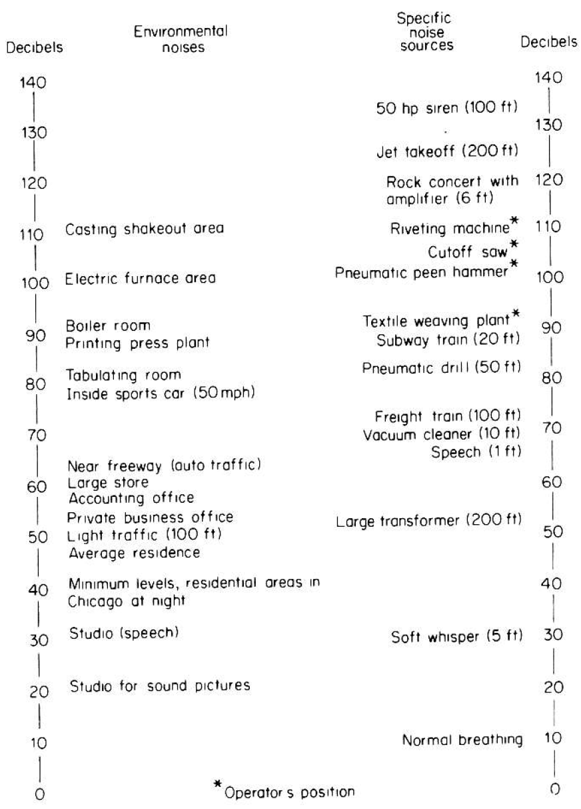
Cont. Nature and Measurement of Sounds
Cont. Intensity of Sound
Figure 6-2: Decibel levels for various sounds (0-150 dB)
Note ↑ 10 dB ⇒ ↑ 10 fold sound power ⇒ ↑ 100-fold sound pressure (why?)
Signal-to-Noise Ratio (SNR): difference bet. meaningful signal, & background noise
e.g. 90 dB signal, 70 dB noise ⇒ SNR = +20 dB
Notes:
A: remember that power is related to square of pressure

Slide 20
Cont. Nature and Measurement of Sounds: Ranges of Typical Sound Levels for Common Sounds
Notes:
A: remember that power is related to square of pressure

Slide 21
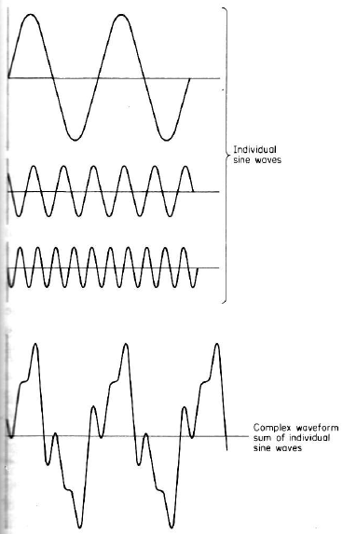
Cont. Nature and Measurement of Sounds
Complex Sounds:
Very few sounds are pure
Most complex sounds are non-harmonic
Figure 6-3: waveform depiction of a complex sound formed by 3 individual sine waves (method 1)
Q: what is different in individual waves: frequency or amplitude?
Notes:
A: both; Note how complex sound has same amplitude as highest sound amplitude , and same frequency as lowest sound frequency

Slide 22
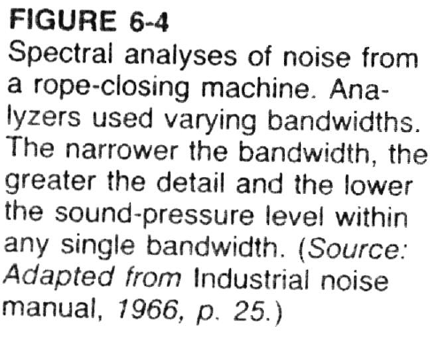
Cont. Nature and Measurement of Sounds
Cont. Complex Sounds:
Method 2 of depiction: Sound Spectrum
Divide sound into frequency bands,
Measure intensity of sound in each band
Achieved using “frequency-band analyzer”
Narrower bandwidth ➔
greater detail of the spectrum
lower sound level within each bandwidth

Slide 23
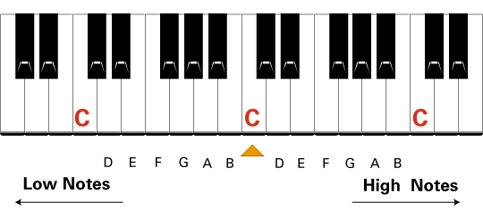
Cont. Nature and Measurement of Sounds
Cont. Complex Sounds:
Methods of dividing the sound spectrum:
Method 1: Octaves
1 octave has double the frequency of the one below it
E.g. “Middle C” has a frequency of 256 Hz
one octave above “middle C” has a frequency of 512 Hz
i.e. octave is Interval between one pitch and another with half or double its frequency
Method 2: Bands (ANSI)
divide audible range into 10 bands
center frequencies @: 31.5, 63, 125, 250, 500, 1000, 2000, 4000, 8000, 16000 Hz

Slide 24
Masking
Masking (defined):
Condition when one component of the sound environment reduces the sensitivity of the ear to another component
It is amount that the “threshold of audibility”* of a sound (the masked sound) is raised by the presence of another (masking) sound
Experimentally:
1: get absolute threshold (i.e. minimum audible level) of sound to be masked (by itself)
2: repeat this in the presence of masking sound (see next slide)
Masking must be considered when considering noise in auditory displays
Q: Can you a give an example of “masked” and “masking” sounds from our everyday lives?
Q: difference between masked and complex sounds?
Notes:
“threshold of audibility” or threshold of hearing

Slide 25
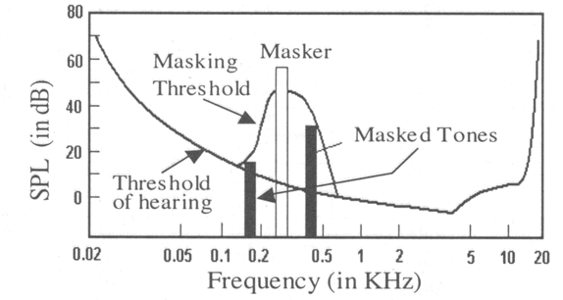
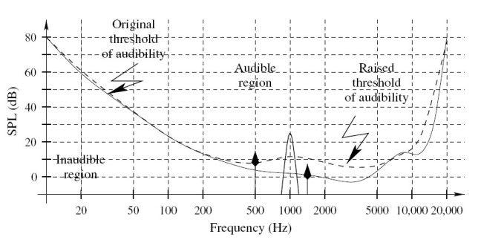
Cont. Masking
Masking examples:
Can you analyze the examples below?
What effect does masker (i.e. masking sound) have on masked sound(s)?

Slide 26
Auditory Displays

Slide 27
Auditory Displays
Chapter 3: auditory vs. visual modality (e.g. auditory preferred: message is short, simple, urgent, etc.)
4 types of human functions/tasks involved in the reception of auditory signals:
Detection (i.e. whether a signal is present)
Relative discrimination (differentiating bet. ≥2 signals presented together)
Absolute identification (only 1 signal is present)
Localization (knowing the direction that the signal is coming from)

Slide 28
Cont. Auditory Displays
Detection of signals
Signals can occur in “peaceful” surroundings or noisy surroundings
The signal plus noise (SN) should be distinct from the noise (N) itself
Otherwise, signal cannot always be detected in the presence of noise
i.e. signal (masked sound) + noise (masking sound) ⇒ threshold of detectability is elevated (see slides on masking)
⇒ signal must be > threshold to detect signal
Using filters ⇒ noise removed
⇒ ↑ detectability, SNR
⇒ more audible sound*
Notes:
Q: what effect does this have on threshold of audibility? A: threshold of audibility/hearing is decreased (i.e. you can lower sounds at given frequency/frequencies)

Slide 29
Cont. Auditory Displays
Relative Discrimination of Auditory Signals
Relative discrimination of signals on basis of
intensity
frequency
A common measure of discriminability: just-noticeable difference (JND):
JND: “the smallest difference or change along a stimulus dimension (frequency, intensity) that can just be detected 50% of the time by people.”
The smaller the JND, the easier it is for people to detect differences on the dimension being changed.
Small JND ⇒ subjects could detect small changes
Large JND ⇒ large change necessary before noticing change
Notes:
JND is affected by intensity and frequency; however, as a general rule, it requires about 1 dB to be heard as a difference; can you tell difference between detectability threshold and JND?
(source: http://hyperphysics.phy-astr.gsu.edu/hbase/Sound/db.html#c4)

Slide 30
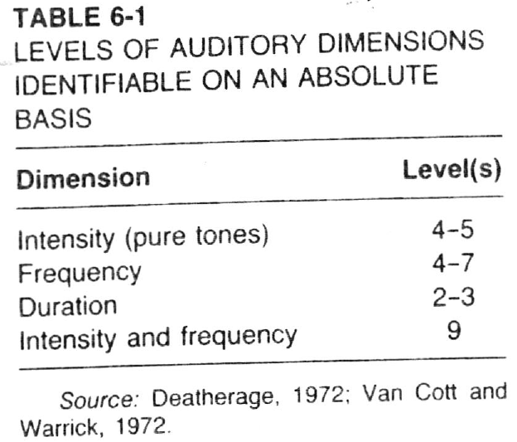
Cont. Auditory Displays
Absolute Identification
This is used when it is necessary to make an absolute identification of an individual stimulus (by itself)
e.g. identify
someone’s pitch/frequency
specific animal/bird
certain car siren/honk tone
Sound durations
Number of levels along a continuum (range or scale) that can identified usually is quiet small (see Table 6-1)
It is better to use more dimensions with fewer steps or levels of each dimension, than to use fewer dimensions and more levels of each (see last row of table, can you explain?)
Notes:
* Note how it is easier (thus, better) to absolutely identify a multi-dimensional (intensity + frequency) sound vs. just one-dimensional sounds (i.e. only based on intensity or frequency)

Slide 31
Cont. Auditory Displays
Localization
Stereophony: “the ability to localize (guess/predict) the direction from which the sound is emanating (coming from)”
Primary factors/cues used to determine direction
intensity of sound
phase (lag) of sound
e.g. if sound reaches directly one side of head first, sound reaches the nearer ear approx. 0.8 ms before other ear ⇒ localizing sounds below 1500 Hz
For frequencies > 3000 Hz, intensity is used to localize sound (e.g. try to gradually increase volume in one speaker and decrease volume in opposite speaker)
Sounds between 1500-3000 Hz: hard to localize*
Notes:
* Can you suggest a way to localize sounds between 1500-3000 Hz?

Slide 32
Cont. Auditory Displays
Special purpose auditory displays:
Warning and alarm signals
Each signal having preferred frequency, intensity
Each causing certain “attention-getting” and “noise-penetration” ability
Aids for the blind
Mobility aids (go-no-go safety signals at certain distance)
Environmental sensors (information about surrounding, e.g. surface characteristics, directional information, distance)
Notes:
Elaborate on this

Slide 33
Noise

Slide 34
Noise
Noise
“Unwanted sound”
Information theory: “auditory stimulus of stimuli bearing no informational relationship to the presence or completion of the immediate task”
Causes: startle response, annoyance
Interferes with speech, sounds (i.e. masking)
Decreases “complex” task performance
But actually may increase “simple” task performance!*
Effects of noise
Hearing loss (e.g. occupational hearing loss)
Temporary loss, permanent loss
Physiological effects
Psychological effects
Notes:
* Can you explain this?

Slide 35
Cont. Noise
Hearing loss
Long term exposure → hearing loss
↑ with ↑ in frequency and ↑ in duration
First signs appear in range: 4-6 kHz
Risk of damage ↑ in frequency range: 2400-4800 Hz
Effect: damage to hair cells (i.e. nerve damage)
Conductive hearing loss
Damage to eardrum and middle ear
Measured with “audiometer”: bone vs. air conduction tests
Age-related hearing loss
30% of people > 65 have significant hearing loss
Natural damage occurs to hair cells (higher freq.: 4-6 kHz)
Aging brain cannot filter background noise (can cause “tinnitus” )
Watch video on noise and hearing loss: https://youtu.be/ZeYRxlP4YEQ
Notes:
Tinnitus = طنين; example of conductive hearing loss occurs with people who play musical instruments
Here’s also another video on hearing loss: https://youtu.be/iTFPh-COLFk

Slide 36
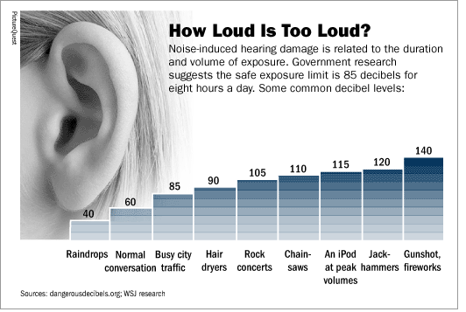
Cont. Noise
Notes:
* note, for noise exceeding a duration of 8 hours a day, the safe exposure limit is less than 85 dB (why?)

Slide 37
Cont. Noise: Occupational Noise Control: industrial prevention methods
Notes:
* Can you name other commonly used methods to reduce industrial noise?

Slide 38
References
Human Capabilities - Hearing
Human Factors in Engineering and Design. Mark S. Sanders, Ernest J. McCormick. 7th Ed. McGraw: New York, 1993. ISBN: 0-07-112826-3.
Slides by: Dr. Khaled Al-Saleh; online at: http://faculty.ksu.edu.sa/alsaleh/default.aspx
Slides by: Dr. Tamer Khalaf
Slides by: Prof. Mohammed Z. Ramadan
See what frequencies you can/can’t hear at the following Web Site:
The Mosquito Ringtone

