Slide 1
King Saud University College of Engineering IE – 341: “Human Factors” Fall – 2015 (1st Sem. 1436-7H)
Applied Anthropometry, Work-Space Design
Part I – Anthropometry
(Chapter 13)
Prepared by: Ahmed M. El-Sherbeeny, PhD

Slide 2
Lesson Overview
Introduction
Anthropometry
Static Dimensions
Dynamic (Functional) Dimensions
Discussion: Static, Dynamic Dimensions
Use of Anthropometric Data
Principles in the Application of Anthropometric Data
Designing for Extreme Individuals
Designing for Adjustable Range
Designing for the Average
Discussion of Anthropometric Design Principles

Slide 3
Introduction
Poor design features of tools, facilities, e.g.:
uncomfortable chairs
high shelves
too low or too high sinks
clothes too tight/loose in certain parts
equipment with no space to insert repair tool
Failure to design equipment, facilities to fit people’s physical dimensions ⇒
not suitable to human use
physiological disorders, diseases:
e.g. poorly designed seats ⇒ back injury, muscle aches, pain: neck + shoulder, leg circulatory problems
Chapter: designing tools to fit physical dimensions of people, with emphasis on:
seats, seated workstations

Slide 4
Anthropometry
Def^{n}: “measurement of humans for purposes of understanding human physical variation”
Involves measurement of:
body dimensions
other body physical characteristics, e.g.:
volumes
center of gravity
masses of body segments
Body dimensions
applies to wider range of design problems (here)
types of body measurement:
static
dynamic (functional)
Engineering Anthropometry:
applying these 2 types of data to designing objects

Slide 5
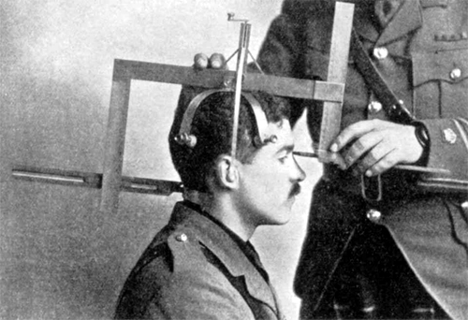
Cont. Anthropometry
Static Dimensions
Def^{n}: measurements taken when body is in fixed (static) position
Consist of:
skeletal dimensions (bet. centers of joints e.g. bet. elbow & wrist)
contour dimensions (skin-surf. dimensions e.g head circum.)
Many dimensions can be measured:
NASA Anthropometric Source Book: 973 measurements from 91 worldwide surveys
Dimensions applications (many):
specific applications (helmets, earphones, gloves)
general utility of measuring certain body features:
figure 13-1 + table 13-1 (next 2 slides)
“head-measurer”: tool used for research early 1910s (Wikipedia)

Slide 6
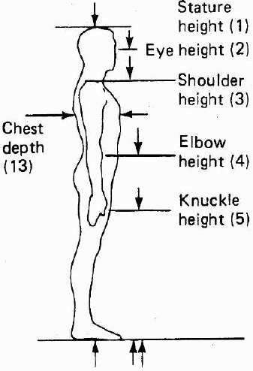
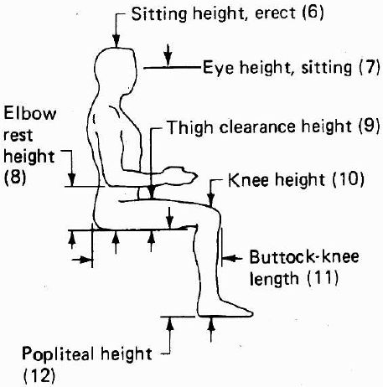
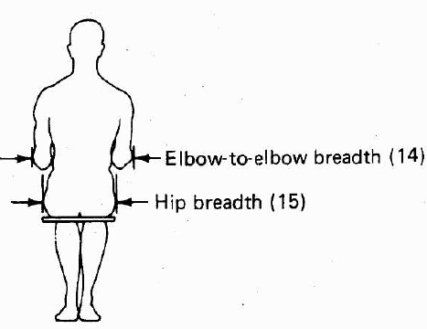
Cont. Anthropometry
Cont. Static Dimensions
Figure below: structural (static) body features
Notice: reference can be:
ground (1), or 2 body parts (11), or ends of the same body part (9,13)

Slide 7
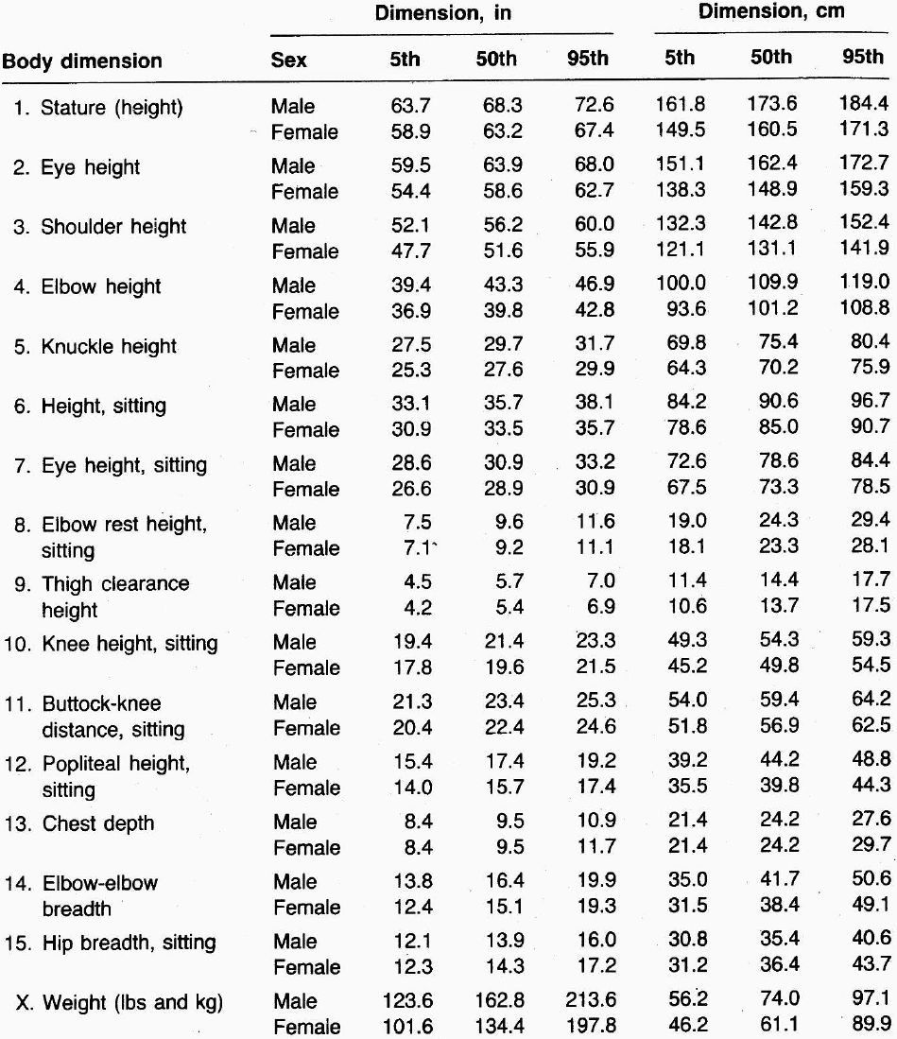
Cont. Anthropometry
Cont. Static Dimens.
Table: selected body dimensions and weights of US adult civilians
Dimensions 1-15 shown in last slide
Questions:
How would this compare to Saudi body dimensions?
What factors affect these dimensions?
What is the meaning of “percentile”?

Slide 8
Cont. Anthropometry
Cont. Static Dimensions
Percentile :
Def^{n}:“a value on a scale of 100 that indicates the percent of a distribution that is equal to or below it”
Examples from last slide: male stature (which dim.?)
5th percentile of standing males: 63.7 in (i.e. 162 cm) ⇒ only 5% of males heights (US: 20-60) are ≤ 63.7 in
50th percentile of male height: 68.3 in (i.e. 173 cm) ⇒ 50% of males are shorter (or taller) than 68.3 in i.e. median of male heights (US: 20-60): 68.3 in (why?)
Q: what is 95 percentile of US male sitting height?
Q: what %ge of US females (20-60) weigh > 89.9 kg
Interquartile range
middle 50% of distribution: i.e. 25th – 75th percentiles
this is measure of variability

Slide 9
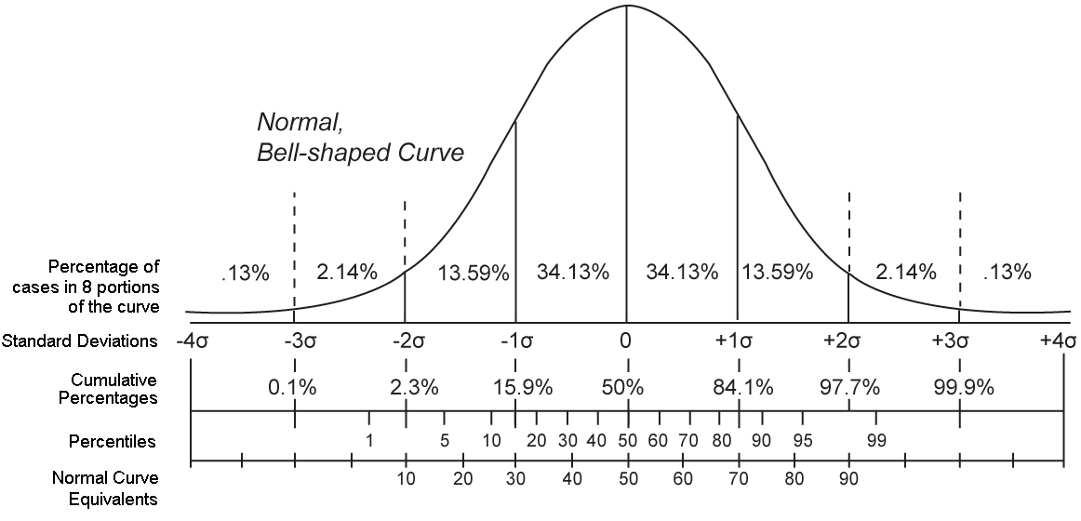
Cont. Anthropometry
Cont. Static Dimensions
Cont. Percentile :
Figure below: percentiles in normal “bell” curve
Percentiles = sum of area (∫) under normal curve

Slide 10
Cont. Anthropometry
Cont. Static Dimensions
Body dimensions vary with:
sex (males and females): next slide
ethnicity (whites, blacks, Asians, etc.): next slide
age:
generally lengths, heights ↑ until late teens/early 20’s
then remain relatively constant through adulthood
then ↓: early-middle adulthood into old age
Did you know: exception is ear (continues all life long!)
occupation (i.e. job)
caused by:
imposed height and/or weight restrictions
physical activity involved in work
self-selection of applicants for practical reason (?)
e.g. truck drivers: taller, heavier > general population
times: US, Eur. ht. ↑ 1 cm/decade:1880-1960 (?)

Slide 11
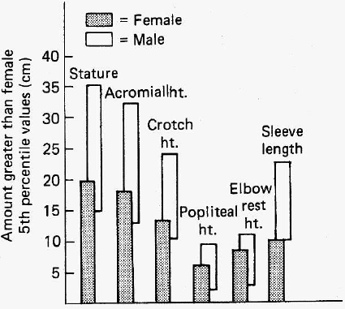
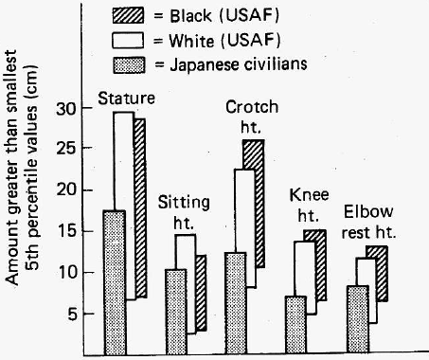
Cont. Anthropometry
Cont. Static Dimensions
Cont. Body dimensions variations:
Sex (left figure): comparison showing overlap in male 5th %ile with female 95th %ile heights (huge!)
Ethnicity: (right figure): comparison showing 5th-95th %ile among different male heights

Slide 12
Cont. Anthropometry
Dynamic (Functional) Dimensions
Def^{n}: measurements taken while body is engaged in some physical activity; e.g.
operating a steering wheel
assembling a toy
reaching across the table for salt, etc.
Individual body members function mostly in concert
i.e. all parts are affected together, at the same time
e.g. limit of arm reach involves
arm length, but also:
shoulder movement
trunk rotation (possible)
back bending (possible)
hand function

Slide 13
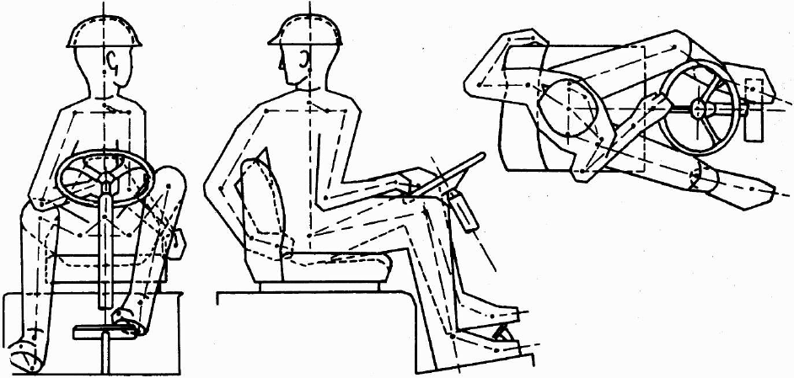
Cont. Anthropometry
Cont. Dynamic (Functional) Dimensions
Somatography: diagram showing interaction of various body members
e.g. below: 3 views (front, side, top) for forklift truck operator

Slide 14
Cont. Anthropometry
Discussion: Static, Dynamic Dimensions
Anthropometric data
Static data exists » dynamic data
However, dynamic data: more representative of actual human activity
Converting static data to dynamic data
No systematic procedure available
However, following recommendations are helpful:
Heights (stature, eye, shoulder, hip): reduce by 3%
Elbow height: no change, or ↑ by 5% if elevated at work
Knee or popliteal height, sitting: no change, except with high-heel shoes
Forward and lateral reaches:
↓ by 30 percent for convenience
↑ by 20 percent for extensive shoulder and trunk motions
Note, these estimates may change: e.g. work condition

Slide 15
Use of Anthropometric Data
Which anthropometric data to use?
Data should be representative of population that would use the designed item
If designing for “everyone”⇒ the design features must accommodate as many people as possible
If designing for specific groups ⇒ use data for your specific groups; examples:
adult females
children
elderly (seniors)
soccer players
the handicapped (can you name more examples?)
Note, many specific groups do not yet have available anthropometric data

Slide 16
Use of Anthropometric Data
Principles in Application of Anthropometric Data
Three general principles
Each applies to different situation:
Designing for Extreme Individuals
Designing for Adjustable Range
Designing for the Average

Slide 17
Use of Anthropometric Data
Cont. Principles in Appl. of Anthropometric Data
Designing for Extreme Individuals:
designs should try to accommodate everyone
a single design dimension can be:
limiting factor restricting use of facility for some
a dictate for max./min. value of variable in question
designing for max. population value:
used if given max/high value of some design feature should accommodate –almost- all people
examples: heights of doorways, strength of supporting devices (e.g. rope ladder, workbench, trapeze)
designing for min. population value:
used if given min/low value of some design feature should accommodate –almost- all people
examples: distance of control button from operator; force required to operate the control

Slide 18
Use of Anthropometric Data
Cont. Principles in Appl. of Anthropometric Data
Designing for Adjustable Range:
equipment/facilities can have design features: adjustable to individuals who use them
e.g.’s: automobile seats, office chairs, foot rests
adjustments (e.g. arm reach) usu. cover range: 5th female - 95th male %tile of pop. characteristic
⇒ covers 95% (not 90%) of 50/50 male/female pop. (??)
used when hard to cover extreme cases (100% of pop) due to resulting technical difficulties involved
designing for adjustable range: preferred method of design, but is not always possible (why?)

Slide 19
Use of Anthropometric Data
Cont. Principles in Appl. of Anthropometric Data
Designing for the Average
Designing for average generally not preferred:
it should not just be “quick, easy way out” for design
there is no “average” person
person may be average on 1-2 dimensions but almost impossible on more than that:
no perfect correlation exists between body dimensions
e.g. people with short arms don’t have to have short legs
When it is ok to design for average:
in situations involving non-critical work (?)
when not appropriate to design for extreme cases
where adjustability is impractical
e.g.: checkout counter at supermarket built for the average customer

Slide 20
Use of Anthropometric Data
Cont. Principles in Appl. of Anthropometric Data
Discussion of Anthrop. Design Principle
above principles apply to only single dimension
e.g. arm reach (only), or stature height (only)
considering > 1 dimension may cause “problems”
taking 5th – 95th %ile on >1 dimension ⇒ eliminates high %ge of population
on 13 dimen. ⇒ eliminates 52% (not just 10%) (Bittner, ’74)
why? no perfect correlation exists bet. body dimensions
⇒imp. to consider body dimension combinations in design
adding 5th or 95th %ile of body segments ≠ corresponding %ile value for combined dimension
e.g. lengths: fingertip to elbow + elbow to shoulder ≠ fingertip to shoulder
why? (again): no perfect correlation bet. body dimensions
building 5th %ile female (ankle height, ankle to crotch, etc.) ⇒ female is 6 in (15.6 cm) < actual 5th %ile stature!

Slide 21
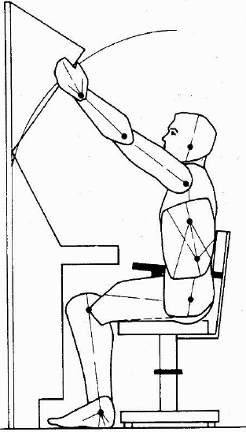
Use of Anthropometric Data
Cont. Principles in Appl. of Anthropometric Data
Cont. Discussion of Anthrop. Design Principle
articulated models
AKA: articulated anthropometric scale models
physical models (i.e. full-scale mockup)
represent specific population %ile
usu. used with work-space design (see right)
note, computer software also exists to model work-space design

Slide 22
Use of Anthropometric Data
Cont. Principles in Appl. of Anthropometric Data
Suggested Procedure for Using Anth. Data
Determine body dimensions important in design
e.g. application: sitting height or stature height?
Define population to use facility/equipment
establishes dimensional range to be considered
e.g. children, women, Saudi men, world population)
Determine principle to be applied
i.e. extreme individuals, adjustable range, average?
Select %ge of pop. to be accommodated (e.g. 90%)
Find appropriate anthropometric data tables for chosen population used, extract relevant values
Add appropriate allowances (e.g. clothing, shoes)
Build full-scale mock-up of facility/equipment, have representative people of large and small users (of the population) test it (very important!)

