Slide 1
Computer Organization & Assembly language

Slide 2
Lecture Overview
Course description
Chapter 1 : Introduction
Overview of Computer Organization & Assembly language
The main components of a computer
An example system: wading through the jargon
The computer level hierarchy
The Von Neumann model

Slide 3
Lecture Overview
Course description
Chapter 1 : Introduction
Overview of computer organization and architecture
The main components of a computer
An example system: wading through the jargon
The computer level hierarchy
The Von Neumann model

Slide 4
Overview of computer organization and assembly language
What is computer organization and architecture?
In a computer system, hardware and many software components are fundamentally related
Computer organization and architecture help us to understand how hardware and software interact with each other

Slide 5
Overview of computer organization and assembly language
Computer organization?
It encompasses all physical aspects of computer systems.
How components are connected together?
How components interact with/talk to each other?
It addresses issues such as
Control signals, signaling methods
Memory types, …
It helps us to answer the question: How does a computer work?

Slide 6
Overview of computer organization and assembly language
Computer architecture?
It focuses on the structure and behavior of the computer system
It refers to the logical aspects of system implementation as seen by the programmer.
It includes many elements such as
instruction sets and formats, data types, addressing modes, number and type of registers, …
It helps us to answer the question: How do I design a computer?

Slide 7
Overview of computer organization and assembly language
Computer organization VS architecture?
The distinction between computer organization and computer architecture is not clear-cut.
These are strongly interrelated and interdependent.
We can truly understand each of them only when we comprehend both of them.

Slide 8
The main components of a computer
From Software to Hardware
Computer scientists design algorithms
Computer scientists implement an algorithm by using high level programing language (Java, C, etc.)
Another algorithm runs this algorithm and another one runs that algorithm and so on
We finally get down to machine level
Machine level can be thought of as an algorithm implemented as an electronic device

Slide 9
The main components of a computer
Principle of Equivalence of Hardware and Software
Anything that can be done with software can also be done with hardware, and anything that can be done with hardware can also be done with software
We implement an application in Hardware or Software level?
Our knowledge of computer organization and architecture will help us to make the best choice

Slide 10
The main components of a computer
Computer Hardware main components
A processor to interpret and execute programs
A memory to store both data and programs
A mechanism for transferring data to and from the outside world (Input/Output)
Think of how a student sitting in class exhibits the three components of a computer?

Slide 11
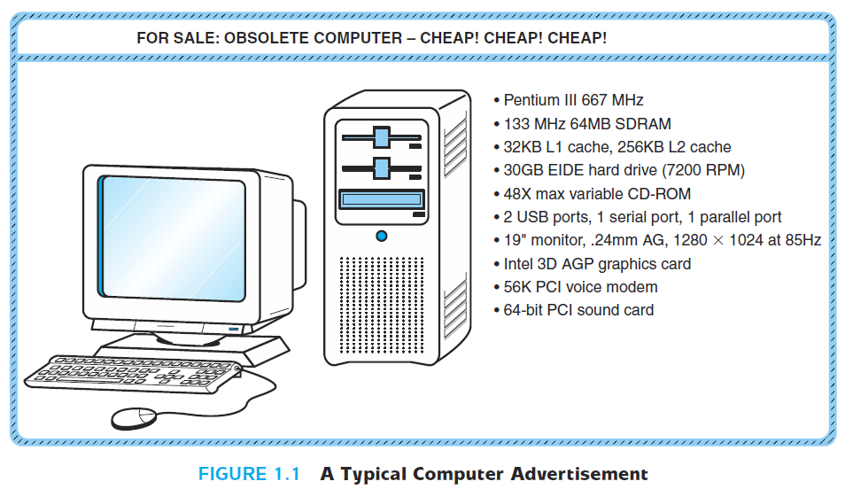
An example system: wading through the jargon
The stated system is a wise buy?
Does it serve your needs?

Slide 12
An example system: wading through the jargon
“64MB SDRAM”, “64-bit PCI sound card”, “32KB L1cache”, …?
Without having a handle on such terminology, you would be hard-pressed to answer such questions…
The next few slides explain the content of the advertisement (ad)

Slide 13
An example system: wading through the jargon
Computers do computations in base 2 (binary system)
A binary character is called a bit (0 or 1)
A byte is a set of 8 bits

Slide 14
An example system: wading through the jargon
Pentium III 667 MHz?
Pentium III : The microprocessor type
667 MHz: microprocessor’s clock speed
Each microprocessor has a synchronization clock (it sends electrical pulses)
Here, the clock speed is 667 million electrical pulse per second
The number of instructions per second that a processor can execute is proportionate to its clock speed (not equal to).
133 MHz 64MB SDRAM?
SDRAM: Main memory type, “Synchronous Dynamic Random Access Memory”
133 MHz: Speed of the system bus (between the memory and the microprocessor)
64 MB : Memory Capacity (64 x 2²⁰ x 8 bits = 536870912 bits)

Slide 15
An example system: wading through the jargon
32KB L1 cache, 256KB L2 cache?
Two cache memory to speed up the data transfer between the main memory and the processor
32KB and 256KB are the capacity of level 1 (L1) and level 2 (L2) memory respectively
30GB EIDE hard drive (7200 RPM)?
30GB: The capacity of the hard drive
7200 RPM: Speed of disk rotation is 7200 round per minute
EIDE: disk interface (connectivity with the rest of the computer’s components). EIDE stands for Enhanced Integrated Drive Electronics
48X max variable CD-ROM
CD-ROM drive
48X: the maximum reading data rate the CD drive can achieve (48 times the traditional audio CD data transfer rate)

Slide 16
An example system: wading through the jargon
2 USB ports, 1 serial port, 1 parallel port?
Ports that allow movement of data to and from devices external to the computer.
19" monitor, .24mm AG, 1280 x 1024 at 85Hz?
The monitor size (19”), resolution (1280 x 1024), refresh rate (85Hz) and pixel size (0.24mm).
Intel 3D AGP graphics card?
Graphic interface for 3D graphics
56K PCI voice modem? 64-bit PCI sound card?
PCI : Dedicated I/O buses, PCI stands for Peripherial Component Interconnect
PCI voice modem: for internet connection
PCI sound card : for the system’s stereo speakers

Slide 17
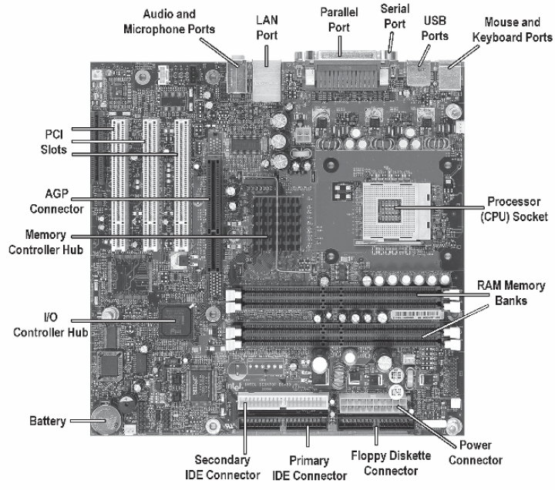
An example system: wading through the jargon
A look inside a computer

Slide 18
The computer level hierarchy
The user executes programs on a PC (Paint, word files, games, etc.)
The user is outside the computer! He uses input and output devices to communicate with the computer.
Now, what happens INSIDE the computer?
To understand, we will use a “divide and conquer” approach.

Slide 19
The computer level hierarchy
Imagine the machine (computer) as a hierarchy of levels, in which each level has a specific function.
The highest level – Level 6 – is the “user’s level”
Level 6 is composed of applications
User runs programs such as word processors, graphics packages, or games.
The lower levels are unseen by the user those can be considered as “virtual machines”.
Let us discover these “virtual machines”.

Slide 20
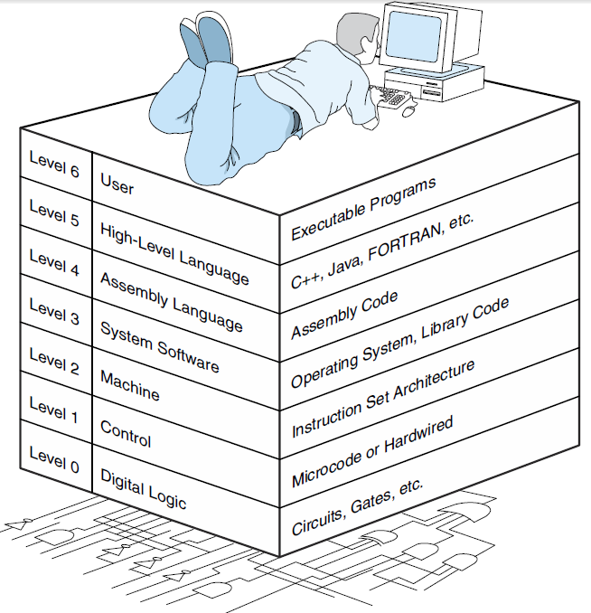
The computer level hierarchy

Slide 21
The computer level hierarchy
Level 5: High-Level Language Level
Consists of languages such as C, C++, FORTRAN, Lisp, Pascal, and Prolog.
Programmers write programs at this level.
Compilers translates these languages to a language the machine can understand (that lower levels could understand): Assembly then machine languages.
Level 4: Assembly Language Level
More “machine dependent” language.
Assembly language is then one to one translated to machine language (one assembly language instruction is translated to exactly one machine language instruction).

Slide 22
The computer level hierarchy
Level 3: System Software Level
Deals with operating system instructions (multiprogramming, protecting memory, synchronizing processes, and various other important functions)
Instructions translated from assembly language to machine language are passed through this level unmodified
Level 2: Instruction Set Architecture (ISA), or Machine Level
Machine language recognized by the particular architecture of the computer system
Programs written in machine language can be executed directly by the electronic circuits without any interpreters, translators, or compilers.

Slide 23
The computer level hierarchy
Level 1: The Control Level
Is where a control unit do its job
Receives machine instructions from the level above
decodes and executes those instructions properly
Moves data to where and when it should be
The control unit interprets the machine instructions
Level 0: The Digital Logic Level
is where we find the physical components of the computer system: the gates and wires

Slide 24
The Von Neumann model
A computer architecture model published by a famous Hungarian mathematician named John von Neumann
The idea is to store programs’ instructions inside a main memory in order to avoid rewiring the system each time it had a new problem to solve, or an old one to debug.
All stored-program computers have come to be known as von Neumann systems using the von Neumann architecture

Slide 25
The Von Neumann model
The Von Neumann architecture is shown in Figure 1.4 – Slide 43
It satisfies at least the following characteristics
Consists of three hardware systems (see figure 1.4 – slide 43)
A central processing unit (CPU) with a control unit, an arithmetic logic unit (ALU), registers (small storage areas), and a program counter;
a main-memory system, which holds programs that control the computer’s operation;
and an I/O system.
Capacity to carry out sequential instruction processing
Contains a single path, between the main memory system and the control unit of the CPU

Slide 26
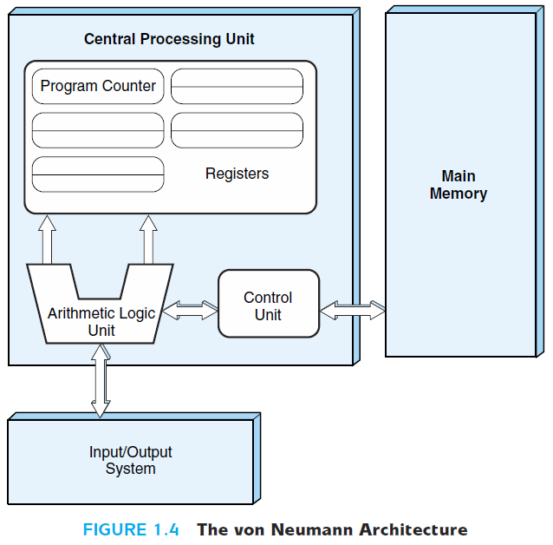
The Von Neumann model

Slide 27
The Von Neumann model
Program instructions are stored inside the main memory
The machine runs the programs sequentially (instruction per instruction – machine instruction)
Each machine instruction is fetched, decoded and executed during one cycle known as the von Neumann execution cycle (also called the fetch-decode-execute cycle)
One iteration of the cycle is as follows:
1. The control unit fetches the next program instruction from the memory, using the program counter to determine where the instruction is located.
2. The instruction is decoded into a language the ALU can understand.
3. Any data operands required to execute the instruction are fetched from memory and placed into registers within the CPU.
4. The ALU executes the instruction and places the results in registers or memory.

Slide 28
The Von Neumann model (5/6)
Chapter 1: Introduction
Fetch
PC indicates the iteration number
CU fill the instruction register
Instruction 1
Instruction 2
Instruction 3
Instruction 3
Data 1
Data 2
Instruction 4
…
2. Decode
what ALU should do (add, multiply, …)?
Fill registers with needed data
…
…
Instruction N

Slide 29
The Von Neumann model
3. Execute
Execute the instruction
Place the results in registers or memory
Instruction 1
Instruction 2
Instruction 3
Instruction 3
Data 1
Data 2
Instruction 4
Result
…
…
…
Instruction N

