Slide 1
Chapter 7
Retailing and Wholesaling

Slide 2
Retailing and Wholesaling
Topic Outline
Retailing
Retailer Marketing Decisions
Retailing Trends and Developments
Wholesaling

Slide 3
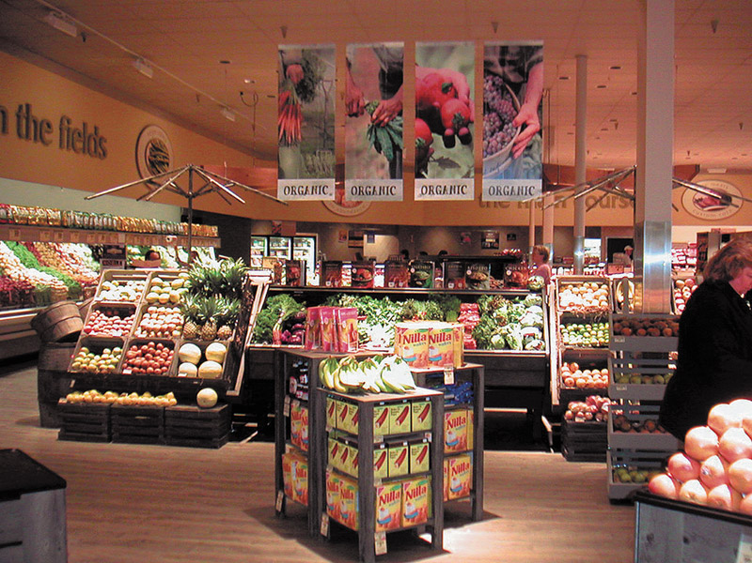
Retailing
Retailing includes all the activities in selling products or services directly to final consumers for their personal, non-business use
Retailers are businesses whose sales come primarily from retailing

Slide 4
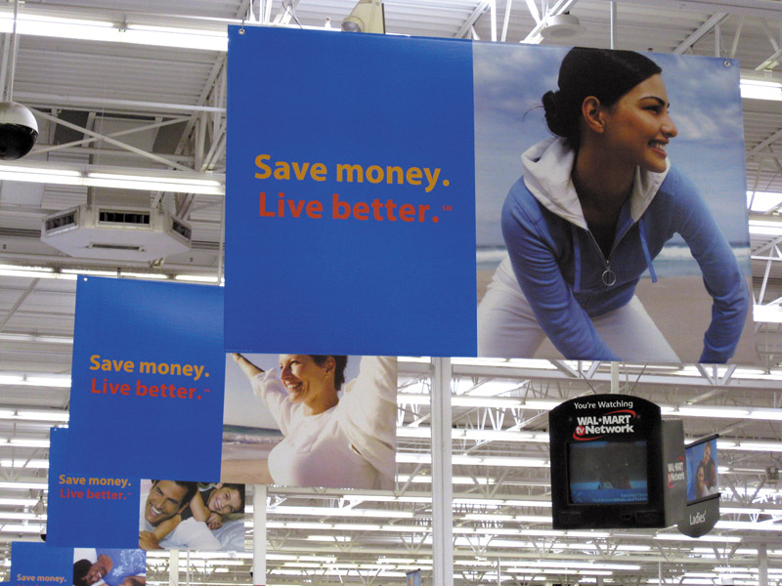
Retailing
Types of Retailers
Relative Prices
Discount stores
Off-price retailers
Factory outlets
Warehouse clubs
Notes:
Note to Instructor
Discount stores sell standard merchandise at lower prices by accepting lower margins and selling higher volume.
Independent off-price retailers either are owned and run by entrepreneurs or are divisions of larger retail corporations.
Off-price retailers buy at less-than-regular wholesale prices and charge customers less than retail.
Factory outlets are producer-operated stores. The link on this slide is to a Premium Factory Outlet mall. Students are probably familiar with these types of shopping locations.
Warehouse clubs are large warehouse-like facilities with few frills and offer ultra-low prices.

Slide 5
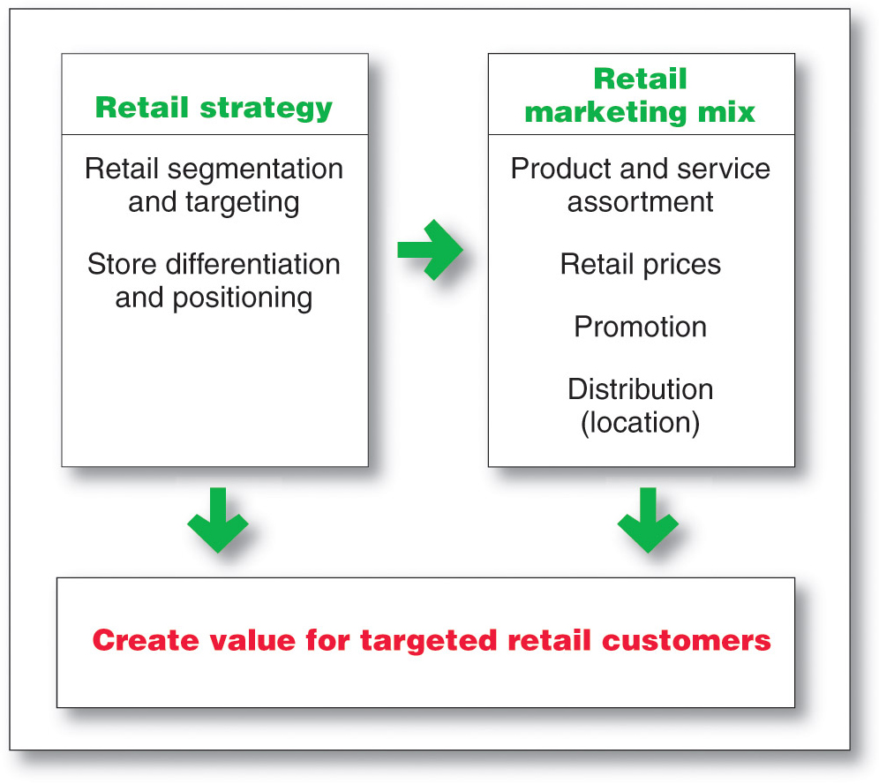
Retailing
Retailer Marketing Decisions

Slide 6
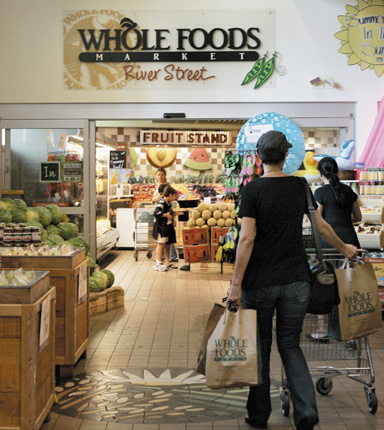
Retailing
Retailer Marketing Decisions
Segmentation targeting, differentiation, and positioning involves the definition and profile of the market so the other retail marketing decisions can be made
Notes:
Note to Instructor
This is a good time to visit the Web site for Trader Joe’s. Ask the students who they target and how they position their business. You can also ask students how this is different than Whole Foods which is discussed in the text.

Slide 7
Retailing
Retailer Marketing Decisions
Product Assortment and Service
Product assortment and service decisions include:
Product assortment
Services mix
Store atmosphere
Notes:
Note to Instructor
Product assortment should differentiate the retailer while matching target shoppers’ expectations. Offers merchandise that no other competitor carries:
Private or national brands
Merchandising events
Highly targeted product assortment
Services mix should also serve to differentiate the retailer from the competition with customer support.
Store atmosphere is the physical layout that makes moving around the store hard or easy.

Slide 8
Retailing
Retailer Marketing Decisions
Price Decision
Price policy must fit the target market and positioning, product and service assortment, and competition
High markup on lower volume
Low markup on higher volume

Slide 9
Retailing
Retailer Marketing Decisions
Price Decision
High-low pricing involves charging higher prices on an everyday basis, coupled with frequent sales and other price promotions
Everyday low price (EDLP) involves charging constant, everyday low prices with few sales or discounts
Notes:
Note to Instructor
Discussion Question
Why would a retailer engage in high-low pricing?
In most cases it is to increase store traffic, clear out unsold merchandise, create a low price image, or attract customers who will buy other goods at full price.

Slide 10
Retailing
Retailer Marketing Decisions
Promotion Decision
Advertising
Personal selling
Sales promotion
Public relations
Direct marketing
Notes:
Note to Instructor
Ask students for examples of retailers that advertise heavily. They might even be able to mention a local retailer whose ads they seem to constantly see on television. Local furniture stores and car dealers invest heavily on local television.

Slide 11
Retailing
Retailing Trends and Developments
New Retail Forms and Shortening Retail Life Cycles
Wheel-of-retailing concept states that many new types of retailing forms begin as low-margin, low-price, low-status operations, and challenge established retailers. As they succeed they upgrade their facilities and offer more services, increasing their costs and forcing them to increase prices, eventually becoming the retailers they replaced.

Slide 12
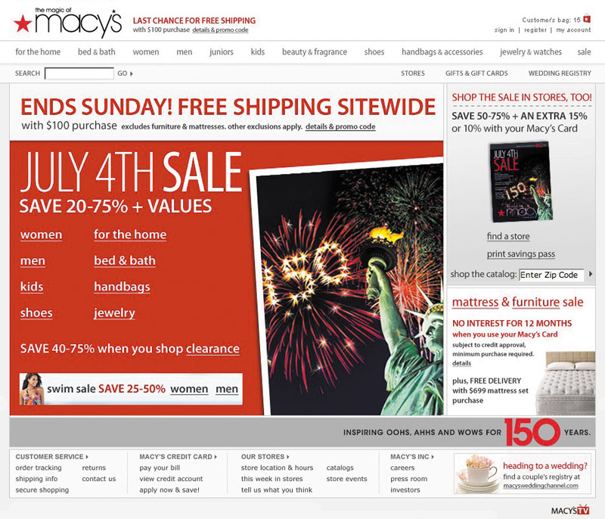
Retailing
Retailing Trends and Developments
New Retail Forms and Shortening Retail Life Cycles
s
Growth of non-store retailing includes:
Mail order
Television
Phone
Online
Notes:
Note to Instructor
Discussion Question
What percent of your purchases are online? Why is it low for some types of products?
It might be surprising to see that for certain categories it is very high but for others it remains low. You can ask why they differ by category. It might include shipping costs, need to try the product, size, impulse purchase, etc.

Slide 13
Retailing
Retailing Trends and Developments
New Retail Forms and Shortening Retail Life Cycles
Retail convergence involves the merging of consumers, producers, prices, and retailers, creating greater competition for retailers and greater difficulty differentiating offerings

Slide 14
Wholesaling
Wholesaling includes all activities involved in selling goods and services to those buying for resale or business use
Selling and promoting
Buying assortment building
Bulk breaking
Warehousing
Transportation
Financing
Risk bearing
Market information
Management services and advice

Slide 15
Wholesaling
Wholesaling
Selling and promoting involves the wholesaler’s sales force helping the manufacturer reach many smaller customers at lower cost
Buying assortment building involves the selection of items and building of assortments needed by their customers, saving the customers work

Slide 16
Wholesaling
Wholesaling
Bulk breaking involves the wholesaler buying in larger quantity and breaking into smaller lots for its customers
Warehousing involves the wholesaler holding inventory, reducing its customers’ inventory cost and risk

Slide 17
Wholesaling
Types of Wholesalers
Merchant wholesalers
Agents and brokers
Manufacturers’ sales branches and offices

Slide 18
Wholesaling
Types of Wholesalers
Merchant wholesalers is the largest group of wholesalers and include:
Full-service wholesalers who provide a full set of services
Limited service wholesalers who provide few services and specialized functions

Slide 19
Wholesaling
Types of Wholesalers
Brokers and agents do not take title, perform a few functions, and specialize by product line or customer type
Brokers bring buyers and sellers together and assist in negotiations
Agents represent buyers or sellers

Slide 20
Wholesaling
Types of Wholesalers
Manufacturers’ sales branches and offices is a form of wholesaling by sellers or buyers themselves rather than through independent wholesalers

Slide 21
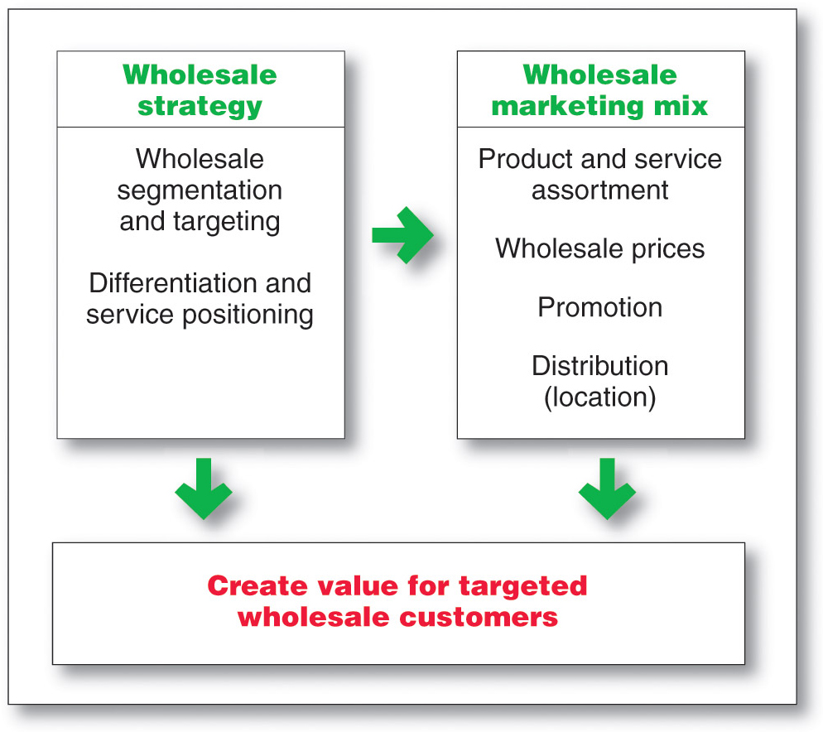
Wholesaling
Wholesaler Marketing Decisions

Slide 22
Wholesaling
Wholesaler Marketing Decisions
Target market and positioning decisions
Size of customer
Type of customer
Need for service

Slide 23
Wholesaling
Wholesaler Marketing Decisions
Marketing mix decisions
Product
Price
Promotion
Place

Slide 24
All rights reserved. No part of this publication may be reproduced, stored in a retrieval system, or transmitted, in any form or by any means, electronic, mechanical, photocopying, recording, or otherwise, without the prior written permission of the publisher. Printed in the United States of America.
Copyright © 2012 Pearson Education, Inc.
Publishing as Prentice Hall

