Slide 1
Representing Relations

Slide 2
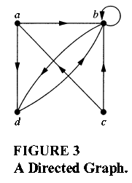
Representing Relations Using Digraphs
DEFINITION 1
A directed graph, or digraph, consists of a set V of vertices (or nodes) together with a set E of ordered pairs of elements of V called edges (or arcs). The vertex a is called the initial vertex of the edge (a,b), and the vertex b is called the terminal vertex of this edge.
An edge of the form (a,a) is represented using an arc from the vertex a back to itself. Such an edge is called a loop.

Slide 3
EXAMPLE 7
The directed graph with vertices a, b, c, and d, and edges (a,b), (a,d), (b,b), (b,d), (c,a),(c,b), and (d,b) is displayed in Figure 3 .

Slide 4
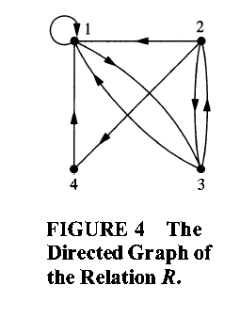
EXAMPLE 8 The directed graph of the relation
R = { (1,1) , (1,3), (2,1), (2,3), (2,4) , (3,1) , (3,2), (4,1) }
on the set { 1 , 2 , 3 , 4 } is shown in Figure 4.

Slide 5
Homework
Page 542
1 (a,b)
3 (a)
7
13 (c)
14 (a)
23
24

