Slide 1
Advanced Studies in Fungi Symbiotic Relationships
MBI 633

Slide 2
Symbiotic Relationships of Fungi
Chapter 1

Slide 3
Symbiotic Relationships of Fungi
Not all fungi feed on dead organisms. Many are involved in symbiotic relationships, including parasitism and mutualism.
Fungi as Parasites
In a parasitic relationship, the parasite benefits while the host is harmed. Parasitic fungi live in or on other organisms and get their nutrients from them. Fungi have special structures for penetrating a host. They also produce enzymes that break down the host’s tissues.

Slide 4
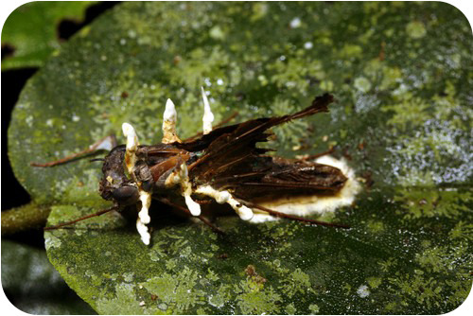
Symbiotic Relationships of Fungi
Parasitic fungi often cause illness and may eventually kill their host. They are the major cause of disease in agricultural plants.
Fungi also parasitize animals, such as the insect pictured in Figure. Fungi even parasitize humans. Did you ever have athlete's foot? If so, you were the host of a parasitic fungus.
Parasitic Fungus and Insect Host. The white parasitic fungus named Cordyceps is shown here growing on its host—a dark brown moth

Slide 5
Symbiotic Relationships of Fungi
Mutualism in Fungi
Fungi have several mutualistic relationships with other organisms. In mutualism, both organisms benefit from the relationship. Two common mutualistic relationships involving fungi are mycorrhiza and lichen.

Slide 6
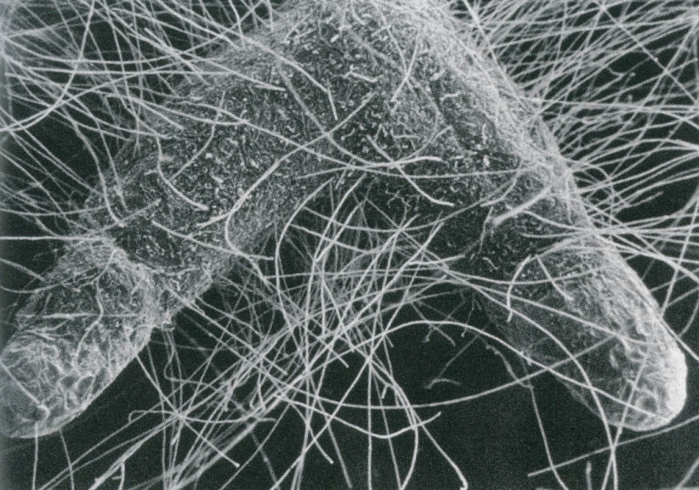
Symbiotic Relationships of Fungi
A mycorrhiza is a mutualistic relationship between a fungus and a plant. The fungus grows in or on the plant roots. The fungus benefits from the easy access to food made by the plant. The plant benefits because the fungus puts out mycelia that help absorb water and nutrients. Scientists think that a symbiotic relationship such as this may have allowed plants to first colonize the land.
Mycorrhizal fungal filaments (mycelia) radiate into the soil from mycorrhizae-colonized root tips

Slide 7
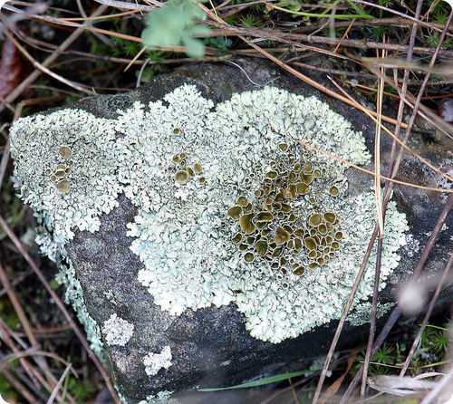
Symbiotic Relationships of Fungi
A lichen is an organism that results from a mutualistic relationship between a fungus and a photosynthetic organism. The other organism is usually a cyanobacterium or green alga.
The fungus grows around the bacterial or algal cells. The fungus benefits from the constant supply of food produced by the photosynthesizer. The photosynthesizer benefits from the water and nutrients absorbed by the fungus.
Lichen Growing on Rock. Unlike plants, lichen can grow on bare rocks because they don’t have roots.

Slide 8
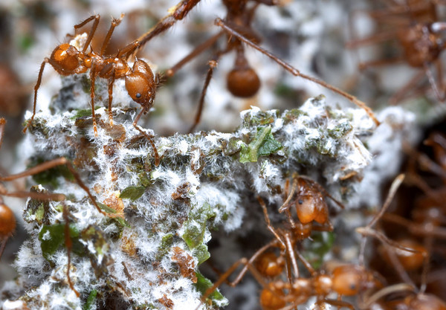
Symbiotic Relationships of Fungi
Some fungi have mutualistic relationships with insects. For example:
Leafcutter ants grow fungi on beds of leaves in their nests. The fungi get a protected place to live. The ants feed the fungi to their larvae.
Fungal Farming in Leafcutter Ants

Slide 9
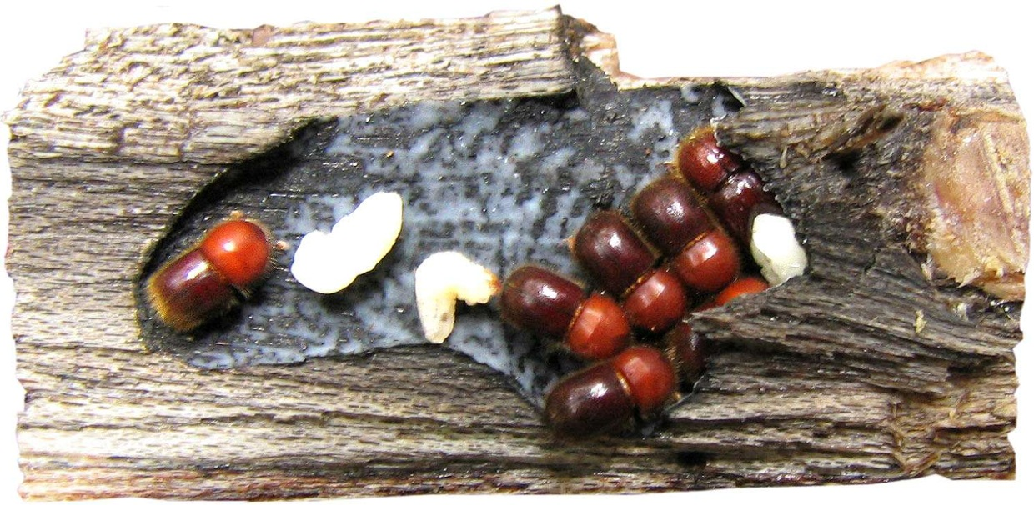
Symbiotic Relationships of Fungi
Ambrosia beetles bore holes in tree bark and “plant” fungal spores in the holes. The holes in the bark give the fungi an ideal place to grow. The beetles harvest fungi from their “garden.”
Ambrosia Beetle and Fungus in a Tree Branch

Slide 10
Parasitic Fungi
Chapter 2

Slide 11
Parasitic Fungi
FUNGAL PARASITES OF ANIMALS
Fungi are able to grow parasitically on a great variety of animals. In fact, it would be difficult to find an animal that doesn't have fungal parasites. When a biologist speaks of animals he or she doesn't just mean the big things like lions, tigers, dogs, cats and elephants. To a biologist an animal is any organism that is multicellular, non-photosynthetic and digests its food inside its body. This definition differentiates animals from plants and fungi. It also excludes (with some intriguing exceptions) the multitude of simple organisms that we now know to be genetically only distantly related to the three large groups.

Slide 12
Parasitic Fungi
Biologically speaking the kingdom of animals includes everything from the tiniest microscopic beings to large vertebrates, including ourselves. With such a wide variety of organisms to colonize it's not surprising that parasitic fungi come in a great variety of forms and have an equally great diversity of methods to do their work. It is also not surprising that the ones attacking worms or insects are quite different from those attacking birds or humans. Because of this division of labour among parasitic fungi we will examine them according to the group they attack.

Slide 13
Parasitic Fungi
INVERTEBRATE ANIMALS
An invertebrate animal is an animal without a backbone. This includes an immense diversity of organisms ranging from such simple things as corals, sponges and jellyfish to more complex animals like insects and lobsters. Of the approximately 1 million animals known to science about 950,000 (95%) are invertebrates. In fact the group is so large and complex that it would only be possible to discuss their fungal parasites in detail by subdividing it further. Instead we will examine a few examples.

Slide 14
Nematodes
Nematodes or roundworms comprise a large group of animals found in almost every habitat on earth. They are exceedingly numerous. Prof. E. O. Wilson has stated that if the surface of the earth were suddenly removed its shape could still be discerned by the ghostly outline of living nematodes. Four out of five species of animals are nematodes and most of these remain unnamed. With such a mass of living organisms we should not be surprised to learn that many fungi are able to use them as a source of nutrition. Several groups of fungi are specialized for detecting, infecting and consuming these little worms.
Fungi attacking nematodes are often divided into two functional groups, the endoparasites and the predators. Endoparasitic fungi develop entirely within the nematode and really have no life outside the animal while the predacious ones grow extensively in environments rich in nematodes and lay various sorts of traps to capture them.

Slide 15
The picture at right depicts Harposporium anguillulae, a typical and common endoparasitic form. The large banana-shaped structure running diagonally from lower left to upper right is a single nematode. Numerous hyphae of H. anguillulae can be seen inside its body giving rise to spore-bearing structures that have broken through the nematode's cuticle and are producing sickle-shaped conidia (asexual spores). This nematode was orginally obtained from a sample of garden soil where it had been foraging for bacteria, fungal spores and other small bits of nutrition. In the process of this indiscriminant feeding it had ingested one or more of the sharp, curved conidia of H. anguillulae which had become lodged in its oesophagus. The conidia had then germinated and produced the hyphae filling the nematode's body. Recent research has shown that species of Harposporiumare in fact asexual forms produced by species of the ascomycete genus Podocrella. This is of great interest to mycologists because Podocrella species, members of the family Clavicipitaceae, are parasites of insects and other arthropods. This means that Podocrella species are among several groups of parasitic organisms that depend upon two or more hosts (prey) in their life cycles.

Slide 16
Predaceous fungi employ a variety of means to capture nematodes. These fungi grow abundantly in habitats where nematodes are abundant, producing modified sticky branches that adhere to the nematode cuticle. When a nematode comes into contact with one of these branches it gets stuck and cannot get loose. These special structures may take the form of simple short branches, knobs or loops. In some cases they have the ability to close down and form a strangle-hold on nematodes that attempts to pass through them.

Slide 17
Parasitic Fungi
Insects
Insects live among fungi, pushing their way through hyphal masses and brushing against their spores. Many insects even eat fungi. With such close contact between insects and fungi is is not at all surprising that some fungi have developed the ability to live as parasites on insects. Like the fungi that attack nematodes many of those attacking insects are highly specialized and have sophisticated means of locating and infecting their prey. They may also be host-specific and occur on a few or even single species of insect.
The number and diversity of fungi parasitic upon insects is so great that is is impractical to try to deal with it here. Instead we will discuss a few characteristic types and leave it to you to delve more deeply into the subject.

Slide 18
Parasitic Fungi

Slide 19
Parasitic Fungi
Of the many fungi infecting insects three groups stand out as especially numerous. These are the orders Entomophthorales, Laboulbeniales and Clavicipitaceae. The picture above illustrates these three common groups. At the left is Entomophthora muscae a common parasite of flies in our area. Infected flies often land on an upright plant stem, turn bottom up and die. The parasite, which has been growing inside the insect, grows out of its recently killed prey and produces masses of white spores along each of the abdominal segments. You can easily find this fungus in the garden during late summer. Just look for grasses or other plants with an inverted dead fly clinging to ther tops. If the fungus is not obvious, place the fly on a piece of glass or plastic food wrap and enclose it so it will not dry out. By morning you will have a halo of spores surrounding the fly.

Slide 20
Parasitic Fungi
The middle picture is of Laboulbenia philonthi, a member of the Laboulbeniales. Members of this group grow attached to the outside of the insect; the black structure at the bottom is the point at which it is attached. although external, the fungus does have an absorption cell called a haustorium inside the insect at the point of attachment. although clearly parasitic the Laboulbeniales probably do little harm to their hosts. They are equivalent to fleas and ticks on mammals

Slide 21
Parasitic Fungi
The fungus at right is Cordyceps variabilis. It was infecting the larva of a beetle inside a dead log, which has been cut away to show the relationship between host and parasite. Cordyceps, a member of the Clavicipitaceae, produces its spores inside the swollen head-like structure above the log. The Clavicipitaceae are fairly common in temperate parts of the world but become exceedingly abundant in the tropics.

Slide 22
Parasitic Fungi
The picture at right shows a dead moth colonized by the fungus Cordyceps bassiana. This one was photographed by Karen Vanderwolf in a cave in New Brunswick where it was growing at a temperature lower than 10 degrees C. This fungus is known to produce a sexual stage typical of the Clavicipitaceae. In fact, that stage was found for the first time in 2001. The asexual form, shown here and known as Beauveria bassiana, has been recognized since the early nineteenth century when the Italian mycologist Agostina Bassi demonstrated it to be the cause of 'muscardine disease' in silkworms.

Slide 23
Parasitic Fungi
VERTEBRATE ANIMALS
Vertebrate animals can serve as hosts for parasitic fungi. although vertebrates make up only a small part of the animal kingdom they display a some diversity in both aquatic and terrestrial habitats. Aquatic habitats support quite different kinds of fungi than terrestrial ones so it is not surprising that fish and amphibians harbour fungal parasites having little in common with those infecting birds and mammals.

Slide 24
Parasitic Fungi
Fish
Most of the fungi parasitizing fish are not really fungi at all and instead belong to the phylum Oomycota. although once thought to be fungi we now know that the Oomycota and more closely related to certain algae.
Species of several genera of Oomycota are known to attack fish. Home aquarium owners will undoubtedly recognize the genus Saprolegnia, a notorious group of parasites that can wipe out an aquarium in a short period of time. Species of Saprolegnia get into the fish through open wounds and rapidly penetrate its tissues with broad tubular hyphae. Infected but still-living fish may be seen swimming with a tuft of hyphae trailing out behind them. The next time you visit a pet store have a look at the fish medicines; many claim effectiveness against Saprolegnia.
A few "true" fungi also parasitize fish, including some species of Exophiala and Fusarium. although we usually think of Fusarium species as plant parasites they can become parasitic on a variety of animals, including humans.

Slide 25
Parasitic Fungi
Amphibians
Amphibians, including frogs, toads, newts and salamanders, may be air-breathing in their adult stages but generally are not very resistant to dryness and must remain in aquatic or very moist habitats. Because of the moisture that usually surrounds them they are susceptible to many of the same parasites as fish. Even woodland salamanders can be infected with species of Saprolegnia.
More recently biologists have begun to experience severe declines in the populations of frogs in many parts of the world. although the cause of this decline is still not entirely understood a major factor appears to be the the fungus Batrachochytrium dendrobatidis which infects the skin of frogs causing severe leasons and finally death. The disease is called chytridiomycosis. Batrachochytrium dendrobatidis is a member of the Chytridiomycota, a group of true fungi having motile spores that can swim in search of aquatic prey. Why this fungus has become prevalent in just the last few years is not clear. Scientists have suggested global warming, pollution, habitat disturbance and other causes but the answer is still not known.

Slide 26
Parasitic Fungi
Birds and mammals
Birds and mammals are together a smaller group than fish, and of these birds are the more numerous. Apparently swimming and flying are the way to success! These terrestrial, warm-blooded animals have a variety of fungal parasites. Of course the ones infecting humans and domestic animals are the best-known while those parasitic on wild mammals and birds remain largely unstudied. There are several excellent sites on the internet discussing these fungi in detail and presenting what some may find to be rather alarming photographs.

Slide 27
Parasitic Fungi
The fungi causing mycoses or diseases in birds and mammals are often divided into several groups depending upon the site of infection. These groups are:
Superficial mycoses
These are fungi that grow on the surface of the body or on hair shafts. They do not invade living tissues and usually cause no symptoms. They may often be present but undetected. One of the most common of these is Malassezia furfur, a relative of the smut fungi which may cause a mild dermatitis or discolouration of the skin. It can also be the cause of dandruff.
Cutaneous mycoses
A very common group of fungi found in the outermost layers of dead skin. although they do not invade living tissues they produce enough enzymes and other metabolites in the outer layers of skin that they elicit a response in the host that is usually seen as reddening at the site of infection. These fungi, commonly called dermatophytes, are the cause of athlete's foot, ringworm and nail disorders. Candida albicans, a member of this group that also grows on mucus membranes in the mouth, anus and vagina can cause more serious infections under certain conditions.
Subcutaneous mycoses
This is a group of fungi that are probably not primarily parasitic and only become so if they enter a wound. Generally they remain localized and form small masses of hyphae in the affected tissues. They may at times invade bones. Subcutaneous mycoses may remain on the host for many years and form leaky swollen lesions.

Slide 28
Parasitic Fungi
Dimorphic systemic mycoses
Fungi in this group are called dimorphic because they can grow as hyphae or in a single-celled budding form, depending upon where they are. In a petri dish at room temperature they grow as "normal" hyphal colonies but in living tissue they begin to behave like yeasts and travel through the body as single cells. They are called systemic because they have the ability to spread to various organs. Typically the spores are inhaled with dust and germinate to form colonies in the lungs. They may remain there and cause tuberculosis-like symptoms or they may spread to other parts of the body. The diseases they cause can be serious or even fatal. Members of this group tend to be quite common in certain endemic areas and quite rare elsewhere.

Slide 29
Parasitic Fungi
Opportunistic systemic mycoses
This group includes fungi that are able to invade tissues within the body but are not dimorphic. They are opportunistic because they normally exist as non- parasitic forms and only become virulent when the immune system has been compromised in some way. This can occur through the use of immunosuppressant drugs following organ transplant surgery or because of diseases such as AIDS and diabetes that suppress the immune system. The use of chemotheraputic agents, corticosteroids and other chemicals having a profound effect on the body may also allow them entry. These fungi are not in any kind of "balance" with the host and can invade rapidly and destructively.

Slide 30
FUNGAL PARASITES OF PLANTS
The study of plant disease, plant pathology, is a large and important one. Many universities have entire departments of plant pathology. The importance of the subject is obvious; since the beginning of agriculture humans have had to endure major crop losses because of disease. Even today, when crop health is under careful scrutiny, disease may suddenly strike and ruin an entire season's growth. It happens every year in some part of the globe, even in so-called developed nations.
Most plant diseases are caused by fungi; losses to bacteria and viruses are important, but less so than those caused by fungi. A great diversity of fungi cause plant disease, nearly all major groups are involved. In spite of these numbers there are just two types of parasite to consider: nectrotrophs and biotrophs. Necrotrophs are a little like predators; they kill the tissues they are about to consume before they eat them. Unlike predators, however, they don't normally kill the whole organism, just a part of it. They do this by means of toxins that diffuse out into the host tissues, killing the cells they encounter. The fungus then extends its hyphae into these killed areas and digests them. Biotrophs obtain their nutrition from living cells with which they may establish fairly long-lived associations. They usually penetrate the cell walls of their hosts and establish contact with the cell membrane by means of haustoria, cells specialized for the absorption of nutrients.

Slide 31
Plants do not just accept parasitic fungi. They have a large array of defense mechanisms that guard against fungal disease so that most fungi cannot get in. These defenses include physical barriers like the tough cuticle lining the surfaces of plants or the bark on trees. Chemical barriers including various toxins and strong oxidizers may be utilized. Fungi in their turn have developed ways of circumventing these defenses and seem to be able to develop new ones as soon as the plant confronts them. Some scientists have referred to this as a biological arms race. Plants differ greatly from one another in how they resist disease.

Slide 32
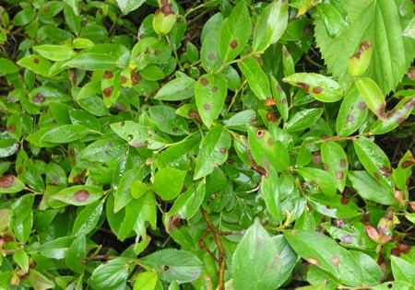
NECROTROPHS
The plants in the photo at right are mainly blueberries but if you look closely you will also see chokeberries, raspberries and perhaps some other species. All are common in New Brunswick and are frequently infected by fungi. In this example the leaves are riddled with dead spots brought about by necrotrophic plant parasites. These range from small dark spots to larger dead areas, often ringed by discoloured dying zones. The fungi are within the spots, releasing toxins that kill the leaf cells and then spreading out into the killed areas.
Necrotrophic parasites are not always easy to characterize. At times such infections may be caused by biotrophic parasites that make such large nutritional demands on their host that they kill parts of it and thus resemble a necrotroph. However, biotrophs do not produce lethal toxins and they do not feed on dead tissues.

Slide 33
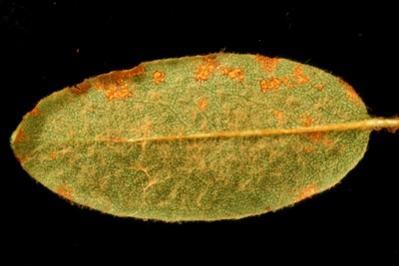
BIOTROPHS
Because they do not produce toxins biotrophs may have longer and less damaging relationships with their hosts. In the figure at right the rust fungus Chrysomyxa ledi has formed several sites of sporulation on the underside of a leaf of Labrador tea. These areas of sporulation are confined within zones defined by veins. No yellowing or senescence of the host leaf due to this infection is visible although there appears to have been some damage from a necrotroph on the upper margin.

Slide 34
DIVERSITY OF PLANT PARASITIC FUNGI
Species of fungi causing plant disease can be found in nearly all taxonomic groups and will be encountered frequently in the section on classification. Instead we will examine diversity from a pathologist's point of view, focussing more on the disease than on the agent of the disease.

Slide 35
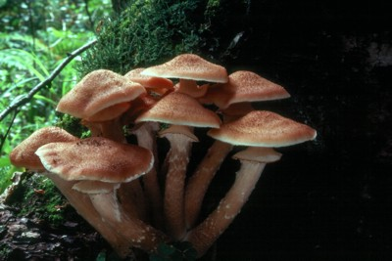
Roots
Plant roots are attacked by a great range fungi, from simple organisms parasitic on a single cell to ones attacking an entire root system. Many live inconspicuously in the root, inflicting little damage on the host. Others, such as the species of Armillaria at right, probably A. ostoyae, can attack entire root systems of trees, causing the whole plant to die. Armillaria species often grow harmlessly on the rotting wood various trees but under certain conditions can spread to living roots. This spread is accomplished by means of dark shoestring-like structures called rhizomorphs. When a rhizomorph of this fungus encounters a root it will penetrate and begin to develop between the wood and the bark, eventually colonizing up to the root collar (the part of the trunk where the roots arise. The growth beneath the bark forms a white mat of mycelium that will eventually kill the tree. Armillaria root rot is a major forest disease that particularly affects young conifers, such as those planted during reforestation efforts or in Christmas tree plantations.

