Slide 1
Aerosols
Sneeze simulation method

Slide 2
Aerosols
Suspension of a microbe containing particle
Airborne pathogenic microorganisms
Constitute a major hazard to humans
Viruses, bacteria, fungi are carried from host to host by air currents.

Slide 3
Nature aerosols formation
Thermal shifts
High pressure to low pressure areas
Air currents
Strong winds
Lab techniques that can generate aerosols
Streaking, serial dilution , swabbing ,making a smear, loop inoculation.

Slide 4
Some human actions that generate aerosols
Unguarded sneezing
Talking
Dusting
Unguarded coughing
Making beds
Toilet flushing
Dry mopping floors

Slide 5
Sneeze simulation method
MATERIALS
6 nutrient agar plates, One sterile atomizer.
10 ml of a 24-hour Trypticase Soy broth (TSB) culture of Micrococcus lutea.
PROCEDURE
This procedure is to be demonstrated by the instructor.
1. Arrange the 6 (NA) plates on a table in a straight line with approximately 12 inches between them. Each plate should be numbered in consecutive order.
2. Load the atomizer with broth culture of M. lutea and position the atomizer approxim .12 inches in front of plate number 1 , approximately 3-4 feet above it.
3. Remove all Petri plate covers and spray the suspension simulate a sneeze.
4. Replace the covers and incubate the preparations at room temp. overnight.
5. After incubation, return the plates to their positions on the table.
6. Students examine the plates for relative numbers of the organism colonies.

Slide 6
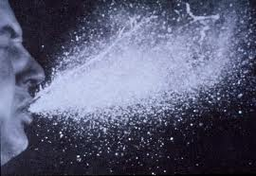
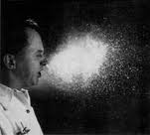
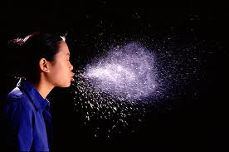
Sneeze Spread

Slide 7
CREATION OF LABORATORY AEROSOLS
MATERIALS:
24 hour TSB cultures of Micrococcus lutea dispensed in 5-ml aliquots.
Sterile 1-ml pipettes
NB dispensed in 9-ml amounts
NA plates for environment sampling

Slide 8
PROCEDURE
Before performing any of the following experiments, place 3 nutrient agar plates in the immediate working area spaced well apart from each other, label as near, moderate, far
Uncover each plate with a label corresponding to its position.
Cover each plate upon completion of these procedures.
Incubate all plates at 37C overnight.
Report the results.

Slide 9
Specific Procedures
Serial dilution:
Place 4 tubes of NB in a test –tube rack and number each consecutively from 1to 6. Introduce into tube 1 1ml of the bacterial culture selected.
Mix well with a fresh pipette.
Repeat mixing in the same tube 10 times up and down.
Remove 1ml of suspension and deliver it in tube 2.
Repeat the same procedure in all 6 tubes.
Loop inoculation:
Place 6 NB tubes in a test tube rack.
Inoculate the first tube with 1 loopful of the culture provided.
Mix the contents of the tube by rotating the tube between the palms of the hands 10 times.
Repeat this procedure with the other tubes.

Slide 10
Specific Procedures
Streak plate:
Streak 3 NA plates with the culture provided.
Smear technique:
Prepare 3 bacterial smears according to the usual procedure.
Swabbing technique for antibiotic testing:
Swab 3 NA plates using sterile swab dipped into provided
broth culture in the way as for antibiotic testing.

Slide 11
Interpretation of results
This exercise demonstrates the ease with which microorganisms are transported through air
Plates that contain high numbers of micrococcus are indication of aerosol generation( more than2-3 colonies)
If plates were exposed to air for long periods, there will other organisms of air

