Slide 1
BIORHYTHMS Biology is RHYTHMICAL!!

Slide 3
Biological rhythm, periodic biological fluctuation in an organism that corresponds to, and is in response to, periodic environmental change.
Examples of such change include cyclical variations in the relative position of Earth to the Sun and to the Moon and in the immediate effects of such variations—e.g., day alternating with night, high tide alternating with low tide.
The internal mechanism by which such a rhythmic phenomenon occurs and is maintained even in the absence of the apparent environmental stimulus is termed a biological clock.

Slide 9
Common Bio-Rhythms
RHYTHM PERIOD
Tidal 12.4 h
Circadian ~ 24 h
Lunar 28 d
Circannual ~ 12 months
Rhythms keep our internal workings in phase with the outside world

Slide 10
•Circadian rhythms : ~24 hr cycles in
many bio processes & behaviors (e.g. sleep/waking,
temp., hormones, urination, sensitivity to drugs)
•Rhythms are endogenous (generated internally,
by biological clocks) but are influenced or “reset” by
external stimuli. There are also biorhythms of other lengths:
•Circannual rhythms (yearly cycle)
•Examples: Birds’ migratory patterns, animals storing food for
the winter or hibernating, annual mating.
•Circalunar rhythm (monthly cycle)
•Menstrual rhythm

Slide 16
Biological Clocks
•Key circadian clock:
Suprachiasmatic nuclei (SCN) of the hypothalamus
•SCN lesions disrupt activity, sleep, eating, &
hormone rhythms.
• SCN transplants can change an animal’s natural
biorhythm to that of donor.
•SCN very sensitive, very adaptive.this allows “re-setting” of our biological clock

Slide 17
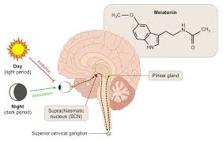

Slide 18
The SCN regulates the pineal gland located posterior to the thalamus.
•
The pineal gland secretes melatonin, a hormone that increases sleepiness, beginning a couple
Hrs before your bedtime.
•
Melatonin (~.3mg) in the afternoon may make you sleepy earlier; melatonin after midnight may help you adjust to sleeping later.
•
SCN has melatonin receptors (allows feedback)•
SCN control of rhythms shows some deterioration with aging

Slide 19
Researchers have discovered several rhythm related genes which influence our biological clocks.
For example 3 of these genes are involved in the production of proteins which accumulate over the day & eventually make you sleepy.
Light increases production; production stops during night.
Differences in these genes are responsible for inborn differences in circadian rhythms, both normal and
extreme.

Slide 20
Environmental cues that animals use to be rhythmic are
called ZEITGEBERS ("time givers").
When a rhythm somehow get matched to environmental cycles: ENTRAINMENT
2 most important zeitgebers??
LIGHT & TEMPERATURE

Slide 28
CIRCANNUAL RHYTHMS
---
rhythms of about a year.
Long living animals may divide year into ...
active & inactive phases ,breeding & nonbreeding phases
feeding & nonfeeding phases
Among them is the cycle of dormancy and activity marked by the hibernation of certain species in the winter. There are also certain times of the year when animals shed things—fur, skin, antlers, or simply pounds. Likewise, at some points in the year animals gain weight. Orientation of the migratory birds is very probably strictly related with the circannual rhythm of the endocrine system. Therefore, it seems to be interesting to mention briefly also this aspect as a special example of
circannual biorhythms.

Slide 30
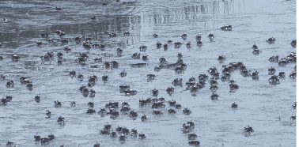
TIDAL
RHYTHMS
--
about a 12 hr period.
Fiddler crabs feed on tidal flats during low tide & stay
in burrow during high tide.

Slide 31
SOURCE OF ANIMAL RHYTHMS
Do animals simply “read” zeitgebers??
Or ... do they reside within the animal??
Endogenous rhythm
Exogenous rhythm
Rhythms based on “reading” zeitgebers are EXOGENOUS.
An exogenous rhythm disappears when environmental cues are
eliminated.
Rhythms not requiring environmental cues are ENDOGENOUS
.
Endogenous rhythms are controlled by a
BIOLOGICAL CLOCK
.
Generalization: Most biorhythms are both endo
-and exogenous
-

Slide 32
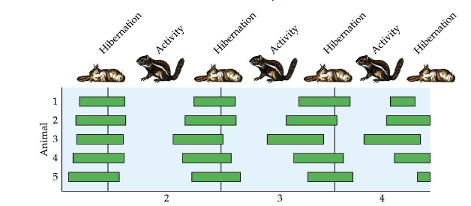
Endogenous Rhythm in a Hibernator
Golden mantled ground squirrel: 4 year experiment
From birth: no environmental cues ,abundant food,constant darkness/temperature
Years

Slide 33
A) MELATONIN.
The pineal gland secretes two hormones (molecules that send signals to the body), melatonin and serotonin.
During the late 1990s, melatonin became a popular over-the-counter treatment for persons afflicted with sleep disorders, because it is believed that the hormone is associated with healthful sleep.
Scientists do not fully understand the role that melatonin plays in the body, although it appears that it regulates a number of diurnal, or daily, events.
In addition, melatonin seems to serve the function of controlling fat production, which is one reason why good sleep is associated not only with a healthy lifestyle but also with a healthy physique.
Many health specialists maintain that for adults there is a close link between a "spare tire" (that is, fat accumulation around the waist) and stress, lack of sleep, and low melatonin levels.
Among the many roles melatonin plays in the body is its job of regulating glucose levels in the blood, which, in turn, serve to govern the production of growth hormone, or somatotropin.

Slide 34
Melatonin: Synthesis, Secretion and Receptors
The precursor to melatonin is serotonin, a neurotransmitter that itself is derived from the amino acid tryptophan. Within the pineal gland, serotonin is acetylated and then methylated to yield melatonin.
Synthesis and secretion of melatonin is dramatically affected by light exposure to the eyes. The fundamental pattern observed is that serum concentrations of melatonin are low during the daylight hours, and increase to a peak during the dark.

Slide 35
Two melatonin receptors have been identified from mammals (designated Mel1A and Mel1B) that are differentially expressed in different tissues and probably participate in implementing differing biologic effects.
The highest density of receptors has been found in the suprachiasmatic nucleus of the hypothalamus, the anterior pituitary and the retina. Receptors are also found in several other areas of the brain.

Slide 36
Biological Effects of Melatonin
Melatonin has important effects in integrating photoperiod and affecting circadian rhythms. Consequently, it has been reported to have significant effects on reproduction, sleep-wake cycles and other phenomena showing circadian rhythm.
Effects on Reproductive Function
Seasonal changes in daylength have profound effects on reproduction in many species, and melatonin is a key player in controlling such events. In temperate climates, animals like hamsters, horses and sheep have distinct breeding season. During the non-breeding season, the gonads become inactive (e.g males fail to produce sperm in any number), but as the breeding season approaches, the gonads must be rejuvenated. Photoperiod - the length of day vs night - is the most important cue allowing animals to determine which season it is.

Slide 37
The effect of melatonin on reproductive systems can be summarized by saying that it is anti-gonadotropic. In other words, melatonin inhibits the secretion of the gonadotropic hormones luteinizing hormone and follicle stimulating hormone from the anterior pituitary. Much of this inhibitory effect seems due to inhibition of gonadotropin-releasing hormone from the hypothalamus, which is necessary for secretion of the anterior pituitary hormones.

Slide 38
Effects on Sleep and Activity
Melatonin is probably not a major regulator of normal sleep patterns, but undoubtedly has some effect. One topic that has garnered a large amount of interest is using melatonin alone, or in combination with phototherapy, to treat sleep disorders. There is some indication that melatonin levels are lower in elderly insomniacs relative to age matched non-insomniacs, and melatonin therapy in such cases appears modestly beneficial in
Other Effects of Melatonin
One of the first experiments conducted to elucidate the function of the pineal, extracts of pineal glands from cattle were added to water containing tadpoles. Interestingly, the tadpoles responded by becoming very light in color or almost transparent due to alterations in melanin pigment distribution. Although such cutaneous effects of melatonin are seen in a variety of "lower species", the hormone does not have such effects in mammals or birds.

Slide 39
B) SEROTONIN.
Melatonin is not the only important hormone that is both secreted by the pineal gland and critical to the regulation of the body clock.
Complementary to melatonin is serotonin, which is as important to waking functions as melatonin is to sleepiness. Like melatonin, serotonin serves several functions, including the regulation of attention.
Serotonin is among the substances responsible for the ability of a human with a healthily functioning brain to filter out background noise and sensory data.
Thanks in part to serotonin, you are able to read this book without having your attention diverted by other sensory data around you: the voice of someone talking nearby, the sunlight or a bird singing outside, the hum of a light or a fan in the room.

