Slide 1
240 Chem
Organic Chemistry -1
Chapter 1
Introduction

Slide 2
What Is Organic Chemistry About?
The term organic suggests that this branch of chemistry has something to do with organisms, or living things.
It gradually became clear that most compounds in plants and animals differ in several respects from those that occur in nonliving matter, such as minerals. In particular, most compounds in living matter are made up of the same few elements: carbon, hydrogen, oxygen, nitrogen, and sometimes sulfur, phosphorus, and a few others. Carbon is virtually always present. This fact led to our present definition:
Organic chemistry is the chemistry of carbon compounds
This definition broadens the scope of the subject to include not only compounds from nature but also synthetic compounds.

Slide 3
Organic Chemistry in Everyday Life
Organic chemistry touches our daily lives. We are made of and surrounded by organic compounds.
The major constituents of living matter: proteins, carbohydrates, lipids (fats), nucleic acids (DNA and RNA), cell membranes, enzymes, hormones are organic.
Other organic substances include the gasoline, oil, and tires for our cars; the clothing we wear; the wood for our furniture; the paper for our books; the medicines we take; and plastic containers, camera film, perfume, carpeting, and fabrics.

Slide 4
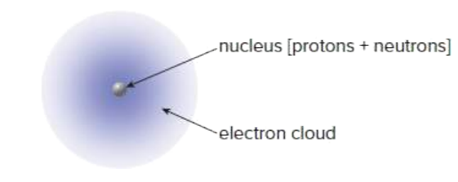
Atomic Structure
An atom consists of a small, dense nucleus containing positively charged protons and neutral neutrons and surrounded by negatively charged electrons.
In a neutral atom, the positive charge of the nucleus is exactly balanced by the negative charge of the electrons that surround it.
The atomic number of an element equals the number of protons in its nucleus.
The atomic weight is the sum of the number of protons and neutrons in its nucleus.

Slide 5
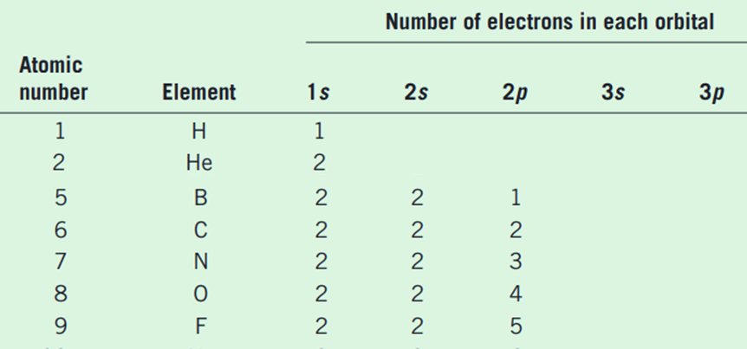
Atomic Structure
The atom’s electrons:
Electrons are concentrated in certain regions of space around the nucleus called orbitals.
Each orbital can contain a maximum of two electrons.
The orbitals, which differ in shape, are designated by the letters s, p, and d.
Each shell contains different types and numbers of orbitals, corresponding to the shell number.

Slide 6
Chemical Bonds
Theory of chemical bonding was proposed in 1916 by Gilbert Newton Lewis.
Lewis noticed that the inert gas helium had only two electrons surrounding its nucleus and that the next inert gas, neon, had 10 electrons, that atoms of these gases must have very stable electron arrangements.
He further suggested that other atoms might react in such a way in order to achieve these stable arrangements. This stability could be achieved in one of two ways:
by complete transfer of electrons from one atom to another.
by sharing of electrons between atoms.

Slide 7
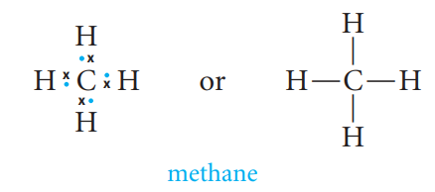
Chemical Bonds
Ionic Bonding
Ionic bonds are formed by the transfer of one or more valence electrons from one atom to another.
Ionic compounds are composed of positively charged cations and negatively charged anions.
Covalent Bonding
Elements that are neither strongly electronegative or that have similar electronegativities, tend to form bonds by sharing electron pairs rather than completely transferring electrons.
A covalent bond involves the mutual sharing of one or more electron pairs between atoms.

Slide 8
Chemical Bonds
Polar Covalent Bonding
Covalent bonds can be formed not only between identical atoms (H-H, C-C) but also between different atoms (C-H, C-Cl).
If the atoms are different from one another, the electron pair may not be shared equally between them. Such a bond is called a polar covalent bond because the atoms that are linked carry a partial negative and a partial positive charge.
Coordinate Covalent Bonds
There are molecules in which one atom supplies both electrons to another atom in the formation of a covalent bond.

Slide 9
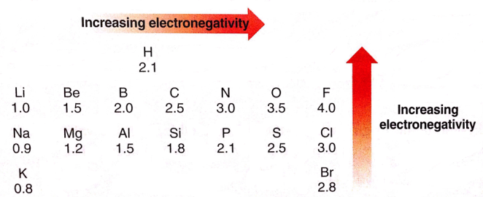
Bond Polarity and Dipole Moment (µ)
Dipole moment depends on the inductive effect.
Inductive effect can be defined as the permanent displacement of electrons forming a covalent bond (σ bonds ) towards the more electronegative element or group, The direction of polarity of a polar bond can be symbolized by a vector quantity .
Dipole moment (µ) defined to be the amount of charge separation ( +δ and –δ ) multiplied by the bond length.
The bond polarity is measured by its dipole moment (µ).

Slide 10
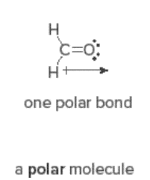
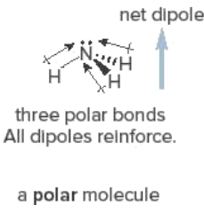
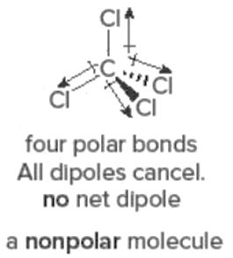
A bond with the electrons shared equally between two atoms is called a nonpolar bond.
A bond with the electrons shared unequally between two different elements is called a polar bond.

Slide 11
Valence
The valence of an element is simply the number of bonds that an atom of the element can form.
The number is usually equal to the number of electrons needed to fill the valence shell.
Notice the difference between the number of valence electrons and the valence. Oxygen, for example, has six valence electrons but a valence of only 2. The sum of the two numbers is equal to the number of electrons in the filled shell.
The valences apply whether the bonds are single, double, or triple. For example, carbon has four bonds in each of the structures we have written so far: methane, tetrachloromethane, ethane, ethene, ethyne, carbon dioxide, and so on.
Valences of Common Elements

Slide 12
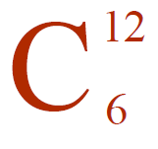
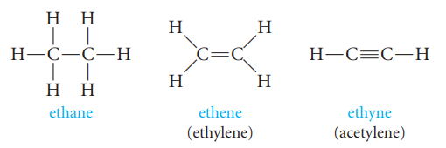
The Uniqueness of Carbon:
It has 6 electrons in its outer shell arranges 1s²2s²sp²
The unique property of carbon atoms that is, the property that makes it possible for millions of organic compounds to exist is their ability to share electrons not only with different elements but also with other carbon atoms.
Carbon atoms can be connected to one another by double bonds or triple bonds, as well as by single bonds. Thus, there are three hydrocarbons (compounds with just carbon and hydrogen atoms) that have two carbon atoms per molecule: ethane, ethene, and ethyne.

Slide 13
Formula and Diagrams
Molecular Formula
The molecular formula of a substance gives the number of different atoms present. For example, C₂H₆O.
Electron-dot Formula (Lewis structure)
Electron valance as electron dots.

Slide 14
structural formula
The structural formula indicates how those atoms are arranged, it can be expressed by several ways.

Slide 15
Atomic Orbitals and their Shapes
The electrons that fill an s orbital confine their movement to a spherical region of space around the nucleus.
The three p orbitals are dumbbell shaped and mutually perpendicular, oriented along the three coordinate axes, x, y, and z.

Slide 16
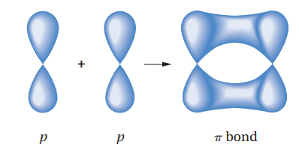
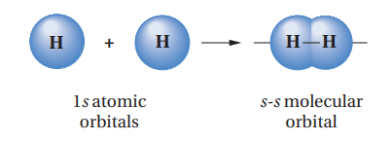
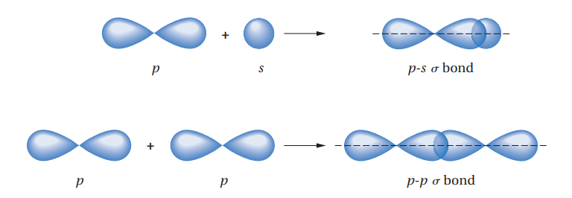
Molecular Orbital
A molecular orbital is formed when two atomic orbitals overlap to generate a bond.
A molecular orbital is the space occupied by electrons in a molecule.

Slide 17
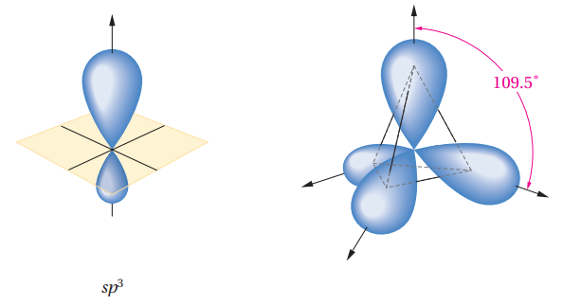
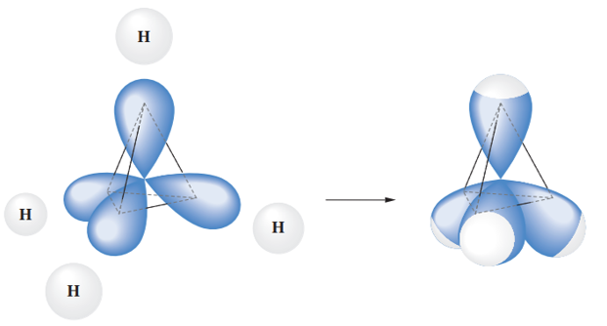
Carbon sp³ Hybrid Orbitals (Alkane )
Carbon with an electron configuration of 1s²2s²ap_{x}¹2p_{y}¹ has only two half-filled orbitals, so how can it have bonds to four hydrogens ?
Methane, CH₄
Tetrahedron

Slide 18
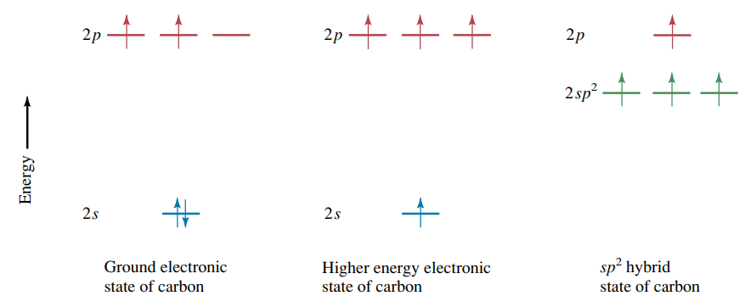
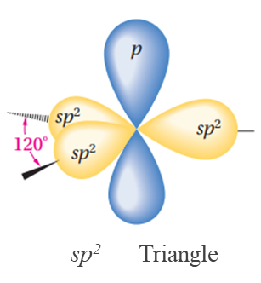
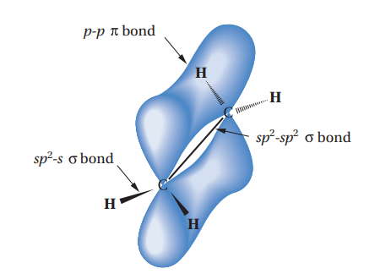
Carbon sp² Hybrid Orbitals (Alkene )
Ethene, CH₂=CH₂

Slide 19
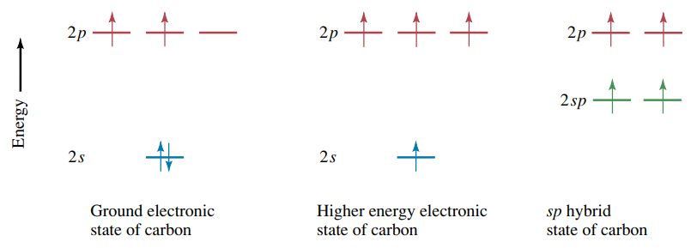
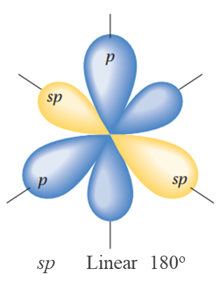
Carbon sp Hybrid Orbitals (Alkyne )

Slide 20
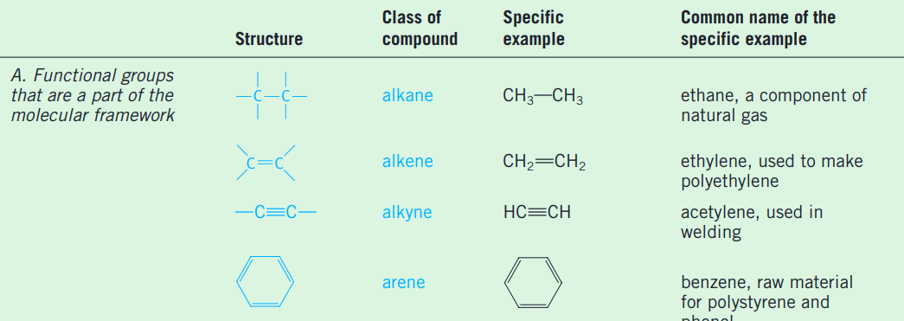
Functional Groups
Functional groups: special groups of reactive atoms that carry out chemical reactions in many organic compounds.

Slide 22
