Slide 1
Chapter 6
Stereochemistry

Slide 2
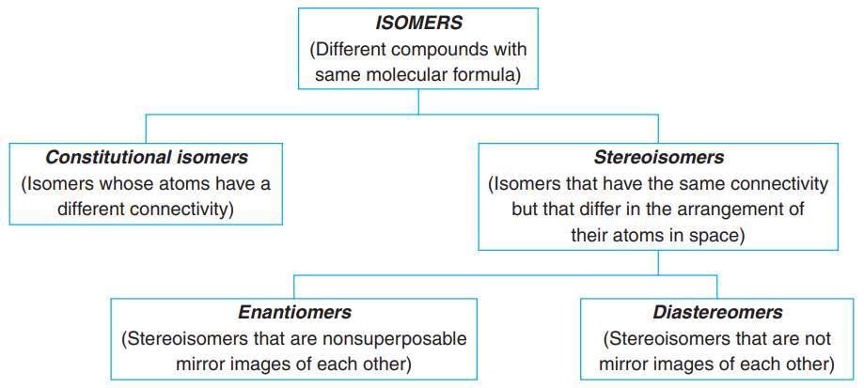
Isomerism: Constitutional Isomers and Stereoisomers
Isomers are different compounds that have the same molecular formula.
Constitutional isomers have the same molecular formula but different connectivity, meaning that their atoms are connected in a different order. Examples of constitutional isomers are the following:

Slide 3
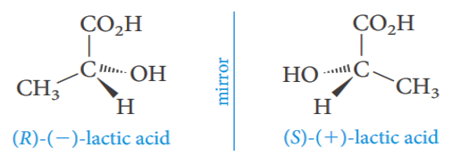
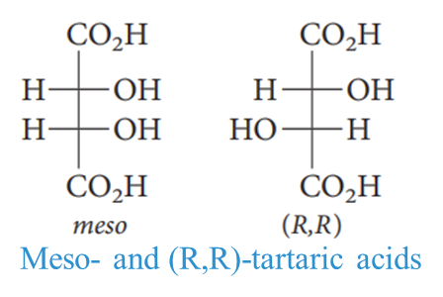
Stereoisomers have their atoms connected in the same sequence (the same constitution), but they differ in the arrangement of their atoms in space.
Stereoisomers can be subdivided into two general categories:
Enantiomers and Diasteromers.
Enantiomers are stereoisomers whose molecules are nonsuperposable mirror images of each other.
Diastereomers are stereoisomers whose molecules are not mirror images of each other.

Slide 4
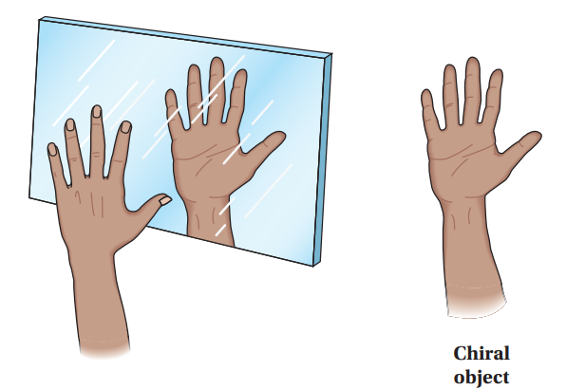
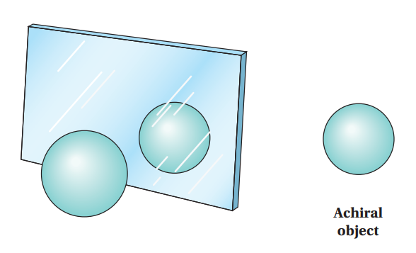
Chirality and Enantiomers
A chiral molecule (or object) is one that exhibits the property of handedness. An
achiral molecule does not have this property.
The mirror image of a chiral molecule cannot be superimposed on the molecule itself. The mirror image of an achiral molecule, however, is identical to or superimposable on the molecule itself.

Slide 5
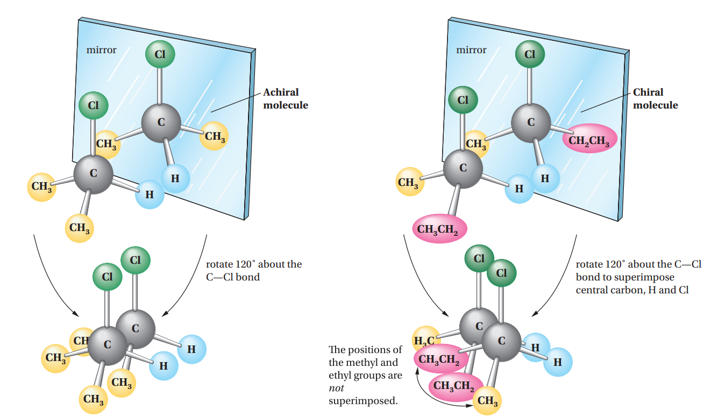
Enantiomers are a pair of molecules related as nonsuperimposable mirror images.

Slide 6
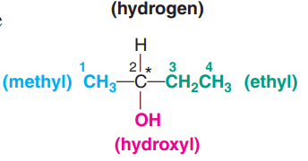
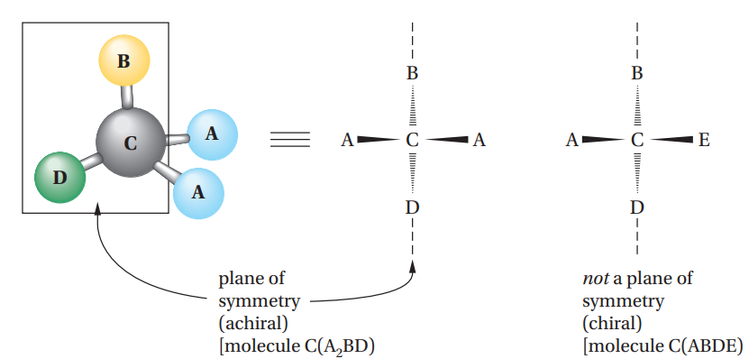
Stereogenic Centers; the Stereogenic Carbon Atom
A carbon atom with four different groups attached to it is called a stereogenic carbon atom. This type of carbon is also called a stereogenic center because it gives rise to stereoisomers.
Stereogenic centers are often designated with an asterisk (*).
A plane of symmetry (sometimes called a mirror plane)is a plane that passes through a molecule (or object) in such a way that what is on one side of the plane is the exact reflection of what is on the other side. Any molecule with a plane of symmetry is achiral. Chiral molecules do not have a plane of symmetry.

Slide 7
Configuration and The R-S Convention
Enantiomers differ in the arrangement of the groups attached to the stereogenic center. This arrangement of groups is called the configuration of the stereogenic center.
Enantiomers are another type of configurational isomer.
A convention for doing this is known as the R-S system or Cahn–Ingold–Prelog system.
The four groups attached to the stereogenic center are placed in a priority order ( a b c d ). The stereogenic center is then observed from the side opposite the lowest priority group, d. If the remaining three groups (a b c) form a clockwise array, the configuration is designated R (from the Latin rectus, right). If they form a counterclockwise array, the configuration is designated as S (from the Latin sinister, left).

Slide 8
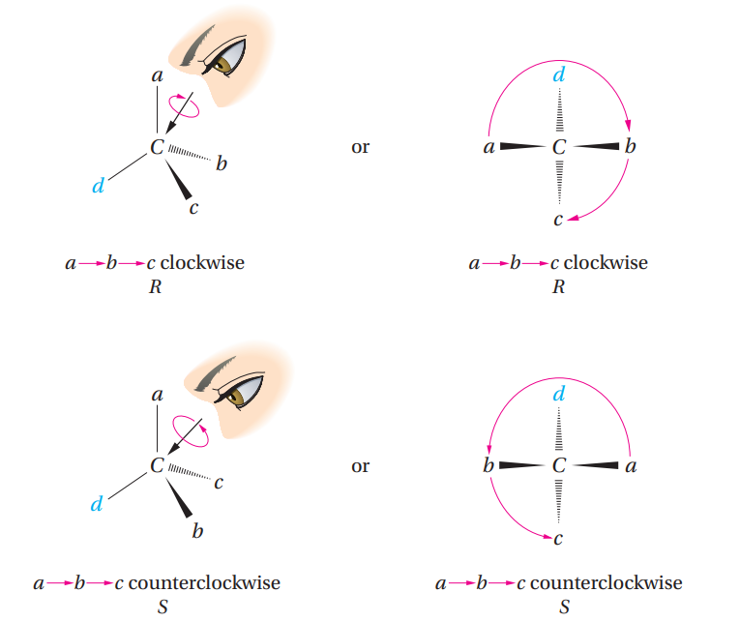
R-S system

Slide 9
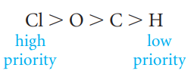
The priority order of the four groups is set in the following way:
Rule 1: The atoms directly attached to the stereogenic center are ranked according to atomic number.
Rule 2: If two or more of the directly attached atoms are the same, work outward from the stereogenic center until a decision is reached. For example, the ethyl group has a higher priority than the methyl group, because at the first point of difference, working outward from the stereogenic center, we come to a carbon (higher priority) in the ethyl group and a hydrogen (lower priority) in the methyl.

Slide 10
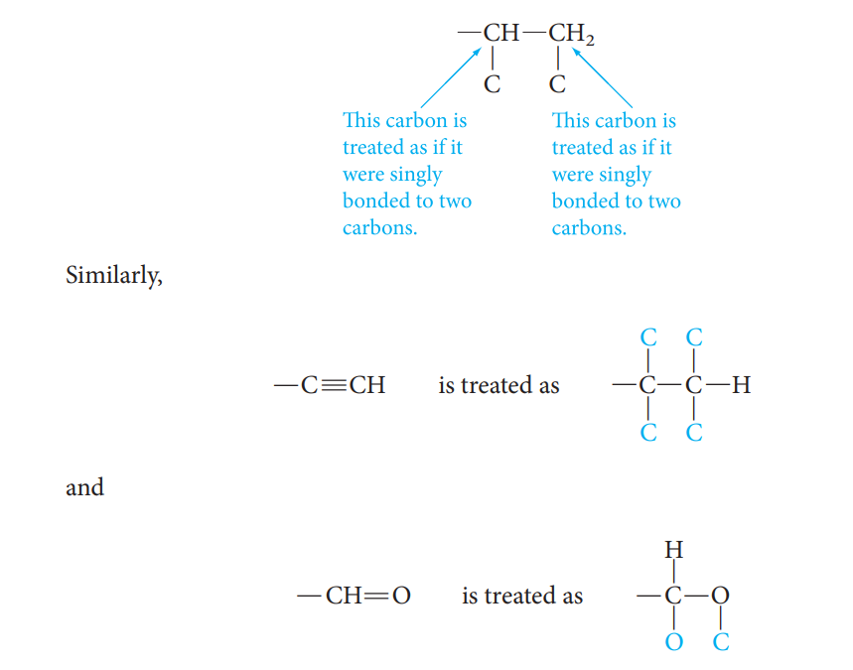
Rule 3: Multiple bonds are treated as if they were an equal number of single bonds. For example, the vinyl group -CH=CH₂ is counted as:

Slide 11
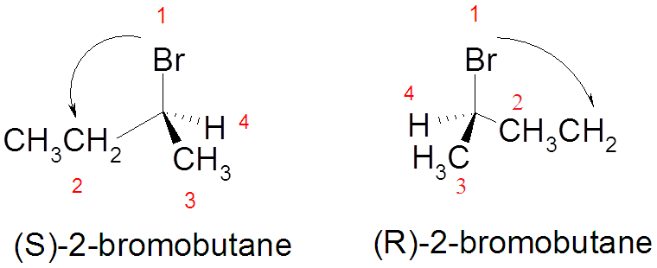
Examples:
In drawing the arrow from group (1) to group (2), you can draw past the group with the lowest priority (4) but never draw past the group with the next lower priority (3)

Slide 12
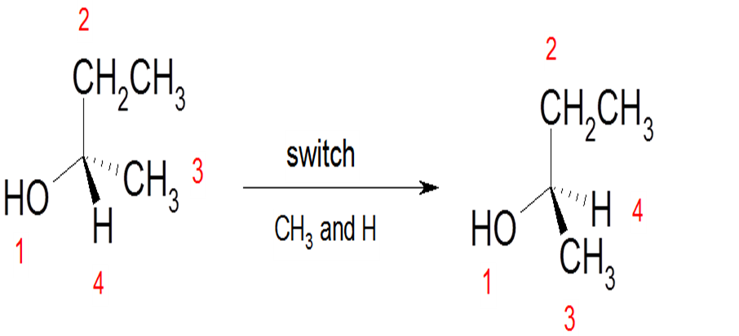
If the group with the lowest priority (4) is not bonded with a dashed wedge, switch two groups to make it bonded with a dashed wedge and switch again for any two groups without switching the lowest priority (4). As you switched the groups, also switch the configurations, i.e. if the molecule appears to be S then it is originally R , and if it appears to be R then it was originally S.

Slide 13
Properties of Enantiomers: Optical Activity
Enantiomers have identical physical properties such as boiling points, melting points, refractive indices, and solubilities in common solvents except optical rotations.
Enantiomers rotate the plane of plane-polarized light in equal amounts but in opposite directions.
Plane-Polarized Light: The light used to measure optical activity has two properties: consists of a single wavelength And it is plane-polarized.
Optical activity is the ability of a chiral substance to rotate the plane of plane-polarized light and is measured using an instrument called Polarimeter.

Slide 14
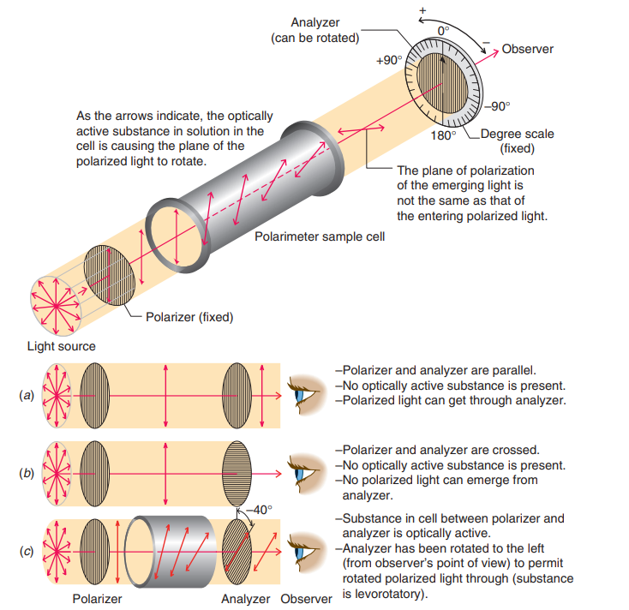
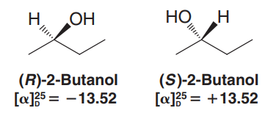
Polarimeter
A polarimeter measures the rotation of plane-polarized that has passed through a solution.
The angle between the entrance and exit planes is the optical rotation.
Rotation, in degrees, is [α].
Clockwise rotation is called dextrorotatory ( + ).
Anti-clockwise is levorotatory ( - ).
Examples:

Slide 15
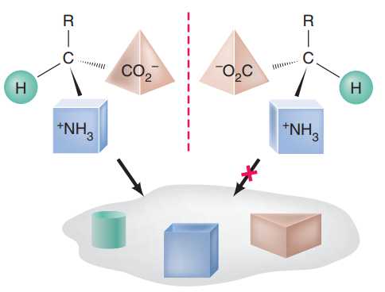
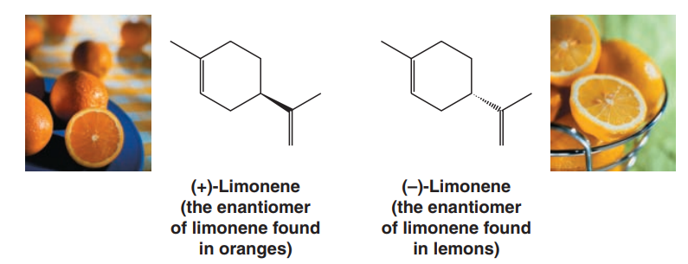
The Biological Importance of Chirality
Only one of the two amino acid enantiomers shown ( the right-hand one) can achieve three-point binding with hypothetical binding site ( e.g., in an enzyme ).
Chiral molecules can show their handedness in many ways, including the way they affect human beings.

Slide 16
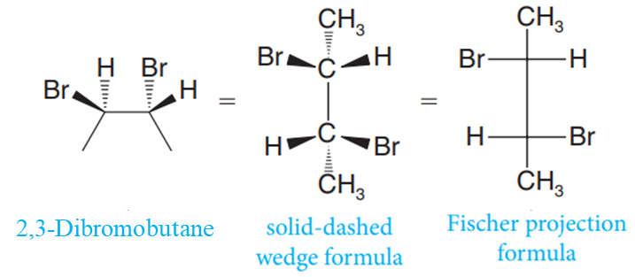
Fischer Projection Formulas
A Fischer projection is a type of two-dimensional formula of a molecule used to represent the three-dimensional configurations (dashed and solid wedges ) of stereogenic centers.

Slide 17
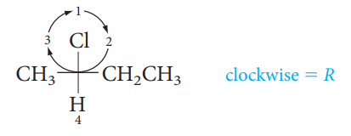
Assigning R,S Configuration to Fischer Projections
Assign priorities to the four substituents.
The group of the lowest priority has to be at the horizontal arm.
Determine the direction of rotation in going from priority 1 to 2 to 3, and assign R or S configuration.
If the group with the lowest priority (4) is not at the a horizontal arm, switch two groups to make it on the top and switch again for any two groups without switching the lowest priority (4).

Slide 18
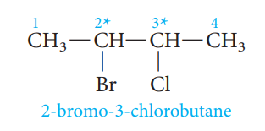
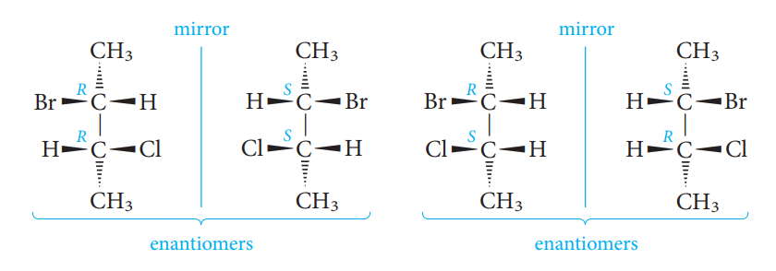
Compounds with More Than One Stereogenic Center
Compounds may have more than one stereogenic center, so it is important to be able to determine how many isomers exist in such cases and how they are related to one another.
2^{n} possible stereoisomers, (n is the numbers of stereogenic center in the compound).
The molecule has two stereogenic centers. Each of these could have the configuration R or S. Thus, four isomers in all are possible: (2R,3R), (2S,3S), (2R,3S), and (2S,3R). There are two pairs of enantiomers. The (2R,3R) and (2S,3S) forms are nonsuperimposable mirror images, and the (2R,3S) and (2S,3R) forms are another such pair.
Diastereomers are stereoisomers that are not mirror images of one another.

Slide 19
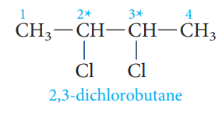
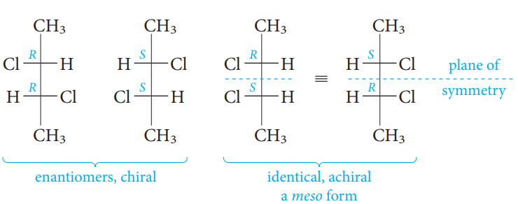
Meso Compounds
The (R,R) and (S,S) isomers constitute a pair of nonsuperimposable mirror images, or enantiomers. However, the other “two” structures, (R,S) and (S,R) have a plane of symmetry that is perpendicular to the plane of the paper and bisects the central C-C bond. The reason is that each stereogenic center has the same four groups attached. The structures are identical, superimposable mirror images and therefore achiral. We call such a structure a meso compound. Being achiral, meso compounds are optically inactive.

Slide 20
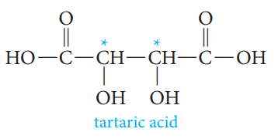
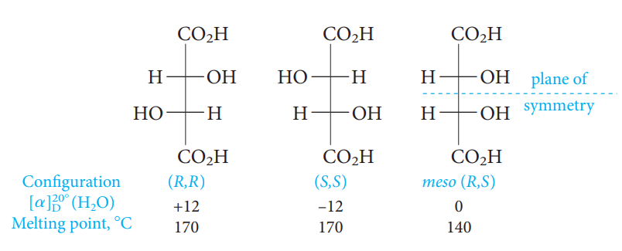
Racemic mixture was a 50:50 mixture of the (R,R) and (S,S) isomers.
A racemic mixture causes no net rotation of plane-polarized light.

Slide 21
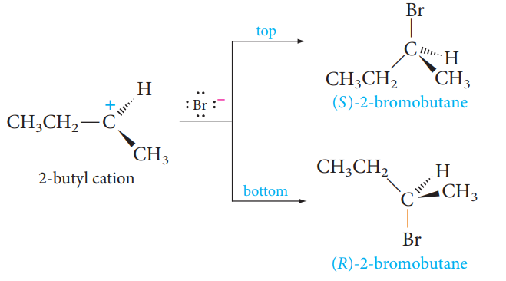
Stereochemistry and Chemical Reactions
The product has one stereogenic center, marked with an asterisk (*) , but both enantiomers are formed in exactly equal amounts. The product is a racemic mixture.
The intermediate 2-butyl cation obtained by adding a proton to the end carbon is planar, and bromide ion can combine with it from the “top” or “bottom” side with exactly equal probability.
Therefore, the product is a racemic mixture, an optically inactive 50:50 mixture of the two enantiomers.

Slide 22
The reaction of a chiral molecule with an achiral reagent to create a second stereogenic center.
If a reaction takes place in a way so that no bonds to the chirality center are broken, the reaction must take place with retention of configuration, and the product of the reaction must have the same configuration of groups around the chirality center.

