Slide 1
108 Chem
Chapter 7
Carboxylic Acids and their derivatives

Slide 2
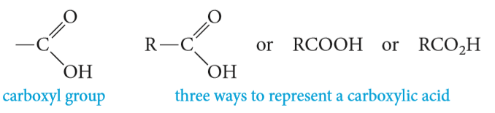
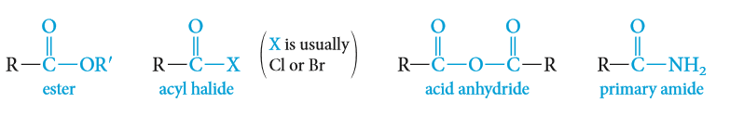
Structure of carboxylic Acids and their derivatives
The combination of a carbonyl group and a hydroxyl on the same carbon atom is called a carboxyl group
Carboxylic acids are strong organic acids which contain the carboxyl group.
Carboxylic acid derivatives, in which the hydroxyl group of an acid is replaced by other functional groups.
Carboxylic acids are classified as aliphatic or aromatic depending on whether R or an Ar is attached to the carboxylic group R-COOH or Ar-COOH

Slide 3
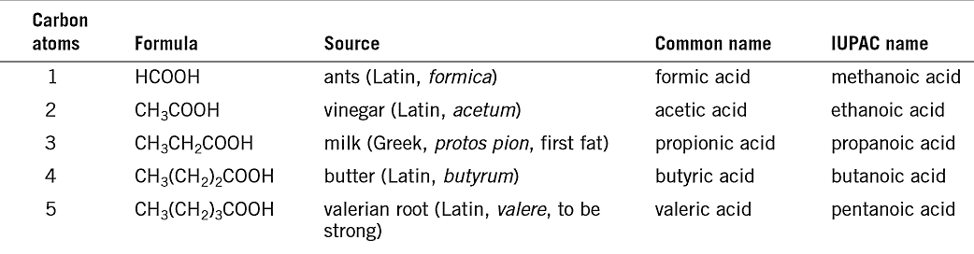
Nomenclature of carboxylic Acids
The IUPAC name:
The root name is based on the longest continuous chain of carbon atoms bearing the carboxyl group.
The -e is replaced by -oic acid.
The chain is numbered starting with the carboxyl carbon atom.
Cycloalkanes with carboxyl substituents are named as cycloalkanecarboxylic acids.
The Common name:
In common names, the positions of substituents are named using Greek letters ($α$, β, ɣ , δ…..) beginning with carbon next the carboxyl group.
Dicarboxylic Acids:
Dicarboxylic acids are named as alkanedioic acids in the IUPAC system.

Slide 4
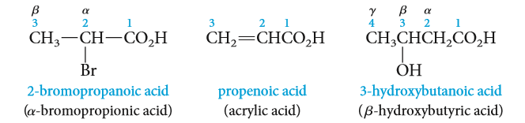
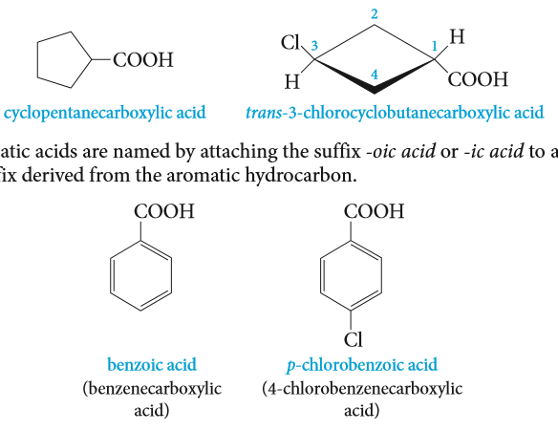
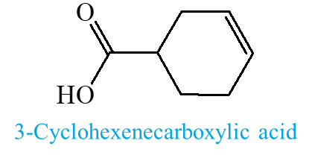
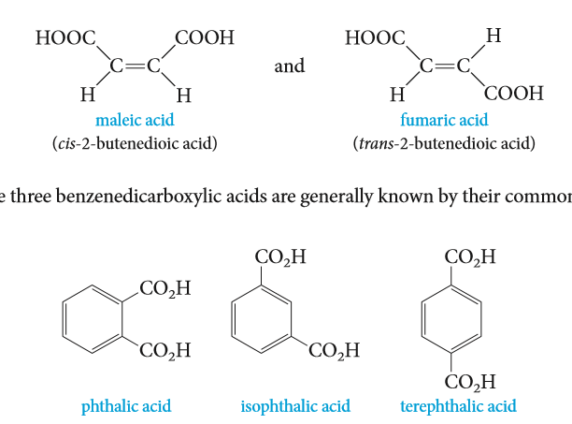

IUPAC name:
Common name:
4-Hydroxycyclohexanecarboxylic acid
4-chlorobenzoic acid
Benzenecarboxylic acid
2-Hydroxy-benzoic acid
Salicylic acid
1,2-Benzenedicarboxylic acid
phthalic acid
1,3-Benzenedicarboxylic acid
isophthalic acid
2-Aminobenzoic acid
Butanedioic acid
1,4-Benzenedicarboxylic acid
terephthalic acid

Slide 5
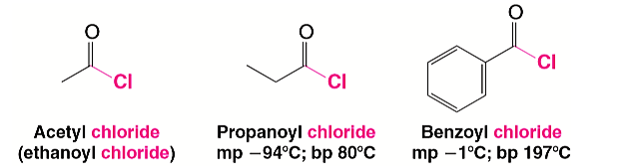
Nomenclature of Acyl Chlorides
Nomenclature of carboxylic Acid derivatives
Acyl chlorides are also called acid chlorides.
They are named by dropping -ic acid from the name of the acid and then adding -yl chloride.
Ethanoyl chloride
Acetyl chloride
Propanoyl chloride
Benzoyl chloride

Slide 6
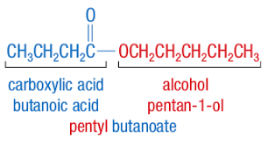
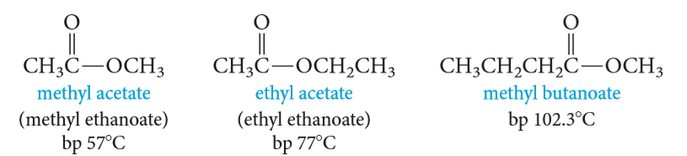
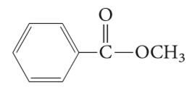
Nomenclature of carboxylic Acid derivatives
Nomenclature of Esters
The names of esters are derived from the names of the alcohol (with the ending -yl) and the acid (with replacing of the ending –ic acid by –ate).
Methyl ethanoate
Methyl acetate
Ethyl ethanoate
Ethyl acetate
Methyl butanoate
Methyl benzoate

Slide 7
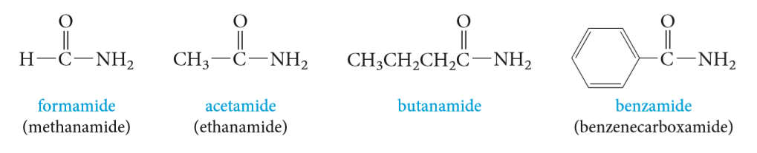
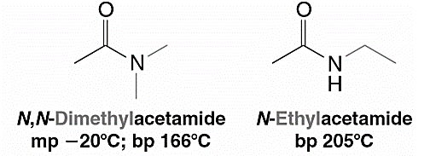
Nomenclature of carboxylic Acid derivatives
Nomenclature of Amides
Amides are named by replacing the -oic acid ending of the acid name, either the common or the IUPAC name, with the -amide ending.
Alkyl groups on the nitrogen atom of amides are named as substituents, and the named substituent is prefaced by N- or N,N-
Methanamide
formamide
Ethanamide
actamide
N,N-Dimethylethanamide
N-Ethylethanamide
N-Ethyl-N-methylbenzamide

Slide 8
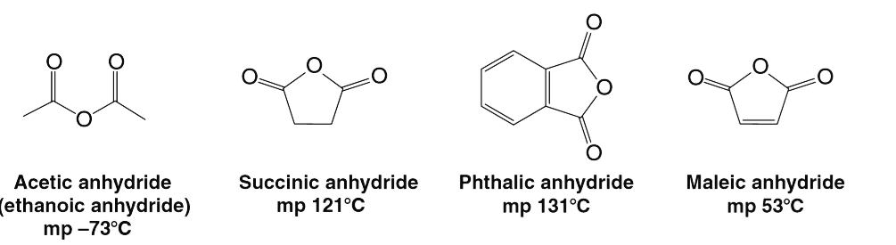
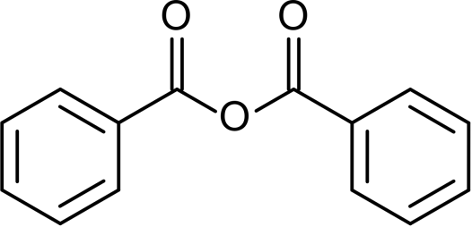
Nomenclature of carboxylic Acid derivatives
Nomenclature of Acid Anhydrides
Most anhydrides are named by dropping the word acid from the name of the carboxylic acid and then adding the word anhydride
Ethanoic anhydride
acetic anhydride
Butandioic anhydride
succinic anhydride
Benzoic anhydride
Phthalic anhydride
Cyclohexanecarboxylic anhydride
Benzoic ethanoic anhydride

Slide 9
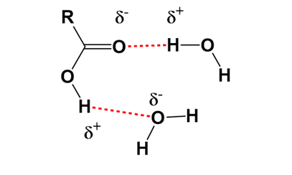
Physical Properties of Carboxylic acids
Solubility
Carboxylic acids interact with water molecules by hydrogen bonding through both the carbonyl and hydroxyl groups. Because of greater hydrogen bonding interactions, aliphatic carboxylic acids are more soluble in water than are alcohols, ethers, aldehydes, and ketones of comparable molecular weight.
Aromatic acids are insoluble in water.

Slide 10
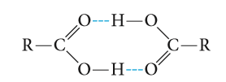
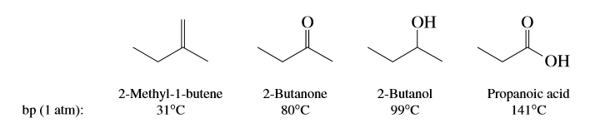
Physical Properties of Carboxylic acids
Boiling Point
Carboxylic acids have significantly higher boiling points than other types of organic compounds of comparable molecular weight, such as alcohols, aldehydes, and ketones. This is due to carboxylic acids usually exist as dimers by forming two intramolecular hydrogen bonds in nonpolar media.

Slide 11
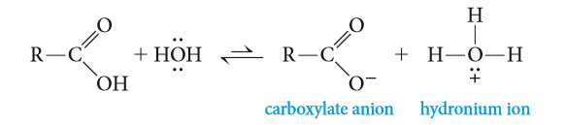
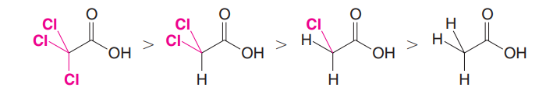
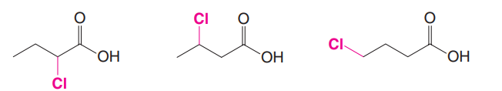

Acidity
Carboxylic acids are the most acidic class of compounds, they are much stronger acids than water and alcohols.
Dissociation of either an acid or an alcohol involves breaking an O-H bond, but dissociation of a carboxylic acid gives a carboxylate ion with the negative charge spread out equally over two oxygen atoms, compared with just one oxygen in an alkoxide ion .This charge delocalization makes the carboxylate ion more stable than the alkoxide ion.
Effect of Structure on Acidity; the Inductive Effect Revisited
This effect relays charge through bonds, by displacing bonding electrons toward electronegative atoms, or away from electropositive atoms. Recall that electron-withdrawing groups enhance acidity, and electron-donating groups reduce acidity.

Slide 12
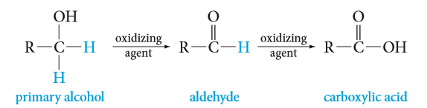
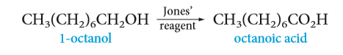
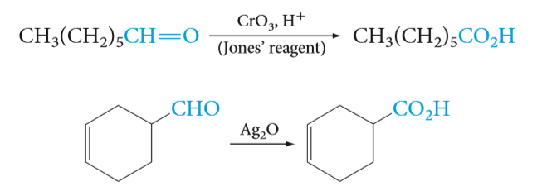
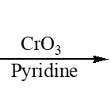
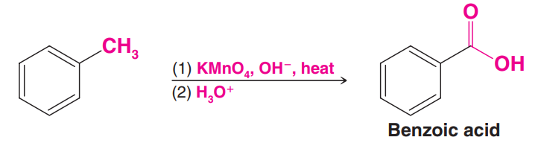
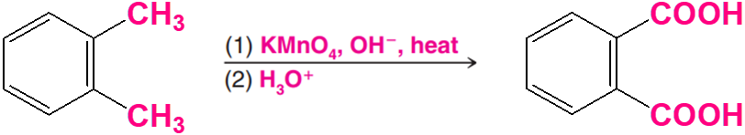
Preparation of Carboxylic Acids
1- Oxidation of aldehydes and primary alcohols:
Strong oxidizing agent
Weak oxidizing agent
Potassium permanganate KMnO₄ ,OH⁻/ H₃O⁺
Chromic oxide CrO₃ / H₂SO₄ (H₂CrO₄ Jones’ reagent )
Chromic oxide CrO₃ / pyridine
2- Oxidation of Aromatic Side Chains:

Slide 13
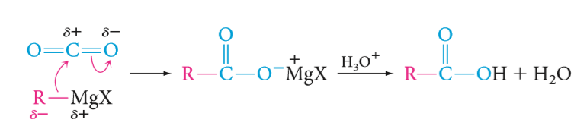
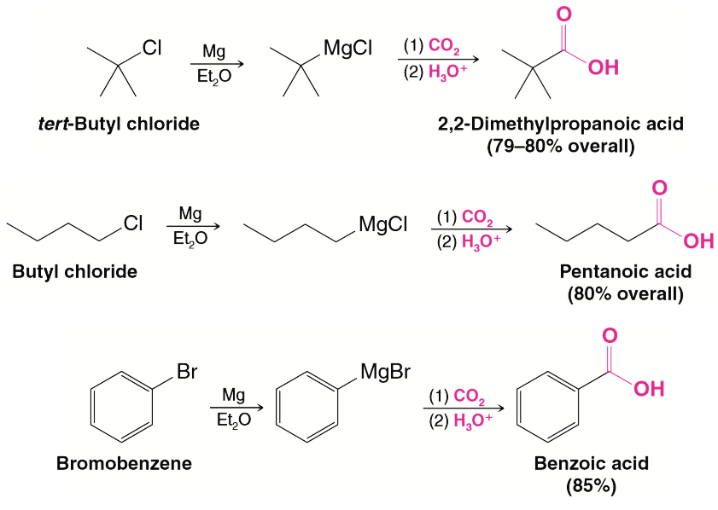
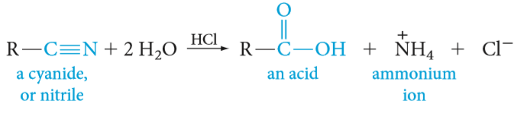
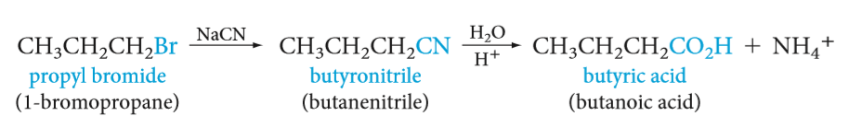
4- Hydrolysis of cyanohydrins and other nitriles:
Preparation of Carboxylic Acids
3- Reaction of Grignard Reagents with Carbon Dioxide:

Slide 14
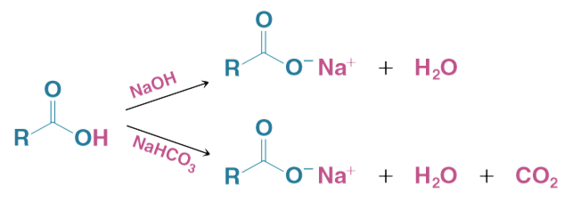
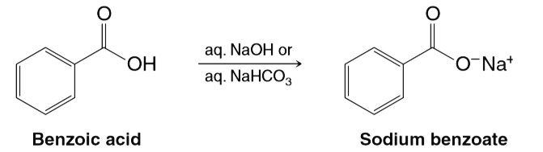
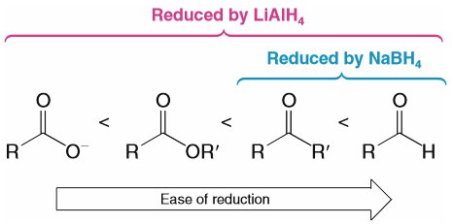
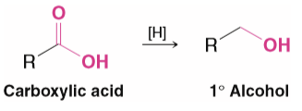
Reaction of Carboxylic Acids
1- Reaction with Strong Bases: NaOH , NaHCO₃ or NH₃
2- Reduction of carbonyl group: Addition of metal hydrides (formation of alcohol)

Slide 15
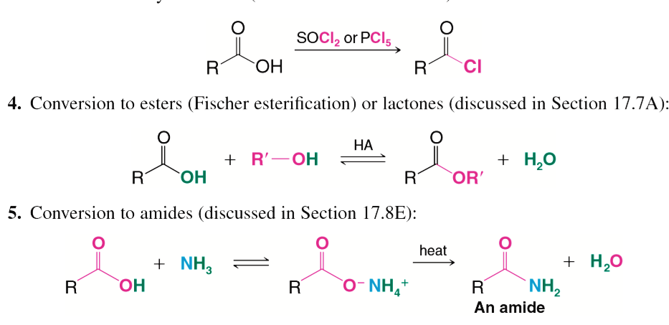
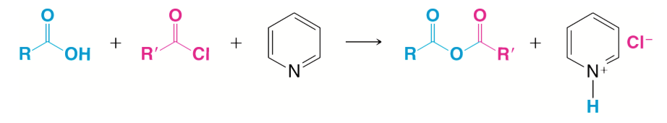
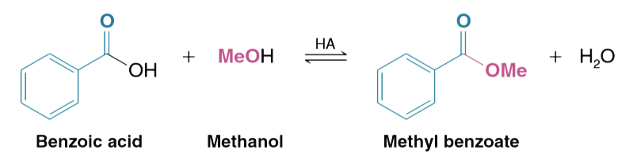
Reaction of Carboxylic Acids
3- Nucleophilic Substitution of Hydroxyl Group
a) Conversion to acyl chlorides:
c) Conversion to acid anhydrides:
Pyridine
d) Conversion to amides:
b) Conversion to esters:

Slide 16
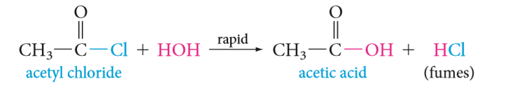
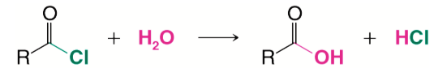
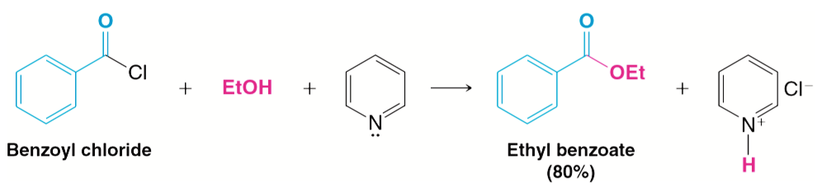
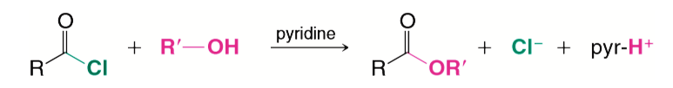
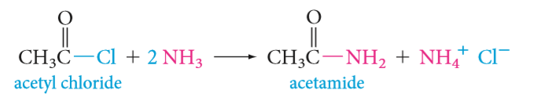
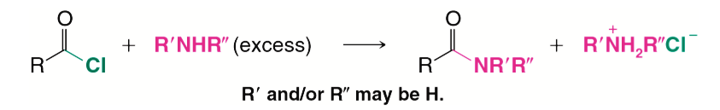
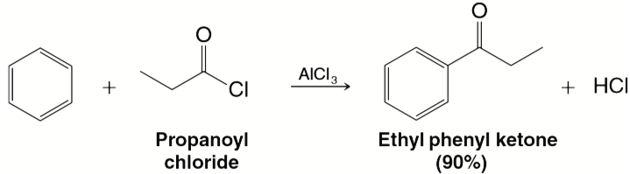
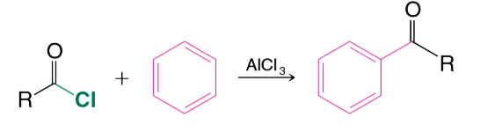
Reaction of Acyl Chlorides
1- Conversion to Acids (hydrolysis):
2- Conversion to Esters:
3- Conversion to Amides:
4- Conversion to Ketones (Friedel–Crafts acylation):

Slide 17
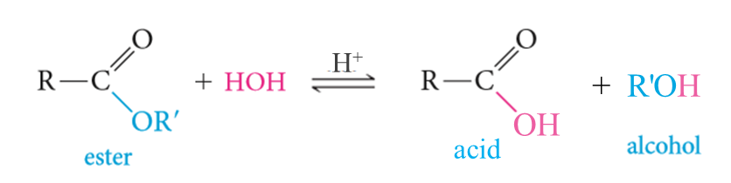
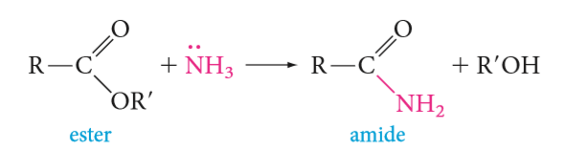
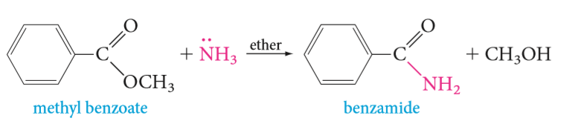
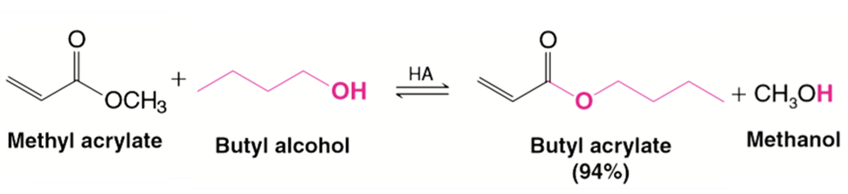

Reaction of Esters
1- Hydrolysis of Esters:
2- Ammonolysis of Esters:
3- Transesterification:

Slide 18




Reaction of Esters
4- Reduction of Esters:
5- Reaction of Esters with Grignard Reagents:

Slide 19







Reaction of Amides
1- Conversion to acids (hydrolysis):
Acidic Hydrolysis:
Basic Hydrolysis:
2- Nitriles from the Dehydration of Amides:
Benzonitrile
3- Reduction of Amides:
Benzylamine
4- Hofmann degradation:
Aniline

Slide 20






Reaction of Acid Anhydride
1- Conversion to Acids (hydrolysis):
2- Conversion to Esters:
3- Conversion to Amides:
4- Conversion to Aryl ketones (Friedel–Crafts acylation):

