Slide 1
CSC 111 Lab 10 Part3

Slide 4
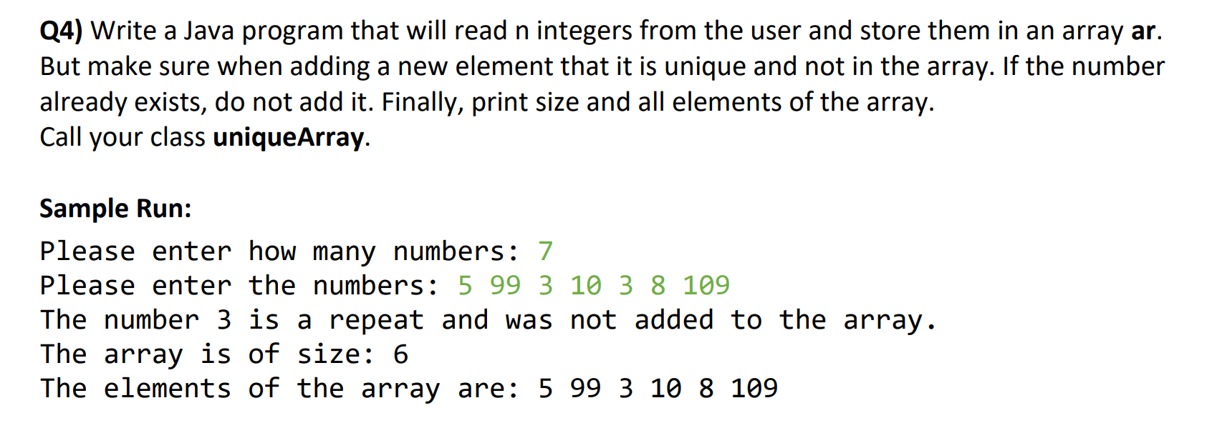

Slide 5
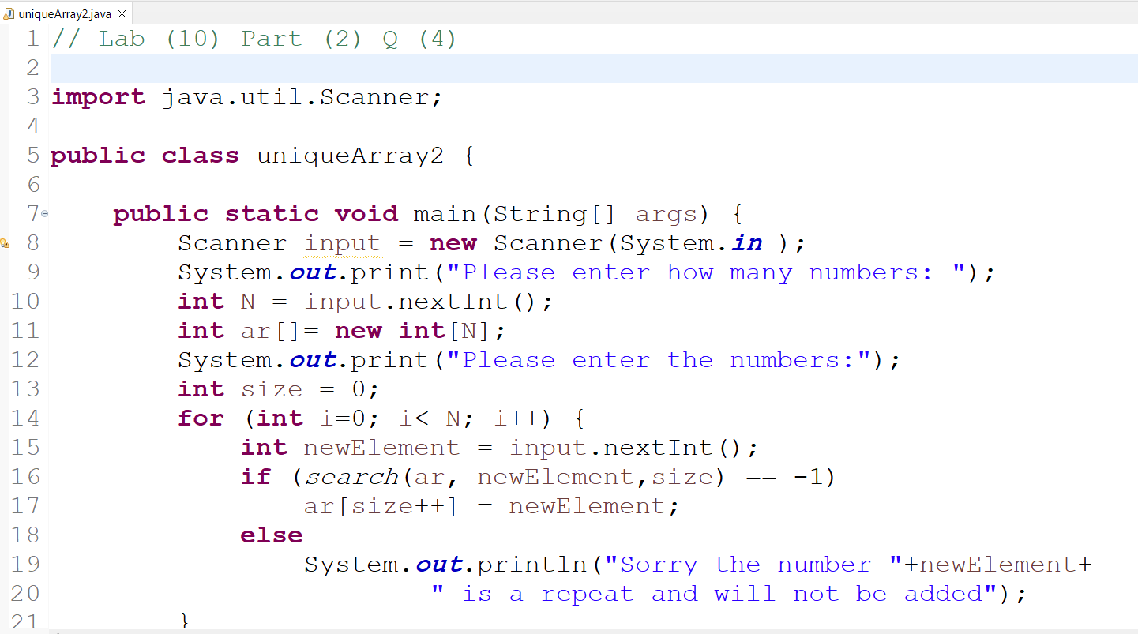

Slide 6
