Slide 1
CSC 111 Lab 2

Slide 3
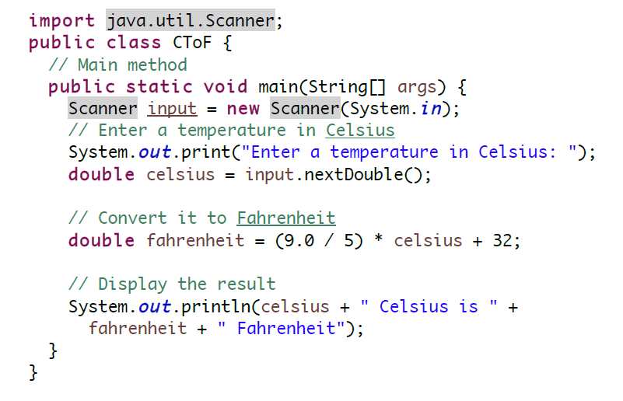

Slide 4
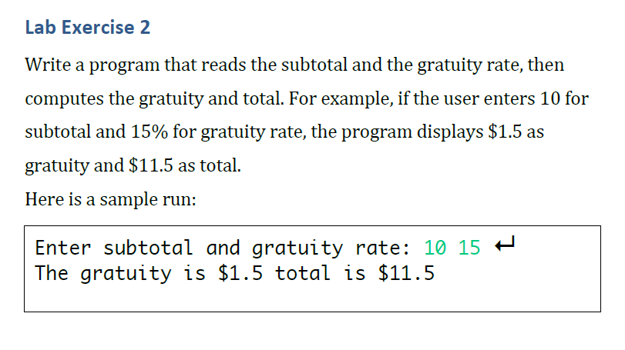

Slide 5
