Slide 1
CSC 111 Lab 3

Slide 3
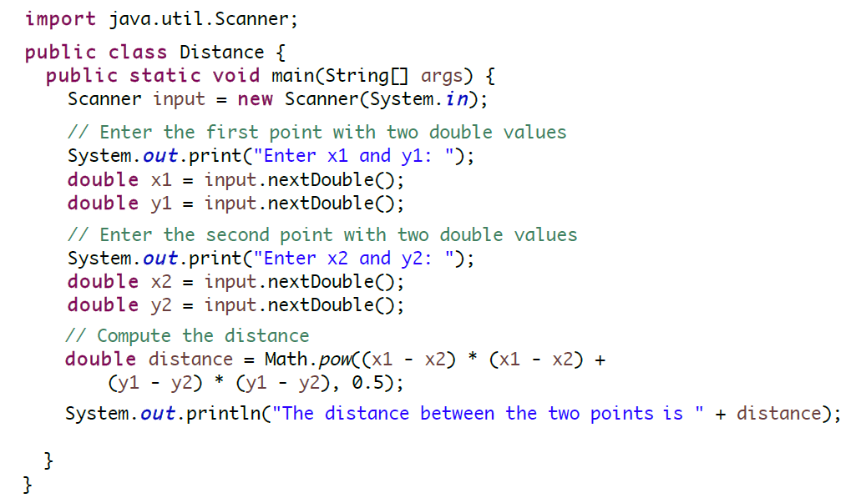

Slide 5
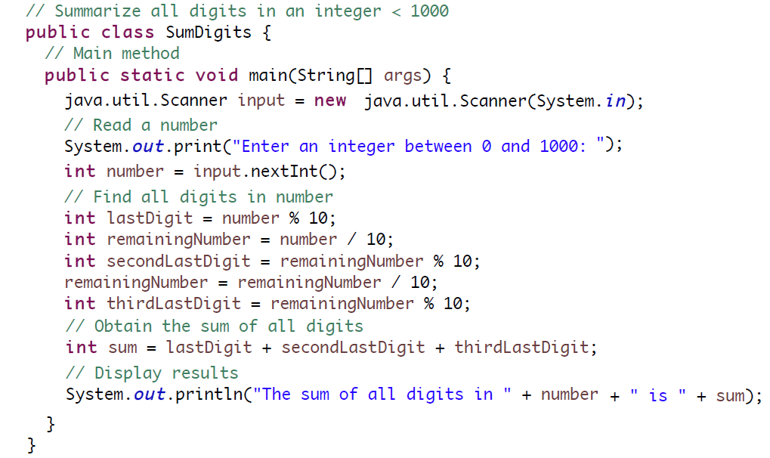

Slide 6
