Slide 1
CSC 113 Exceptions 1

Slide 5
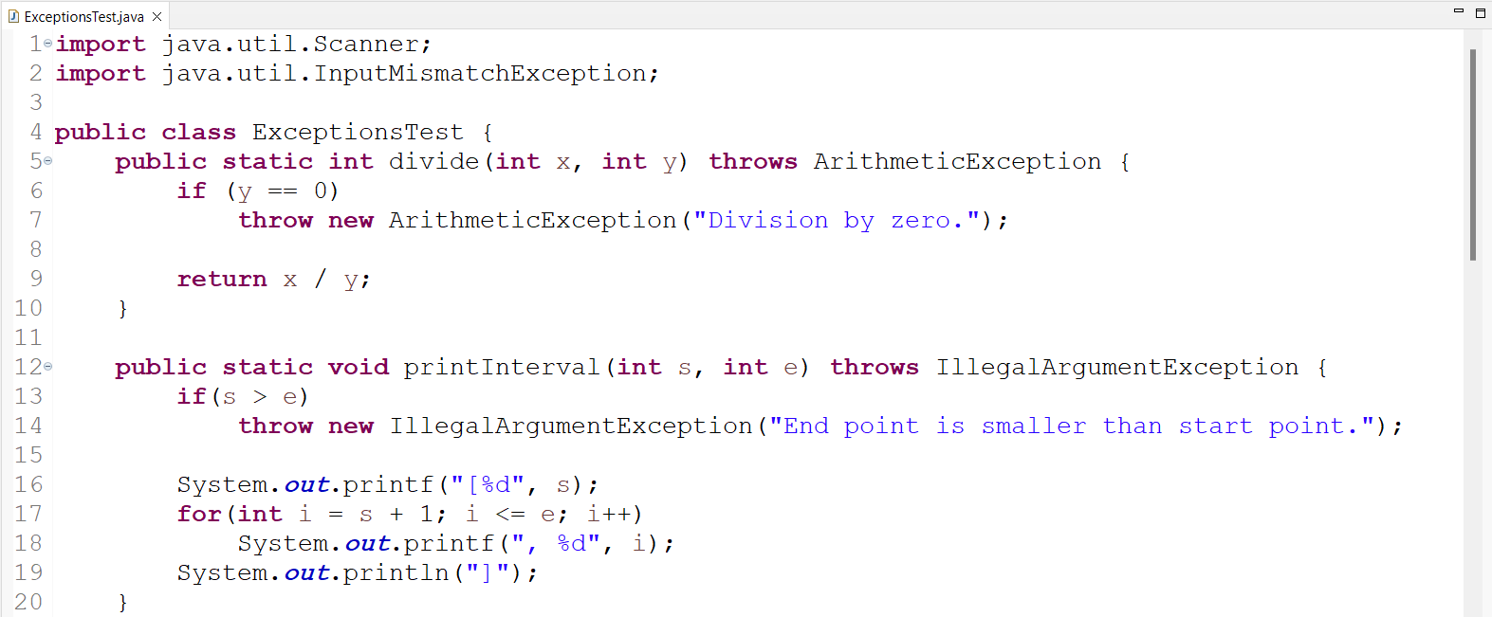

Slide 6
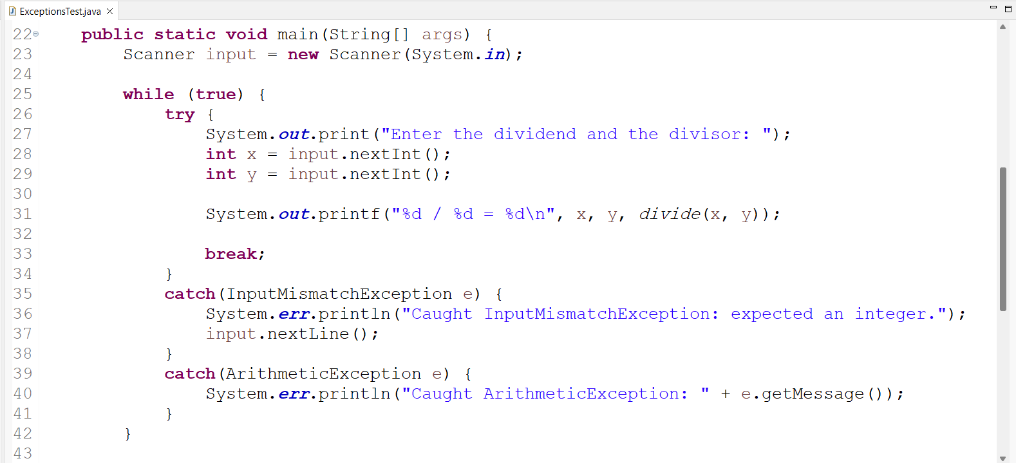

Slide 7
