Slide 1
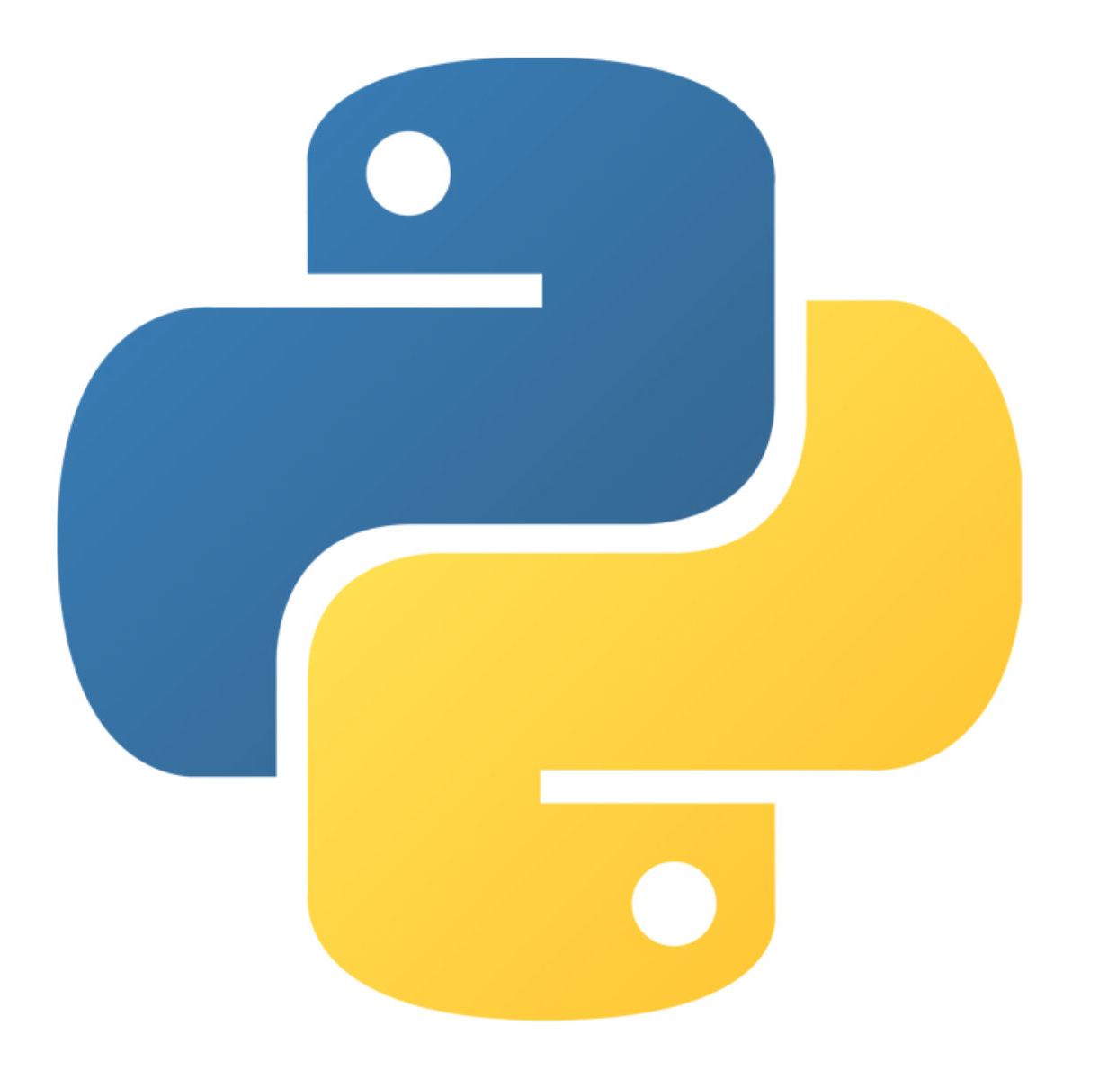
Python sequences
lists and Dictionary

Slide 2
Sequences
Sequence: an object that contains multiple items of data
The items are stored in sequence one after another
Python provides 4 built-in different types of sequences, including lists and tuples , Set and Dictionary
List: items are ordered(indexed), changeable, and allow duplicate values.
Tuple: items are ordered(indexed), unchangeable, and allow duplicate values.
Set items are unordered, unchangeable, and do not allow duplicate values.
Dictionary items are ordered, changeable, and does not allow duplicates.

Slide 3
Python Dictionaries

Slide 4
Dictionary
Dictionaries are used to store data values in
key : value pairs.
A dictionary is a collection which is ordered, changeable and does not allow duplicates.
Creating a dictionary is as simple as placing items inside curly braces {} separated by commas.
An item has a key and a corresponding value that is expressed as a pair (key: value).

Slide 5
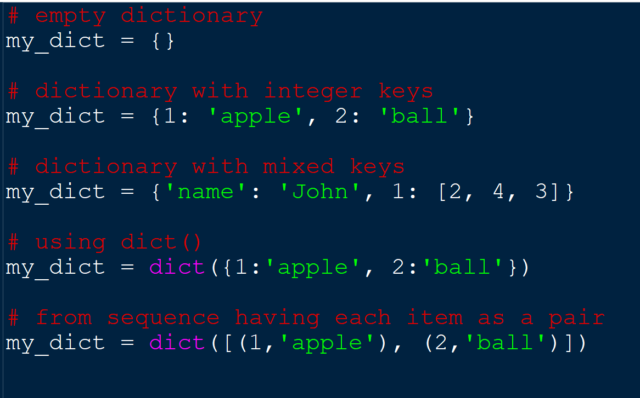
Dictionary

Slide 6
Accessing Elements from Dictionary
You can access the items of a dictionary by referring to its key name, inside square brackets:
Keys can be used with the get() method.
Trying to access keys which doesn't exist throws error

Slide 7
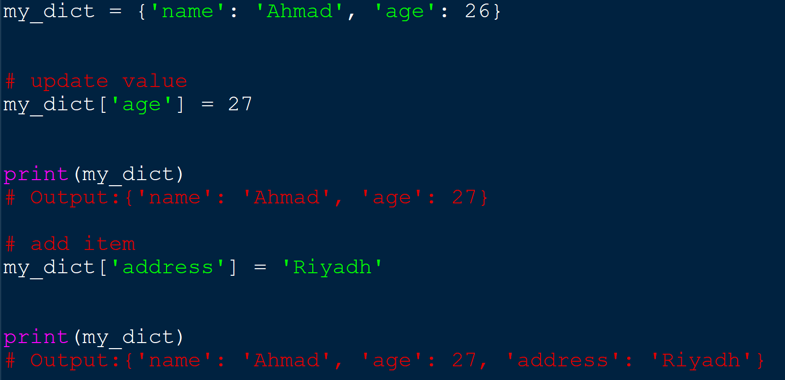
Changing and Adding Dictionary elements

Slide 8
Dictionary functions
To determine how many items a dictionary has, use the len() function
The keys() method will return a list of all the keys in the dictionary.
The values() method will return a list of all the values in the dictionary.
To determine if a specified key is present in a dictionary use the in keyword

Slide 9
Dictionary functions
The update() method will update the dictionary with the items from the given argument.
The pop() method removes the item with the specified key name:

Slide 10
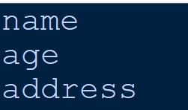
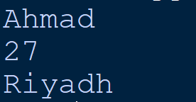
Loop Through a Dictionary
When looping through a dictionary, the return value are the keys
Print all values in the dictionary

Slide 11
References:
https://www.programiz.com/python-programming/dictionary
https://www.w3schools.com/python/python_dictionaries.asp

