Slide 1
Python Classes 1

Slide 2
Introduction to Classes and Object-Oriented programming

Slide 3
Two methods of programming:
Procedural
Object-oriented

Slide 4
Procedural Programming
Procedural programming: writing programs made of functions that perform specific tasks
Procedures typically operate on data items that are separate from the procedures
Data items commonly passed from one procedure to another
Focus: to create procedures that operate on the program’s data

Slide 5
Object-Oriented Programming
An object represents an entity in the real world that can be distinctly identified.
You can look around you now and see many examples of real-world objects: your cat, your television set, your bicycle, a student, a desk, a circle, a button and point
These real-world objects share two characteristics: they all have state, and they all have behavior
For example, dogs have state (name, color, breed, hungry) and dogs have behavior (barking, fetching).

Slide 6
Object-Oriented Programming
Object-oriented programming: focused on creating objects
Object: Software objects are modeled after real-world objects in that they, too, have state and behavior.
A software object maintains its state in variables and implements its behavior with methods.
WHY USE OOP AND CLASSES OF OBJECTS ?
mimic real life
group different objects part of the same type

Slide 7
Encapsulation in Python
Encapsulation is one of the fundamental concepts in object-oriented programming (OOP).
It describes the idea of wrapping data and the methods that work on data within one unit. This puts restrictions on accessing variables and methods directly and can prevent the accidental modification of data.
To prevent accidental change, an object’s variable can only be changed by an object’s method. Those types of variables are known as private variable.
A class is an example of encapsulation as it encapsulates all the data that is member functions, variables, etc.

Slide 8
Object-Oriented Programming (cont’d.)

Slide 9
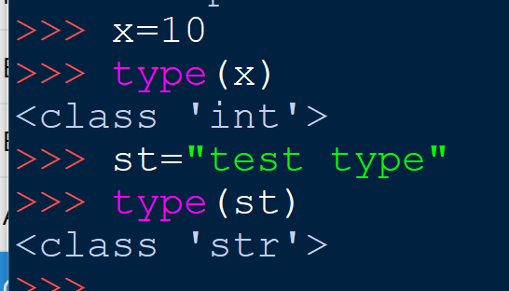
Python is a completely object-oriented language. You have been working with classes and objects right from the beginning of these course .
Every element in a Python program is an object of a class.
A number, string, list, etc., used in a program is an object of a corresponding built-in class. You can retrieve the class name of variables or objects using the type() method

Slide 10
Classes

Slide 11
Classes
Class: code that specifies the data attributes and methods of a particular type of object
Similar to a blueprint of a house or a cookie cutter
Instance: an object created from a class
Similar to a specific house built according to the blueprint or a specific cookie
There can be many instances of one class

Slide 12
Classes (cont’d.)

Slide 13
Classes (cont’d.)

Slide 14
Implementing the Class Vs Using the Class

Slide 15
Class Definitions
Class definition: set of statements that define a class’s methods and data attributes
Format: begin with class Class_name:
Class names often start with uppercase letter

Slide 16
Class Definitions
A Python class uses variables to store data fields and defines methods to perform actions.
Additionally, a class provides a special type method, known as initializer, which is invoked to create a new object. An initializer can perform any action, but initializer is designed to perform initializing actions, such as creating the data fields of objects.
Format: def __init__ (self):
Usually the first method in a class definition
Method definition like any other python function definition
self parameter: required in every method in the class – references the specific object that the method is working on
It does not have to be named self , you can call it whatever you like, but it has to be the first parameter of any function in the class:

Slide 17
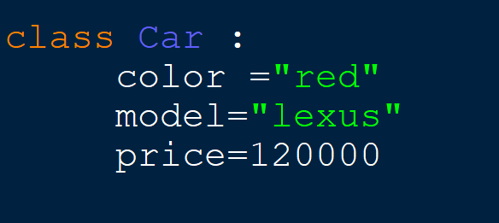
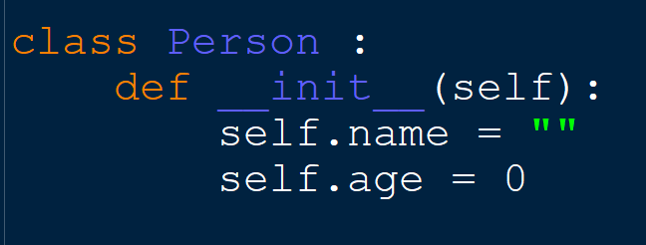
Examples
a class attribute defined inside a class. Its value will remain the same for all the objects unless modified explicitly

Slide 18
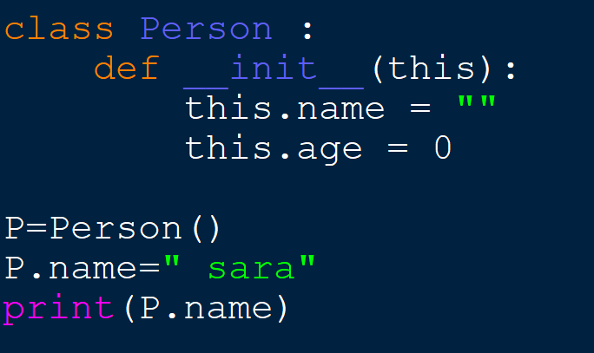
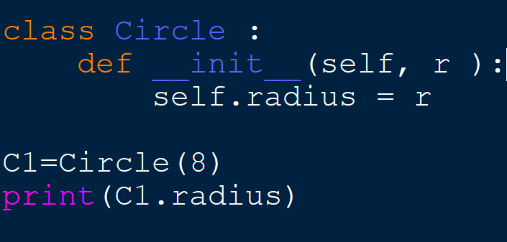
To create a new instance of a class call the initializer method Format: My_instance = Class_Name()

Slide 19
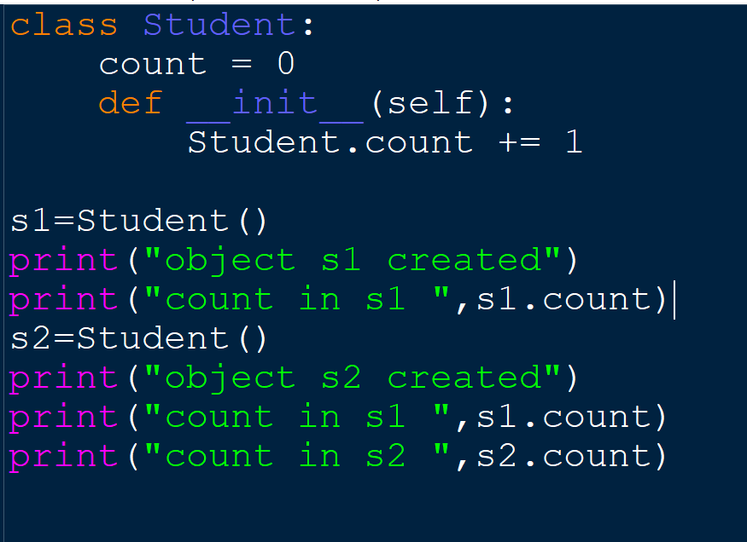
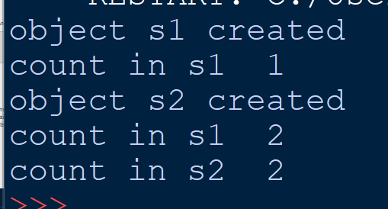
class attribute
The following example demonstrates the use of class attribute

Slide 20
Instances

Slide 21
Working With Instances
Instance attribute: belongs to a specific instance of a class
Created when a method uses the self parameter to create an attribute
If many instances of a class are created, each would have its own set of attributes

Slide 22
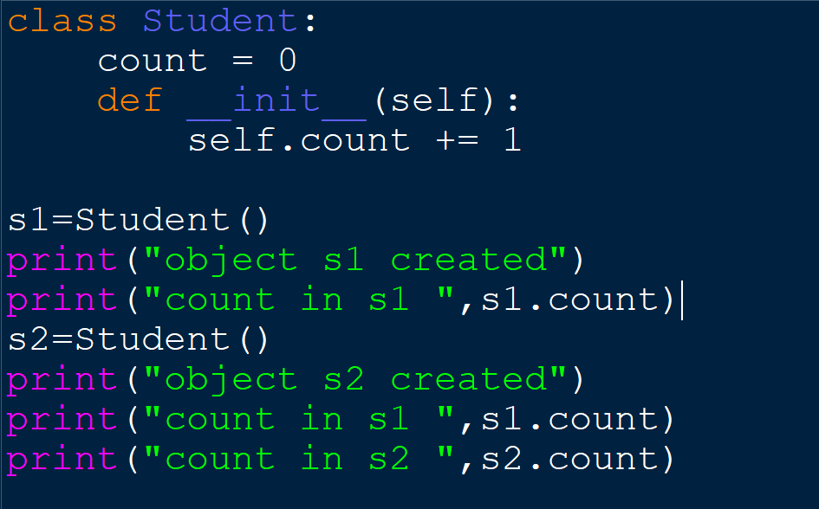
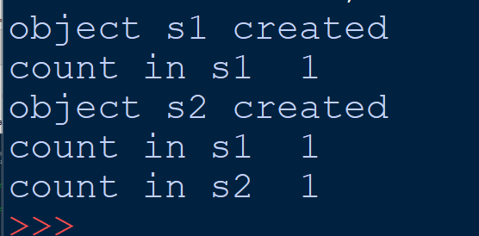
class attribute
The following example demonstrates the use of class attribute

Slide 23
Class Abstraction and Encapsulation
Class abstraction means to separate class implementation from the use of the class.
The creator of the class provides a description of the class and let the user know how the class can be used.
The user of the class does not need to know how the class is implemented. The detail of implementation is encapsulated and hidden from the user.

Slide 24
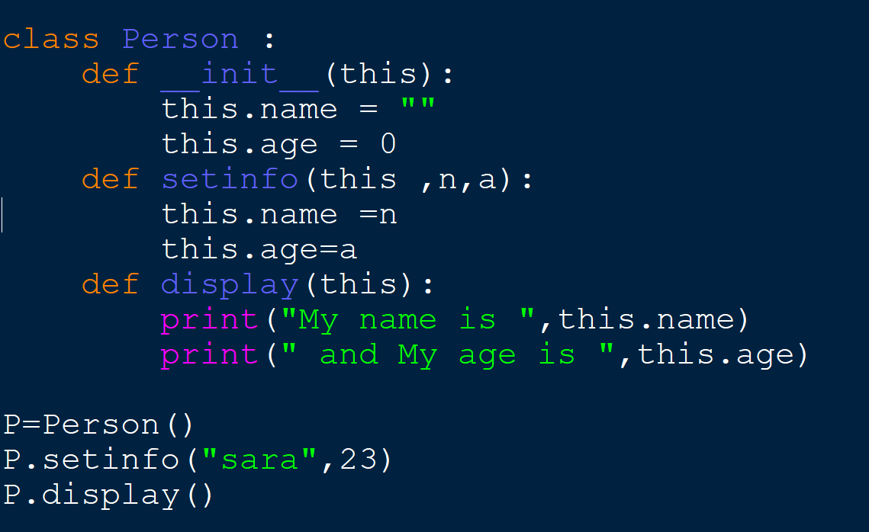
To call any of the class methods using the created instance, use dot notation
Format: My_instance.method()

Slide 25
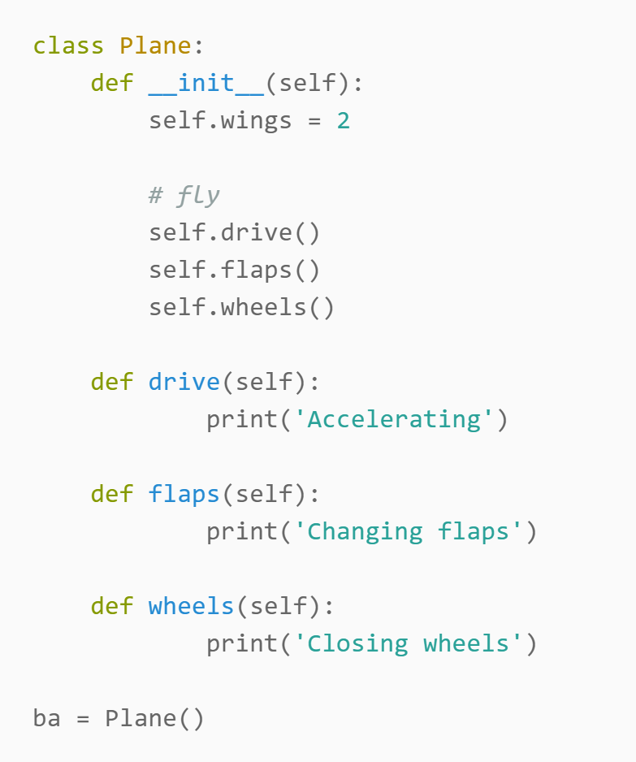
python __init__
The function init(self) builds your object. Its not just variables you can set here, you can call class methods too. Everything you need to initialize the object(s).
It is known as a constructor in object oriented concepts.

Slide 26
Object-Oriented Programming
Data hiding: object’s data attributes are hidden from code outside the object
Access restricted to the object’s methods
Protects from accidental corruption
Outside code does not need to know internal structure of the object
Public methods: allow external code to manipulate the object
Private methods: used for object’s inner workings
Object reusability: the same object can be used in different programs

Slide 27
Protected members
Protected members (in C++ and JAVA) are those members of the class that cannot be accessed outside the class but can be accessed from within the class and its subclasses. To accomplish this in Python, just follow the convention by prefixing the name of the member by a single underscore “_”.
Single Leading Underscore: _var
it has a meaning by convention only(This isn’t enforced by Python), is meant as a hint to another programmer that a variable or method starting with a single underscore is intended for internal use

Slide 28
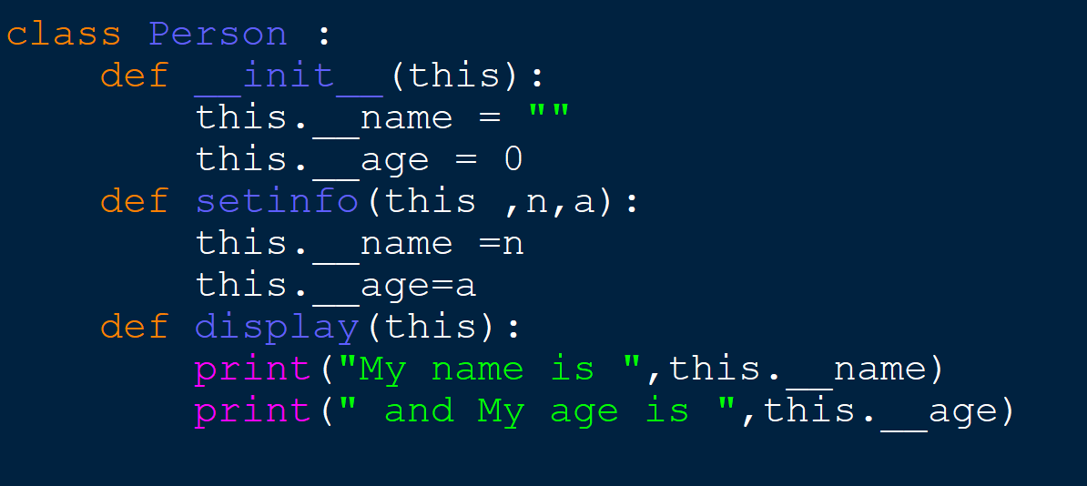
An object’s data attributes should be private which means they cannot be accessed except inside a class in Python, there is no existence of Private instance variables . However, to define a private member prefix the member name with double underscore “__”.
Private members

Slide 29
Accessor and Mutator Methods
Typically, all of a class’s data attributes are private and provide methods to access and change them
Accessor methods: return a value from a class’s attribute without changing it
Safe way for code outside the class to retrieve the value of attributes
Mutator methods: store or change the value of a data attribute

Slide 30
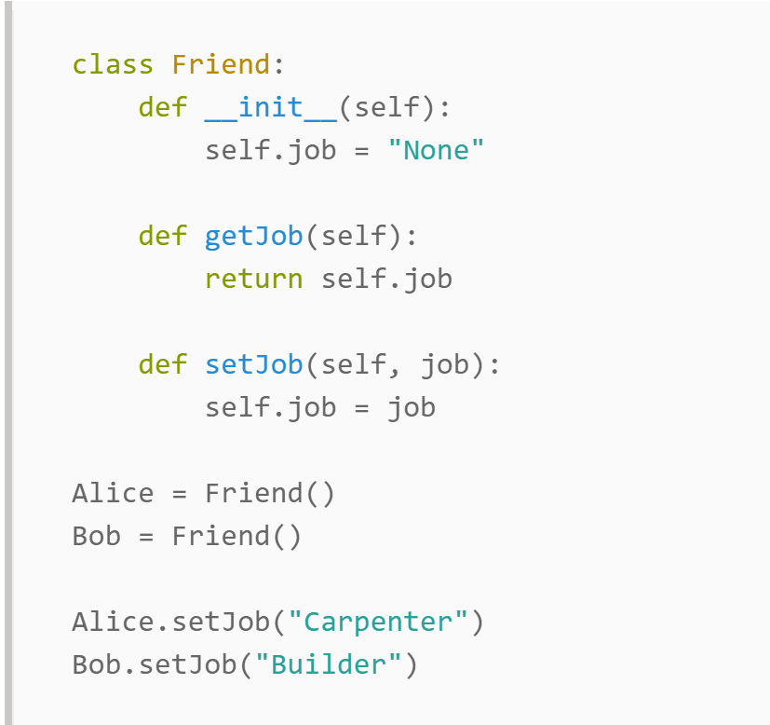
Getter and Setter in Python
Class variables need not be set directly: they can be set using class methods. This is the object orientated way and helps you avoid mistakes.
How can you set a default values to the instance attributes, So, if the values are not provided when creating an object, the values will be assigned latter?

Slide 31
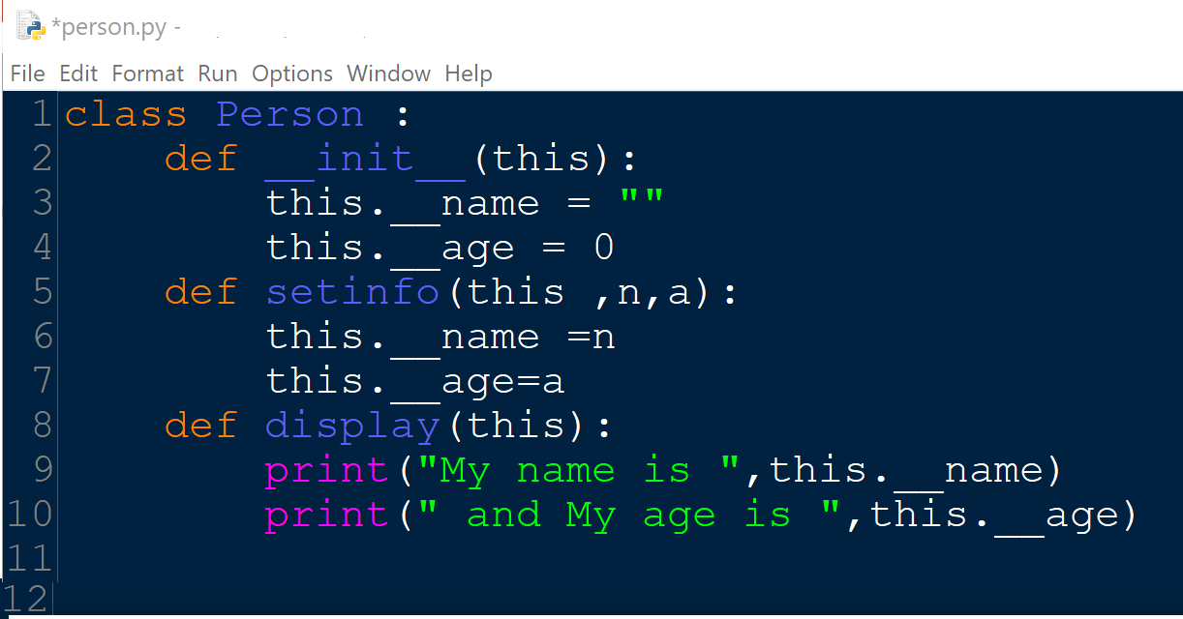
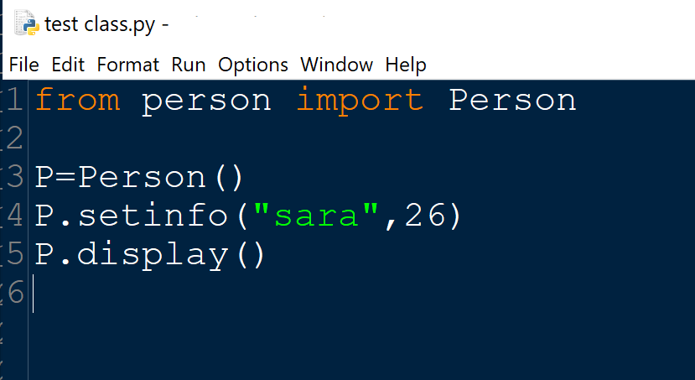
Storing Classes in Modules
Classes can be stored in modules
Filename for module must end in .py
Module can be imported to programs that use the class

Slide 32
Calling Methods
A client can call the methods of an object in two ways:
1) object.method(parameters)
2) Class.method(object, parameters)

Slide 33
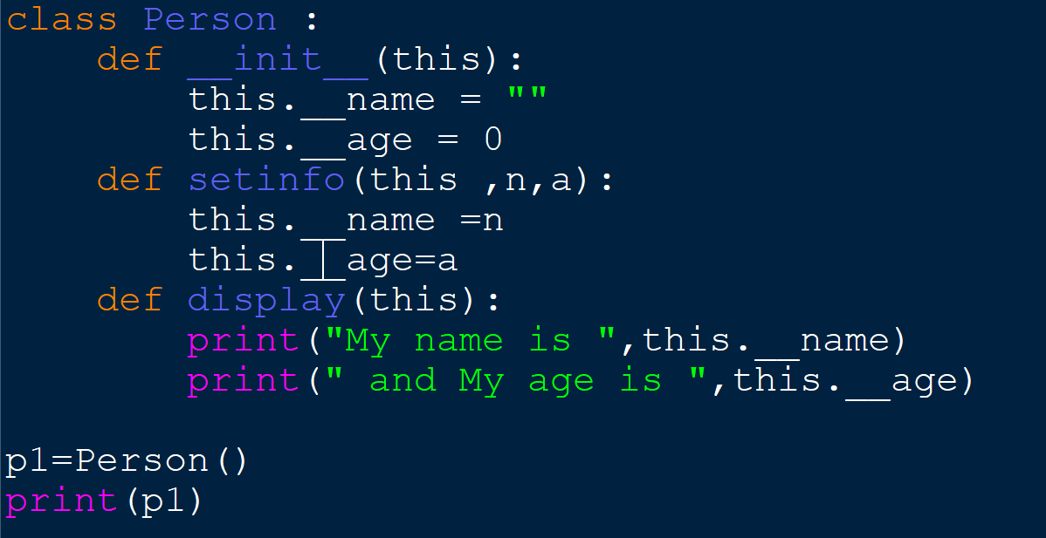
The __str__ method
Object’s state: the values of the object’s attribute at a given moment
__str__ method: displays the object’s state,
It’s Automatically called when the object is passed as an argument to the print function
If we don’t implement __str__() function for a class, then built-in object implementation is used that actually calls __repr__() function.
returns a string that describes the pointer of the object

Slide 34
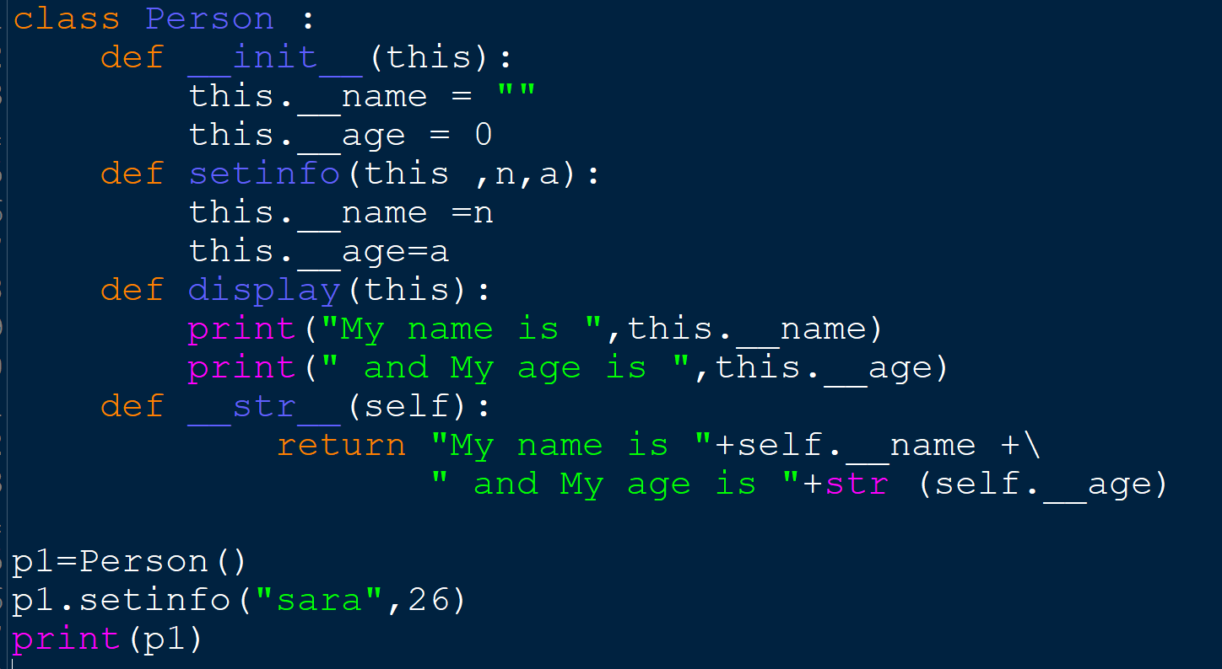
The __str__ method
The custom __str__ method should be defined in a way that is easy to read and returns all the members of the class as a string .
another way to write __str__ function
def __str__(self):
return "{} any text you want {} any text you want {}".format(self.attr1, self.attr2, self.attr3)

Slide 35
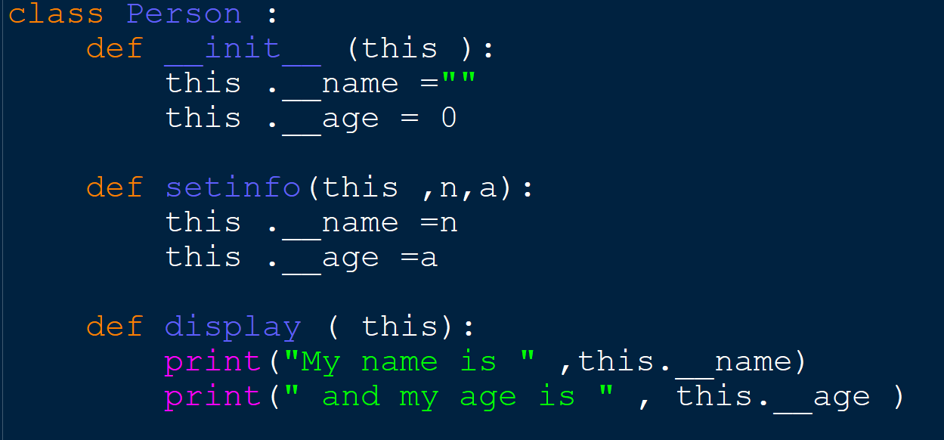
The __repr__ method
The __repr__ method returns a string that describes the pointer of the object by default (if the programmer does not define it).

Slide 36
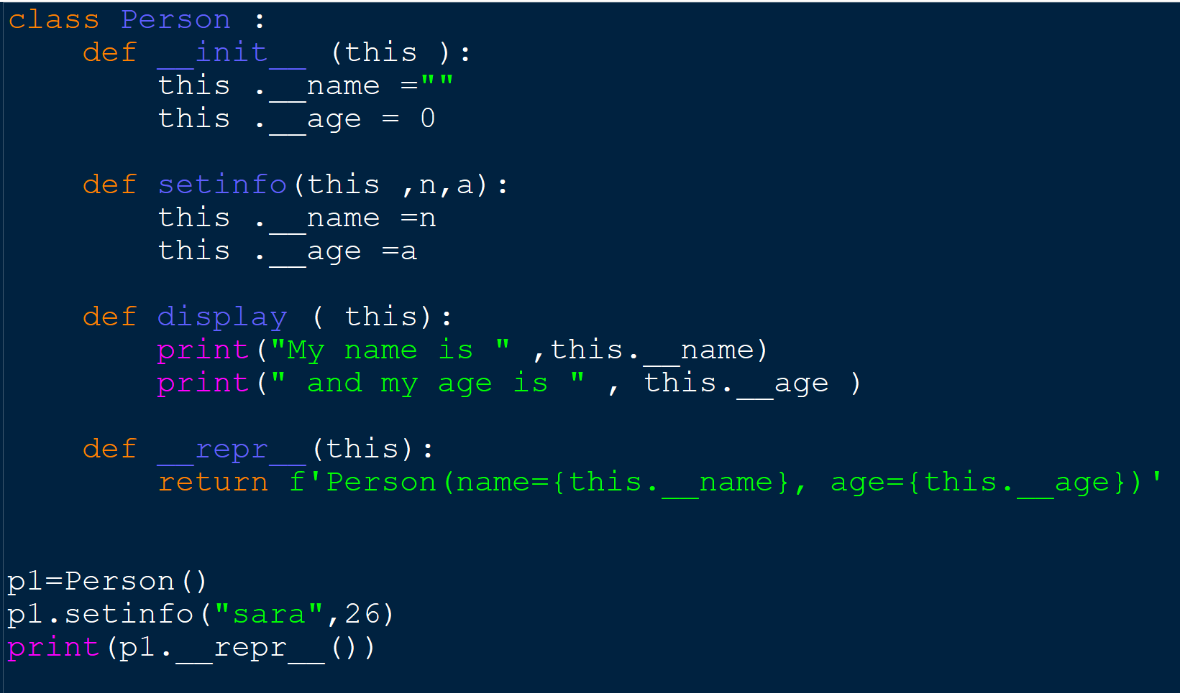
The __repr__ method

Slide 37
__str __ Vs. __repr__
If both the functions return strings, which is supposed to be the object representation, what’s the difference?
Well, the __str__ function is supposed to return a human-readable format, which is good for logging or to display some information about the object. Whereas, the __repr__ function is supposed to return an “official” string representation of the object, which can be used to construct the object again.

Slide 38
Examples

Slide 39
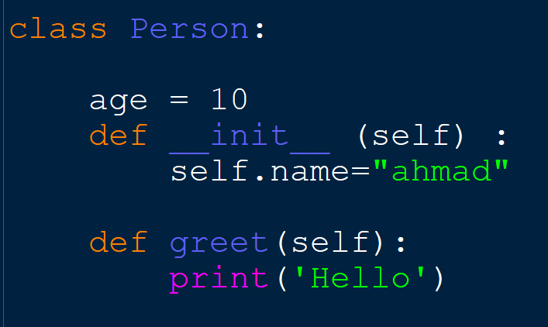
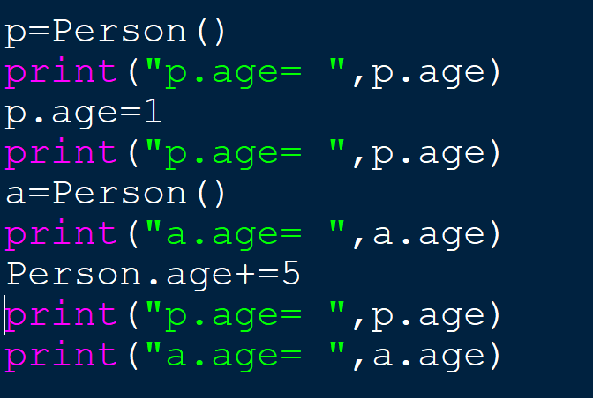
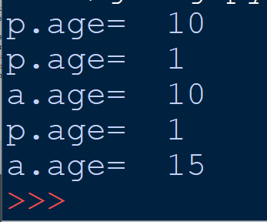

Slide 40
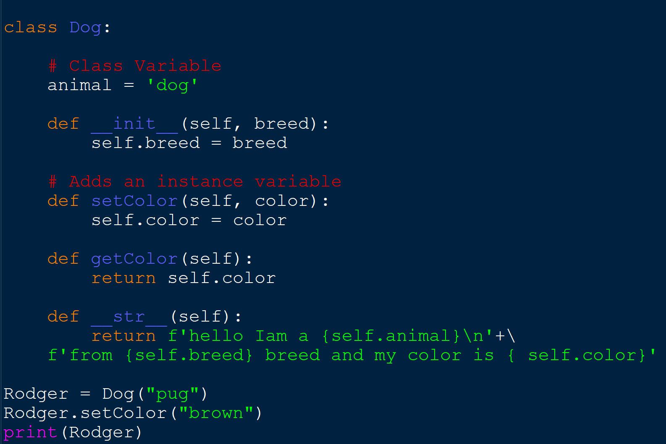

Slide 41
Passing Objects as an Arguments

Slide 42
Passing Objects as Arguments
Methods and functions often need to accept objects as arguments
When you pass an object as an argument, you are actually passing a reference to the object
The receiving method or function has access to the actual object
Methods of the object can be called within the receiving function or method, and data attributes may be changed using mutator methods

Slide 43
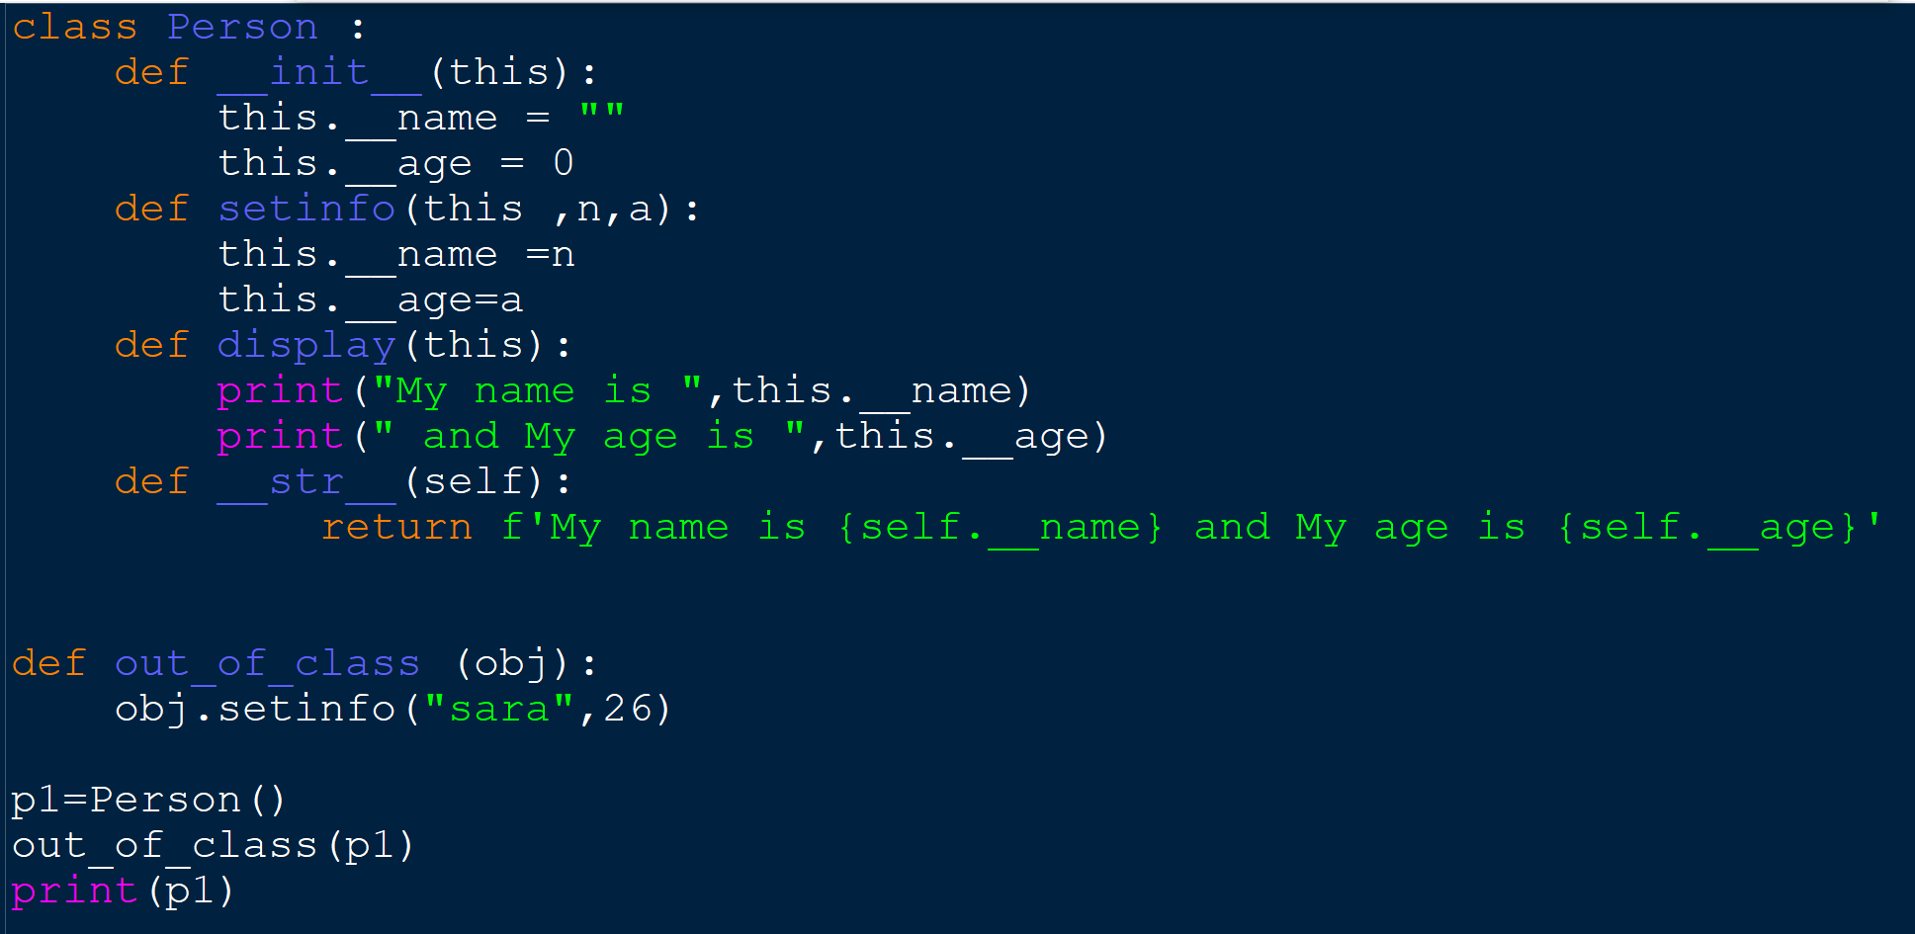
example

Slide 44
Techniques for Designing Classes
UML diagram: standard diagrams for graphically depicting object-oriented systems
Stands for Unified Modeling Language
General layout: box divided into three sections:
Top section: name of the class
Middle section: list of data attributes
Bottom section: list of class methods

Slide 45
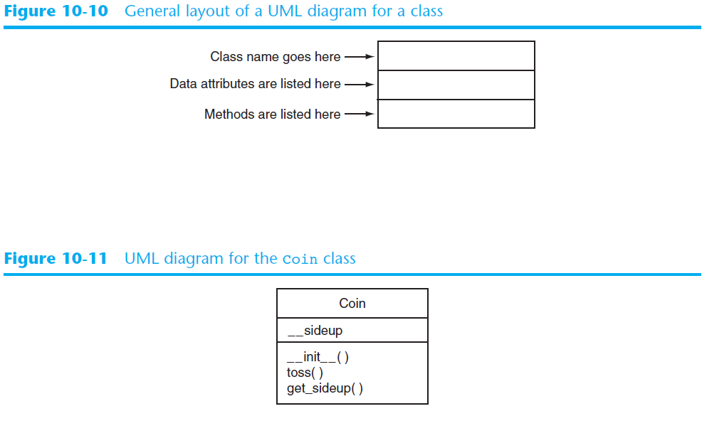

Slide 46
Example : implement the following

Slide 47
More on classes

Slide 48
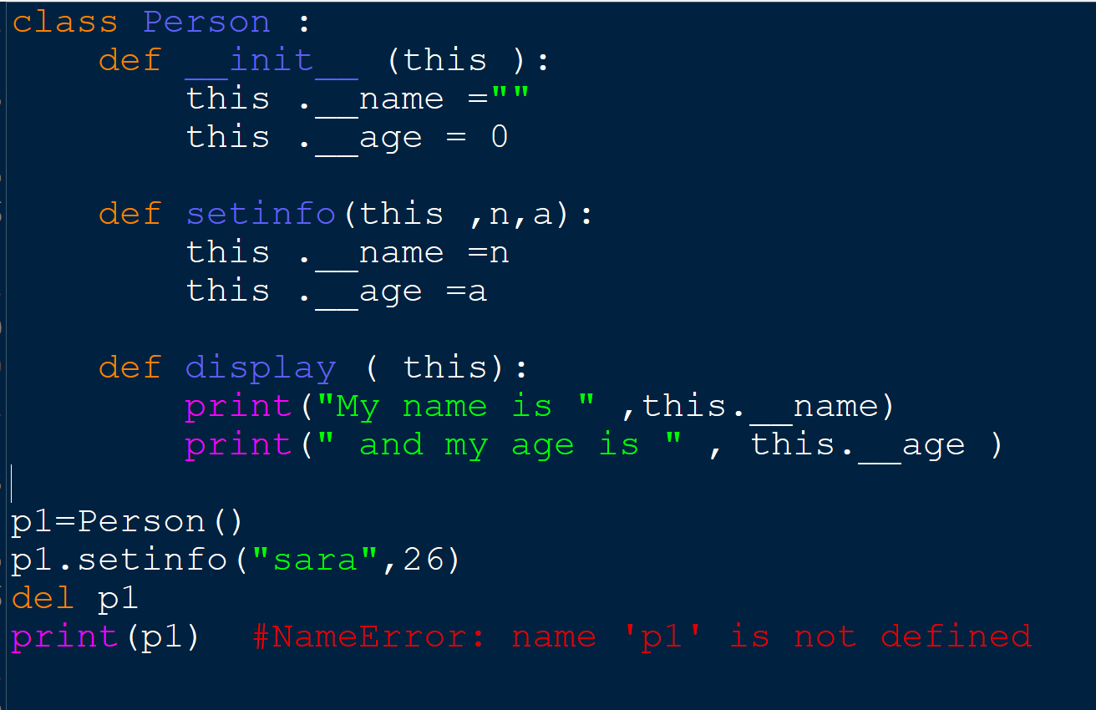
Deleting object
How to Delete Python Object ?
To delete an object in Python, we use the ‘del’ keyword. A when we try to refer to a deleted object, it raises NameError.
How can you delete object properties?
Does it delete from that object only
or from all of the objects from same class?

Slide 49
The pass Statement
class definitions cannot be empty, but if you for some reason have a class definition with no content, put in the pass statement to avoid getting an error.
Example
class Person: pass
The Meaning of Underscores in Python
Single Trailing Unders: var_
Sometimes the most fitting name for a variable is already taken by a keyword. Therefore, names like class or def cannot be used as variable names in Python. In this case, you can append a single underscore to break the naming conflict core

Slide 50
Python None Keyword
The None keyword is used to define a null value, or no value at all.
None is not the same as 0, False, or an empty string.
None is a data type of its own (NoneType) and only None can be None.

Slide 51
built-in functions

Slide 52
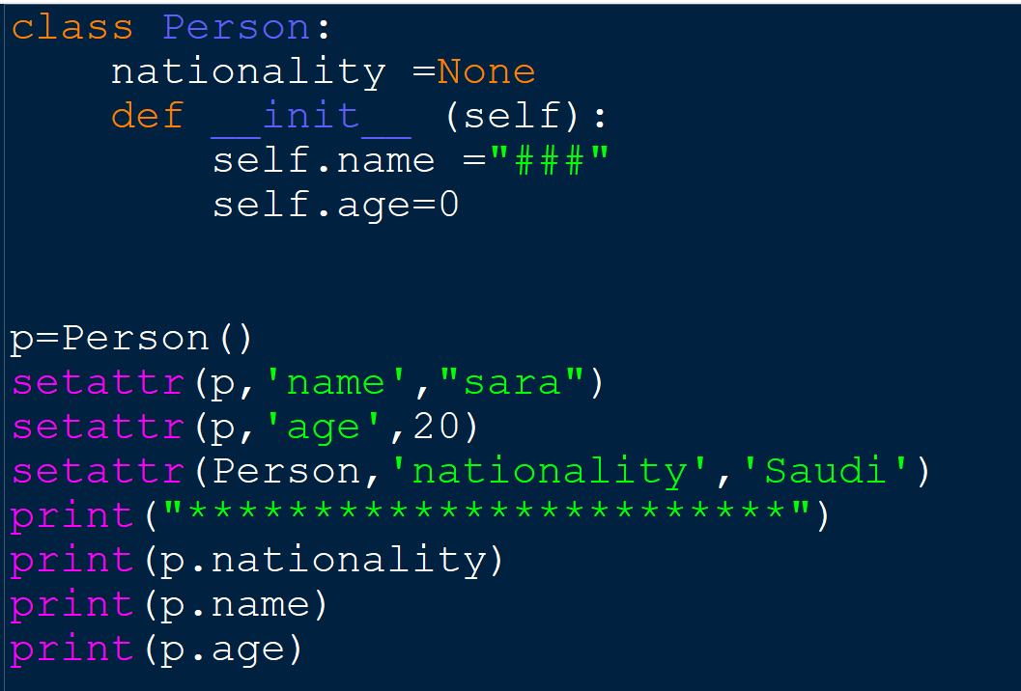
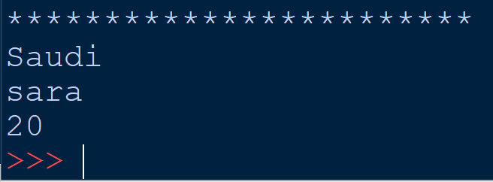
built-in Getter and Setter in Python
The setattr() function sets the value of the specified attribute of the specified object.
Syntax : setattr(object, attribute, value)

Slide 53
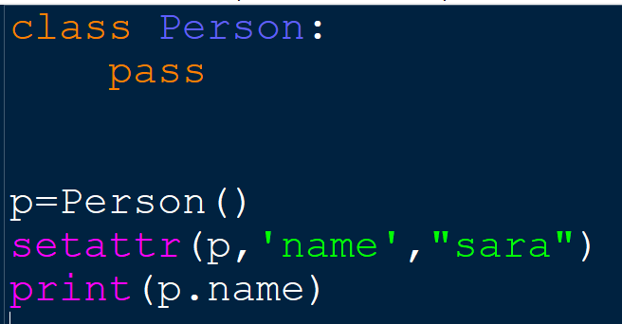
built-in Getter and Setter in Python
The setattr() function can be used to create data attributes of a class in run-time

Slide 54
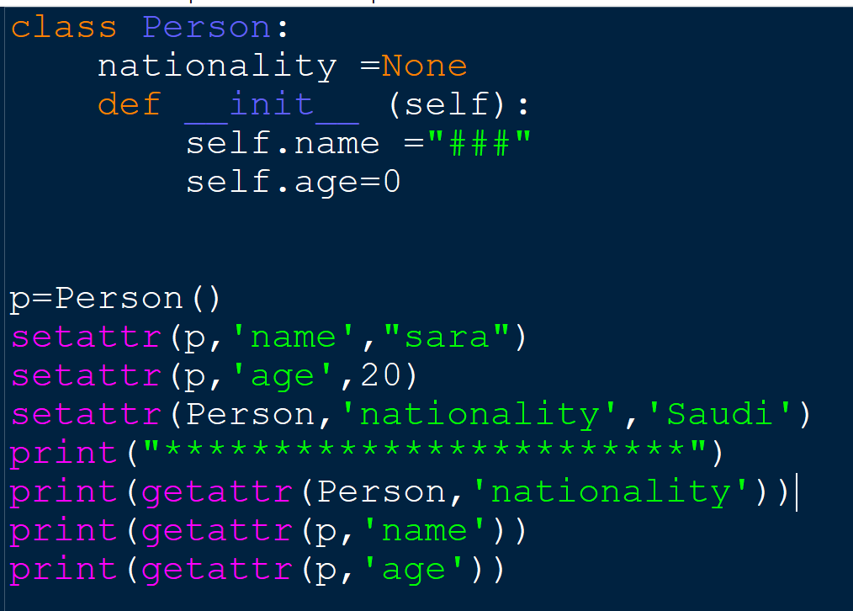
built-in Getter and Setter in Python
The getattr() function returns the value of the specified attribute from the specified object.
Syntax : getattr(object, attribute, default)
default Optional :
The value to return if the attribute does not exist

Slide 55
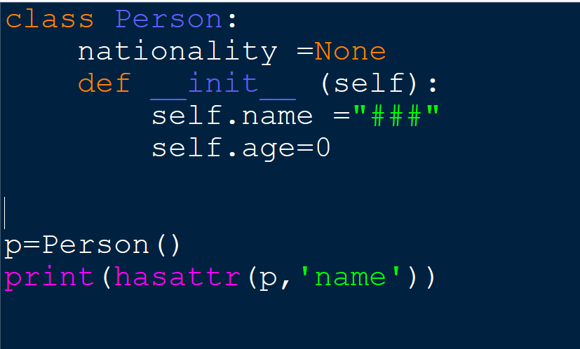
built-in hasattr() in Python
hasattr() : returns True if the specified object has the specified attribute, otherwise False.
Syntax : hasattr(object, attribute)

Slide 56
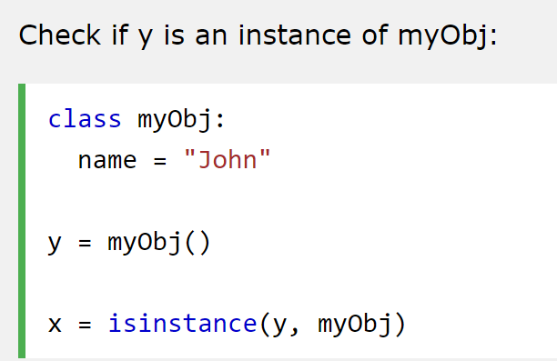
built-in isinstance() in Python
isinstance() : takes two arguments, an object and a class. It checks if the object in the first argument is an instance of the class in the second argument and returns either True or False
Format: isinstance(object, class)

Slide 57
References:
Tony Gaddis - Starting Out with Python, Global Edition (2018, Pearson Education)
https://www.w3schools.com/python/python_file_open.asp
https://www.geeksforgeeks.org/encapsulation-in-python/
https://www.educative.io/edpresso/what-is-the-str-method-in-python
https://www.journaldev.com/22460/python-str-repr-functions
https://www.w3schools.com/python/python_ref_functions.asp
https://data-flair.training/blogs/python-object/

