Slide 1
Inheritance and Composition
Created by : Nouf almunyif

Slide 2
Introduction to Inheritance

Slide 3
Introduction to Inheritance
In the real world, many objects are a specialized version of more general objects
Example: grasshoppers and bees are specialized types of insect
In addition to the general insect characteristics, they have unique characteristics:
Grasshoppers can jump
Bees can sting, make honey, and build hives

Slide 4
Introduction to Inheritance (cont’d.)

Slide 5
Inheritance and the “Is a” Relationship
“Is-a” relationship: exists when one object is a specialized version of another object
Specialized object has all the characteristics of the general object plus unique characteristics
Example:
Grasshoppers is-an insect
Rectangle is-a shape
Daisy is-a flower
a mustang is-a car.

Slide 6
Inheritance and the “Is a” Relationship (cont’d.)
Inheritance is meaningful ways to relate two or more classes.
Inheritance: used to create an “is a” relationship between classes
Superclass (base class): a general class (Parent class)
Subclass (derived class): a specialized class (Child class)
An extended version of the superclass
Inherits attributes and methods of the superclass
New attributes and methods can be added

Slide 7
Inheritance and the “Is a” Relationship (cont’d.)
For example, need to create classes for cars, pickup trucks, and SUVs
All are automobiles
Have a make, year model, mileage, and price
This can be the attributes for the base class
In addition:
Car has a number of doors
Pickup truck has a drive type
SUV has a passenger capacity

Slide 8
Hierarchical Inheritance

Slide 9
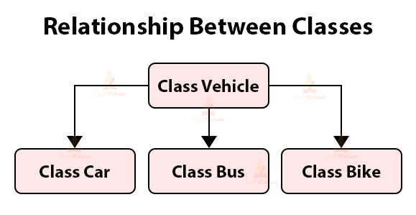
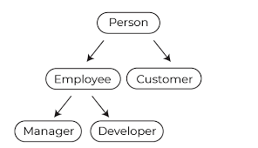
Hierarchical Inheritance

Slide 10
Inheritance and the “Is a” Relationship (cont’d.)
In a class definition for a subclass:
To indicate inheritance, the superclass name is placed in parentheses after subclass name
Example: class Car(Automobile):
The initializer method of a subclass calls the initializer method of the superclass and then initializes the unique data attributes
Add method definitions for unique methods

Slide 11
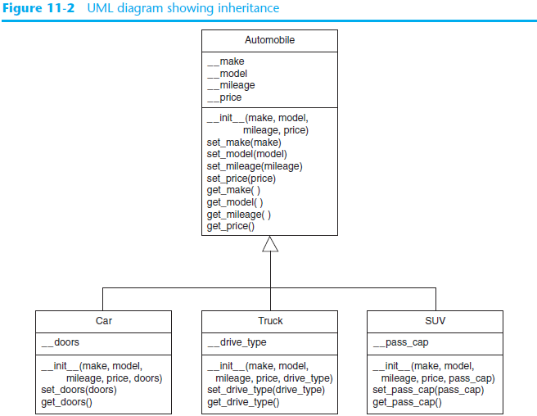
Inheritance in UML Diagrams
show inheritance by drawing a line with an open arrowhead from subclass to superclass

Slide 12
Inheritance implementation

Slide 13
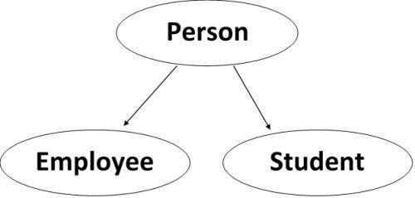
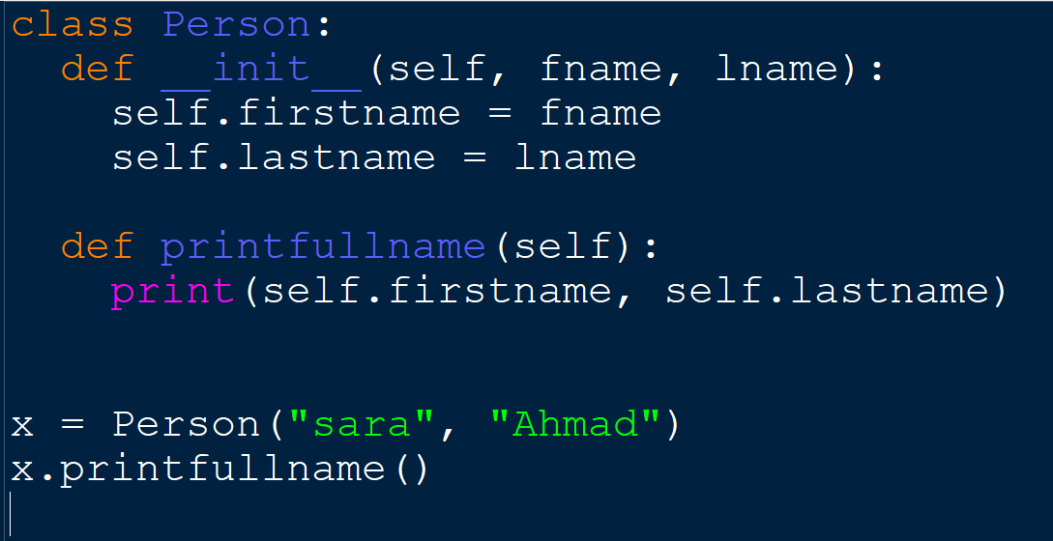
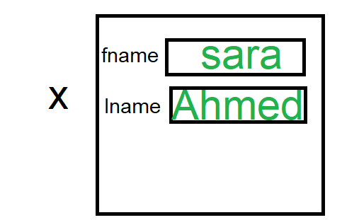
Superclass (base class): (Parent class)

Slide 14
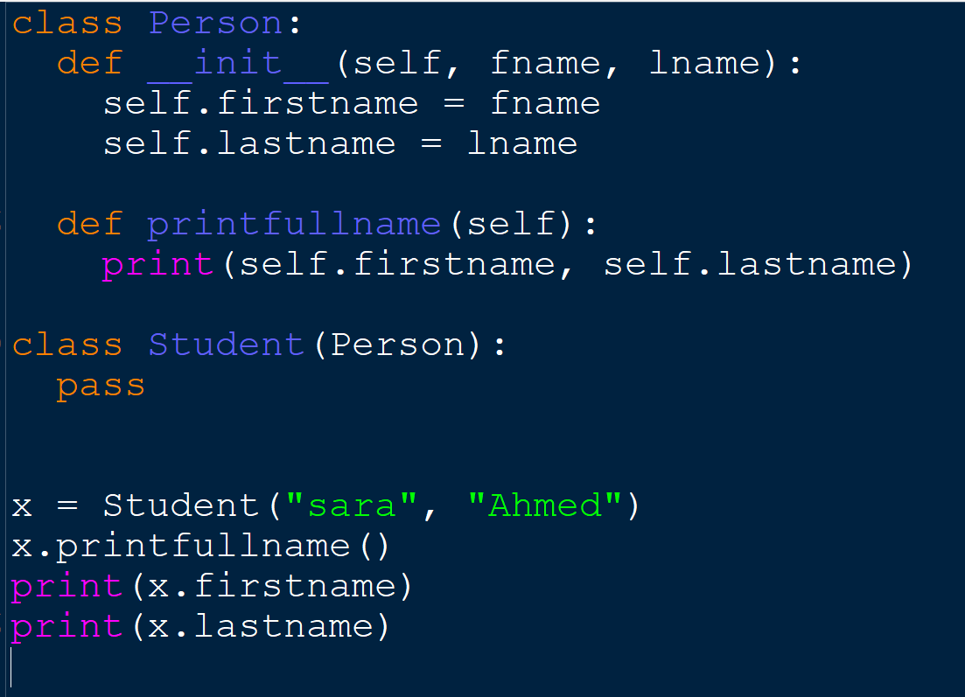
Subclass (derived class): (Child class)

Slide 15
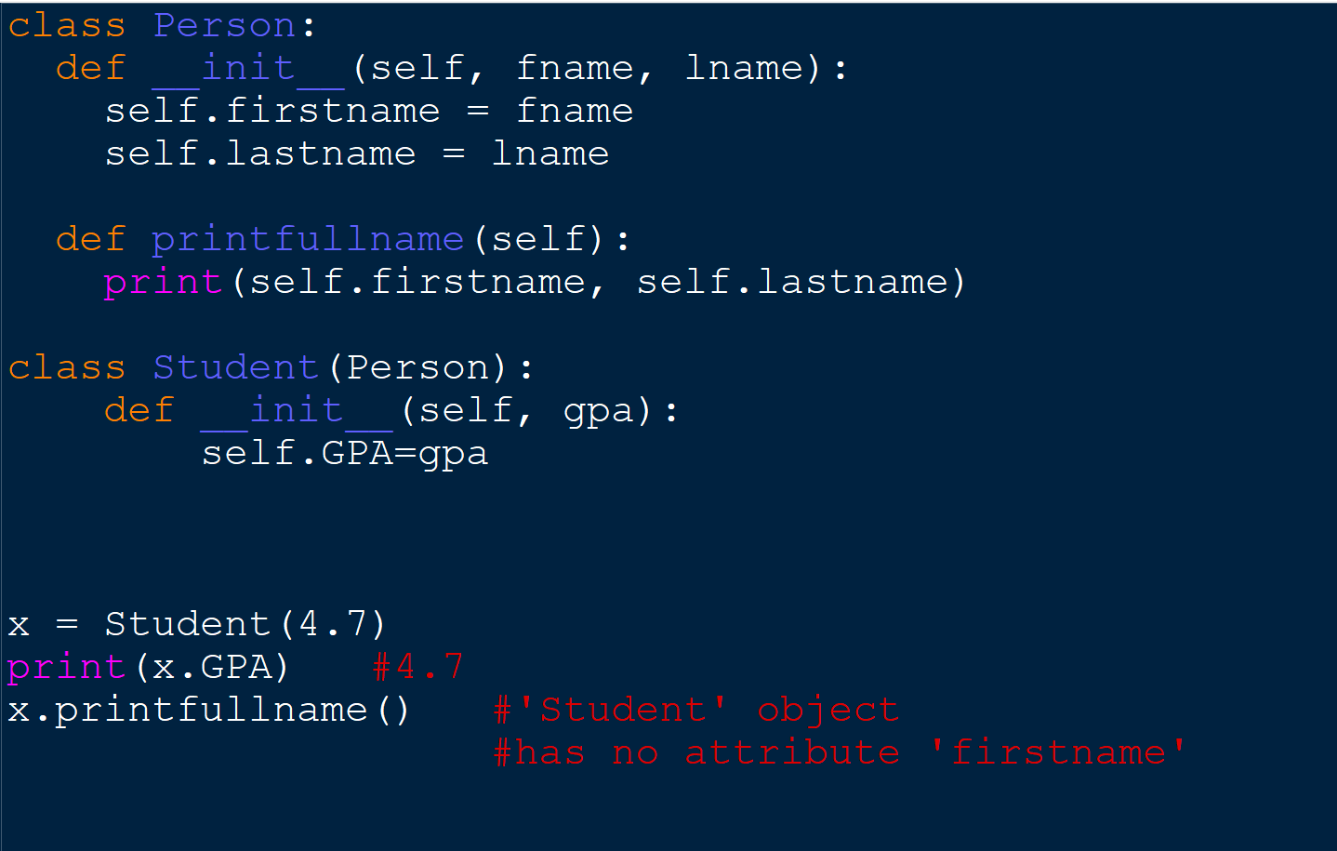
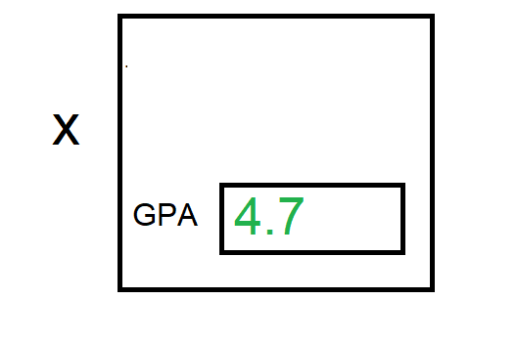
Add Properties

Slide 16
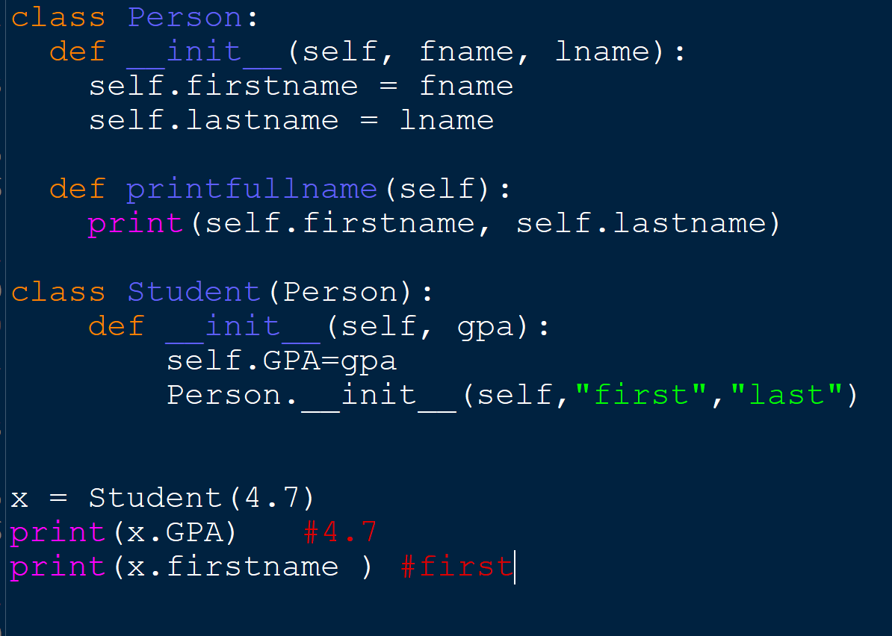
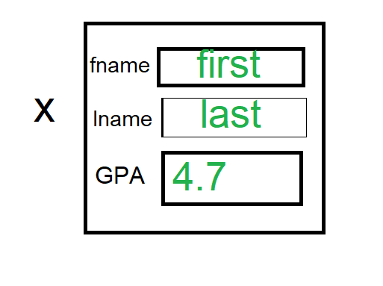
Add Properties
When you add the __init__() function,
the child class will no longer inherit the parent's __init__() function.
To keep the inheritance of the parent's __init__() function,
add a call to the parent's __init__() function

Slide 17
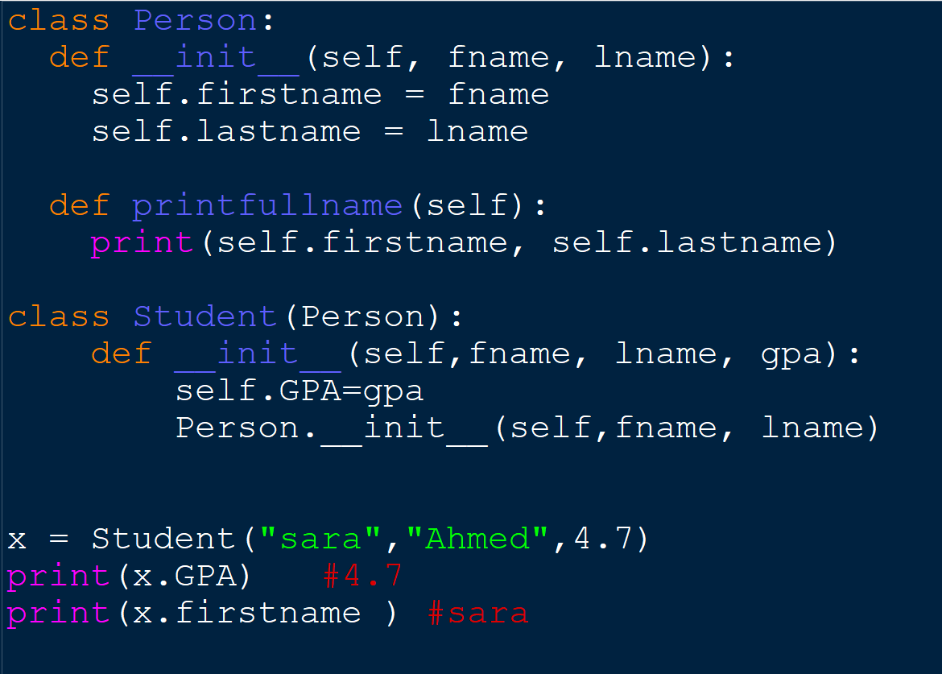
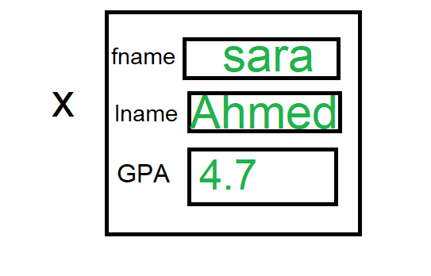
Add Properties

Slide 18
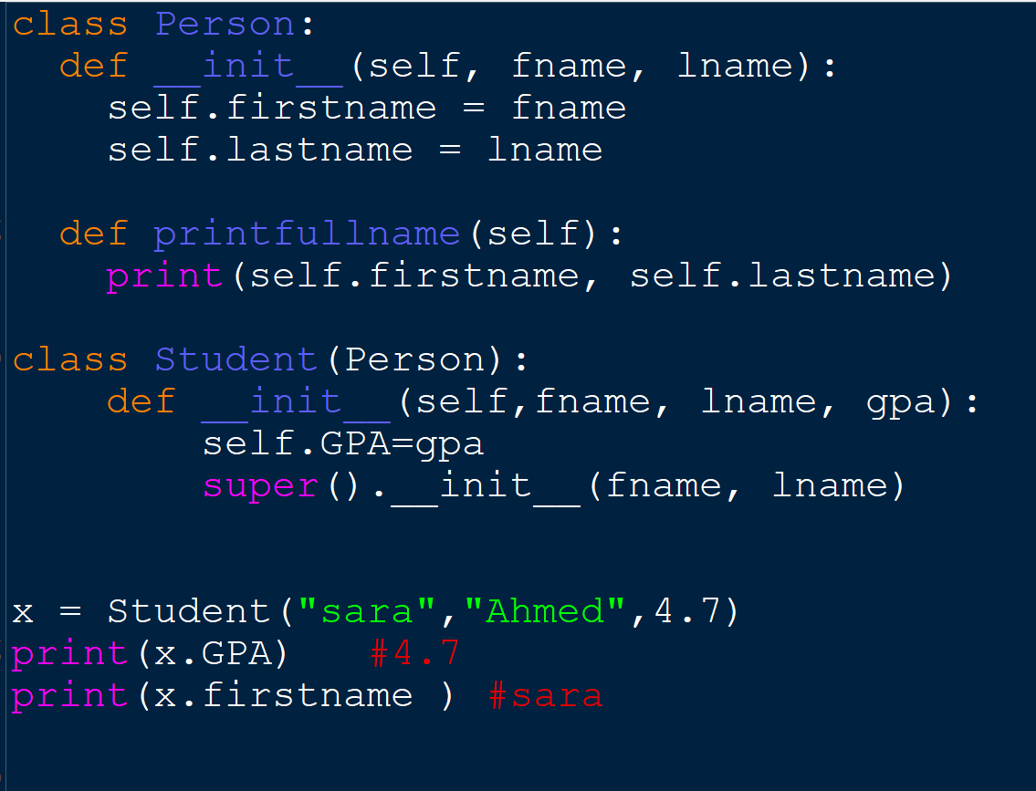
Use the super() Function
No self

Slide 19
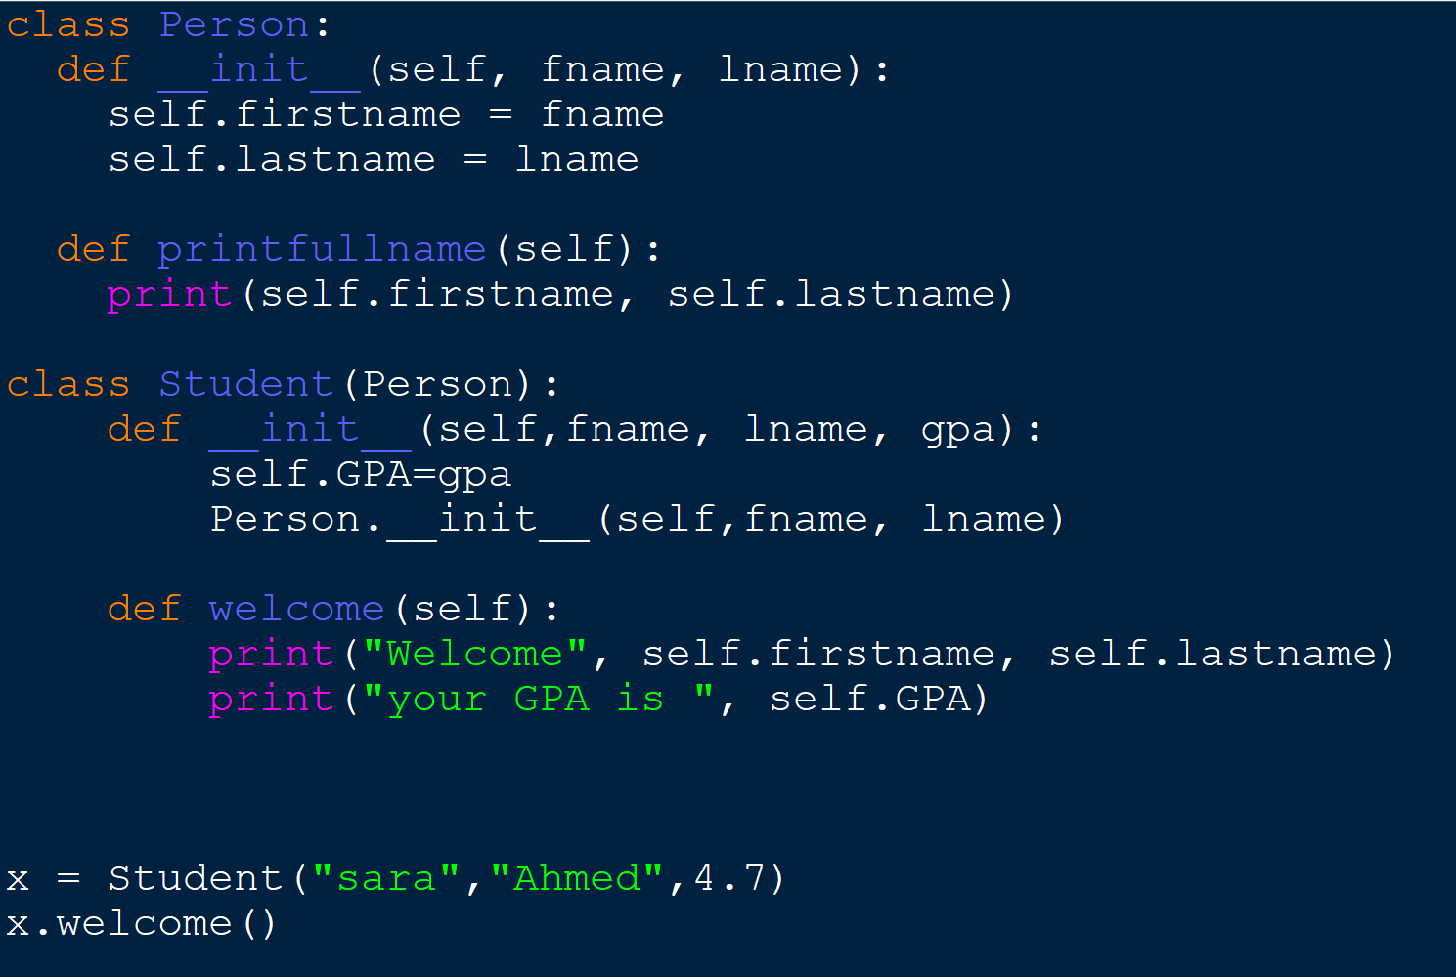
Add Methods
Add a method called welcome to the Student class

Slide 20
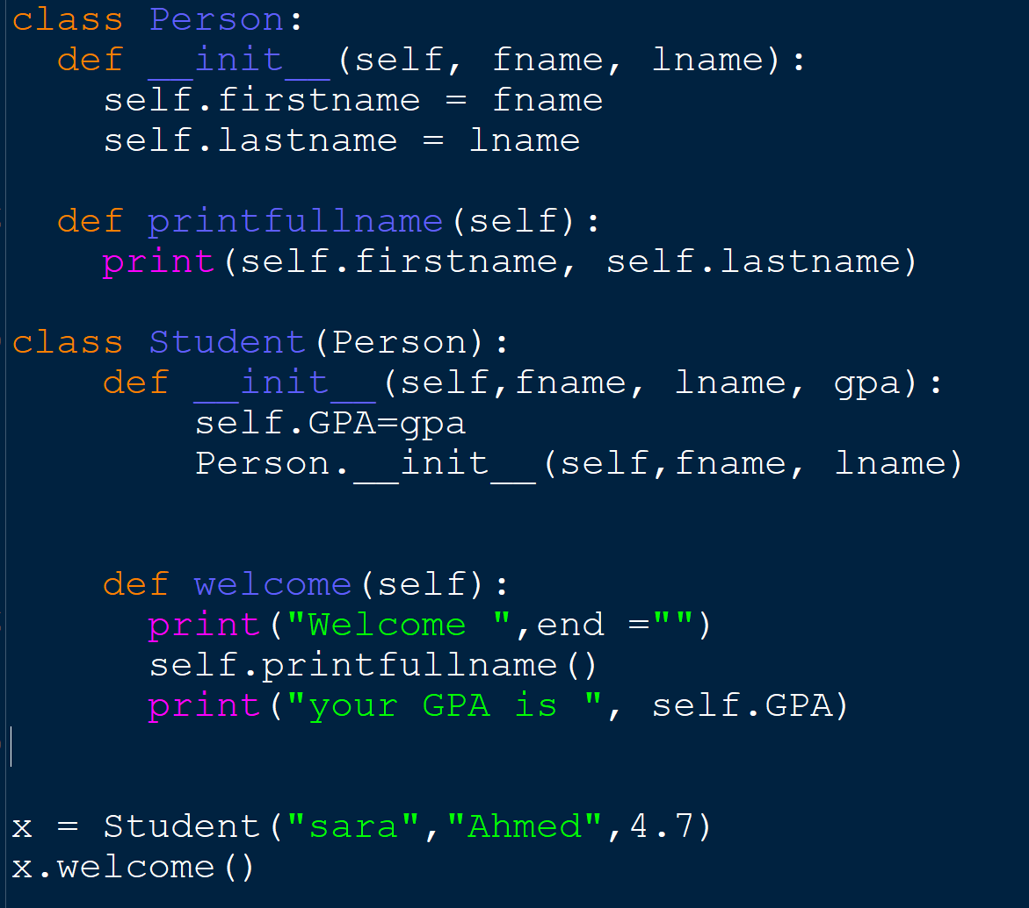
Add Methods
Call printfullname method from person

Slide 21
Exercise
Create a class Employee which inherit from class Person
and have the following attributes :
Employee ID
Worked hours
Pay rate
Salary
And calculate salary function
class Person:
def __init__(self, fname, lname):
self.firstname = fname
self.lastname = lname
def printfullname(self):
print(self.firstname, self.lastname)

Slide 22
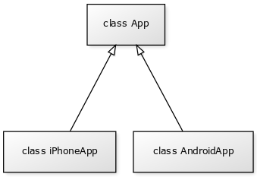
Inheritance
Multiple classes can inherit from the same super class. In such case all of sub classes will get all of the properties and methods of the super class

Slide 23
Python multiple inheritance

Slide 24
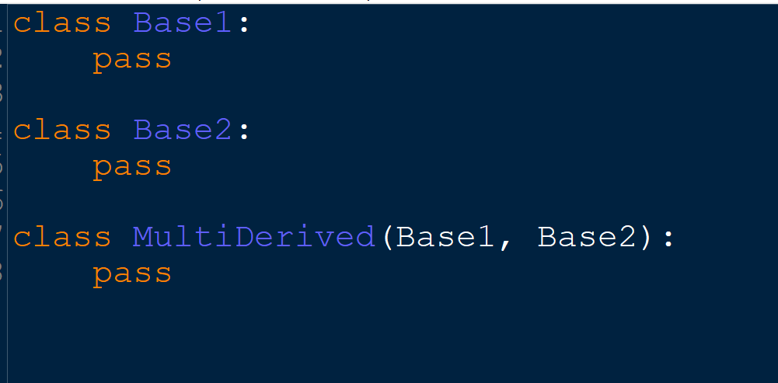
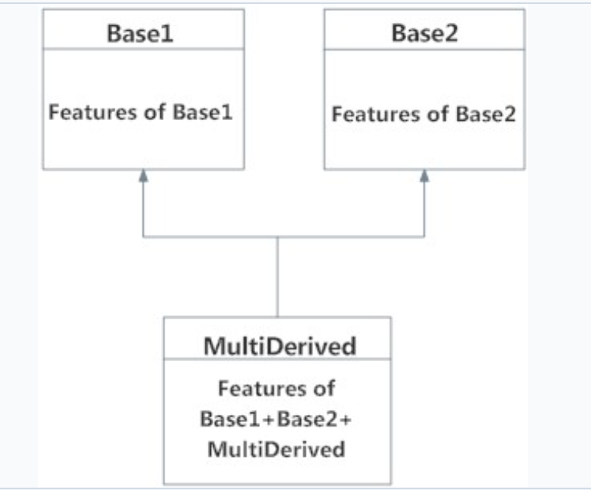
multiple inheritance
In multiple inheritance, the features of all the base classes are inherited into the derived class. The syntax for multiple inheritance is similar to single inheritance.
In the multiple inheritance scenario, any specified attribute is searched first in the current class. If not found, the search continues into parent classes in depth-first, left-right fashion

Slide 25
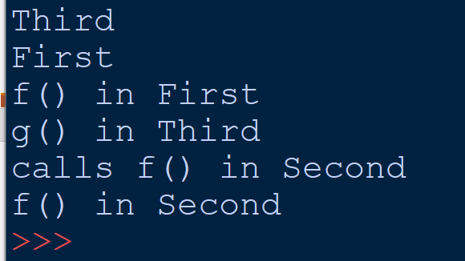
example

Slide 26
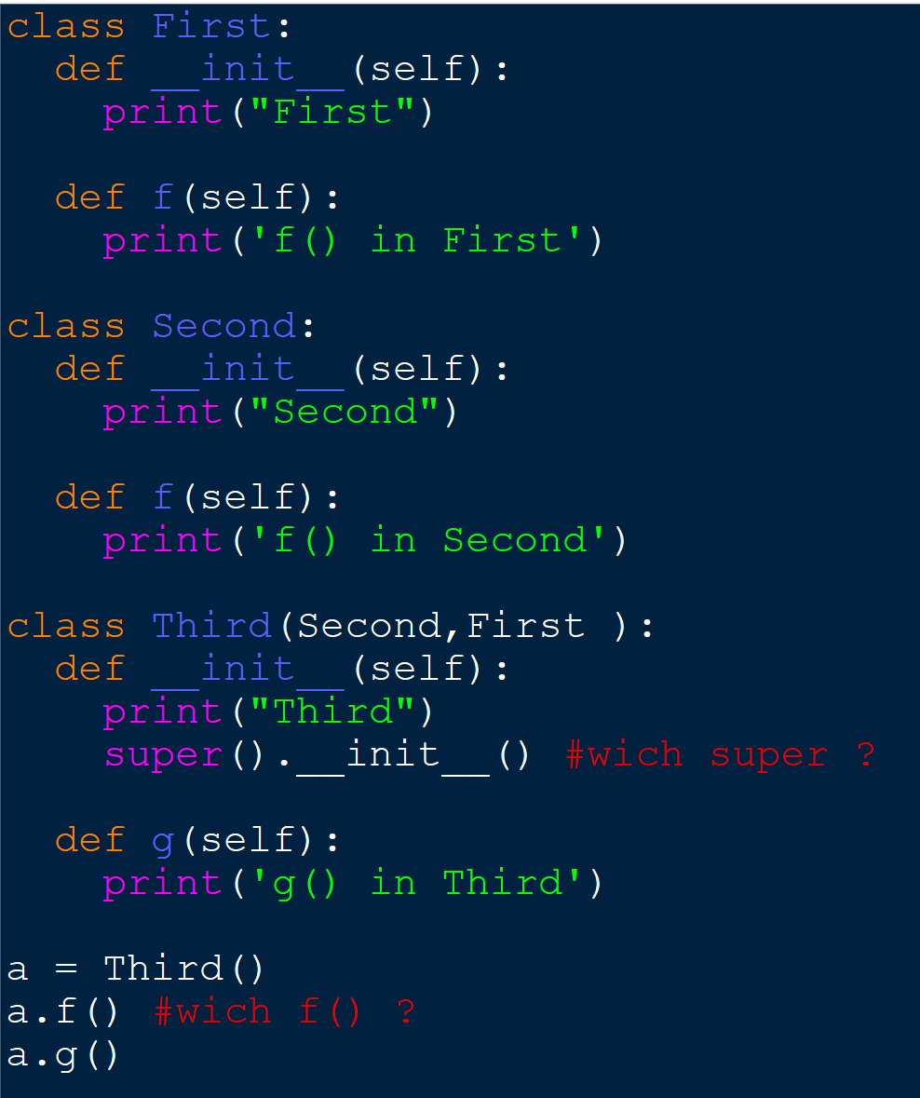
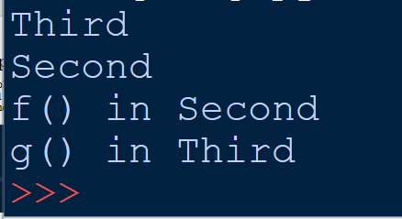
example

Slide 27
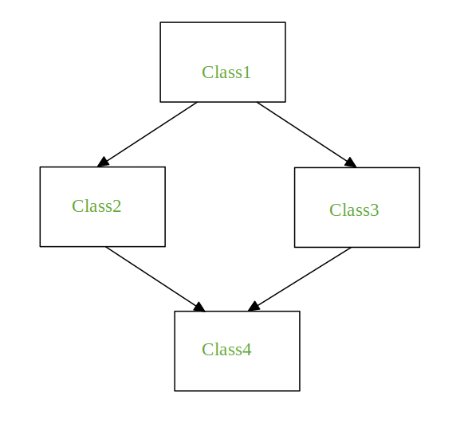
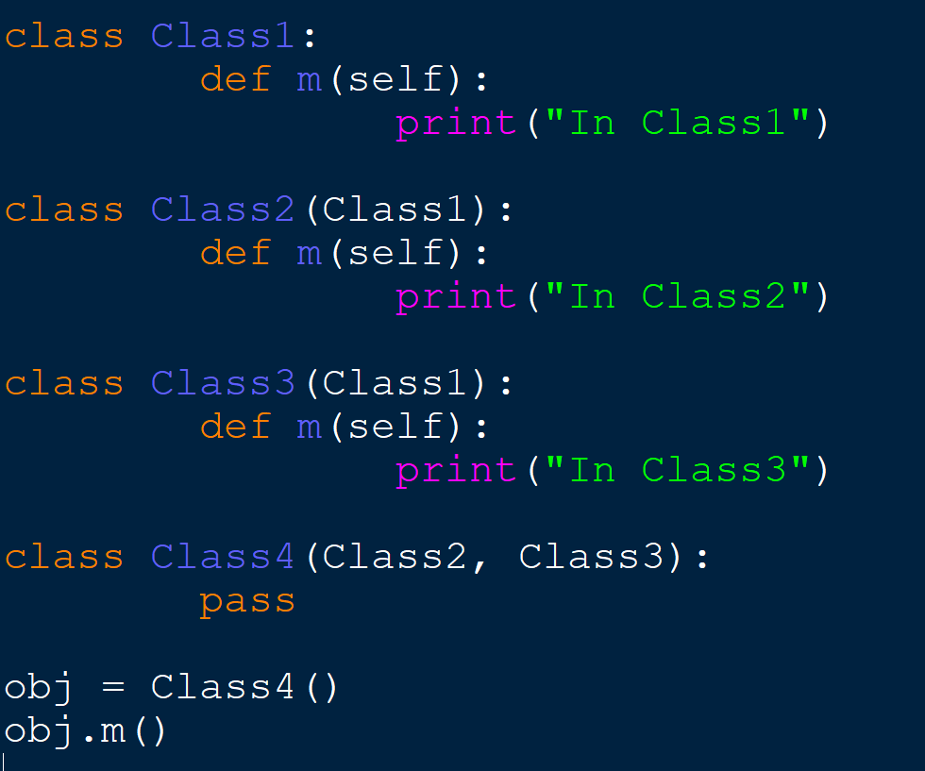
The Diamond Problem
If there is a method “m” which is an overridden method in one of Class2 and Class3 or both then the ambiguity arises which of the method “m” Class4 should inherit.

Slide 28
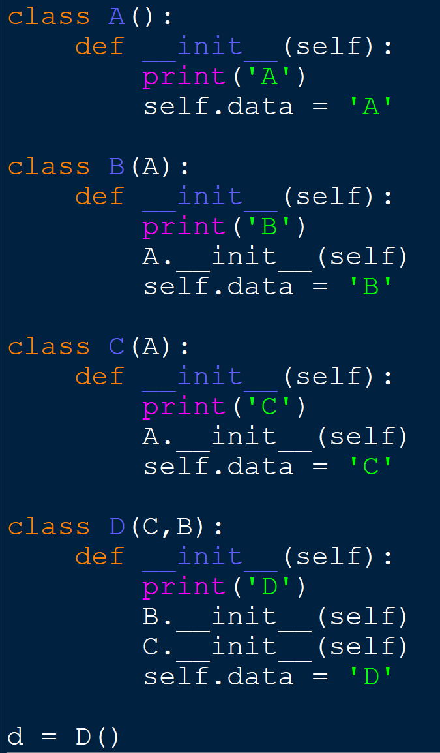
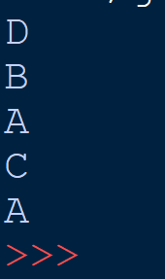
In case of complicated inheritance tree: avoid using super() and call constructors explicitly

Slide 29
Python Multilevel Inheritance

Slide 30
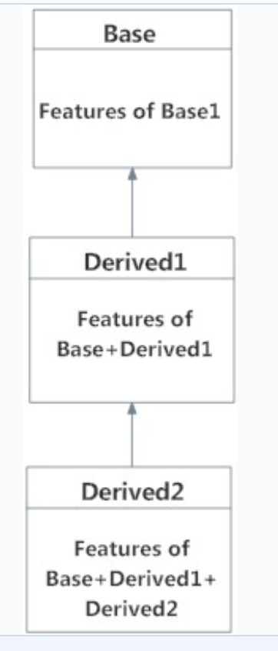
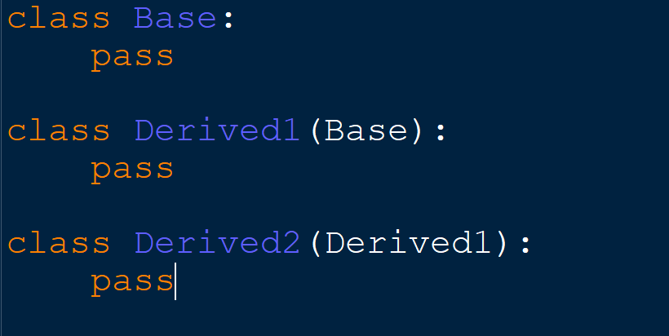
Multilevel Inheritance
We can also inherit from a derived class. This is called multilevel inheritance. It can be of any depth in Python.
The features of the base class and the derived class are inherited into the new derived class.

Slide 31
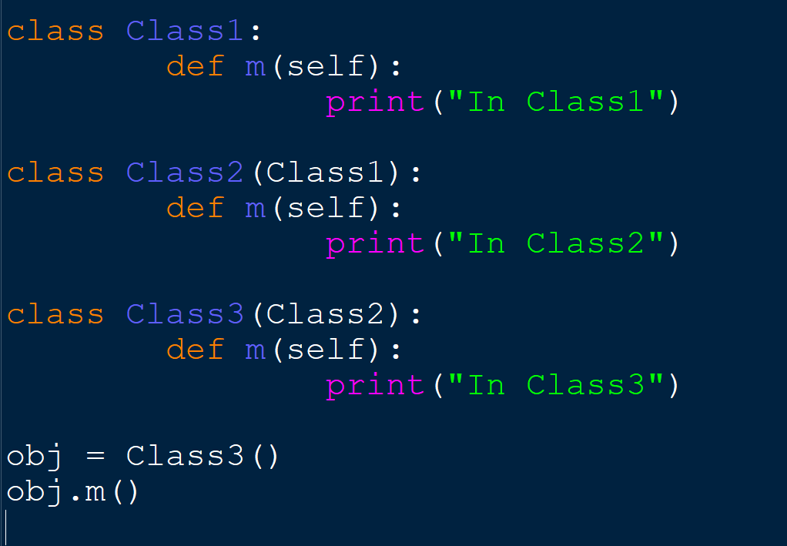
example

Slide 32
Introduction to Composition

Slide 33
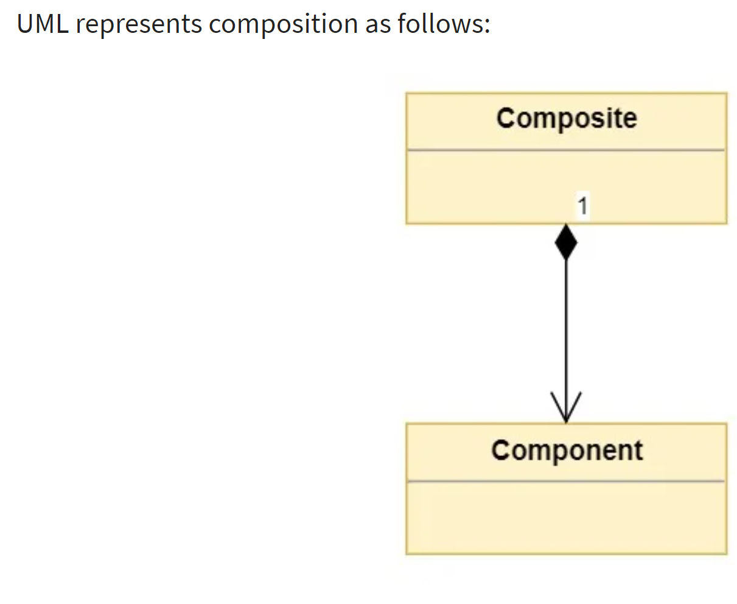
What’s Composition?
Composition is a concept that models a has a relationship. It enables creating complex types by combining objects of other types. This means that a class Composite can contain an object of another class Component. This relationship means that
a Composite has a Component.

Slide 34
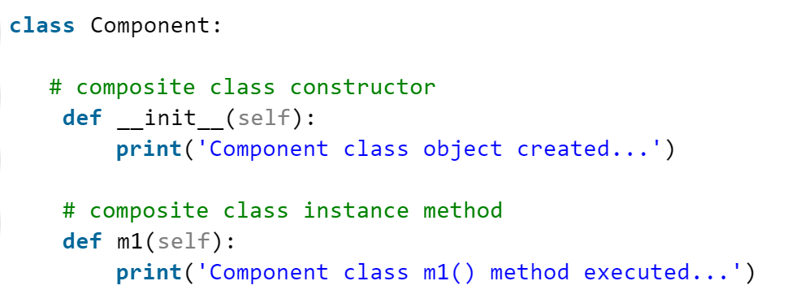
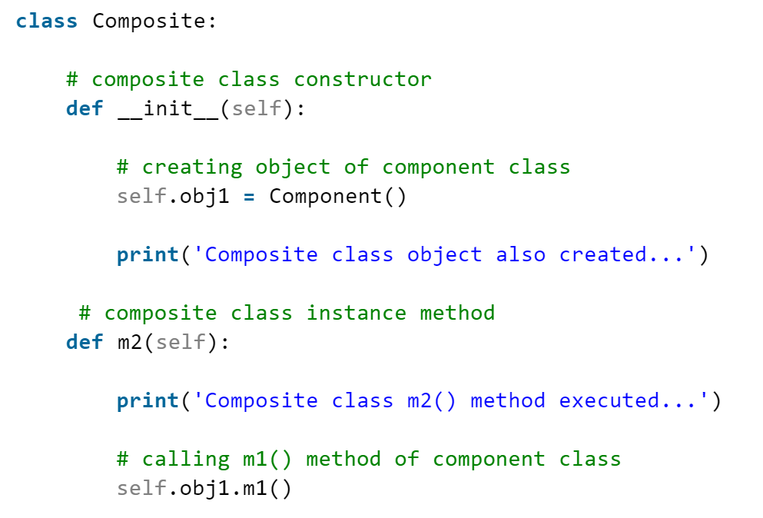
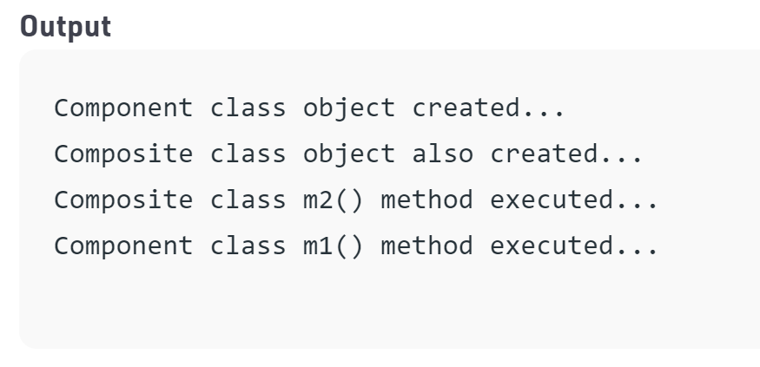
Example

Slide 35
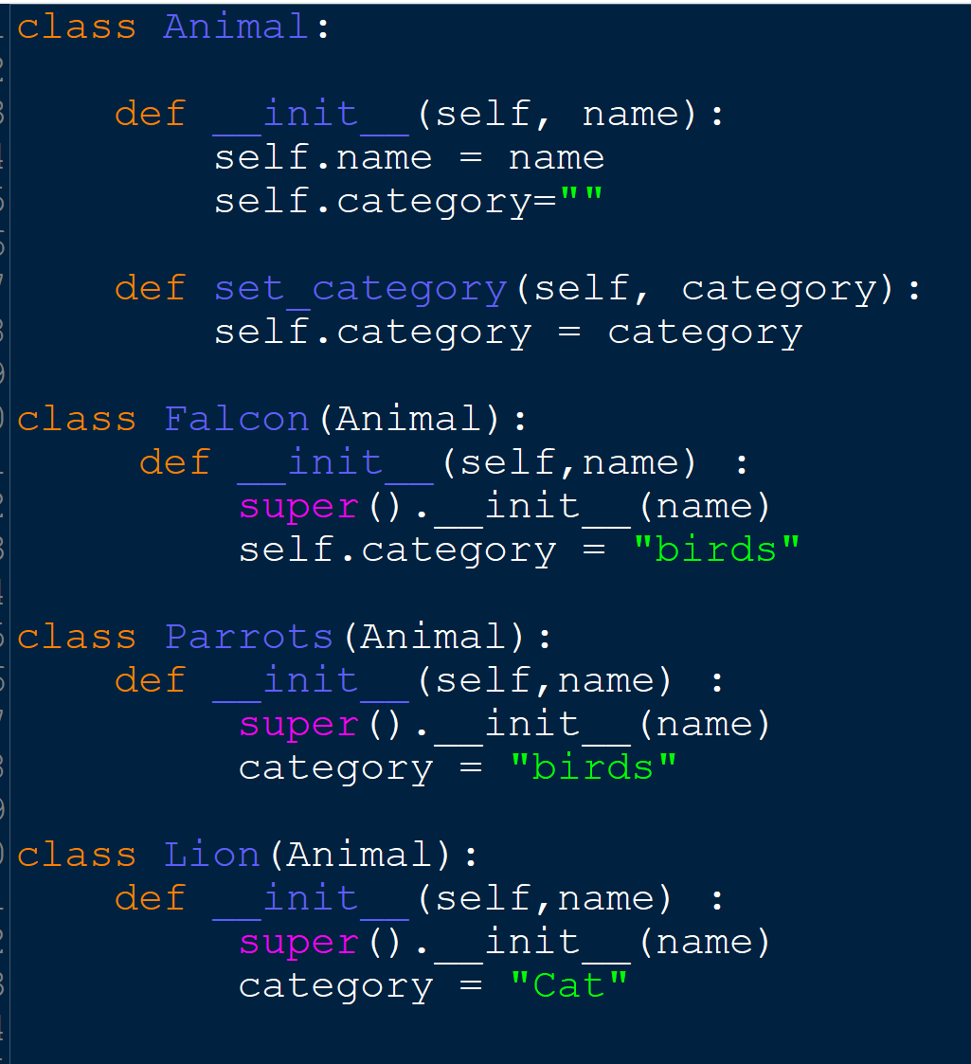
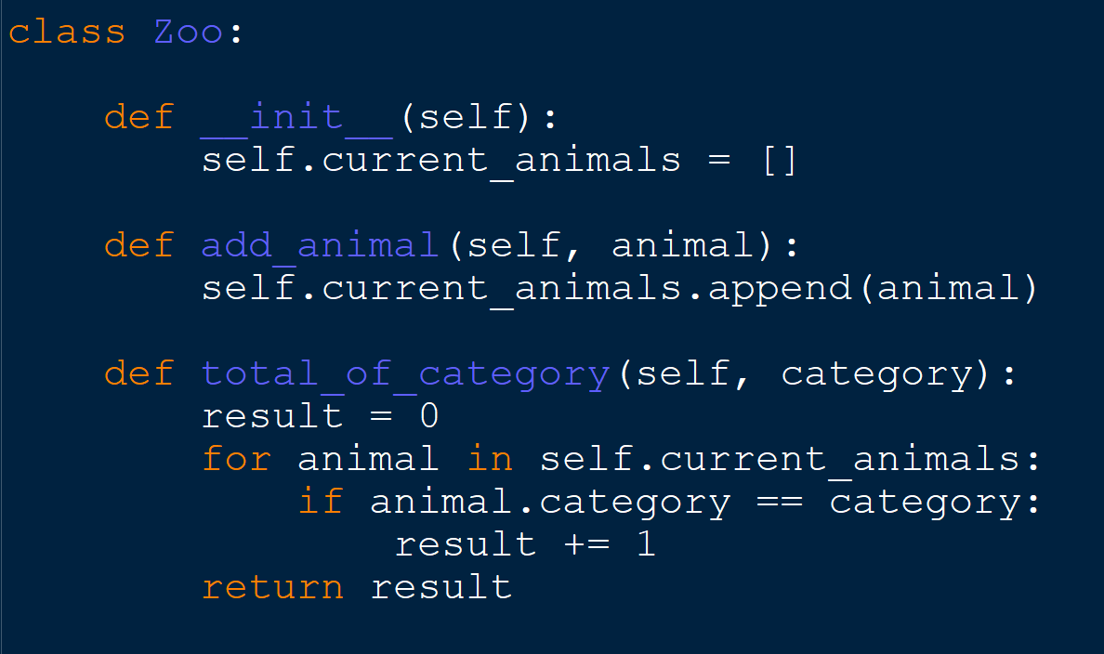
Example 2

Slide 36
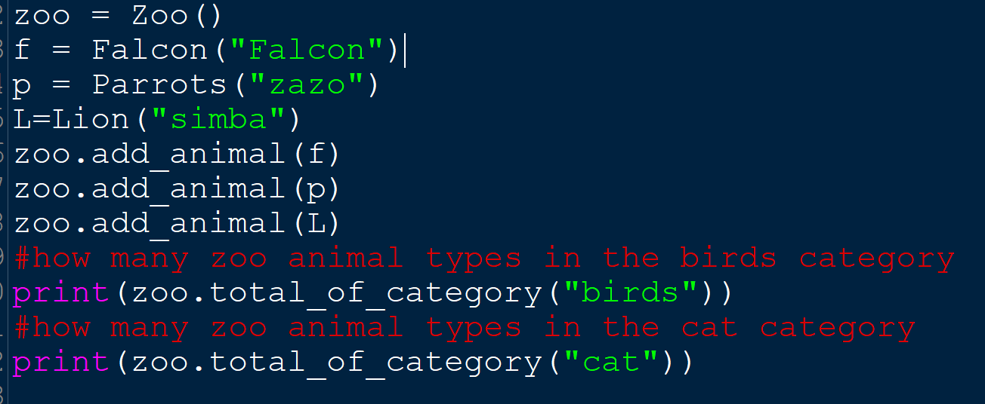
Example 2

Slide 37
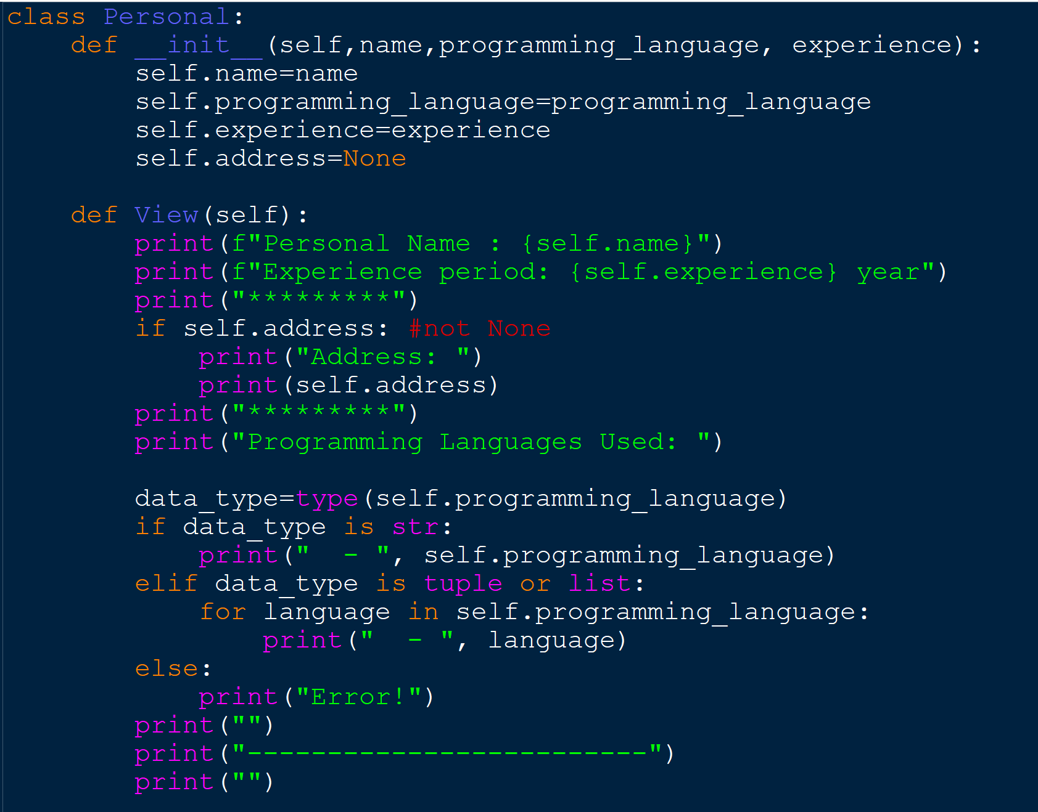
EXTRA example

Slide 38
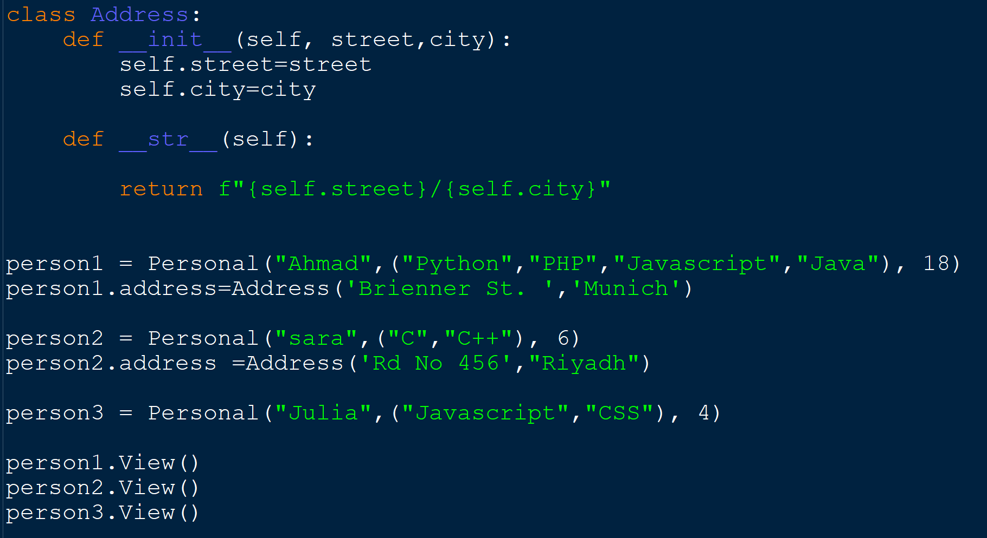
EXTRA example

Slide 39
References:
Tony Gaddis - Starting Out with Python, Global Edition (2018, Pearson Education)
https://www.programiz.com/python-programming/multiple-inheritance
https://realpython.com/inheritance-composition-python/
https://pythonspot.com/polymorphism/
https://www.geeksforgeeks.org/inheritance-and-composition-in-python/
https://www.pythonprogramming.in/give-an-example-of-composition-in-python.html
https://medium.com/swlh/the-best-way-to-understand-composition-in-python-5-case-studies-and-solution-4b23a6a2cc38

