Slide 1
Chapter 11 JavaScript: Objects
Internet & World Wide Web How to Program, 5/e

Slide 2
11.1 Introduction
This chapter presents a more formal treatment of objects.

Slide 3
11.2 Math Object
Math object methods enable you to conveniently perform many common mathematical calculations.
An object’s methods are called by writing the name of the object followed by a dot operator (.) and the name of the method
In parentheses following the method name are arguments to the method

Slide 4
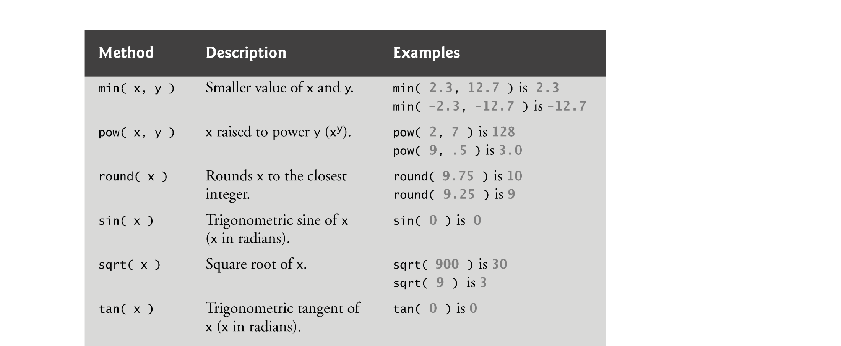

Slide 5
11.3 Date Object
Date object provides methods for date and time manipulations
Based either on the computer’s local time zone or on World Time Standard’s Coordinated Universal Time (abbreviated UTC)
Most methods have a local time zone and a UTC version
Empty parentheses after an object name indicate a call to the object’s constructor with no arguments
A constructor is an initializer method for an object
Called automatically when an object is allocated with new
The Date constructor with no arguments initializes the Date object with the local computer’s current date and time

Slide 6
11.3 Date Object
A new Date object can be initialized by supplying arguments to the Date constructor for year, month, date, hours, minutes, seconds and milliseconds.
Hours, minutes, seconds and milliseconds arguments are all optional
If any one of these arguments is not specified, a zero is supplied in its place
If an argument is specified, all arguments to its left must be specified

Slide 7
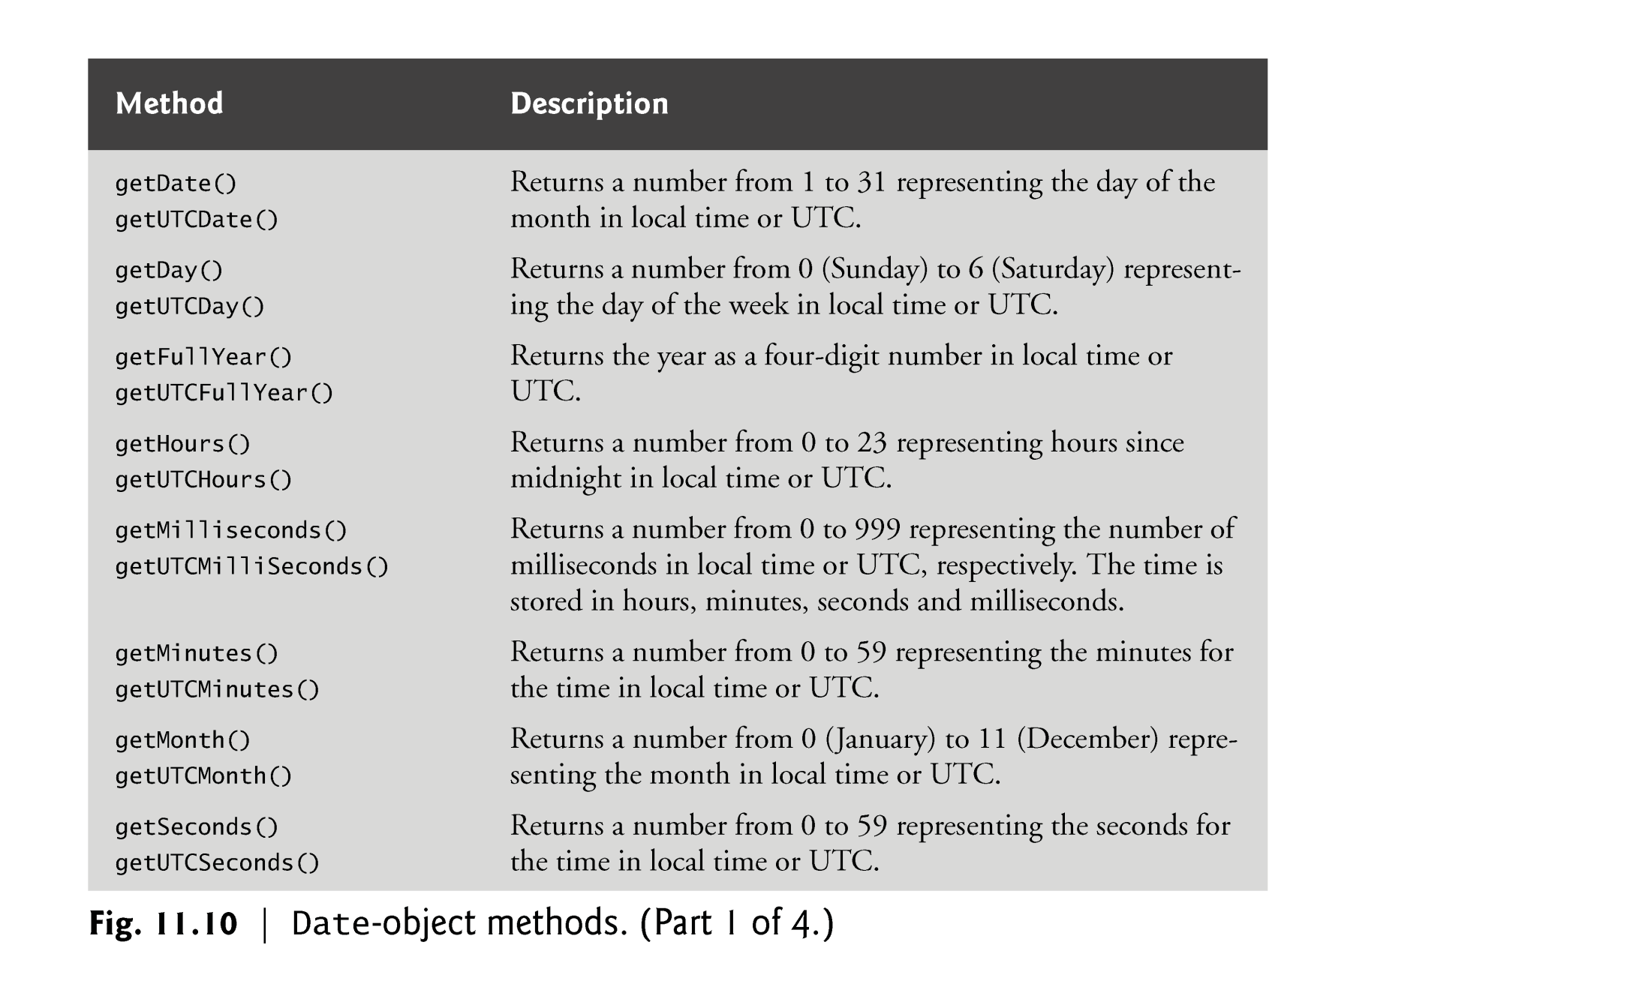

Slide 9
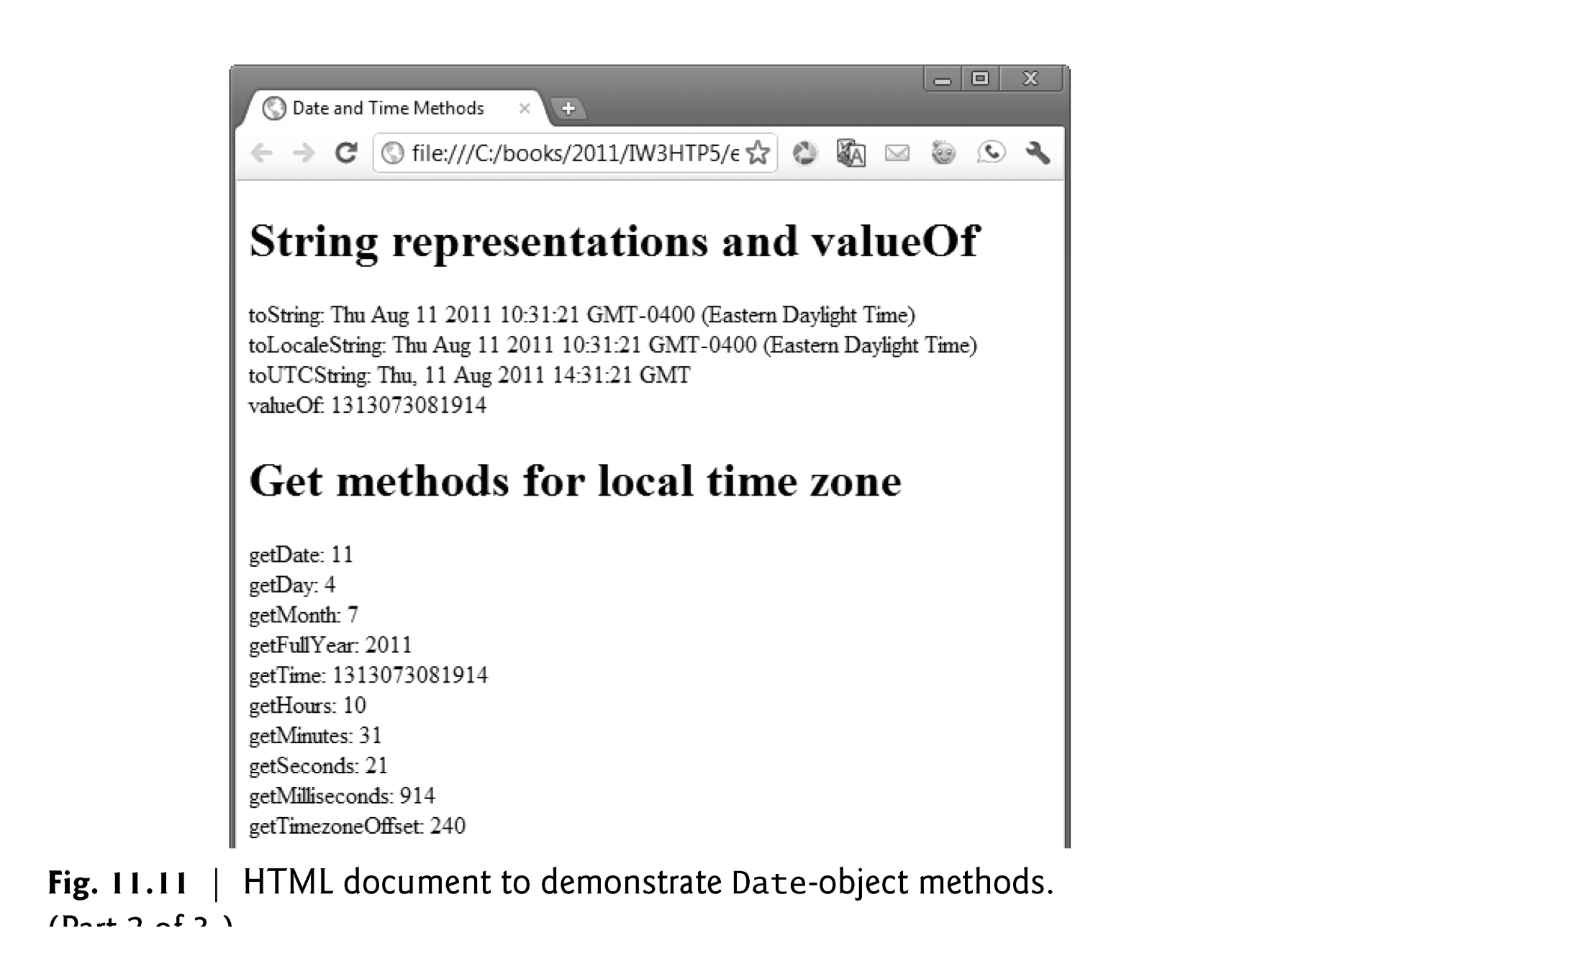

Slide 11
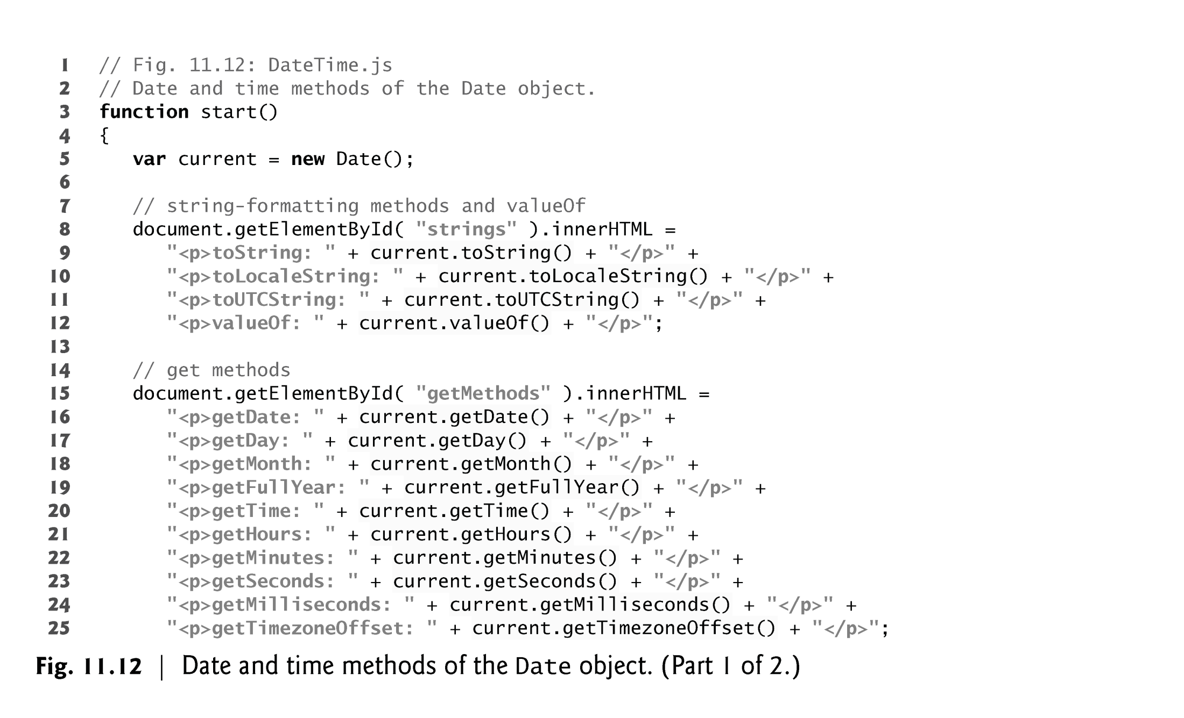

Slide 12
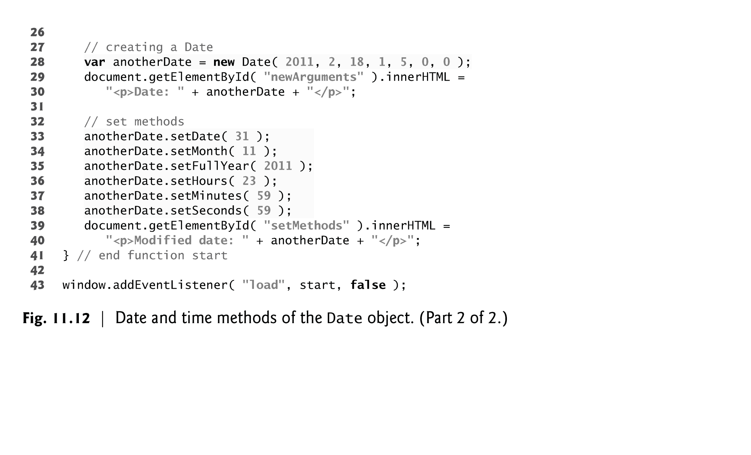

Slide 13
11.4 document Object
document object
Provided by the browser and allows JavaScript code to manipulate the current document in the browser

Slide 15
11.5 String Object
Characters are the building blocks of JavaScript programs
Every program is composed of a sequence of characters grouped together meaningfully that is interpreted by the computer as a series of instructions used to accomplish a task
A string is a series of characters treated as a single unit
A string may include letters, digits and various special characters, such as +, -, *, /, and $
JavaScript supports Unicode, which represents a large portion of the world’s languages
String literals or string constants are written as a sequence of characters in double or single quotation marks

Slide 16
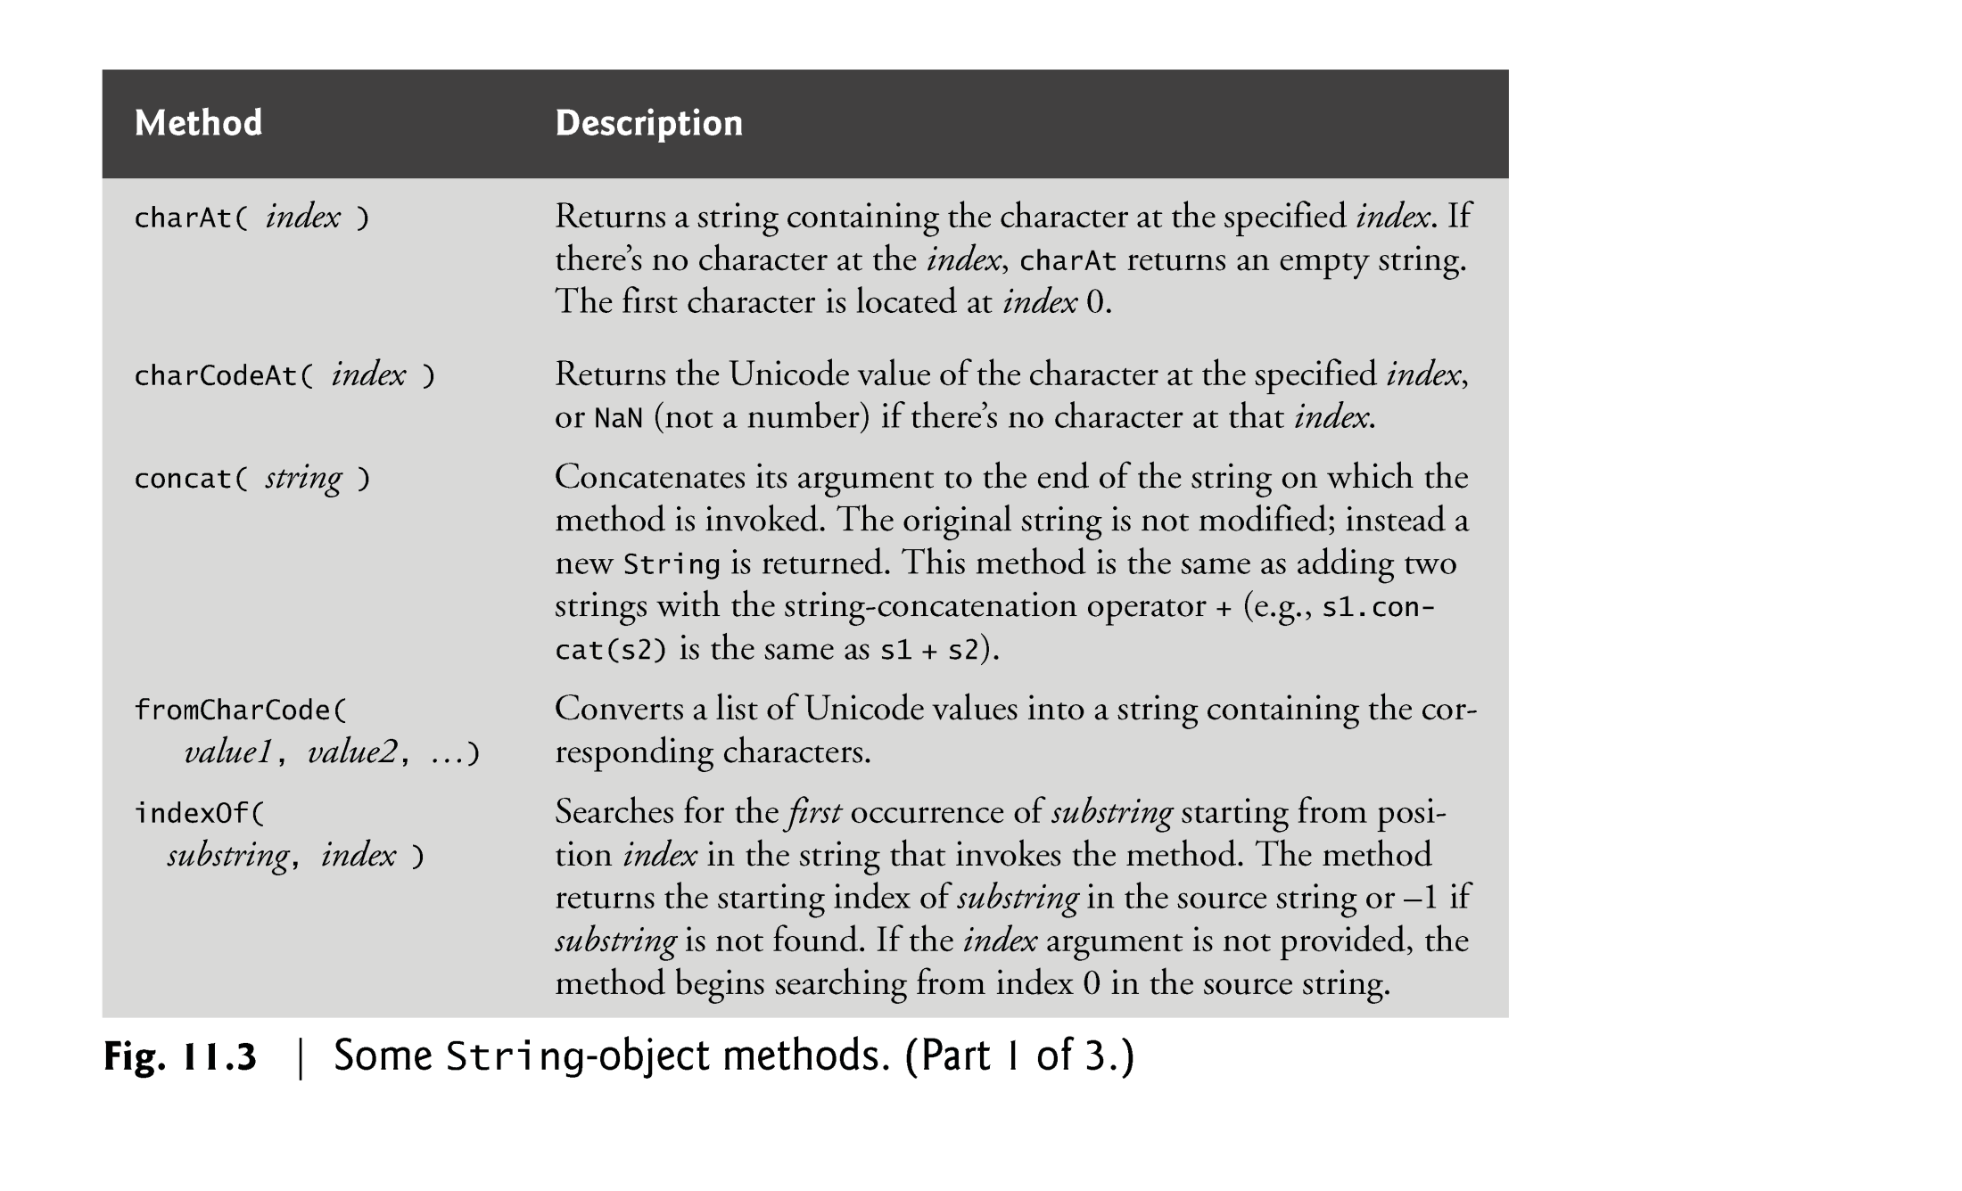

Slide 17
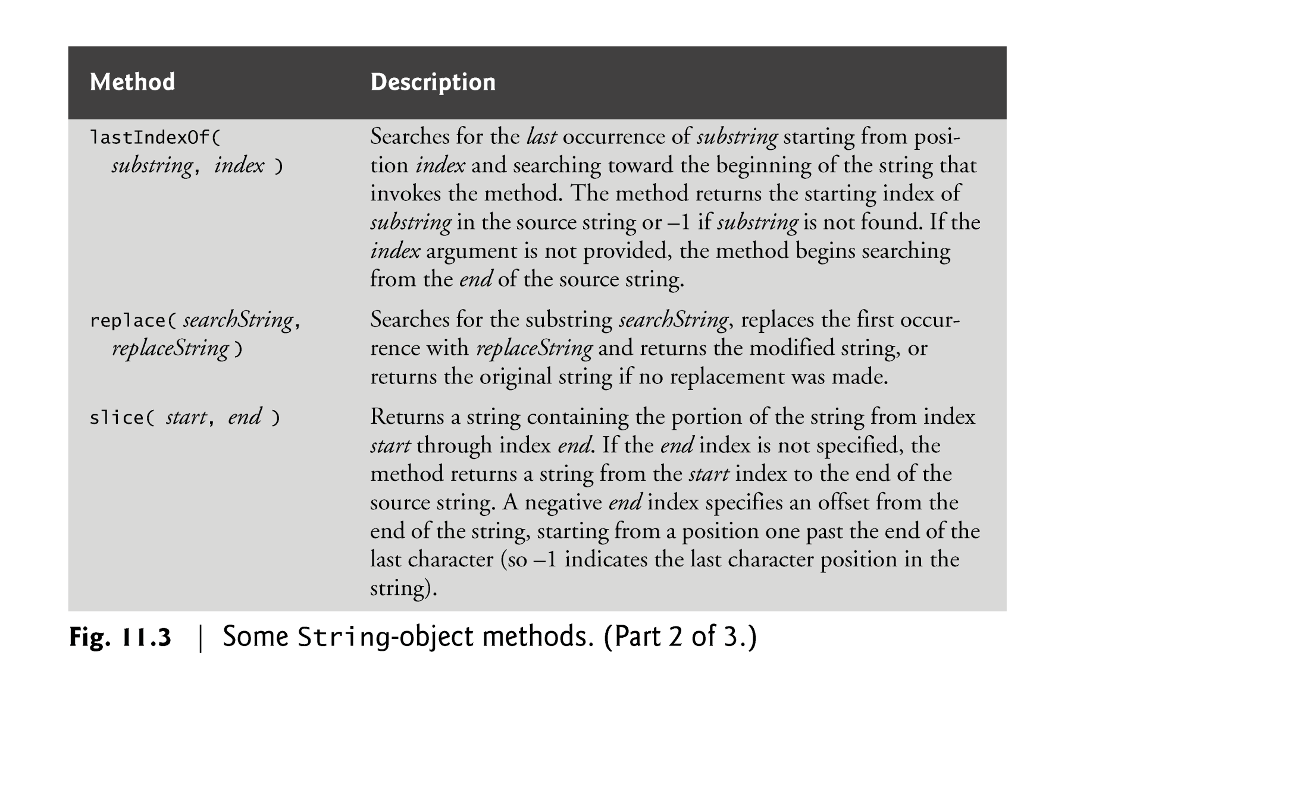

Slide 18
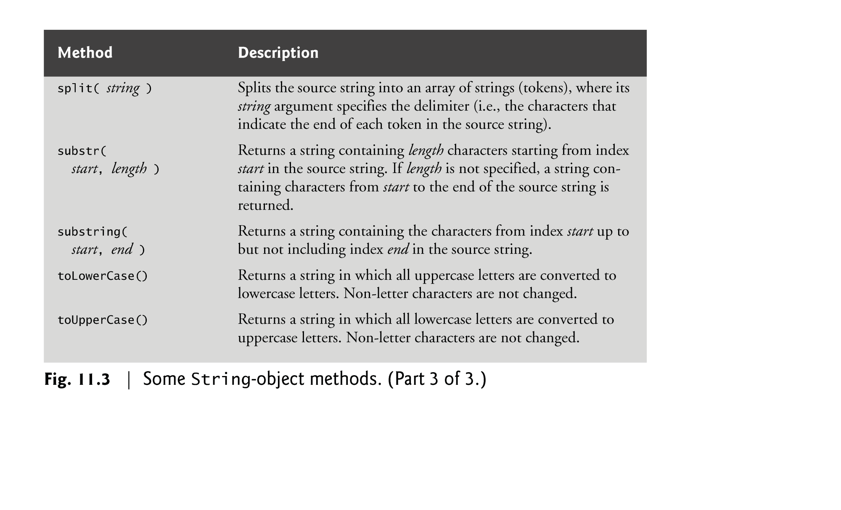

Slide 19
11.5.1 Character Processing Methods
String method charAt
Returns the character at a specific position
Indices for the characters in a string start at 0 (the first character) and go up to (but do not include) the string’s length
If the index is outside the bounds of the string, the method returns an empty string
String method charCodeAt
Returns the Unicode value of the character at a specific position
If the index is outside the bounds of the string, the method returns NaN.

Slide 20
11.5.1 Character Processing Methods (Cont.)
String method fromCharCode
Returns a string created from a series of Unicode values
String method toLowerCase
Returns the lowercase version of a string
String method toUpperCase
Returns the uppercase version of a string

Slide 22
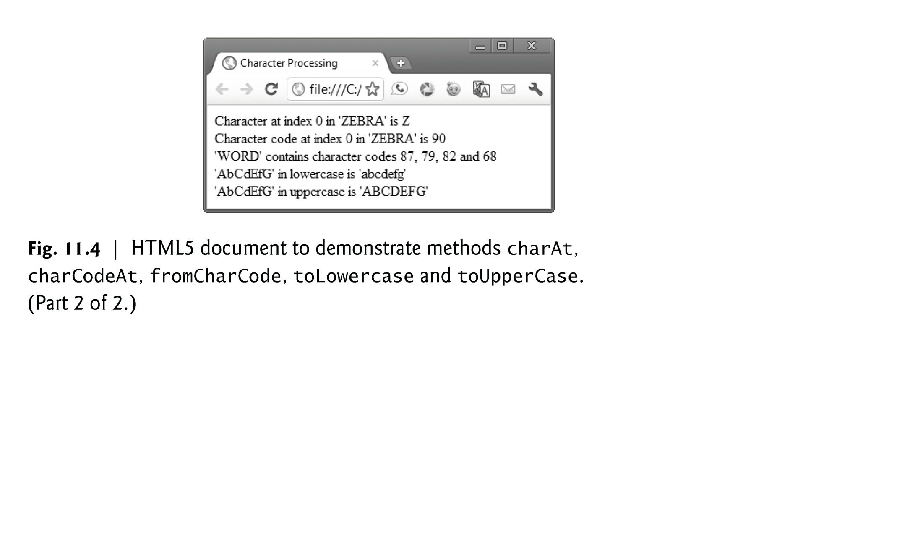

Slide 23
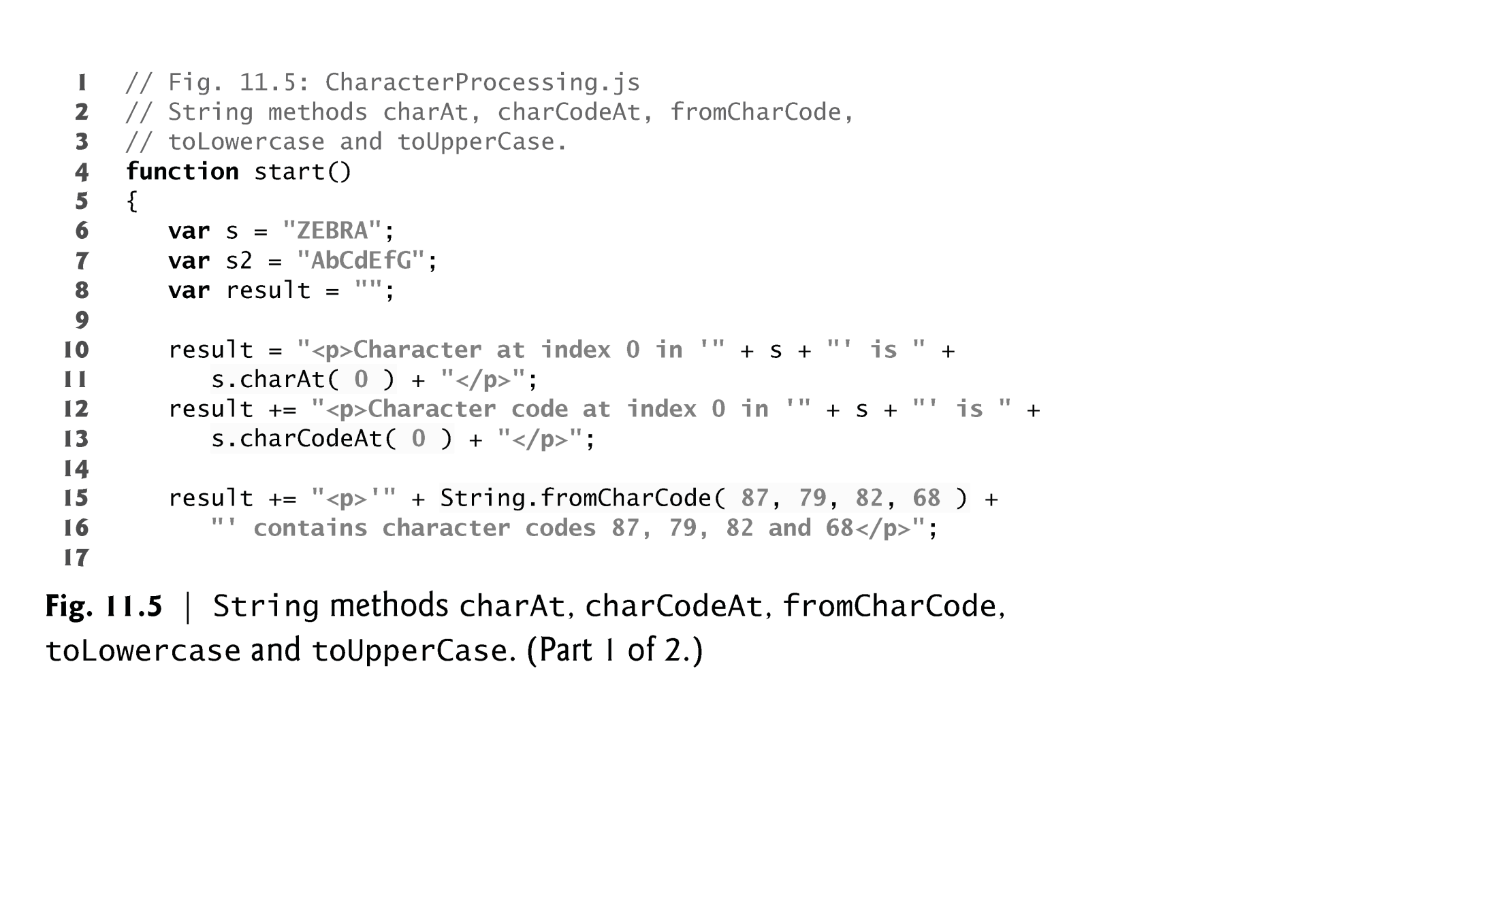

Slide 24
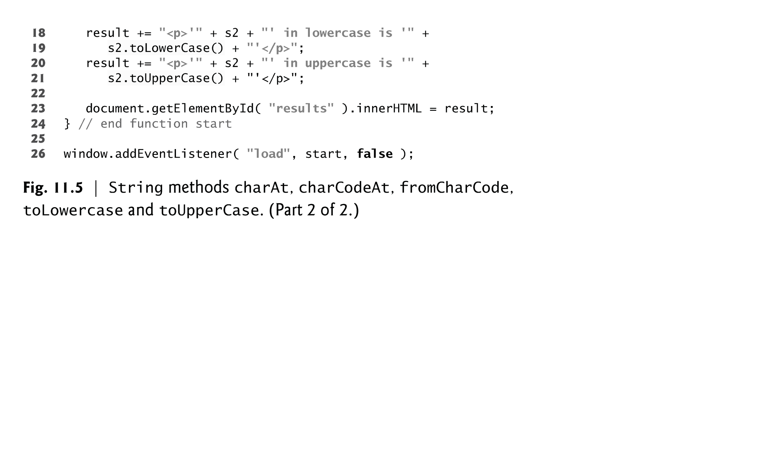

Slide 25
11.5.2 Searching Methods
String method indexOf
Determines the location of the first occurrence of its argument in the string used to call the method.
If the substring is found, the index at which the first occurrence of the substring begins is returned; otherwise, -1 is returned.
Receives an optional second d argument specifying the index from which to begin the search.
String method lastIndexOf
Determines the location of the last occurrence of its argument in the string used to call the method
If the substring is found, the index at which the last occurrence of the substring begins is returned; otherwise, -1 is returned
Receives an optional second argument specifying the index from which to begin the search

Slide 26
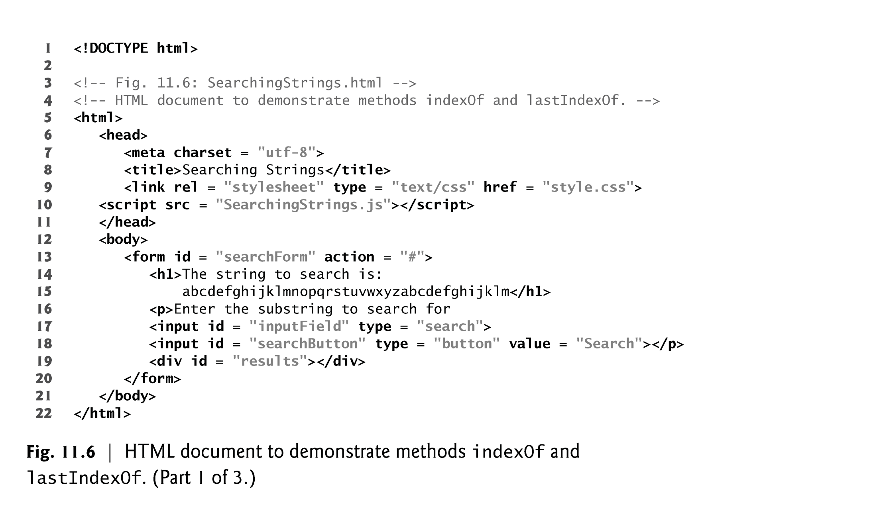

Slide 28
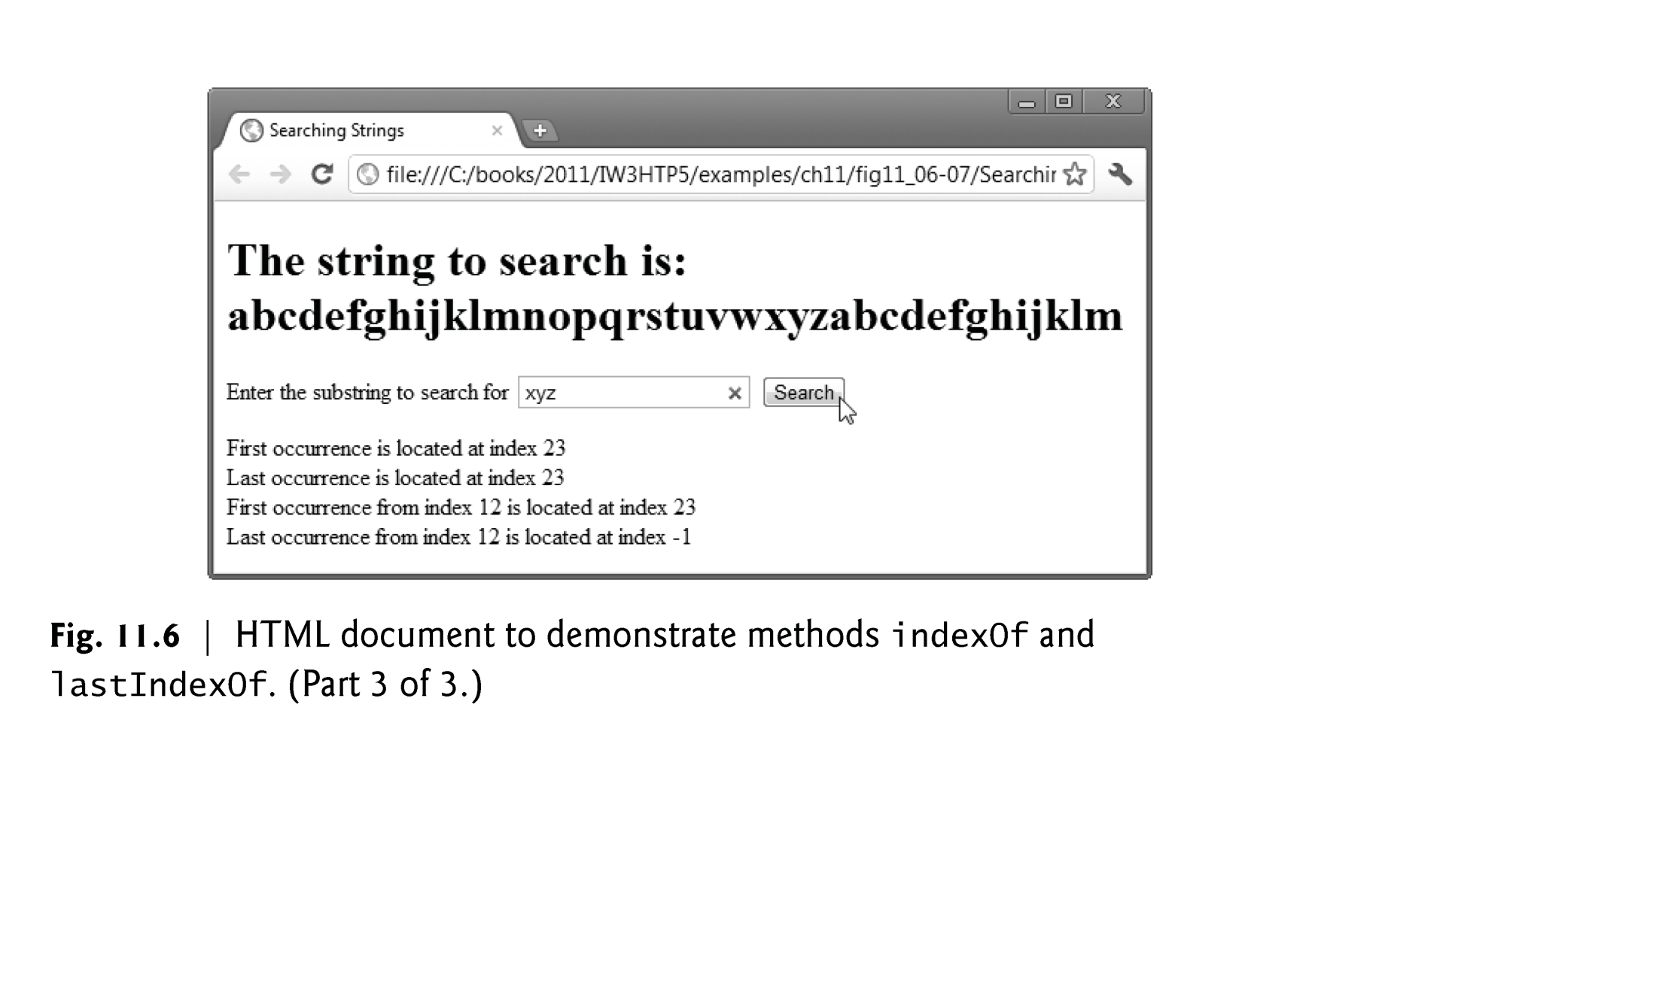

Slide 30
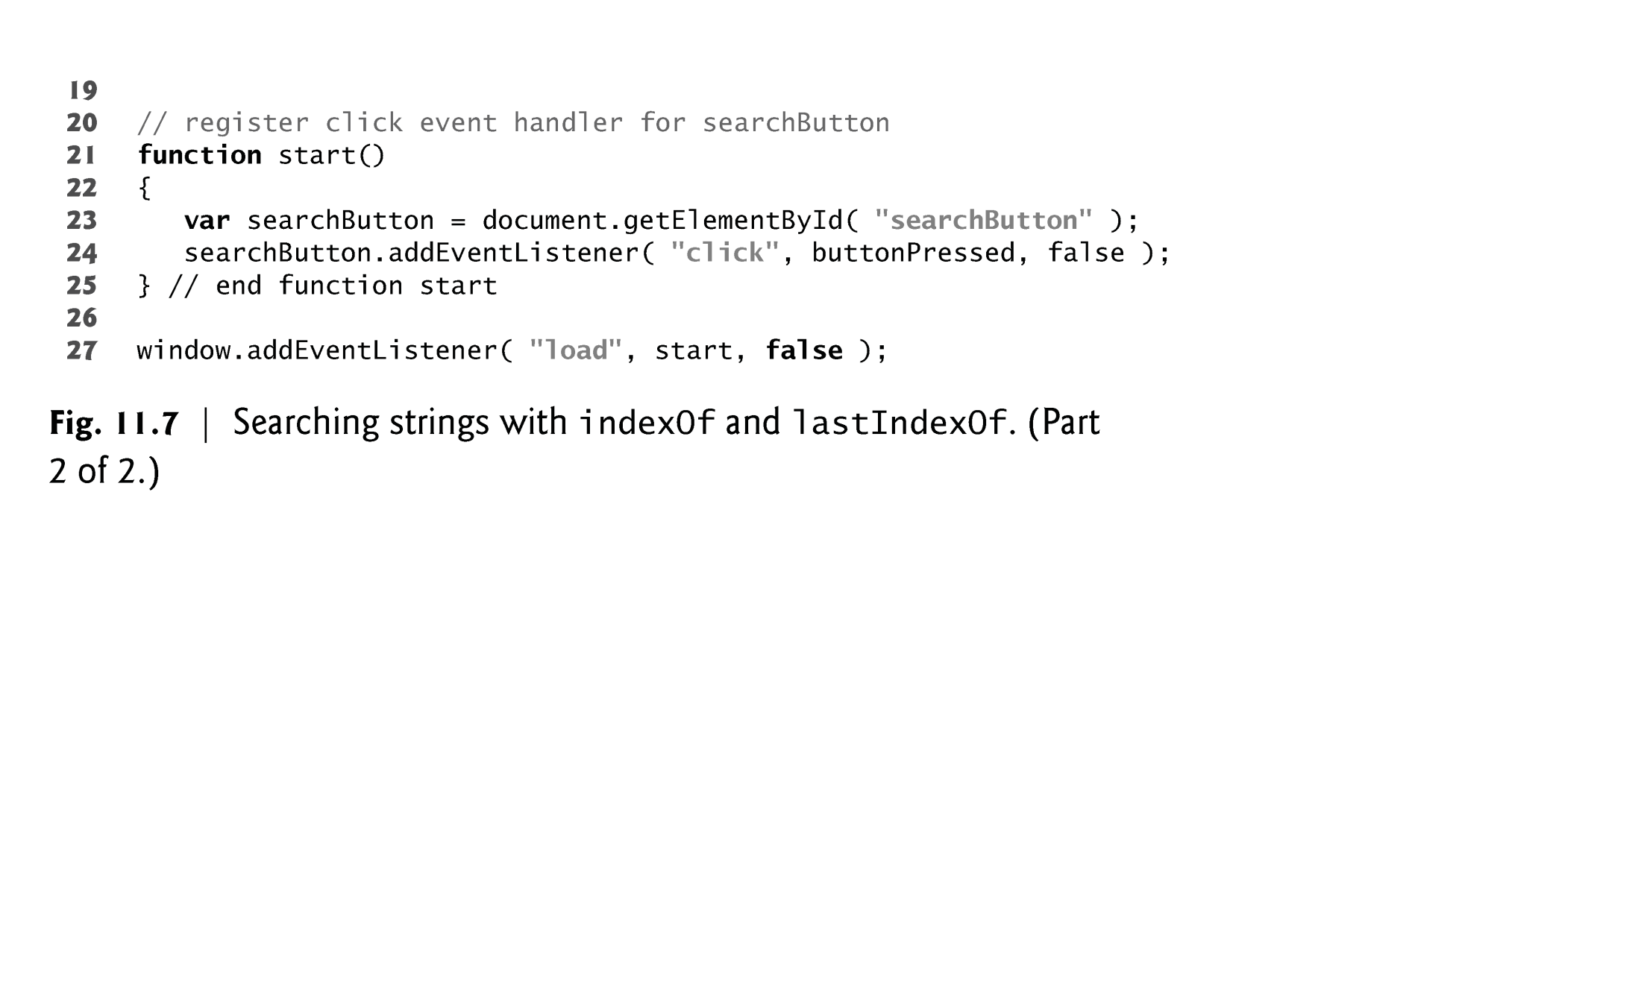

Slide 31
11.5.3 Splitting Strings and Obtaining Substrings
Breaking a string into tokens is called tokenization
Tokens are separated from one another by delimiters, typically white-space characters such as blank, tab, newline and carriage return
Other characters may also be used as delimiters to separate tokens
String method split
Breaks a string into its component tokens
Argument is the delimiter string
Returns an array of strings containing the tokens
String method substring
Returns the substring from the starting index (its first argument) up to but not including the ending index (its second argument)
If the ending index is greater than the length of the string, the substring returned includes the characters from the starting index to the end of the original string
delimiter string
the string that determines the end of each token in the original string.

Slide 33
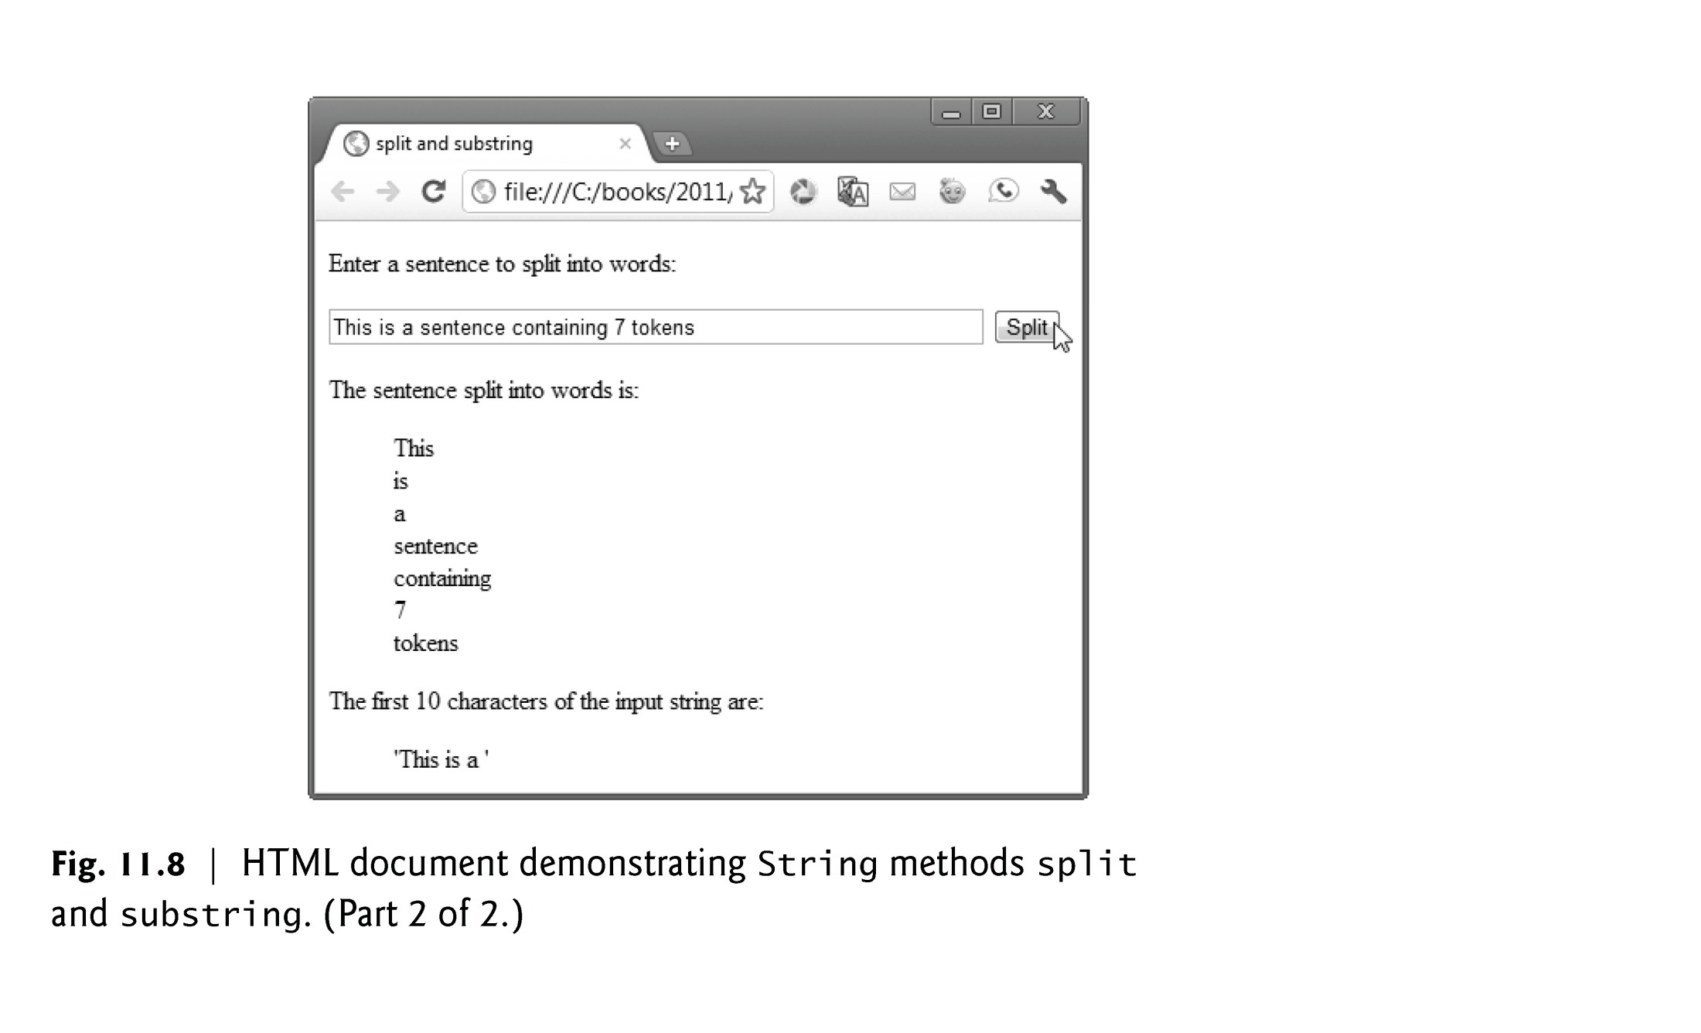

Slide 34
