Slide 1
Chapter 6 JavaScript: Introduction to Scripting
Internet & World Wide Web How to Program, 5/e

Slide 2
6.1 Introduction
JavaScript
Scripting language which is used to enhance the functionality and appearance of web pages.
Before you can run code examples with JavaScript on your computer, you may need to change your browser’s security settings.
IE9 prevents scripts on the local computer from running by default
Firefox, Chrome, Opera, Safari (including on the iPhone) and the Android browser have JavaScript enabled by default.

Slide 3
Common Uses of JavaScript
Display a message box
Select list navigation
Edit and validate form information
Create a new window with a specified size and screen position
Image Rollovers
Status Messages
Display Current Date
Calculations

Slide 4
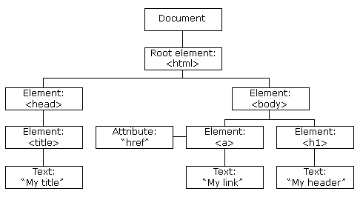
The HTML DOM (Document Object Model)
When a web page is loaded, the browser creates a Document Object Model of the page.
The HTML DOM model is constructed as a tree of Objects.

Slide 5
The HTML DOM (Document Object Model)
With the object model, JavaScript gets all the power it needs to create dynamic HTML:
JavaScript can change all the HTML elements in the page
JavaScript can change all the HTML attributes in the page
JavaScript can change all the CSS styles in the page
JavaScript can remove existing HTML elements and attributes
JavaScript can add new HTML elements and attributes
JavaScript can react to all existing HTML events in the page
JavaScript can create new HTML events in the page

Slide 6
6.2 Your First Script: Displaying a Line of Text with JavaScript in a Web Page
We begin with a simple script that displays the text "Welcome to JavaScript Programming!" in the HTML5 document.
All major web browsers contain JavaScript interpreters, which process the commands written in JavaScript.
The JavaScript code and its result are shown in Fig. 6.1.

Slide 8
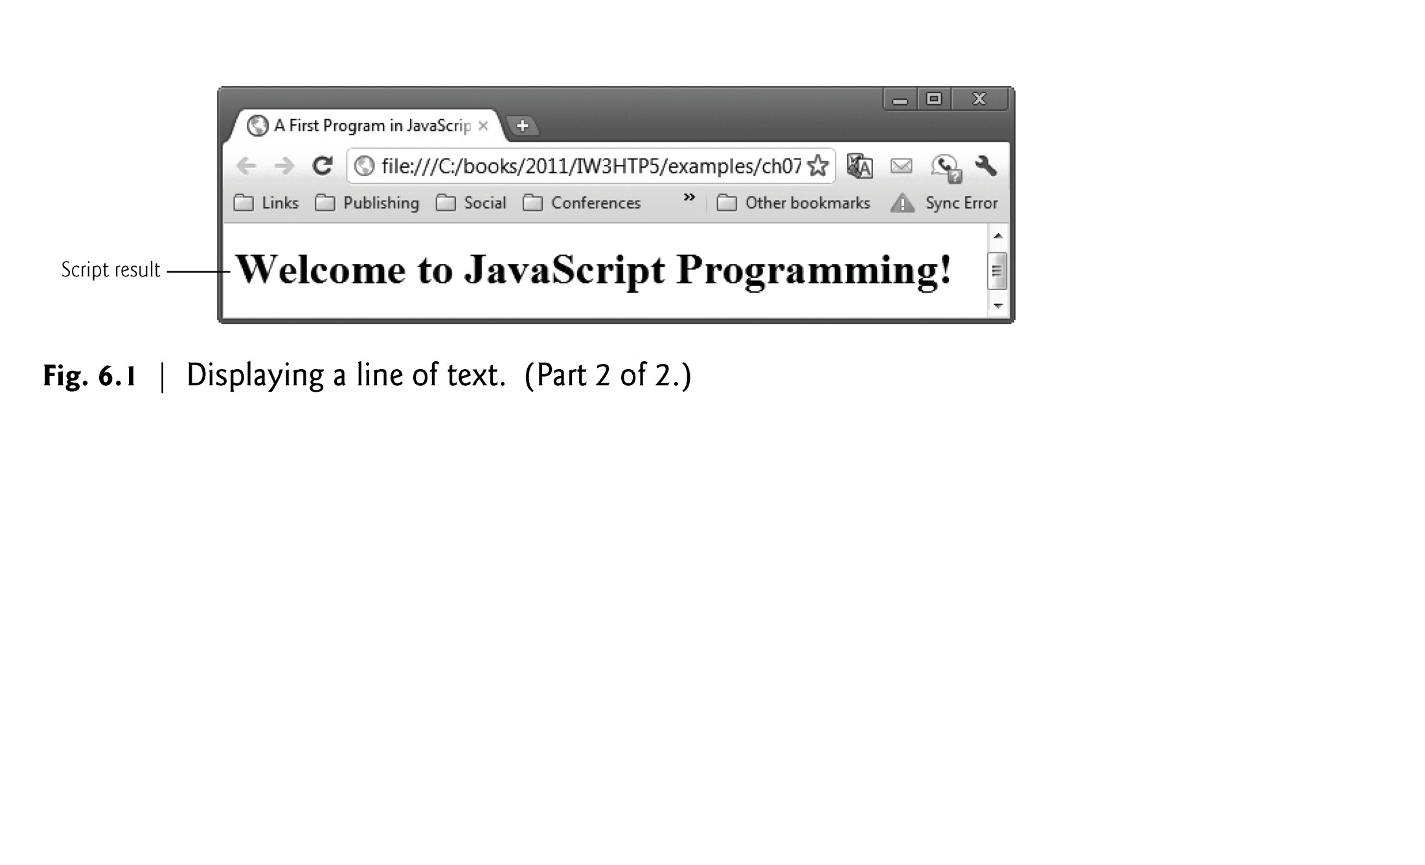

Slide 9
6.2 Your First Script: Displaying a Line of Text with JavaScript in a Web Page (cont.)
Spacing displayed by a browser in a web page is determined by the HTML5 elements used to format the page
Often, JavaScripts appear in the <head> section of the HTML5 document
The browser interprets the contents of the <head> section first

Slide 10
6.2 Your First Script: Displaying a Line of Text with JavaScript in a Web Page (cont.)
The script Element and Commenting Your Scripts
The <script> tag indicates to the browser that the text which follows is part of a script.
The type attribute specifies the MIME type of the script as well as the scripting language used in the script—in this case, a text file written in javascript.

Slide 11
6.2 Your First Script: Displaying a Line of Text with JavaScript in a Web Page (cont.)
A string of characters can be contained between double quotation (") marks (also called a string literal)

Slide 12
6.2 Your First Script: Displaying a Line of Text with JavaScript in a Web Page (cont.)
Browser’s document object represents the HTML5 document currently being displayed in the browser
Allows you to specify HTML5 text to be displayed in the HTML5 document
Browser contains a complete set of objects that allow script programmers to access and manipulate every element of an HTML5 document
Object
Resides in the computer’s memory and contains information used by the script
The term object normally implies that attributes (data) and behaviors (methods) are associated with the object
An object’s methods use the attributes’ data to perform useful actions for the client of the object—the script that calls the methods

Slide 13
6.2 Your First Script: Displaying a Line of Text with JavaScript in a Web Page (cont.)
The parentheses following the name of a method contain the arguments that the method requires to perform its task (or its action)
Every statement should end with a semicolon (also known as the statement terminator), although none is required by JavaScript
JavaScript is case sensitive
Not using the proper uppercase and lowercase letters is a syntax error

Slide 14
6.2 Your First Script: Displaying a Line of Text with JavaScript in a Web Page (cont.)
The document object’s writeln method
Writes a line of HTML5 text in the HTML5 document
Does not guarantee that a corresponding line of text will appear in the HTML5 document.
Text displayed is dependent on the contents of the string written, which is subsequently rendered by the browser.
Browser will interpret the HTML5 elements as it normally does to render the final text in the document

Slide 15
6.2 Your First Script: Displaying a Line of Text with JavaScript in a Web Page (cont.)
A Note About Embedding JavaScript Code into HTML5 Documents
JavaScript code is typically placed in a separate file, then included in the HTML5 document that uses the script.
This makes the code more reusable, because it can be included into any HTML5 document—as is the case with the many JavaScript libraries used in professional web development today.

Slide 16
6.3 Modifying Your First Script
A script can display Welcome to JavaScript Programming! in many ways.
Figure 6.2 displays the text in magenta, using the CSS color property.
Method write displays a string like writeln, but does not position the output cursor in the HTML5 document at the beginning of the next line after writing its argument

Slide 18
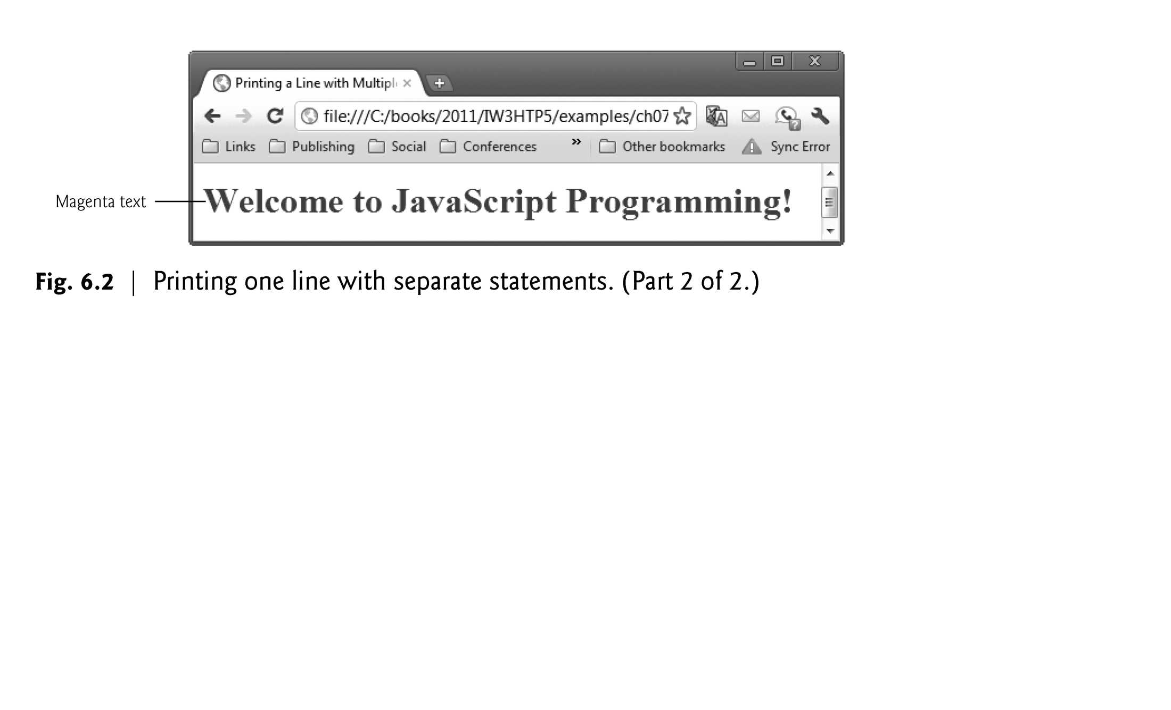

Slide 19
6.3 Modifying Your First Script (Cont.)
The + operator (called the “concatenation operator” when used in this manner) joins two strings together

Slide 20
6.3 Modifying Your First Script (Cont.)
Displaying Text in an Alert Dialog
Dialogs
Useful to display information in windows that “pop up” on the screen to grab the user’s attention
Typically used to display important messages to the user browsing the web page
Browser’s window object uses method alert to display an alert dialog
Method alert requires as its argument the string to be displayed

Slide 22
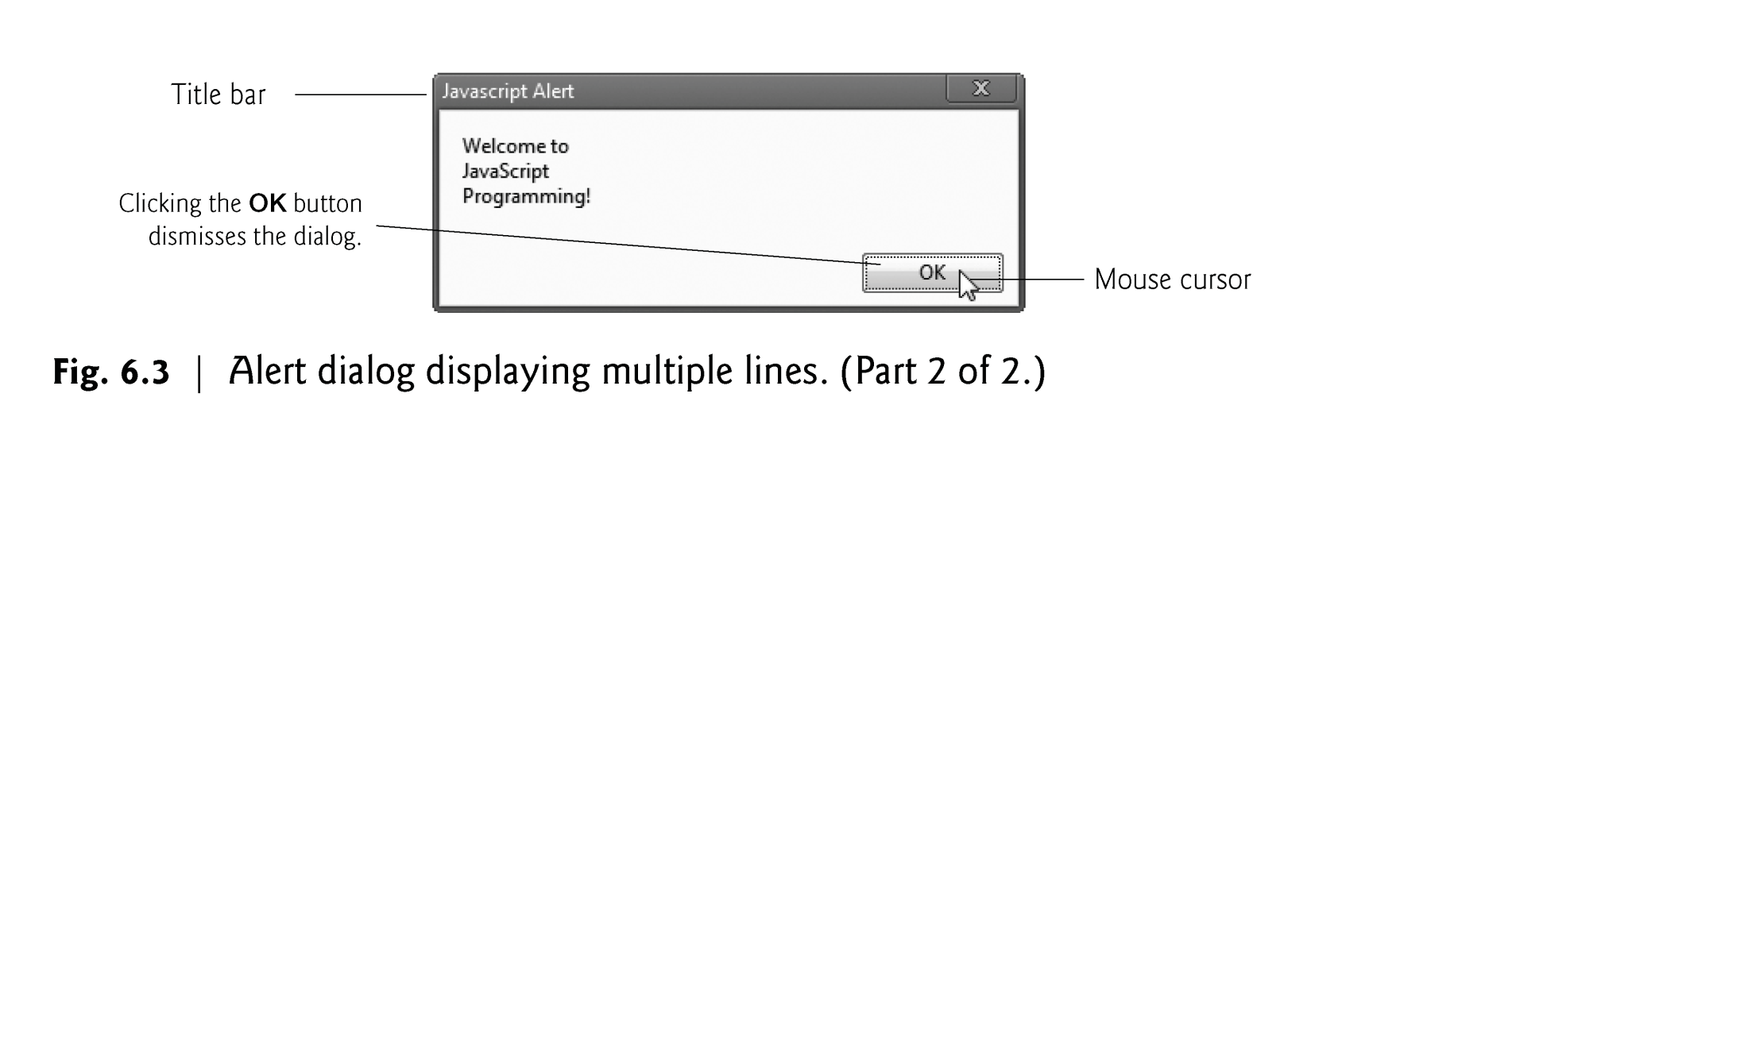

Slide 23
6.3 Modifying Your First Script (Cont.)
Escape Sequences
When a backslash is encountered in a string of characters, the next character is combined with the backslash to form an escape sequence. The escape sequence \n is the newline character. It causes the cursor in the HTML5 document to move to the beginning of the next line.

Slide 24
6.4 Obtaining User Input with prompt Dialogs
Scripting
Gives you the ability to generate part or all of a web page’s content at the time it is shown to the user
Such web pages are said to be dynamic, as opposed to static, since their content can change

Slide 25
6.4.1 Dynamic Welcome Page
The next script creates a dynamic welcome page that obtains the user’s name, then displays it on the page.
The script uses another predefined dialog box from the window object—a prompt dialog—which allows the user to enter a value that the script can use.
Figure 6.5 presents the script and sample output.

Slide 26
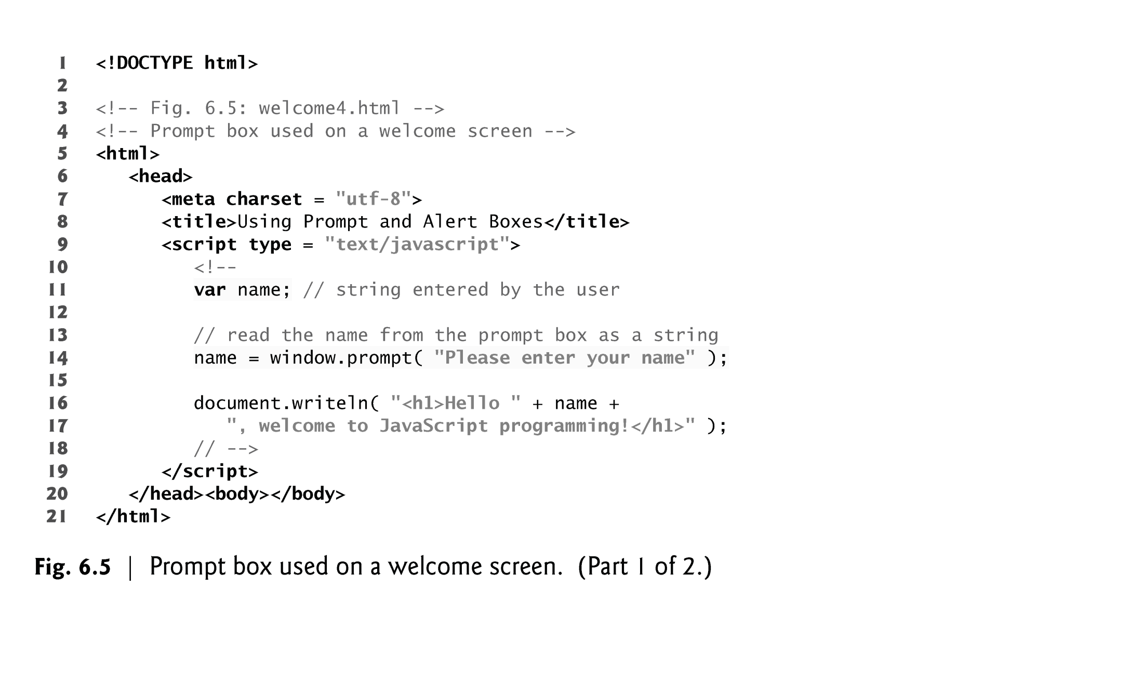

Slide 27
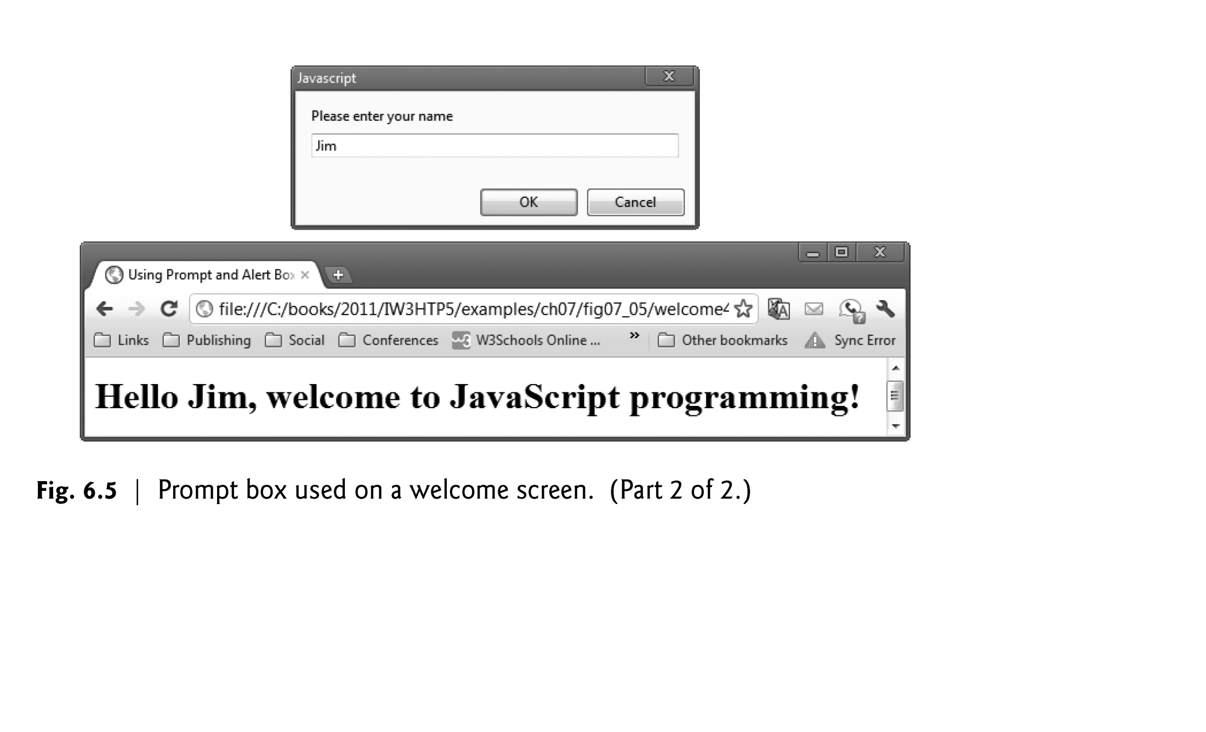

Slide 28
6.4.1 Dynamic Welcome Page (cont.)
Keywords are words with special meaning in JavaScript
Keyword var
Used to declare the names of variables
A variable is a location in the computer’s memory where a value can be stored for use by a script
All variables have a name, type and value, and should be declared with a var statement before they are used in a script
A variable name can be any valid identifier consisting of letters, digits, underscores ( _ ) and dollar signs ($) that does not begin with a digit and is not a reserved JavaScript keyword.

Slide 29
6.4.1 Dynamic Welcome Page (cont.)
Declarations end with a semicolon (;) and can be split over several lines, with each variable in the declaration separated by a comma (forming a comma-separated list of variable names)
Several variables may be declared in one declaration or in multiple declarations.
Comments
A single-line comment begins with the characters // and terminates at the end of the line
Comments do not cause the browser to perform any action when the script is interpreted; rather, comments are ignored by the JavaScript interpreter
Multiline comments begin with delimiter /* and end with delimiter */
All text between the delimiters of the comment is ignored by the interpreter.

Slide 30
6.4.1 Dynamic Welcome Page (cont.)
The window object’s prompt method displays a dialog into which the user can type a value.
The first argument is a message (called a prompt) that directs the user to take a specific action.
The optional second argument is the default string to display in the text field.
Script can then use the value that the user inputs.

Slide 32
6.4.1 Dynamic Welcome Page (cont.)
A variable is assigned a value with an assignment statement, using the assignment operator, =.
The = operator is called a binary operator, because it has two operands.

Slide 33
6.4.1 Dynamic Welcome Page (cont.)
null keyword
Signifies that a variable has no value
null is not a string literal, but rather a predefined term indicating the absence of value
Writing a null value to the document, however, displays the word “null”
Function parseInt
converts its string argument to an integer
JavaScript has a version of the + operator for string concatenation that enables a string and a value of another data type (including another string) to be concatenated

Slide 34
6.4.2 Adding Integers
Our next script illustrates another use of prompt dialogs to obtain input from the user.
Figure 6.7 inputs two integers (whole numbers, such as 7, –11, 0 and 31914) typed by a user at the keyboard, computes the sum of the values and displays the result.

Slide 35
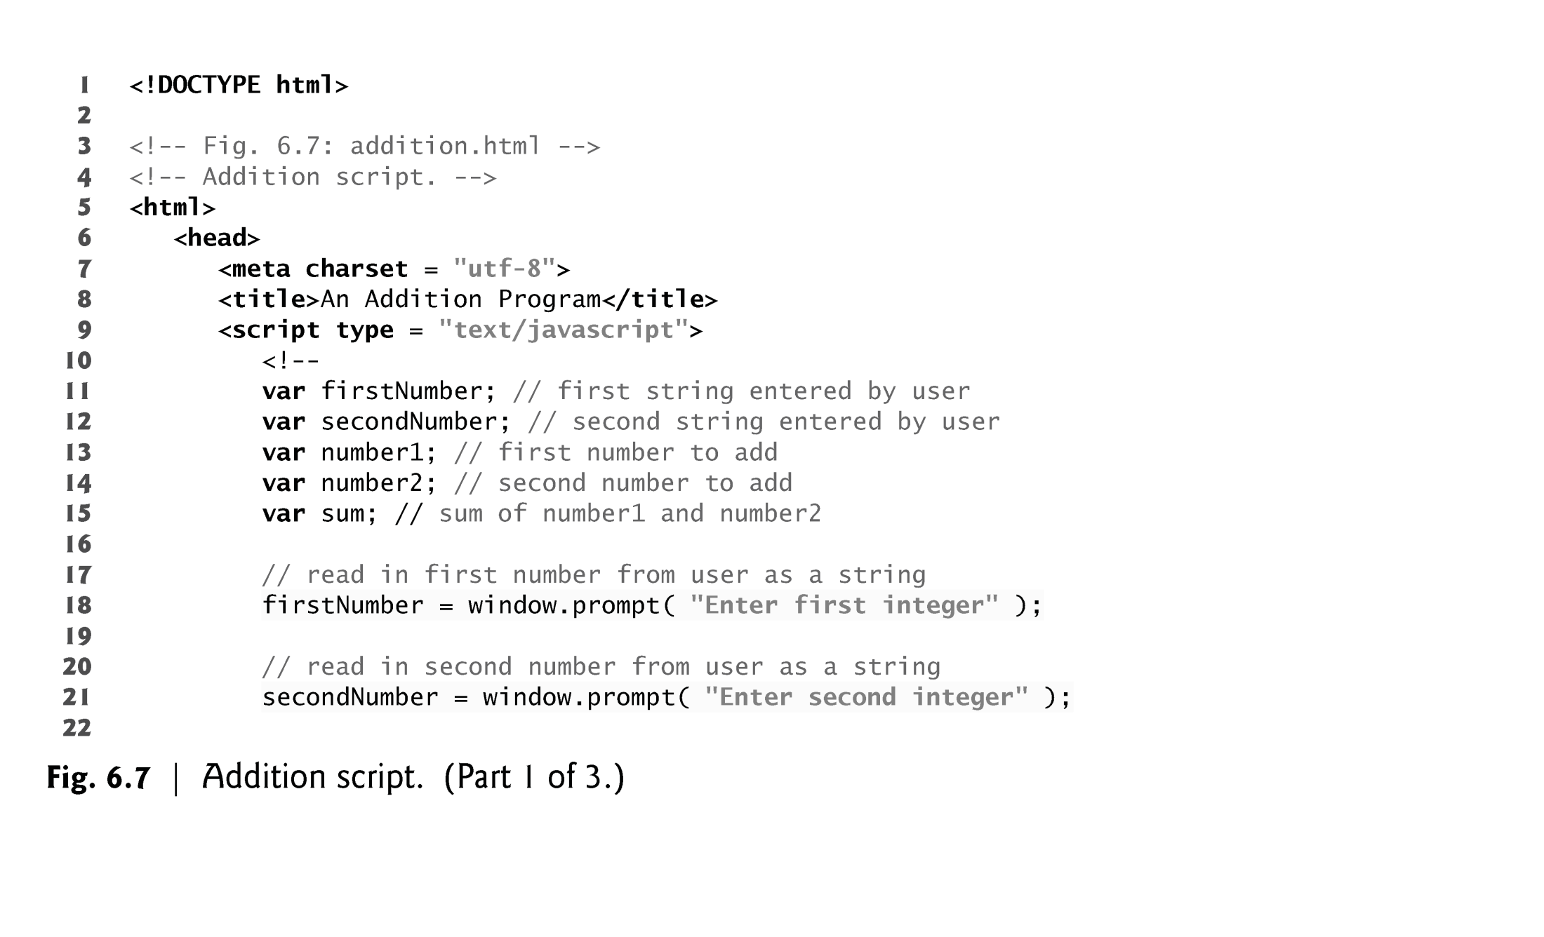

Slide 37
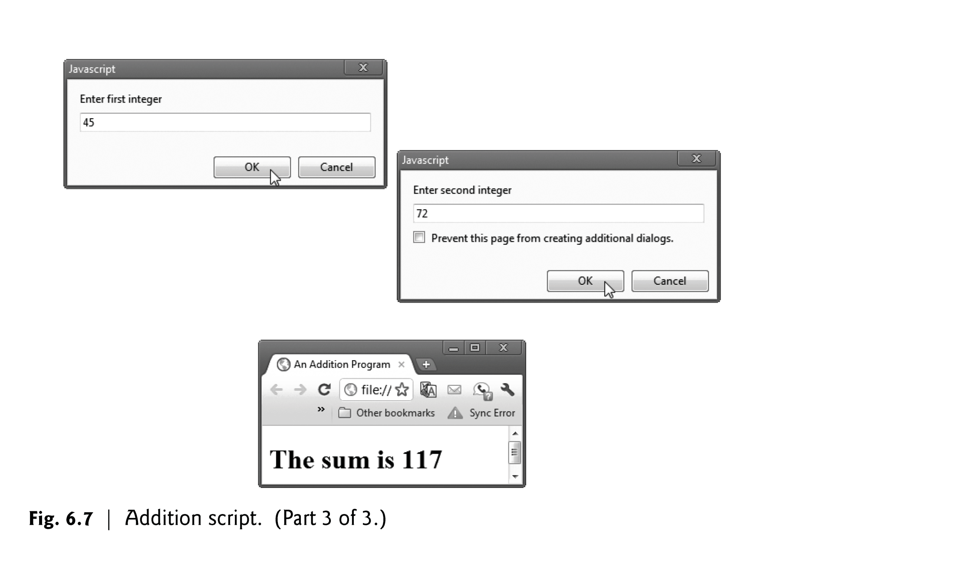

Slide 38
6.5 Memory Concepts
JavaScript does not require variables to have a type before they can be used in a script
A variable in JavaScript can contain a value of any data type, and in many situations, JavaScript automatically converts between values of different types for you
JavaScript is referred to as a loosely typed language
When a variable is declared in JavaScript, but is not given a value, it has an undefined value.
Attempting to use the value of such a variable is normally a logic error.
When variables are declared, they are not assigned default values, unless specified otherwise by the programmer.
To indicate that a variable does not contain a value, you can assign the value null to it.

Slide 39
6.6 Arithmetic
The basic arithmetic operators (+, -, *, /, and %) are binary operators, because they each operate on two operands
JavaScript provides the remainder operator, %, which yields the remainder after division
Arithmetic expressions in JavaScript must be written in straight-line form to facilitate entering programs into the computer

Slide 41
6.7 Decision Making: Equality and Relational Operators
if statement allows a script to make a decision based on the truth or falsity of a condition
If the condition is met (i.e., the condition is true), the statement in the body of the if statement is executed
If the condition is not met (i.e., the condition is false), the statement in the body of the if statement is not executed
Conditions in if statements can be formed by using the equality operators and relational operators

Slide 42
6.7 Decision Making: Equality and Relational Operators (Cont.)
Equality operators both have the same level of precedence, which is lower than the precedence of the relational operators.
The equality operators associate from left to right.

Slide 45
6.7 Decision Making: Equality and Relational Operators (Cont.)
The script in Fig. 6.14 uses four if statements to display a time-sensitive greeting on a welcome page.

Slide 46
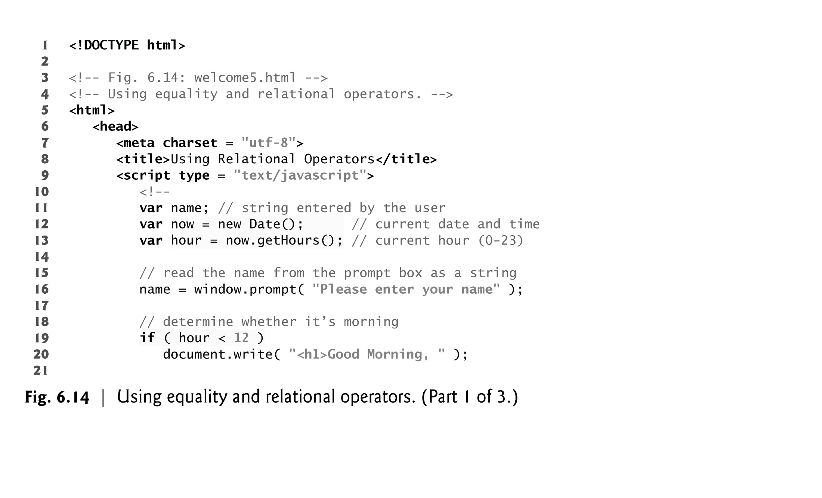

Slide 47
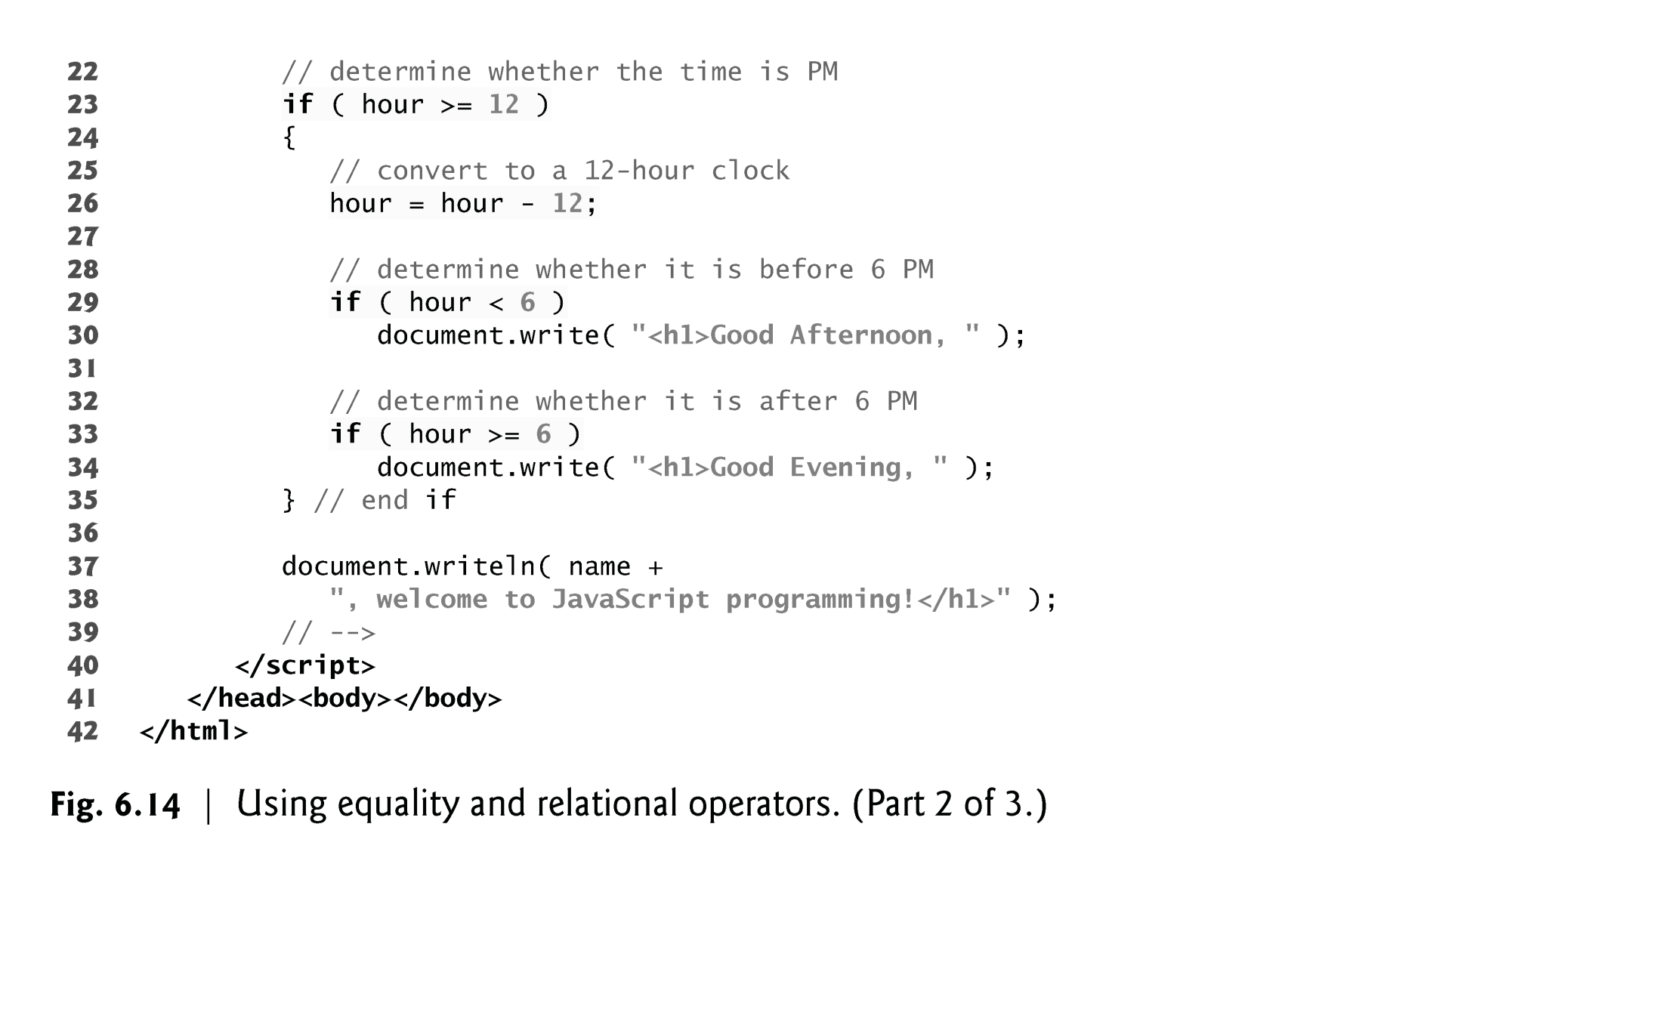

Slide 48
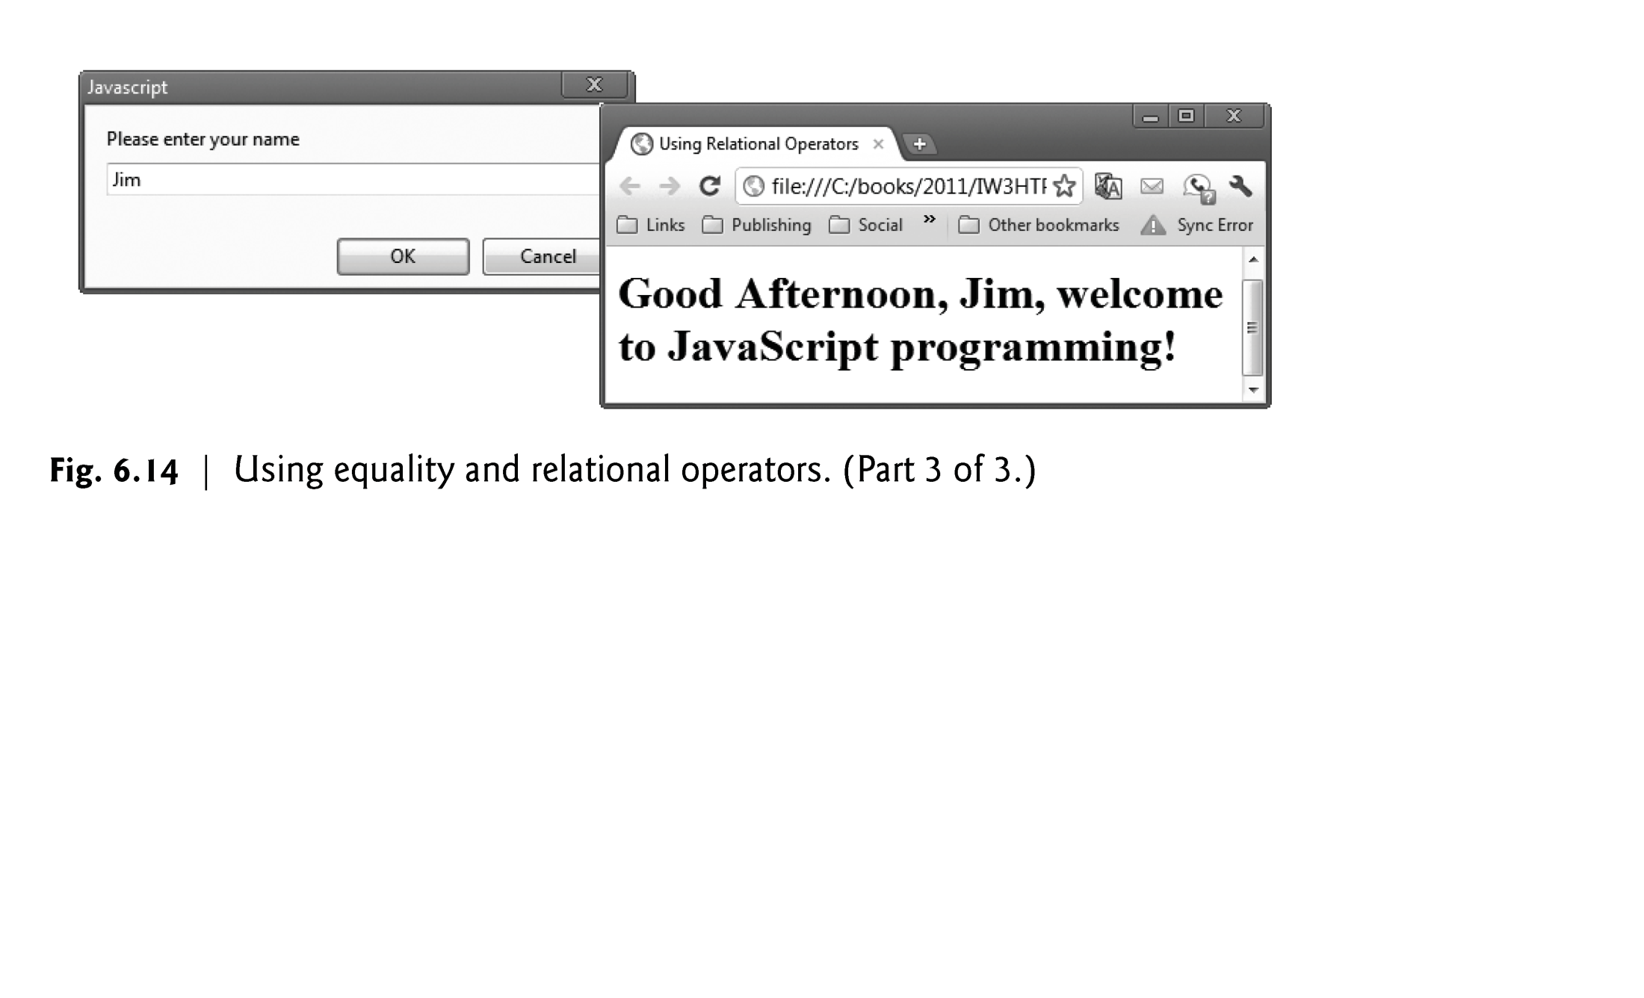

Slide 49
6.7 Decision Making: Equality and Relational Operators (Cont.)
Date object
Used acquire the current local time
Create a new instance of an object by using the new operator followed by the type of the object, Date, and a pair of parentheses

