Slide 1
Working With Financial Statements
Chapter 3

Slide 2
Key Concepts and Skills
Understand sources and uses of cash and the Statement of Cash Flows
Know how to standardize financial statements for comparison purposes
Know how to compute and interpret important financial ratios
Be able to compute and interpret the Du Pont Identity
Understand the problems and pitfalls in financial statement analysis

Slide 3
Chapter Outline
Cash Flow and Financial Statements: A Closer Look
Standardized Financial Statements
Ratio Analysis
The Du Pont Identity
Using Financial Statement Information

Slide 4
Sample Balance Sheet
 | 2009 | 2008 |  | 2009 | 2008
Cash | 696 | 58 | A/P | 307 | 303
A/R | 956 | 992 | N/P | 26 | 119
Inventory | 301 | 361 | Other CL | 1,662 | 1,353
Other CA | 303 | 264 | Total CL | 1,995 | 1,775
Total CA | 2,256 | 1,675 | LT Debt | 843 | 1,091
Net FA | 3,138 | 3,358 | C/S | 2,556 | 2,167
Total Assets | 5,394 | 5,033 | Total Liab. & Equity | 5,394 | 5,033
Numbers in millions of dollars

Slide 5
Sample Income Statement
Revenues | 5,000
Cost of Goods Sold | (2,006)
Expenses | (1,740)
Depreciation | (116)
EBIT | 1,138
Interest Expense | (7)
Taxable Income | 1,131
Taxes | (442)
Net Income | 689
EPS | 3.61
Dividends per share | 1.08
Numbers in millions of dollars, except EPS & DPS

Slide 6
Sources and Uses
Sources
Cash inflow – occurs when we “sell” something
Decrease in asset account (Sample B/S)
Accounts receivable, inventory, and net fixed assets
Increase in liability or equity account
Accounts payable, other current liabilities, and common stock
Uses
Cash outflow – occurs when we “buy” something
Increase in asset account
Cash and other current assets
Decrease in liability or equity account
Notes payable and long-term debt

Slide 7
Statement of Cash Flows
Statement that summarizes the sources and uses of cash
Changes divided into three major categories
Operating Activity – includes net income and changes in most current accounts
Investment Activity – includes changes in fixed assets
Financing Activity – includes changes in notes payable, long-term debt, and equity accounts, as well as dividends

Slide 8
Sample Statement of Cash Flows
Cash, beginning of year | 58 | Financing Activity
Operating Activity |  | Decrease in Notes Payable | -93
Net Income | 689 | Decrease in LT Debt | -248
Plus: Depreciation | 116 | Decrease in C/S (minus RE) | -94
Decrease in A/R | 36 | Dividends Paid | -206
Decrease in Inventory | 60 | Net Cash from Financing | -641
Increase in A/P | 4
Increase in Other CL | 309 | Net Increase in Cash | 638
Less: Increase in other CA | -39
Net Cash from Operations | 1,175 | Cash End of Year | 696
Investment Activity
Sale of Fixed Assets | 104
Net Cash from Investments | 104
Numbers in millions of dollars
Notes:
Investment activity: change in net fixed assets + depreciation (have to add back depreciation because it was deducted from the fixed asset account to get the net fixed asset figure). If the number is positive, then we acquired fixed assets; if it’s negative, then we sold fixed assets.

Slide 9
Standardized Financial Statements
Common-Size Balance Sheets
Compute all accounts as a percent of total assets
Common-Size Income Statements
Compute all line items as a percent of sales
Standardized statements make it easier to compare financial information, particularly as the company grows
They are also useful for comparing companies of different sizes, particularly within the same industry

Slide 10
Ratio Analysis
Ratios allow for better comparison through time or between companies
As we look at each ratio, ask yourself what the ratio is trying to measure and why that information is important
Ratios are used both internally and externally

Slide 11
Categories of Financial Ratios
Short-term solvency or liquidity ratios
Long-term solvency or financial leverage ratios
Asset management or turnover ratios
Profitability ratios
Market value ratios

Slide 12
Computing Liquidity Ratios
Current Ratio = CA / CL
2,256 / 1,995 = 1.13 times
Quick Ratio = (CA – Inventory) / CL
(2,256 – 301) / 1,995 = .98 times
Cash Ratio = Cash / CL
696 / 1,995 = .35 times
NWC to Total Assets = NWC / TA
(2,256 – 1,995) / 5,394 = .05
Interval Measure = CA / average daily operating costs
2,256 / ((2,006 + 1,740)/365) = 219.8 days
B/S
I/S

Slide 13
Computing Long-term Solvency Ratios
Total Debt Ratio = (TA – TE) / TA
(5,394 – 2,556) / 5,394 = 52.61%
Debt/Equity = TD / TE
(5,394 – 2,556) / 2,556 = 1.11 times
Equity Multiplier = TA / TE = 1 + D/E
1 + 1.11 = 2.11
Long-term debt ratio = LTD / (LTD + TE)
843 / (843 + 2,556) = 24.80%
B/S
I/S

Slide 14
Computing Coverage Ratios
Times Interest Earned = EBIT / Interest
1,138 / 7 = 162.57 times
Cash Coverage = (EBIT + Depreciation) / Interest
(1,138 + 116) / 7 = 179.14 times
B/S
I/S

Slide 15
Computing Inventory Ratios
Inventory Turnover = Cost of Goods Sold / Inventory
2,006 / 301 = 6.66 times
Days’ Sales in Inventory = 365 / Inventory Turnover
365 / 6.66 = 55 days
B/S
I/S

Slide 16
Computing Receivables Ratios
Receivables Turnover = Sales / Accounts Receivable
5,000 / 956 = 5.23 times
Days’ Sales in Receivables = 365 / Receivables Turnover
365 / 5.23 = 70 days
B/S
I/S

Slide 17
Computing Total Asset Turnover
Total Asset Turnover = Sales / Total Assets
5,000 / 5,394 = .93
It is not unusual for TAT < 1, especially if a firm has a large amount of fixed assets
NWC Turnover = Sales / NWC
5,000 / (2,256 – 1,995) = 19.16 times
Fixed Asset Turnover = Sales / NFA
5,000 / 3,138 = 1.59 times
B/S
I/S

Slide 18
Computing Profitability Measures
Profit Margin = Net Income / Sales
689 / 5,000 = 13.78%
Return on Assets (ROA) = Net Income / Total Assets
689 / 5,394 = 12.77%
Return on Equity (ROE) = Net Income / Total Equity
689 / 2,556 = 26.96%
B/S
I/S

Slide 19
Computing Market Value Measures
Market Price = $87.65 per share
Shares outstanding = 190.9 million
PE Ratio = Price per share / Earnings per share
87.65 / 3.61 = 24.28 times
Market-to-book ratio = market value per share / book value per share
87.65 / (2,556 / 190.9) = 6.55 times

Slide 20
Deriving the Du Pont Identity
ROE = NI / TE
Multiply by 1 (TA/TA) and then rearrange
ROE = (NI / TE) (TA / TA)
ROE = (NI / TA) (TA / TE) = ROA * EM
Multiply by 1 (Sales/Sales) again and then rearrange
ROE = (NI / TA) (TA / TE) (Sales / Sales)
ROE = (NI / Sales) (Sales / TA) (TA / TE)
ROE = PM * TAT * EM

Slide 21
Using the Du Pont Identity
ROE = PM * TAT * EM
Profit margin is a measure of the firm’s operating efficiency – how well it controls costs
Total asset turnover is a measure of the firm’s asset use efficiency – how well does it manage its assets
Equity multiplier is a measure of the firm’s financial leverage

Slide 22
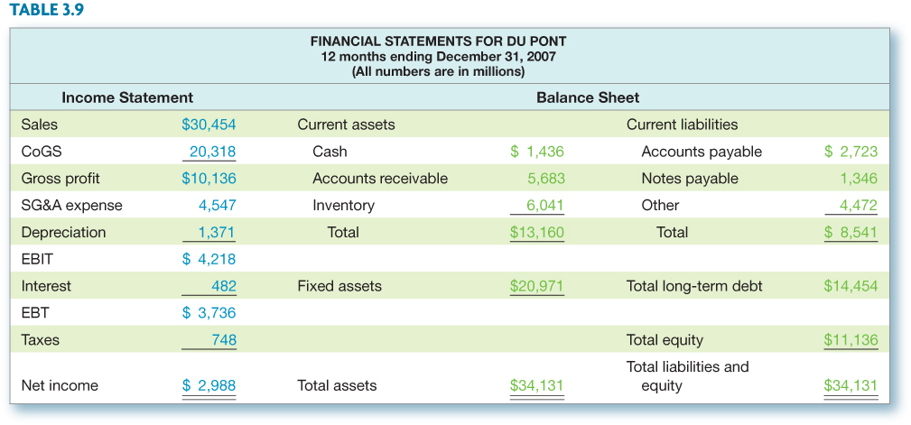
Expanded Du Pont Analysis – Du Pont Data

Slide 23
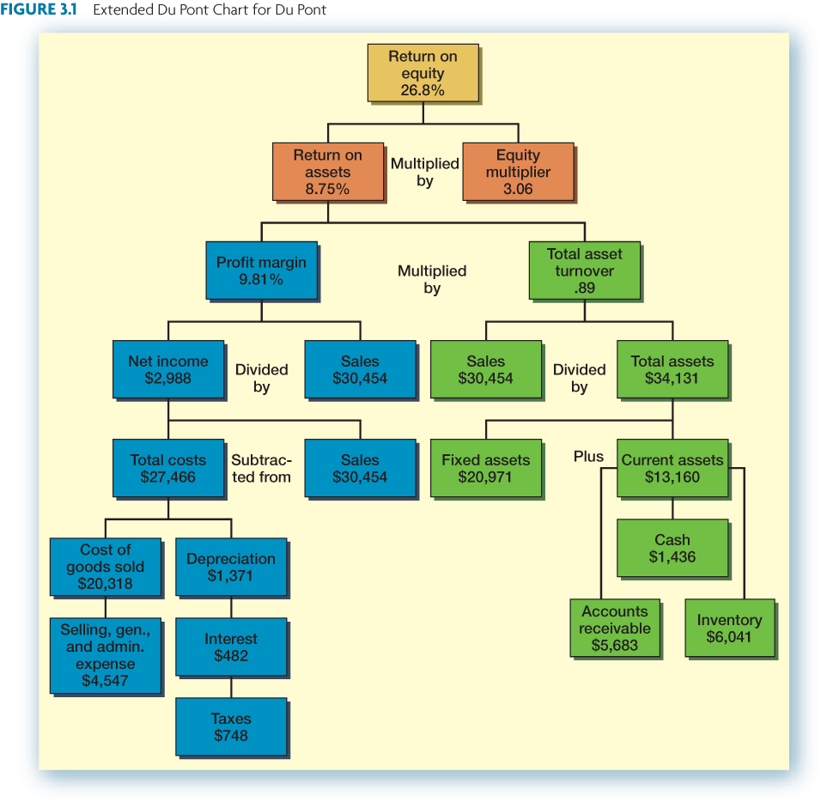
Extended Du Pont Chart

Slide 24
Why Evaluate Financial Statements?
Internal uses
Performance evaluation – compensation and comparison between divisions
Planning for the future – guide in estimating future cash flows
External uses
Creditors
Suppliers
Customers
Stockholders

Slide 25
Benchmarking
Ratios are not very helpful by themselves; they need to be compared to something
Time-Trend Analysis
Used to see how the firm’s performance is changing through time
Internal and external uses
Peer Group Analysis
Compare to similar companies or within industries
SIC and NAICS codes

Slide 26
Potential Problems
There is no underlying theory, so there is no way to know which ratios are most relevant
Benchmarking is difficult for diversified firms
Globalization and international competition makes comparison more difficult because of differences in accounting regulations
Varying accounting procedures, i.e. FIFO vs. LIFO
Different fiscal years
Extraordinary events

Slide 27
Ethics Issues
Should financial analysts be held liable for their opinions regarding the financial health of firms?
How closely should ratings agencies work with the firms they are reviewing? I.e., what level of independence is appropriate?
3-27

Slide 28
Review
What is the Statement of Cash Flows and how do you determine sources and uses of cash?
How do you standardize balance sheets and income statements and why is standardization useful?
What are the major categories of ratios and how do you compute specific ratios within each category?
What are some of the problems associated with financial statement analysis?
3-28

