Slide 1
Long-Term Financial Planning and Growth
Chapter 4

Slide 2
Key Concepts and Skills
Be able to develop a financial plan using the percentage of sales approach

Slide 3
Chapter Outline
The Percentage of Sales Approach

Slide 4
Percent of Sales Approach
Some items vary directly with sales, while others do not
Income Statement
Costs may vary directly with sales - if this is the case, then the profit margin is constant
Depreciation and interest expense may not vary directly with sales – if this is the case, then the profit margin is not constant
Dividends are a management decision and generally do not vary directly with sales – this affects additions to retained earnings
Balance Sheet
Initially assume all assets, including fixed, vary directly with sales
Accounts payable will also normally vary directly with sales
Notes payable, long-term debt and equity generally do not vary directly with sales because they depend on management decisions about capital structure
The change in the retained earnings portion of equity will come from the dividend decision

Slide 5
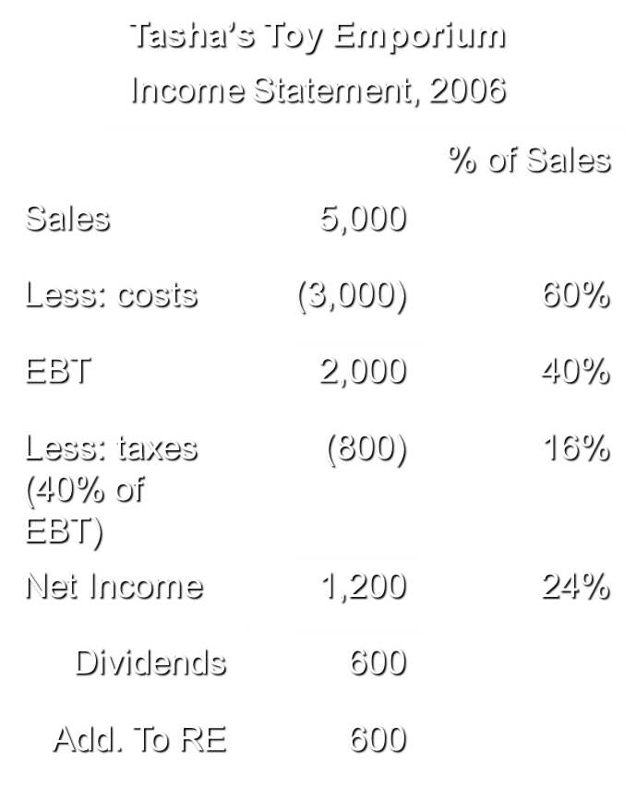
Example: Income Statement
Tasha’s Toy Emporium
Pro Forma Income Statement, 2007
Sales | 5,500
Less: costs | (3,300)
EBT | 2,200
Less: taxes | (880)
Net Income | 1,320
Dividends | 660
Add. To RE | 660
Assume Sales grow at 10%
Dividend Payout Rate = 50%

Slide 6
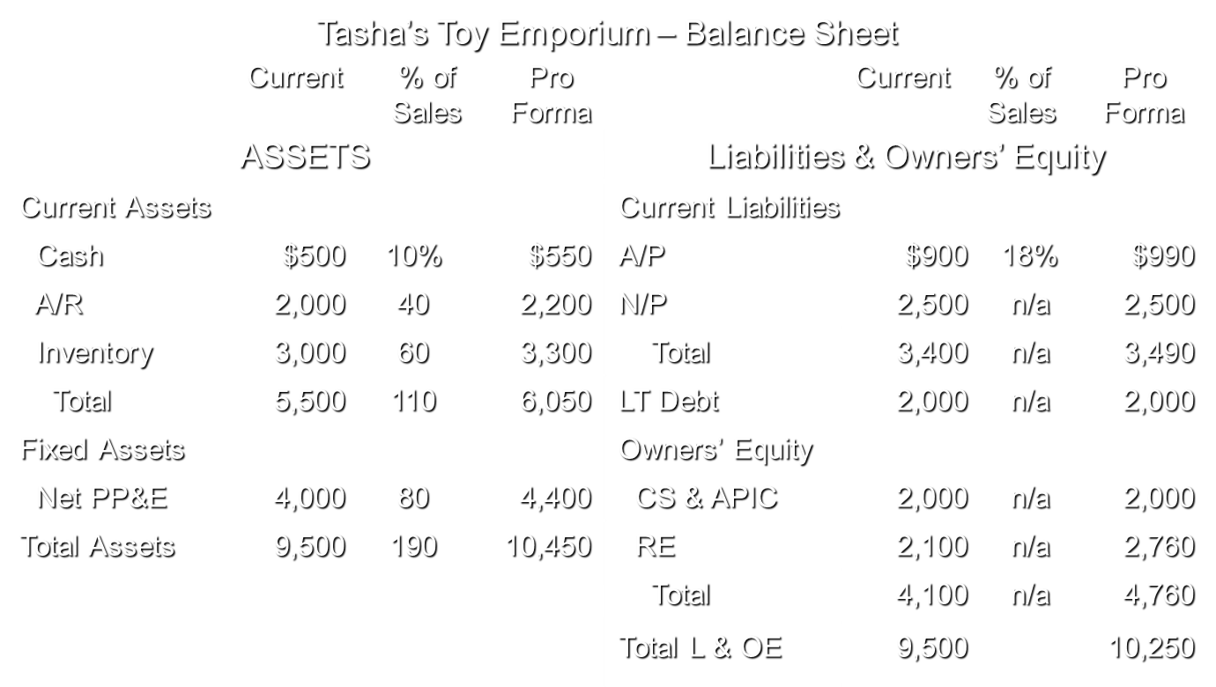
Example: Balance Sheet

Slide 7
Example: External Financing Needed
The firm needs to come up with an additional $200 in debt or equity to make the balance sheet balance
TA – TL&OE = 10,450 – 10,250 = 200
Choose plug variable ($200 external fin.)
Borrow more short-term (Notes Payable)
Borrow more long-term (LT Debt)
Sell more common stock (CS & APIC)
Decrease dividend payout, which increases the Additions To Retained Earnings

Slide 8
Example: Operating at Less than Full Capacity
Suppose that the company is currently operating at 80% capacity.
Full Capacity sales = 5000 / .8 = 6,250
Estimated sales = $5,500, so would still only be operating at 88%
Therefore, no additional fixed assets would be required.
Pro forma Total Assets = 6,050 + 4,000 = 10,050
Total Liabilities and Owners’ Equity = 10,250
Choose plug variable (for $200 EXCESS financing)
Repay some short-term debt (decrease Notes Payable)
Repay some long-term debt (decrease LT Debt)
Buy back stock (decrease CS & APIC)
Pay more in dividends (reduce Additions To Retained Earnings)
Increase cash account

