Slide 1
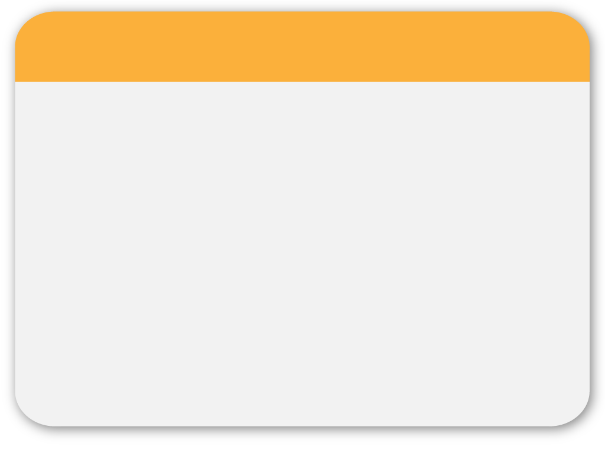
Pharmaceutical Care
05
Drug Related Problems
Prepared by
Refaa AlAjmi
Identify the drug related problem in the following case

Slide 2
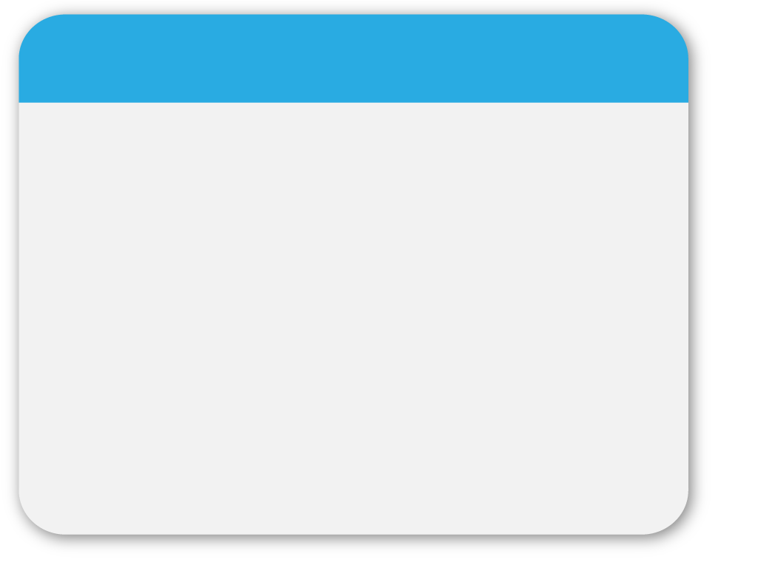
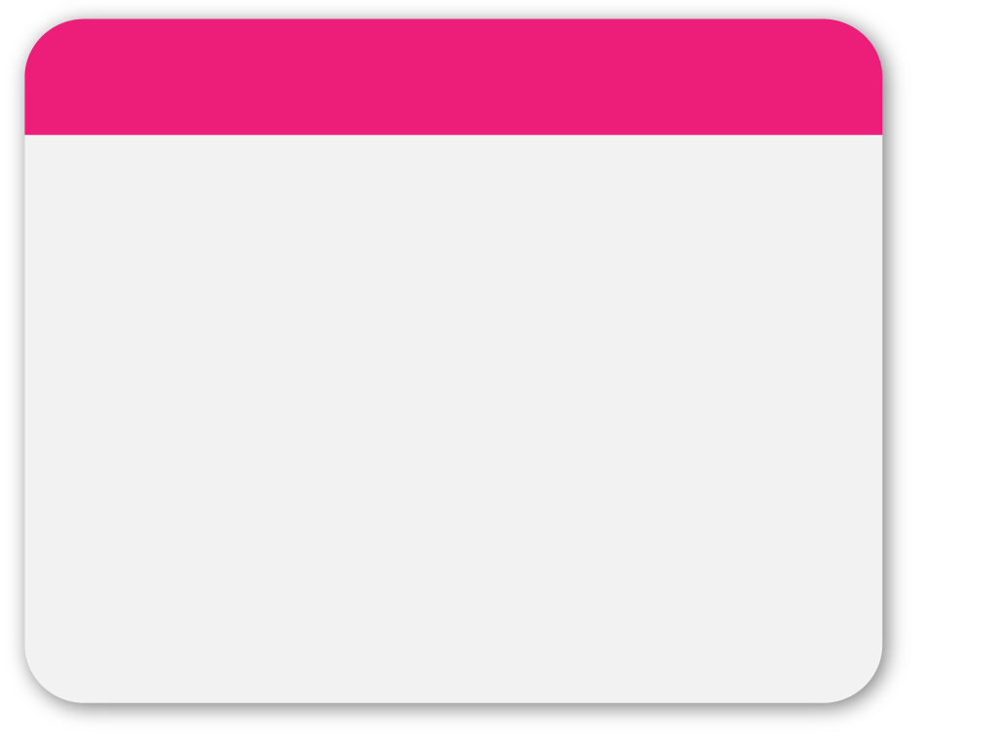
Drug Therapy Problems
WINTER
The patient developed bradycardia and second degree heart block resulting from a 0.5 mg daily dose of digoxin used for congestive heart failure.
Drug Therapy Problem Category: Safety
Sub Category: Dose was too high.
Statement: The patient has developed drug toxicity, appearing as bradycardia and second degree heart block, because the dose of digoxin is too high.
Template

Slide 3
Drug Therapy Problems
L. G. came to her physician for her anemia follow up appointment to check the results of her labs, but the Iron and hemoglobin level was still low. Although L. G. is compliant to her medication, when the pharmacist asked her: she said I take my iron and calcium pills after lunch.
Drug Therapy Problem Category: Effectiveness
Sub Category: Drug-drug interaction.
Statement: The patient is taking iron orally at the same time as oral calcium. She is not exhibiting increased iron and hemoglobin levels, because the interaction of iron with calcium is leading to decreased iron effectiveness.

Slide 4
Drug Therapy Problems
H.Y is a 49 years old female presented in the family medicine clinic for follow-up of her osteoporosis, her BMD T score was found to be -2.8, last appointment it was Tscore = -2.6 . When asked about her medications, she states that she takes Alendronate 70 mg one tablet at morning once a month.
contains two drug related problems
Drug Therapy Problem Category: Effectiveness
Sub Category: Dosage too low; frequency inappropriate
Drug Therapy Problem Category: Compliance
Sub Category: Directions not understood

Slide 5
Drug Therapy Problems
H.Y is a 49 years old female presented in the family medicine clinic for follow-up of her osteoporosis, her BMD T score was found to be -2.8, last appointment it was Tscore = -2.6 . When asked about her medications, she states that she takes Alendronate 70 mg one tablet at morning once a month.
Statement H.Y’s BMD has not improved as she is not taking her medication according to instructions (noncompliance) which led to inappropriate frequency of administration and low dose of medication ; decrease effectiveness

Slide 6
Drug Therapy Problems
Pt. F.A is a 60 y.o female, a diabetic and suffering from osteoporosis and dyslipidemia comes to the outpatient pharmacy for refill of her chronic medications which include
Alendronate 70 mg one tablet at morning every week
Calcium carbonate 600 mg PO BID
Cholecalciferol 800 units tablet, one tablet PO OD
Metformin 500 mg PO TID
Glibenclamide 10 mg PO BID before meals
Drug Therapy Problem Category: Indication
Sub Category: Needs additional therapy, untreated condition
Statement: FA is a 60 years old with dyslipidemia not currently on medication to lower cholesterol. She needs additional therapy to address this untreated indication

Slide 7
Drug Therapy Problems
S.N is a 32 years old male with history of asthma, & mild heartburn. He came to the clinic today for refill and review, his medications include
Ventolin inhaler two puffs PO q4-6hr prn.
Symbicort turbuhaler (80/4.5 mcg) two inhalations twice daily.
The patient takes Zantac 150 mg tablet BID, Gaviscone (Extra Strength) two tablets PO QID prn & Maalox 1-2 tablets PO after meals and at bed time prn to relive his heartburn which he feels occasionally.
Drug Therapy Problem Category: Indication
Sub Category: Unnecessary Drug therapy, duplicate therapy
(Multiple drug products are being used for a condition that requires single drug therapy).
Statement: The patient is taking multiple drug products to relieve his heartburn, his condition is suitably treated with one of the three medications he is taking.

Slide 8
05
Thank You

