Slide 1
Endocrine System

Slide 2
The Endocrine System
Consists of several glands located in various parts of the body
Specific Glands
Hypothalamus
Pituitary
Thyroid
Parathyroid
Adrenal
Kidneys
Pancreatic Islets
Ovaries
Testes

Slide 3
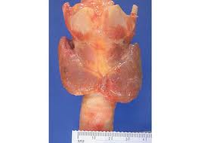
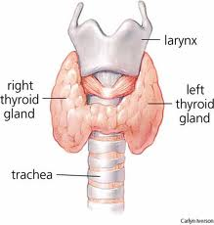
Thyroid Gland
The thyroid gland is located on the front part of the neck below the thyroid cartilage (Adam's apple).
Gross section of normal thyroid gland

Slide 4
Thyroid gland function
Thyroid gland produces thyroid hormones:
Thyroxin (T4) ,and triiodothyronine(T3) are important in:
growth
development
maintaining normal body temperature
energy metabolism regulation
Stimulate metabolism of all cells
Calcitonin
Decreases blood calcium concentration by inhibiting breakdown of bone
*The thyroid gland uses from the diet in foods such as seafood, bread, and salt) to produce thyroid hormones

Slide 5
The hypothalamus releases a thyroid releasing hormone (TRH), which sends a signal to the pituitary to release thyroid stimulating hormone (TSH), (TSH, a pituitary hormone) modulates thyroid function by binding to TSH receptors (TSH-R) and sends a signal to the thyroid to release thyroid hormones. T4&T3

Slide 6
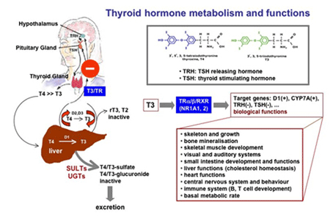

Slide 7
Hyperthyroidism case presentation
A 37-year-old female presents to your clinic with a three week history of palpitations, feeling hot all the time, anxiety ,weigh loss, increased appetite and oligomenorrhea.
On physical examination
Patient has diffuse goiter (enlarged thyroid gland)
Palpitation
Tremor(involuntary movements and can affect the hands, arms, head, face, vocal cords, trunk, and legs)
What do you think the patients primary problem is?

Slide 8
Hyperthyroidism
Hyperthyroidism (overactive thyroid gland):
thyroid gland produces and secretes excessive amounts
of thyroid hormones, riiodothyronine (T3) and thyroxine (T4).

Slide 9
Hyperthyroidism Clinical Manifestations
What signs might you find on exam?
diffuse goiter (enlarged thyroid gland)
weight loss (often accompanied by an increased appetite
intolerance to heat
tremor
Rapid or irregular heartbeat (palpitations or arrhythmia)
hyperactivity, restlessness and difficulty sleeping
Frequent bowel movements
sweating
Nervousness
weakness, fatigue
menstrual irregularities
in women or amenorrhea
nausea, vomiting
diarrhea

Slide 10
Hyperthyroidism
What is the initial test you need it to confirmed the diagnosis?
Diagnosis
Blood tests to measure levels of TSH , total and free T3 and T4( TT3,FT3,TT4,FT4)
Radioactive iodine uptake and scan
CT scan or ultrasound
FNA in thyroid cancer

Slide 11
Hyperthyroidism
What Causes Hyperthyroidism?
There is many causes
Graves’ disease is the most common cause of hyperthyroidism and thyrotoxicosis

Slide 12
Hyperthyroidism
The test results of the patient show
TSH ,T4 ,T3
Confirmed that the patient has hyperthyroidism
Is the patent has hyperthyroidism caused by Graves disease ?!
what additional tests would you order?

Slide 13
Graves disease
Graves' Disease is an autoimmune condition in which autoantibodies are directed against the thyroid-stimulating hormone (TSH) receptor .
lead to stimulate the production of thyroid hormones, thyroxin (T4)and triiodothyronine(T3)
the autoantibodies are not under a negative feedback control system lead to overproduction of the thyroid hormones (hyper thyrpdisim) many metabolic problems.

Slide 15
Graves disease
Risk factors:
is most common in women over age 20.
White and Asian populations are at higher risk than black populations
The disease is more common in female more than male
family history of thyroid disease and Genetic factors
Smoking is also a significant risk factor

Slide 16
Graves disease
symptoms
Patients with Graves' disease can exhibit a variety of symptoms related to hyperthyroidism
some patients with Graves' disease exhibit unique symptoms including:
(bulging eyes)
pretibial myxedema (swelling of legs )
Graves' disease is often called diffuse toxic goiter because the entire thyroid gland is enlarged.

Slide 17
Graves’ disease
Bulging eyes
weight loss
Tremor
heart Palpitation
pretibial myxedema

Slide 18
Thyroid goiter
Thyroid goiter :is enlargement of thyroid gland can be present in hyperthyroidism disorders as well as in hypothyroidism disorders

Slide 19
Hyperthyroidism Graves’ disease
patient with Graves disease show Bulging eyes

Slide 20
Graves disease
Bulging eyes
Thyroid goiter
Patient with Graves’ disease show bulging eyes and diffuse goiter (enlarged thyroid gland)

Slide 21
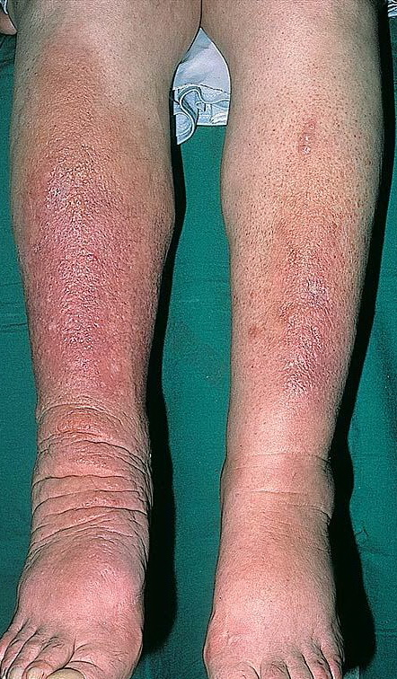
Graves disease : pretibial myxedema

Slide 22
Graves disease
Diffuse toxic goiter of Graves disease, gross, showing symmetric, non-nodular hypervascular enlargement of the thyroid

Slide 23
Graves disease
Diagnosis
Anti-TSH receptor antibody: (TRABs) are specific test for Graves’ disease

Slide 24
Hyperthyroidism
Treatment :
Antithyroid medications
Radioactive iodine (which destroys the thyroid and stops the excess production of hormones)
Surgery to remove the thyroid
If the thyroid must be removed with surgery or destroyed with radiation, the patient must take thyroid hormone replacement pills for the rest of his life.

Slide 25
Hypothyroidism case study presentation
A 46-year-old female presents with a 6-month history of fatigue, constipation, menorrhagia, cold intolerance , loss of pitied and weight gaining. She mentions incidentally that her mother has “thyroid” problems.
What is the probably diagnosis?
Hypothyroidism

Slide 26
Hypothyroidism
What is hypothyroidism?
hypothyroidism : is low production of thyroid hormone (T4),(T3).
Myxedema :is hypothyroidism but in its extreme form

Slide 27
Hypothyroidism
What are the symptoms of hypothyroidism?
Clinical manifestation:
Enlarged neck or presence of goiter
intolerance to cold
weight gain
Increased blood cholesterol
Poor memory
Nigh blindness
Heavy and irregular periods
Sleepiness
constipation
dry skin
droopy eyelids
puffy and swollen face
slowing of the heart rate

Slide 28
Hypothyroidism

Slide 29
Buffy dull face with dray skin
The patient with severe hypothyroidism (myxedema) has a dull, puffy facies. The edema, often particularly pronounced around the eyes, (periorbital edema )does not pit with pressure. The hair and eyebrows are dry, coarse, and thinned. The skin is dry.

Slide 30
hypothyroidism

Slide 31
Hypothyroidism
two cases of hypothyroidism two cases of hypothyroidism, patient before (A and C) and after (B and D) after full replacement with thyroid hormone recovered from hypothyroidism. In fig A, Notice the loss of eyelashes, the areas of vitiligo around the mouth, the region around the eyes, and the scalp. In figure-C, Notice the lethargic expression and the periorbital puffiness disappears with therapy (D).

Slide 32
Hypothyroidism
What causes hypothyroidism?
Causes:
Hashimoto’s disease
Thyroid destruction (from radioactive iodine or surgery , infections )
Pituitary or hypothalamic disease
Medications
Severe iodine deficiency

Slide 33
Hypothyroidism
How is hypothyroidism diagnosed?
Measuring blood levels of thyroid (T4,T3) hormones
TSH blood concentration .
The lab analysis show:
blood levels of thyroid (T4,T3) decreased.
TSH blood concentration increased ( high)
the lab analysis confirmed the patient has hypothyroidism
Is the patient has Hashimoto’s disease ?!

Slide 34
Hashimoto’s disease
What is the Hashimoto’s disease?
Hashimoto's (chronic thyroiditis is) an autoimmune disorder directed against thyroid antigens and is the most common cause of hypothyroidism.
how can be confirmed if the patient has Hashimoto’s disease?
by thyroid peroxidase (anti-TPO antibodies) concentration .
Hashimoto's can be identified by detecting anti-TPO antibodies in the blood

Slide 35
Hypothyroidism
(Right) Struma lymphomatosa in Hashimoto thyroiditis, gross. Note: diffuse, pale yellow infiltrate affecting the entire thyroid. The yellow infiltrate is caused by an influx of lymphocytes, which may form follicles. Normal thyroid (Left)

Slide 36
Hypothyroidism
How is hypothyroidism treated?
receive thyroid hormone replacement therapy

Slide 37
Hashimoto’ disease
Graves’s disease
During Hashimoto's thyroiditis, self-reactive CD4⁺ T lymphocytes recruit B cells and CD8⁺ T cells into the thyroid. Disease progression leads to the death of thyroid cells and hypothyroidism. Both autoantibodies and thyroid-specific cytotoxic T lymphocytes (CTLs) have been proposed to be responsible for autoimmune thyrocyte depletion. b | In Graves' disease, activated CD4⁺ T cells induce B cells to secrete thyroid-stimulating immunoglobulins (TSI) against the thyroid-stimulating hormone receptor (TSHR), resulting in unrestrained thyroid hormone production and hyperthyroidism

Slide 38
Case study
A 51-year-old woman presented with weight loss (despite good appetite), palpitations, tremor, and heat intolerance.
On examination, she had diffusely enlarged thyroid, periorbital edema, and proptosis, as well as mild thickening of the skin in the pretibial area.

Slide 39
Case study (1)
The lab results of thyroid-function tests:
(TSH) thyroid-stimulating hormone level :
0.1 mU /ml < (normal range, 0.5 to 5.15)
(T3) triiodothyronine level:
557 ng/dl normal range, 100 to 190 ng /dl
(T4 )thyroxine level
17.9 μg /dl (normal range, 4.4 to 12.5 μg/dl)
Anti-TSH receptor antibodies 69.6 % . (normal range (0.0 to 16.0 Unit: %)

Slide 40
Case study (1)
What is the diagnosis ?
Hyperthyroidism
What is the cause of hyperthyroidism, and why ?
Graves disease
because the patient has Anti-TSH receptor antibodies

