Slide 1
BCH 462- Biotechnology & Genetic engineering [Practical]
Lab (1) Plasmid Isolation and Purification
Notes:
https://worldwide.promega.com/resources/guides/nucleic-acid-analysis/dna-purification/#plasmid-dna-purification-844e18a7-9e45-4538-9427-a3910abd0ea8
https://bitesizebio.com/180/the-basics-how-alkaline-lysis-works/

Slide 2
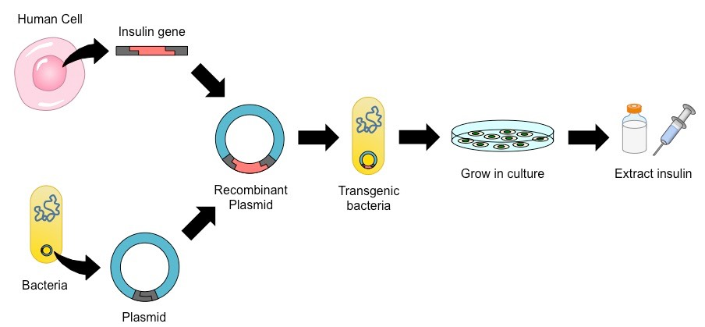
Let’s assume we want to make insulin for the treatment of diabetes.
Which is better to use cow OR bacteria as a biological factory? Why?
➜ How would the cell produce human insulin ?
Molecular cloning
*
*
Figure 1. Schematic representation of recombinant insulin production
Notes:
Fast replication

Slide 3
DNA cloning techniques
Are techniques used to create copies of certain DNA fragments.
1- PCR (in vitro)
[polymerase chain reaction].
2- Cell-based (in vivo)
[using a vector e.g. plasmid carrying the DNA of interest, which eventually inserted to a host cell “usually bacteria” and self replicate].
💡 Remember
Vector e.g. Plasmid
Host e.g. Bacteria
Notes:
https://www2.le.ac.uk/projects/vgec/schoolsandcolleges/topics/recombinanttechniques

Slide 4
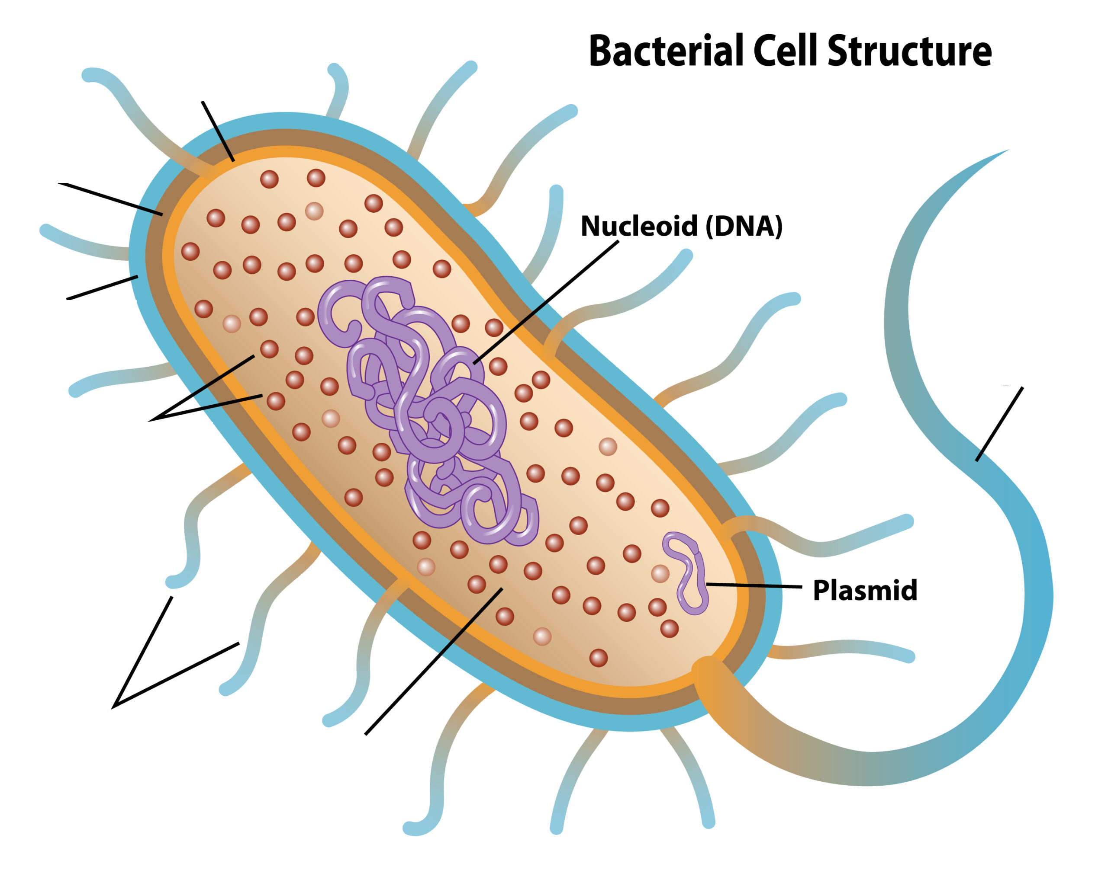
Plasmid
The DNA of most bacteria is contained in a single circular molecule, called the bacterial chromosome.
Many bacteria contain an extrachromosomal element of DNA, termed a plasmid.
Plasmid is a relatively small, covalently closed circular molecule that replicate independently from a bacterial chromosome. (Why ?)
Every plasmid has its own origin of replication (replicon) and use the enzymes and proteins that encoded by its host for its replication and transcription.
Plasmid found in a wild variety of bacterial species and they are not essential for the bacterium but benefit the survival of the organism (Symbiotic relationship with the host ?).
Figure 2. Illustration of a bacterium showing chromosomal DNA and plasmids
Notes:
Why? – its host= the bacteria* // replicon= independently replicated
Plasmid- https://www.youtube.com/watch?v=SdqJFA6mOkI - **
Every plasmid has its own 'origin of replication' – a stretch of DNA that ensures it gets replicated (copied) by the host bacterium.
For this reason, plasmids can copy themselves independently of the bacterial chromosome, so there can be many copies of a plasmid

Slide 5
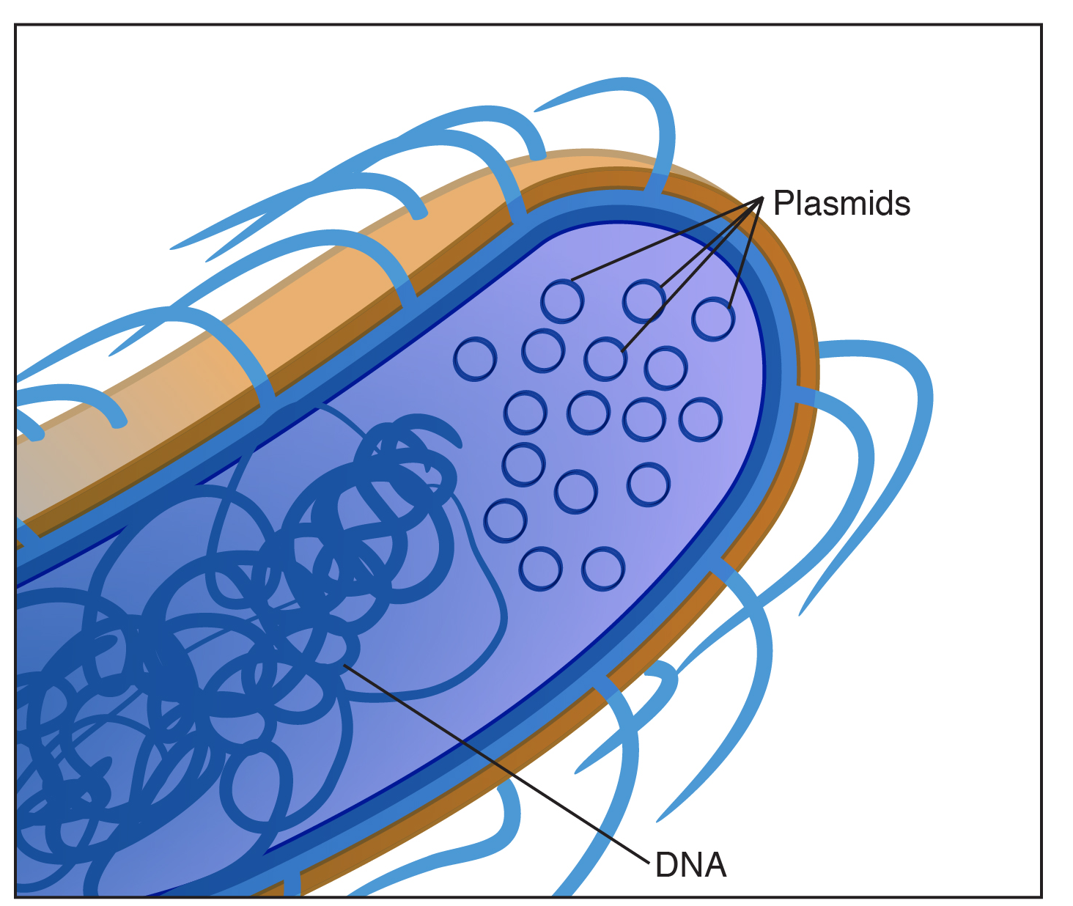
Plasmid cont.
Plasmids classes:
Virulence plasmids encoding toxin genes.
Drug-resistance plasmids that confer resistance to antibiotics.
Plasmids encode genes required for bacterial conjugation.
Plasmids applications:
Molecular cloning
Gene therapy
Drug production
Making a large amount of proteins.
Figure 3. Illustration of E.coli showing chromosomal DNA and plasmids
Notes:
Toxins – for protection from foreign, viruses / bacterial conjugation= bacteria-bacteria connection
Host cell= bacteria
* Bacteria can have more than one plasmid / plasmid can be transferred between bacterias

Slide 6
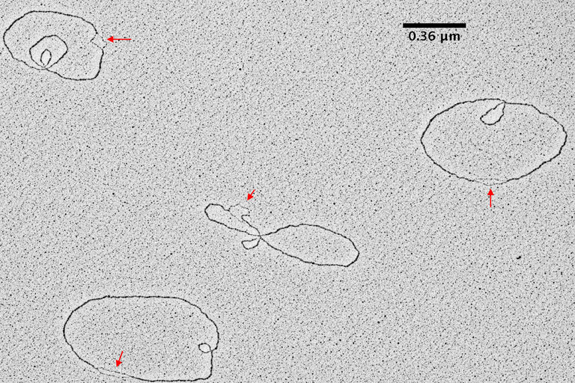
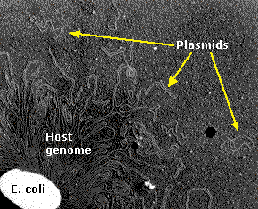
Plasmid cont.
Figure 5. TEM picture of plasmid DNA molecules in solution
Figure 6. Electron micrograph of an E. coli cell ruptured to release its DNA.
Notes:
Electron micrograph of an E. coli cell ruptured to release its DNA. The tangle is a portion of a single DNA molecule containing over 4.6 million base pairs encoding approximately 4,300 genes. The small circlets are plasmids. (Courtesy of Huntington Potter and David Dressler, Harvard Medical School.)

Slide 7
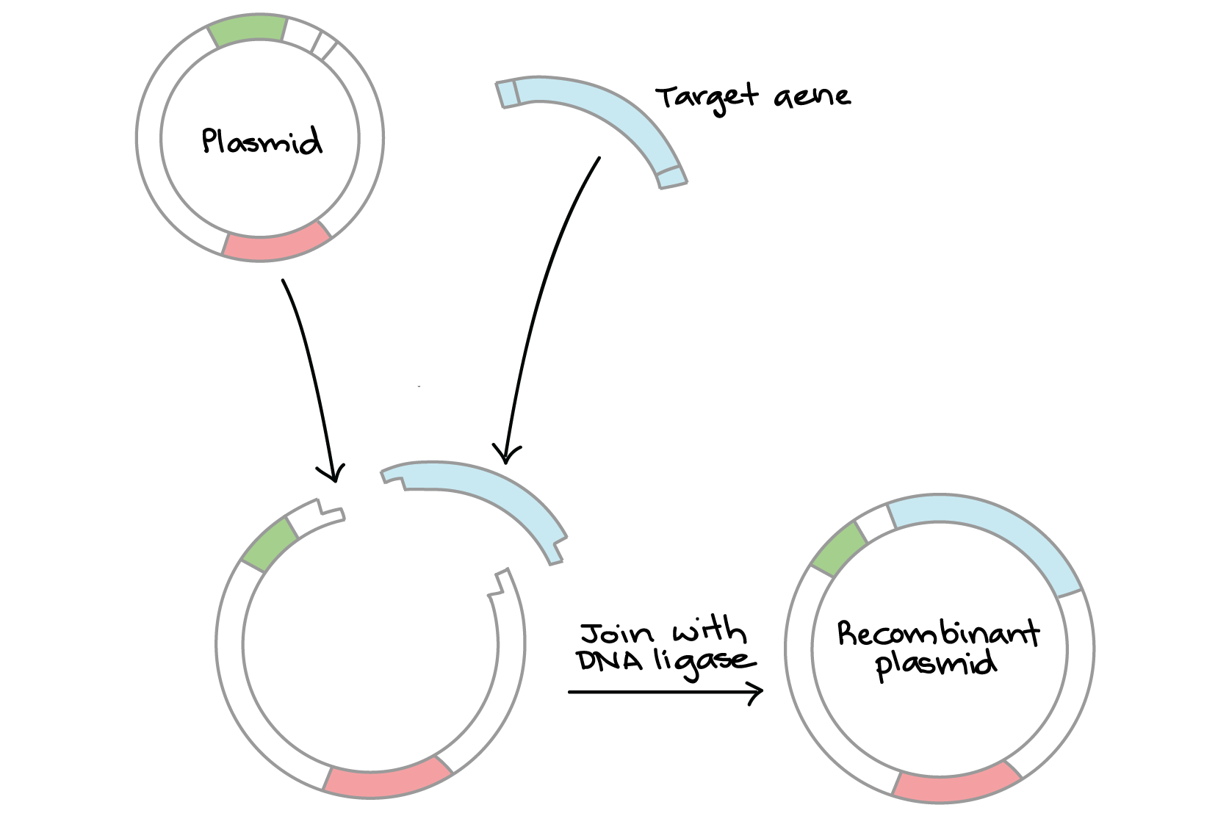
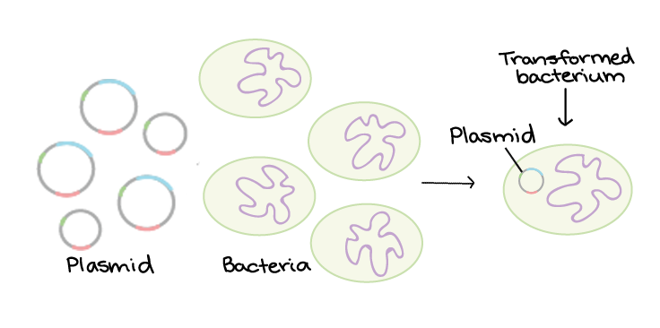
Plasmid as a vector
Plasmids are widely used as vectors in molecular cloning, serving to drive the replication of recombinant DNA sequences within host organisms (It is used to provide a “vehicle” in which to insert a desired DNA fragment).
Recombinant DNA, molecules of DNA from two different species (human/bacteria) that are inserted into a host organism (bacteria) to produce new genetic combinations (human insulin).
In the laboratory, the modified plasmids (recombinant DNA) are usually reintroduced into a host cell for replication via process called transformation.
+
+
Figure 7. Recombinant DNA
Figure 8. Transformation
Notes:
Recombinant DNA is a combination of DNA from different organisms or different locations in a given genome that would not normally be found in nature.
Transformed bacteria* / Transformation

Slide 8
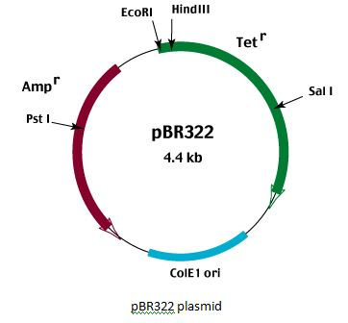
Plasmid vectors should contain three important parts:
Origin of replication (Ori)
antibiotic resistance
gene cloning site
Cloning site is a short segment of DNA which contains several restriction sites allowing for the easy insertion of DNA (A place to insert foreign DNAs).
The Ori is a DNA sequence which allows initiation of replication of the plasmid by cellular enzymes.
Antibiotic resistance gene allows for selection of plasmid-containing bacteria. (?)
Notes:
selection of plasmid-containing bacteria ? Addition of antibiotic in culture media will kill bacteria that didn’t contain plasmid and keep bacteria that have plasmid.
There is another method to defrintiate between bacteria that have the regular plasmid and bacteria that have the recombinante plasmid (contain intrest gene) by white and blue colony*?

Slide 9
Plasmid isolation and purification
Is an essential step for many molecular biology procedures.
In general, plasmid purification involved three steps:
1. Growth of the bacterial culture.
2. Harvesting and lysis of bacteria.
3. Purification of plasmid DNA.
Notes:
Harvesting = by centrifugation

Slide 10
1. Growth of the bacterial culture
Depending upon nutritional status, bacteria exhibit different growth patterns which include:
Lag phase: in this phase bacteria adapt themselves to growth conditions and synthesis its own DNA, RNA and proteins.
Log phase: it is exponential phase, the bacterial cells divide and the production of new cells is proportion to increased time.
Stationary phase: the growth rate slows as nutrients become limited, waste products accumulate and the rate of cell division equals the rate of death.
Death phase: due to continuous accumulation of toxic metabolites and the lack of nutrients, death occurs of the bacteria.
Notes:
https://microbenotes.com/bacterial-growth-curve-and-its-significance/

Slide 11
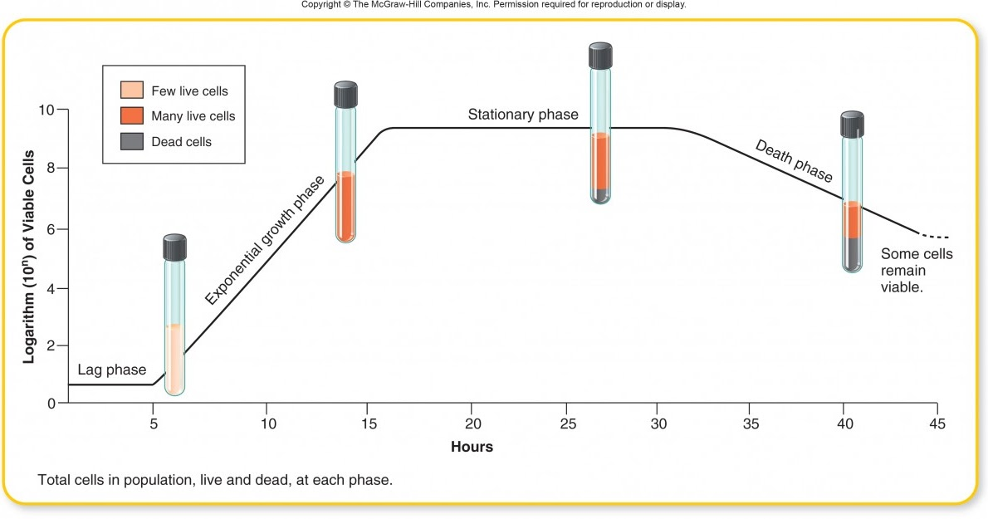
Figure.9. Bacterial culture growth curve.
💡 Pause and Think on which phase should we purify plasmid?
Notes:
on which stage should we harvest bacteria
For plasmid isolation, bacterial cultures should be grown to late logarithmic/early stationary phase. (How to know?) by turbidity and absorption at 600 (the more)
For plasmid extraction you use a night culture to increase the yield of the plasmid extracted, the more bacteria you have the more plasmid will be extracted.

Slide 12
2. Harvesting and lysis of bacteria
Bacteria are recovered by centrifugation.
Cell lysis by any one of many methods, including:
Treatment with detergents, alkali, organic solvents, and heat.
The choice among these methods depends on three factors:
The size of plasmid.
The bacterial strain.
The technique used to subsequently purify the plasmid DNA.
Notes:
The major difference is the outer lipid membrane. It’s difficult to penetrate, which gives gram-negative bacteria extra protection. Gram-positive bacteria don’t have this feature.
Because of this difference, gram-negative bacteria are harder to kill. This means gram-positive and gram-negative bacteria require different treatments.
* Plasmid Copy Numbers

Slide 13
3. Purification of plasmid DNA
The plasmid purification procedures, unlike the procedures for purification of genomic DNA, should involve removal of not only protein but also another major impurity bacterial chromosomal DNA.
There are basic methods of plasmid preparation:
1. Chemical base lysis methods.
2. Application of affinity matrices for plasmid or proteins.
Notes:
NaOH helps to break down the cell wall, but more importantly it disrupts the hydrogen bonding between the DNA bases, converting the double-stranded DNA (dsDNA) in the cell, including the genomic DNA (gDNA) and your plasmid, to single stranded DNA (ssDNA). This process is called denaturation and is central part of the procedure, which is why it’s called alkaline lysis.
Binding of DNA to silica matrix and mini columns.(a) The purification principle for silica matrices is based on the high affinity of the negatively charged DNA molecule for the positively charged silica particles (blue). Under high salt conditions the DNA is tightly bound and extensive washing removed all contaminations, and purified DNA molecules can be eluted under low ionic strength. (b) With mini-columns, elution removes only 90–95% of the DNA.

Slide 14
Practical Part 🧬
Notes:
https://www.gbiosciences.com/image/pdfs/protocol/BE-310_protocol.pdf
https://bitesizebio.com/1660/plasmid-v-genomic-dna-extractionthe-difference/

Slide 15
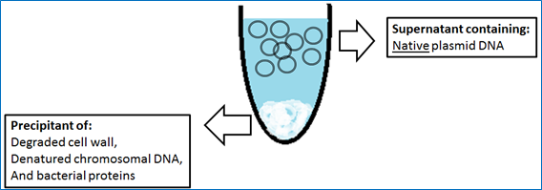
Practical part
Aim:
• To isolate pure plasmid DNA from E. coli using alkaline lysis method.
Principle:
In the alkaline lysis method, cells are lysed and DNA denatured by SDS and alkaline pH.
The SDS will lyse the bacterial cell membrane and denature the proteins.
Alkaline pH will denature the genomic DNA and the proteins too.
Neutralization of the solution, results in a fast reannealing of covalently closed plasmid DNA
Precipitation of protein-SDS complexes, by lowering the temperature.
Subsequently both complexes, DNA and protein, are removed by centrifugation leaving native plasmid molecules in the supernatant.
Notes:
alkaline lysis buffer consisting of a detergent sodium dodecyl sulfate (SDS) and a strong base sodium hydroxide. The detergent cleaves the phospholipid bilayer of membrane and the alkali denatures the proteins which are involved in maintaining the structure of the cell membrane.
- Neutralization of the solution results in a fast reannealing of covalently closed plasmid DNA due to the interconnection of both single-stranded DNA circles. Much more complex bacterial chromosomal DNA cannot reanneal in this short time and forms a large, insoluble DNA network. **
Firstly, they destabilize hydrogen bonds, van der Waals forces and hydrophobic interactions, leading to destabilization of proteins, including nucleases

Slide 16
Figure.10. Alkaline lysis purification method performing steps
Notes:
Harvesting by centrifugation – suspention (by solution 1) – lysis by alkaline + SDS (in solution 2) – neutralization (to reanneal the plasmid after its open by alkaline, bacterial DNA will need more time to reanneal so it will stay denatured then it will be precipitated) by addition of acid (in solution 3)
*alkaline will denature chromosomal DNA and SDS will denature protein – cleaning of lysate by centrifuge – recovery of plasmid by 95% ethanol – washing to remove salt by 70% ethanol
* Place in ice to help precipitate denatured DNA and protein **

Slide 17
Practical part
Results:
Concentration of plasmid DNA (ng/μl) = _________________
Plasmid purity: A260/A280 = _________________
Methodology:
1- Centrifuge the bacterial samples at 4 °C, maximum speed for 5 minutes, using microcentrifuge device.
Bacterial sample was centrifuged at 4°C, maximum speed for 5 minutes using microcentrifuge.
References:
Endnote, Mendeley or Cite This For Me: Web Citer (extension in Google Chrome).
Notes:
https://www.britannica.com/science/recombinant-DNA-technology/Gene-therapy
Ratio of pure DNA = 1.8 (lower contaminated with protein)

