Slide 1



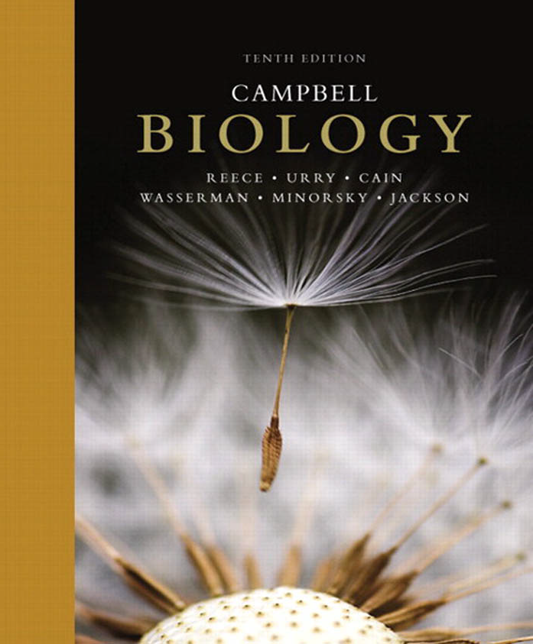
علم الأحياء
College of Science,
Zoology Department

Slide 2



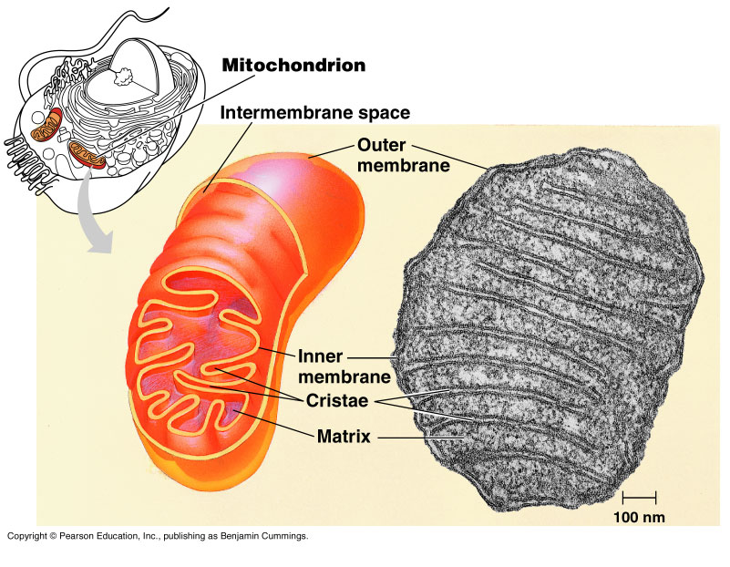
CELLULAR RESPIRATION: Harvesting chemical energy
Copyright © 2002 Pearson Education, Inc., publishing as Benjamin Cummings

Slide 3


Objectives
The Principles of Energy Harvest.
Cellular respiration and fermentation are catabolic, energy-yielding pathways.
Production of Adenosine Tri-Phosphate (ATP).
Redox reactions release energy when electrons move closer to electronegative atoms.
Electrons “fall” from organic molecules to oxygen during cellular respiration.

Slide 4
Overall process
Organic compounds + O₂ → CO₂ + H₂O + energy
Food is the fuel for cellular respiration.
Cellular respiration is a catabolic pathway: it releases energy by breaking down complex molecules.
Cellular respiration involves movement of electrons (gain or loss).
We will study the breakdown of glucose as an example.
Copyright © 2002 Pearson Education, Inc., publishing as Benjamin Cummings

Slide 5
Cellular Respiration
O₂
H₂O
Food
(Fuel of energy)
Energy
+
Respiration
O₂
CO₂
Cellular Activities
Organic compounds + O₂
Energy + CO₂ + H₂O

Slide 6
Adenosine Tri-Phosphate (ATP)
Adenosine
+ H₂O
P
P
P
Triphosphate
Energy
P
P
P
Adenosine Di-Phosphate

Slide 7
Cells recycle the ATP they use for work
ATP (Adenosine Tri-Phosphate) is the important molecule in cellular energetics عمليات إنتاج الطاقة.
  The attachment of three negatively-charged phosphate groups (P) is an unstable غير مستقر, energy-storing مخزن للطاقة arrangement.
  Loss of the end phosphate group release energy.
  Thus, it can diffuse to any part of the cell and release energy.
The price of most cellular work is the conversion of ATP to ADP and phosphate (P).
An animal cell regenerates تعيد إنتاج ATP from ADP by adding P via the catabolism هدم of organic molecules.

Slide 8

How dose ATP drive cellular work ?
P
P
P
P
Cell respiration
Organelle
Motor Protein
P
Energy

Slide 9
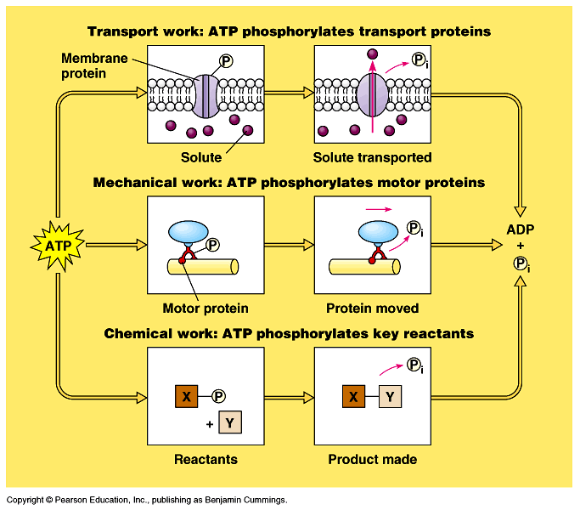
Importance of ATP
The transfer of the terminal phosphate group from ATP to another molecule is phosphorylation فـَسْـفـَرة.
  This changes the shape of the receiving molecule in order to work (transport, mechanical, or chemical).
  When the phosphate
  group leaves the protein molecule, it returns to its original shape.

Slide 10
Redox reactions release energy when electrons move closer to electronegative atoms
Catabolic pathways relocate يبدل أماكن the electrons stored in food molecules, releasing energy that is used to synthesize لتخليق ATP.
Reduction-Oxidation reactions (Redox reactions):
Are reactions that result in the transfer of one or more electrons from one reactant to another
Oxidation: Is the loss فقـد of electrons.
Reduction: Is the addition إكتساب of electrons.
Redox reactions require
both a donor and acceptor of e.
Oxidation (Reducing agent) | Reduction (Oxidizing agent)
Lose electrons | Gain electrons
Lose hydrogen | Gain hydrogen
Gain oxygen | Lose oxygen
e⁻
+
X
+
Y
X
+
Y
Oxidation
(reducing agent)
Reduction
(oxidizing agent)
  Na + Cl Na⁺ + Cl⁻
Energy

Slide 11
Electrons “fall” from organic molecules to oxygen during cellular respiration
In cellular respiration, glucose and other fuel molecules are oxidized, releasing energy.
Glucose is oxidized, oxygen is reduced, and electrons lose potential energy.
H is the source of electrons that transfers to O.
Thus, molecules that have an abundance of وفرة من hydrogen are excellent fuels because their bonds are a source of electrons that “fall” closer to oxygen.
Enzymes lower the barrier of activation energy, allowing these fuels to be oxidized slowly.
When H moves to O, it leaves bonds which degenerated to release energy.
The resulting energy is used by the cell to synthesis ATP .
e⁻
C₆H₁₂O₆ + 6O₂
6CO₂ + 6H₂O + (ATP + Heat)
Reducing
agent
Oxidizing
agent
Energy = 686 kcal/mol
Energy

Slide 12
The “fall” of electrons الإنحدار الإليكتروني during respiration is stepwise مرحلي, by NAD⁺ and an electron transport chain
Cellular respiration does not oxidize glucose in a single step that transfers all the hydrogen in glucose to oxygen at one time.
Rather, glucose and other fuels are broken down gradually تدريجيا in a series of steps, each catalyzed by a specific enzyme.
At key steps فى الخطوات الأساسية, hydrogen atoms move from glucose and passed first to the coenzyme NAD⁺ (Nicotinamide Adenine Dinucleotide).
Dehydrogenase enzymes strip two hydrogen atoms from the fuel (e.g., glucose), pass two electrons to NAD⁺ and release H⁺.
This changes the oxidized form, NAD+, to the reduced form
NADH. Thus, NAD+ is oxidizing agent as it accepts electrons.
  NAD⁺ functions as the oxidizing agent in many of the redox steps during the catabolism of glucose.
As electrons “fall” from NADH to oxygen, their energy is used to synthesize ATP.
Dehydrogenase
H-C-OH + NAD⁺ C=O + NADH + H⁺

Slide 13
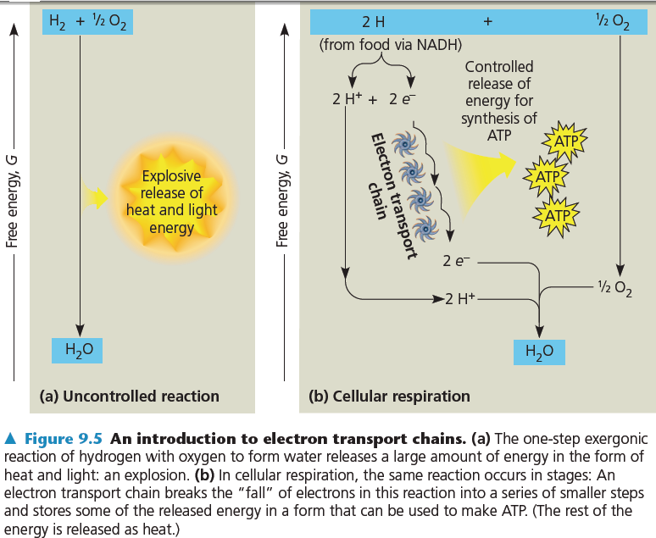
Electron transport chain
Cellular respiration uses an electron transport chain سلسلة نقل الإليكترونات to break يـُقـَسم the fall of electrons to O₂ into several steps عدة خطوات.
The electron transport chain, consisting of several molecules (primarily proteins), is built into the inner membrane of a mitochondrion.
NADH takes electrons from food to the “top” of the chain.
At the “bottom”, oxygen captures the electrons and H⁺ to form water.
Electrons are passed by the chain until they are caught by oxygen (the most electronegative).

Slide 14
Summary of electron “Fall” steps
- Falling of all H atoms from glucose to O is gradually not at once.
- It occurs in steps, each step is catalyzed by an enzyme.
- H atoms of glucose pass first to the co-enzyme NAD⁺ to form NADH
- Then from NADH to electron transport chain, and finally to O and
releases energy to form ATP.
Electron Fall
Mitochondrion
NAD⁺
e
e
Food NADH Transport chain Oxygen
H
Energy
ATP
ADP
The Cell

Slide 15


College of Science,
Zoology Department
General Animal Biology
(Zoo-109)
Zoology Department

