Slide 1
Principles of Information Systems, Thirteenth Edition
Chapter 2
Information Systems in Organizations
Notes:
Principles of Information Systems, Thirteenth Edition
Chapter 2
Information Systems in Organizations

Slide 2
Objectives
After completing this chapter, you will be able to:
Sketch a general model of an organization
Define the term value chain and identify several examples within a typical manufacturing or service organization
Define the term innovation and identify two types
Define reengineering and continuous improvement and explain how they are different
Discuss pros and cons of outsourcing, offshoring, and downsizing
Define the types of roles, functions and careers available in the field of IS
Notes:
Objectives
After completing this chapter, you will be able to:
Sketch a general model of an organization showing how information systems support and work within automated portions of an organizational process
Define the term value chain and identify several examples within a typical manufacturing or service organization
Define the term innovation and identify two types
Define reengineering and continuous improvement and explain how they are different

Slide 3
Organizations and Information Systems
Organization: a group of people that is structured and managed to meet its mission or set of group goals
Organizations are open systems
They affect and are affected by their surrounding environments
Notes:
Organizations and Information Systems
Organization: a group of people that is structured and managed to meet its mission or set of group goals
There are relationships between members of the organization and their various activities
Processes are defined that assign roles, responsibilities, and authority to complete the various activities
Organizations are open systems
They affect and are affected by their surrounding environments

Slide 4
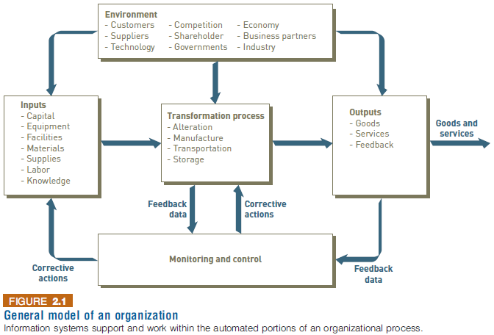
Organizations and Information Systems
Notes:
Organizations and Information Systems

Slide 5
Organizations and Information Systems
Value chain: a series (chain) of activities that an organization performs to transform inputs into outputs
The value of the input is increased
Supply chain: key value chain in a manufacturing organization
Supply chain management (SCM): encompasses all the activities required to get the right product into the right consumer’s hands in the right quantity at the right time and at the right cost
Notes:
Organizations and Information Systems
Value chain: a series (chain) of activities that an organization performs to transform inputs into outputs
The value of the input is increased
Supply chain: key value chain in a manufacturing organization
Supply chain management (SCM): encompasses all the activities required to get the right product into the right consumer’s hands in the right quantity at the right time and at the right cost

Slide 6
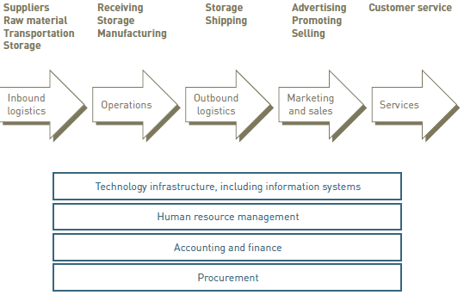
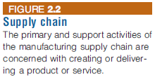
Organizations and Information Systems
Notes:
Organizations and Information Systems

Slide 7
Organizations and Information Systems
Supply chain organizations are “linked” together through both physical flows and information flows
Physical: supplies and raw materials
Information: participants communicating their plans, coordinating their work, and managing the efficient flow of goods and material
The information system can play an integral role in the supply chain process:
Providing input
Aiding product transformation
Producing output
Notes:
Organizations and Information Systems
Supply chain organizations are “linked” together through both physical flows and information flows
Physical: supplies and raw materials
Information: participants communicating their plans, coordinating their work, and managing the efficient flow of goods and material
The information system can play an integral role in the supply chain process:
Providing input
Aiding product transformation
Producing output

Slide 8
Virtual Teams and Collaborative Work
Virtual team: a group of individuals whose members are distributed geographically, but work as a coherent unit through the use of information systems technology
Strength: the best available people are enlisted to solve important organizational problems
Supported by electronic communications: email, instant messages, video conferences, etc
Notes:
Virtual Teams and Collaborative Work
Virtual team: a group of individuals whose members are distributed geographically, but work as a coherent unit through the use of information systems technology
Strength: the best available people are enlisted to solve important organizational problems
Supported by electronic communications: email, instant messages, video conferences, etc.

Slide 9
Innovation
Innovation: the application of new ideas to the products, processes, and activities of a firm, leading to increased value
A catalyst for the growth and success of an organization
Can lead to cutting-edge products
Types of innovation
Sustaining innovation: results in enhancements to existing products, services, and ways of operating
Enable an organization to continually increase profits, lower costs, and gain market share
Example: Microsoft Windows and iPhone in the last decade
Disruptive innovation:
“Makes expensive or sophisticated products and services accessible and more affordable to a broader market” (investopedia.com)
Initially provides a lower level of performance than the marketplace has grown to accept
Over time, however, the disruptive innovation is improved to provide new performance characteristics
Example: Amazon in the mid-1990s when it’s launched as an online bookstore
Notes:
Innovation
Innovation: the application of new ideas to the products, processes, and activities of a firm, leading to increased value
A catalyst for the growth and success of an organization
Can lead to cutting-edge products
New revenue streams
Increased profits
Types of innovation
Sustaining innovation: results in enhancements to existing products, services, and ways of operating
Enable an organization to continually increase profits, lower costs, and gain market share
Disruptive innovation: one that initially provides a lower level of performance than the marketplace has grown to accept
Improved to provide new performance characteristics

Slide 10
Reengineering and Continuous Improvement
Reengineering
Also called process redesign and business process reengineering (BPR)
Involves the radical redesign of business processes, organizational structures, information systems, and values of the organization to achieve a breakthrough in business results
Example: General Electric employs a strategy it calls GE Advantage, which reduces the time it takes to bring a new product to market (in some cases by more than 50 percent)
Continuous improvement
Constantly seeking ways to improve business processes and add value to products and services
Example: the time to assemble Boeing’s 777 jet airliner has been reduced almost in half through the implementation of many small improvements—from 71 days in 1998 to just 37 days today
Boeing has a long tradition and culture supportive of continuous improvement
Notes:
Reengineering and Continuous Improvement
Reengineering
Also called process redesign and business process reengineering (BPR)
Involves the radical redesign of business processes, organizational structures, information systems, and values of the organization to achieve a breakthrough in business results
Continuous improvement
Constantly seeking ways to improve business processes and add value to products and services

Slide 11
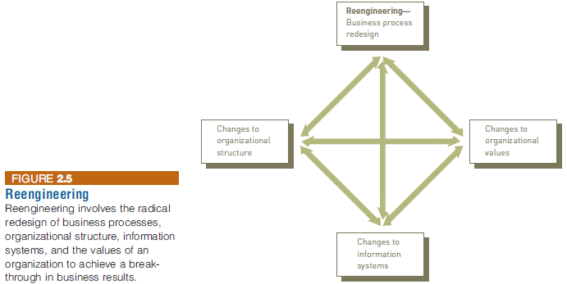
Reengineering and Continuous Improvement
Notes:
Reengineering and Continuous Improvement

Slide 12
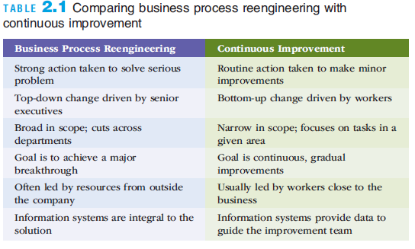
Reengineering and Continuous Improvement
Notes:
Reengineering and Continuous Improvement

Slide 13
Outsourcing, Offshoring, and Downsizing
Outsourcing
A long-term business arrangement in which a company contracts for services with an outside organization that has expertise in providing a specific function
Offshore outsourcing (offshoring)
The service is located in a country different than the firm obtaining the services
Can led to problems due to culture and language differences for some companies
Downsizing
Reducing the number of employees to cut costs
Pros: Reducing total payroll costs
Cons: Product quality and employee morale can suffer
Notes:
Outsourcing, Offshoring, and Downsizing
Outsourcing
A long-term business arrangement in which a company contracts for services with an outside organization that has expertise in providing a specific function
Offshore outsourcing (offshoring)
The service is located in a country different than the firm obtaining the services
A number of companies are finding that outsourcing does not necessarily lead to reduced costs

Slide 14
Careers in Information Systems
Successful IS workers must:
Enjoy working in a fast-paced, dynamic environment
Meet deadlines and solving unexpected challenges
Possess good communication skills
Skills in written and verbal communication
Have solid analytical and decision-making skills
Develop effective team and leadership skills
Most IS careers involve working in project teams that can consist of many of the positions and roles
Be adept at implementing organization change
Be prepared to engage in life-long learning in a rapidly changing field
Notes:
Careers in Information Systems
Successful IS workers must:
Enjoy working in a fast-paced, dynamic environment
Meet deadlines and solving unexpected challenges
Possess good communication skills
Have solid analytical and decision-making skills
Develop effective team and leadership skills
Be adept at implementing organization change
Be prepared to engage in life-long learning in a rapidly changing field

Slide 15
Careers in Information Systems
Technical skills important for IS workers to have:
Capability to analyze large amounts of structured and unstructured data
Ability to design/build applications for mobile devices
Web design and development skills
Programing and application development skills
Technical support expertise
Project management skills
Knowledge of networking and cloud computing
Knowledge of data center operations
Ability to audit systems and implement necessary security measures
Notes:
Careers in Information Systems
Technical skills important for IS workers to have:
Capability to analyze large amounts of structured and unstructured data
Ability to design/build applications for mobile devices
Programing and application development skills
Technical support expertise
Project management skills
Knowledge of networking and cloud computing
Ability to audit systems and implement necessary security measures

Slide 16
Roles, Functions, and Careers in IS
In addition to technical skills, IS professionals need:
Skills in written and verbal communication
An understanding of organizations and the way they operate
The ability to work with people and in groups
Notes:
Roles, Functions, and Careers in IS
In addition to technical skills, IS professionals need:
Skills in written and verbal communication
An understanding of organizations and the way they operate
The ability to work with people and in groups

Slide 17
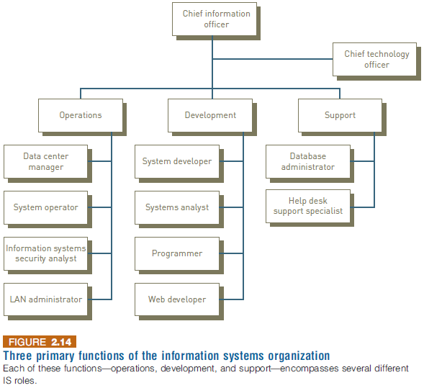
Roles, Functions, and Careers in IS
Notes:
Roles, Functions, and Careers in IS

Slide 18
Typical IS Titles and Functions
Chief information officer (CIO) employs the IS department’s equipment and personnel to help the organization attain its goals
Senior IS Managers
Manager of information systems
Chief technology officer (CTO)
Central role of all of the above is to communicate with other areas of the organization to determine changing business needs
Notes:
Typical IS Titles and Functions
Chief information officer (CIO) employs the IS department’s equipment and personnel to help the organization attain its goals
Senior IS Managers
Vice president of information systems
Manager of information systems
Chief technology officer (CTO)
Central role of all of the above is to communicate with other areas of the organization to determine changing business needs

Slide 19
Typical IS Titles and Functions: Operations Roles
Data center managers are responsible for the maintenance and operation of the organization’s computing facilities
System operators run and maintain IS equipment
IS security analysts are responsible for maintaining the security and integrity of their organizations’ systems and data
Local area network (LAN) administrators set up and manage the network hardware, software, and security processes
Notes:
Typical IS Titles and Functions: Operations Roles
Data center managers are responsible for the maintenance and operation of the organization’s computing facilities
System operators run and maintain IS equipment
IS security analysts are responsible for maintaining the security and integrity of their organizations’ systems and data
Local area network (LAN) administrators set up and manage the network hardware, software, and security processes

Slide 20
Typical IS Titles and Functions: Development Roles
Software developers write the software that customers and employees use
Systems analysts consult with management and users, as well as convey system requirements to software developers and network architects
Programmers convert a program design developed by a systems analyst or software developer into one of many computer languages
Web developers design and maintain Web sites, including site layout and function, to meet the client’s requirements
Notes:
Typical IS Titles and Functions: Development Roles
Software developers write the software that customers and employees use
Systems analysts consult with management and users, as well as convey system requirements to software developers and network architects
Programmers convert a program design developed by a systems analyst or software developer into one of many computer languages
Web developers design and maintain Web sites, including site layout and function, to meet the client’s requirements

Slide 21
Typical IS Titles and Functions: Support
Database administrators (DBAs) design and set up databases to meet an organization’s needs
System support specialists respond to telephone calls, email, and other inquiries from computer users
Notes:
Typical IS Titles and Functions: Support
Database administrators (DBAs) design and set up databases to meet an organization’s needs
System support specialists respond to telephone calls, email, and other inquiries from computer users

Slide 22
Certification
Certification
A process for testing skills and knowledge
Results in a statement by the certifying authority that confirms an individual is capable of performing particular tasks
Frequently involves specific, vendor-provided or vendor-endorsed coursework
Notes:
Certification
Certification
A process for testing skills and knowledge
Results in a statement by the certifying authority that confirms an individual is capable of performing particular tasks
Frequently involves specific, vendor-provided or vendor-endorsed coursework

Slide 23
Other IS Careers
Consulting opportunities
Computer training
Computer and computer-equipment sales
Computer repair and maintenance
Support services
Employment with technology companies
Entrepreneurial ventures
Notes:
Other IS Careers
Consulting opportunities
Computer training
Computer and computer-equipment sales
Computer repair and maintenance
Support services
Employment with technology companies
Entrepreneurial ventures

Slide 24
Finding a Job in IS
Developing an online résumé can be critical to finding a good job
The Internet
Online job sites
Company Web sites
Social networking sites
Networks established from academia and professional environments
Notes:
Finding a Job in IS
Developing an online résumé can be critical to finding a good job
The Internet
Online job sites
Company Web sites
Social networking sites
Informal networks of colleagues or business acquaintances

Slide 25
Summary
Organizations are open systems that affect and are affected by their surrounding environment
Information systems must be implemented in such a manner that they are accepted and work well within the context of an organization and support its fundamental business goals and strategies
The information system worker functions at the intersection of business and technology and designs, builds, and implements solutions that allow organizations to effectively leverage information technology systems
Notes:
Summary
Organizations are open systems that affect and are affected by their surrounding environment
Positive change is a key ingredient for any successful organization
Information systems must be implemented in such a manner that they are accepted and work well within the context of an organization and support its fundamental business goals and strategies
The information system worker functions at the intersection of business and technology and designs, builds, and implements solutions that allow organizations to effectively leverage information technology systems

