Slide 1



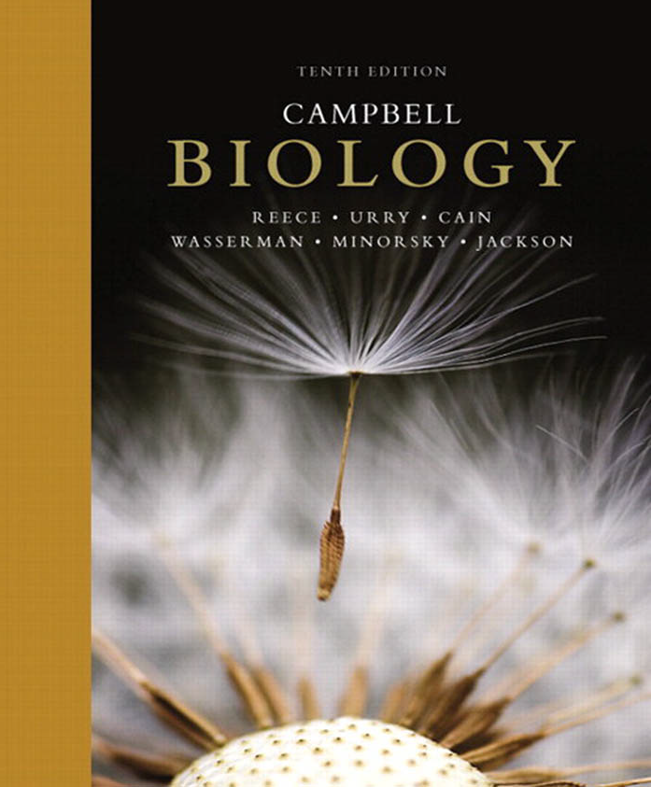
علم الأحياء
College of Science,
Zoology Department

Slide 2



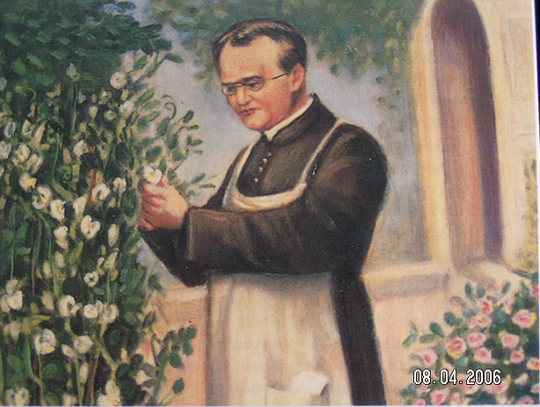
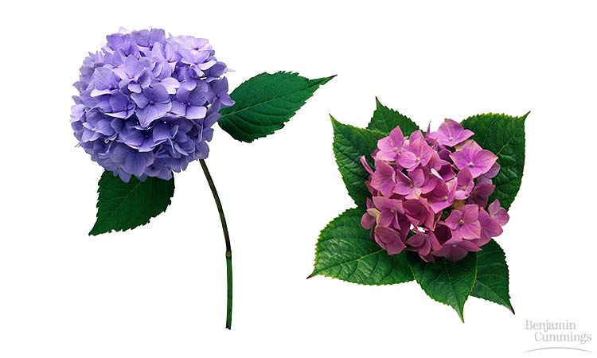
MENDEL AND THE GENE IDEA
Copyright © 2002 Pearson Education, Inc., publishing as Benjamin Cummings

Slide 3


Objectives
Gregor Mendel’s Discoveries.
Mendel used the scientific approach to identify two laws of inheritance:
  A)- The Law of Segregation.
  Useful Genetic Terminologies.
  The Testcross.

Slide 4
Gregor Mendel: the father of genetics
Gregor Mendel (the father of genetics), Czech geneticist 1822–1884.
Gregor Johann Mendel was born on July 22, 1822, in what is now Hyncice, Czech Republic. He entered a monastery in what is now Brno, Czech Republic, and performed a famous and important series of breeding experiments while at the monastery. Mendel died on January 6, 1884, in Brno.
Copyright © 2002 Pearson Education, Inc., publishing as Benjamin Cummings

Slide 5
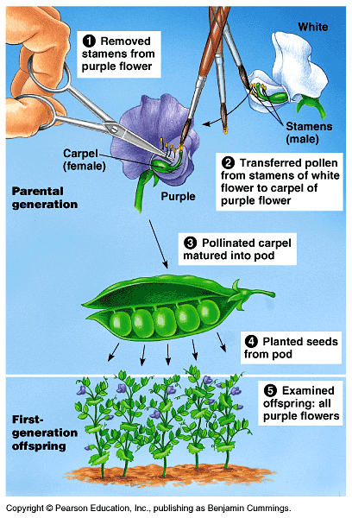
Mendel brought an experimental and quantitative approach to genetics
Around 1857, Mendel began breeding garden peas to study inheritance وراثة. Because they are available in many varieties with distinct heritable مُتوارث characters صفات with different genes.
Each pea plant has male (stamens) and female (carpel) sexual organs.
In nature, pea plants typically
self-fertilize تلقيح ذاتي, (fertilizing ova with their own pollens).
However, Mendel could also move pollens حبوب اللقاح from one plant to another to cross-pollinate يُـلقح plants.

Slide 6
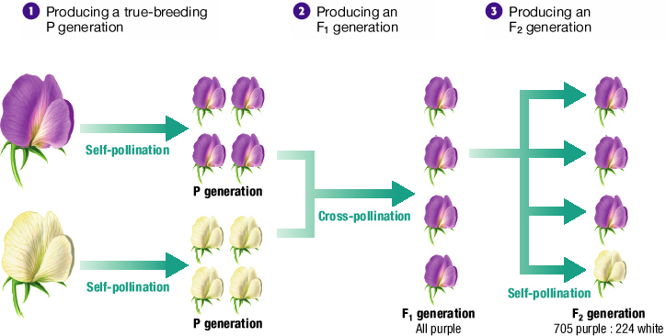
Three Steps of Mendel’s Experiments

Slide 7
Mendel’s Results and Conclusions
Recessive and Dominant Traits
  Mendel concluded that inherited characteristics are controlled by factors that occur in pairs.
  In his experiments on pea plants, he found that one factor in a pair masked the other, Thus:
  The trait that masked the other is called the dominant trait.
  The trait that was masked is called the recessive trait.

Slide 8
Mendel’s laws
In a breeding experiment, Mendel would cross-pollinate تلقيح خلطي (hybridize هَجن) two contrasting متباينين, true-breeding pea varieties أنواع.
  The true-breeding parents are the P (Parental generation) and their hybrid offspring النسل المُهجن are the F₁ (1st Filial generation) .
Mendel would then allow the F₁ (1st Filial generation) hybrids to self-pollinate to produce an F₂ generation.
It was mainly Mendel’s quantitative analysis تحليل كمي of F₂ plants that revealed the two fundamental laws of heredity: A)- The law of segregation. B)- The law of independent assortment.

Slide 9
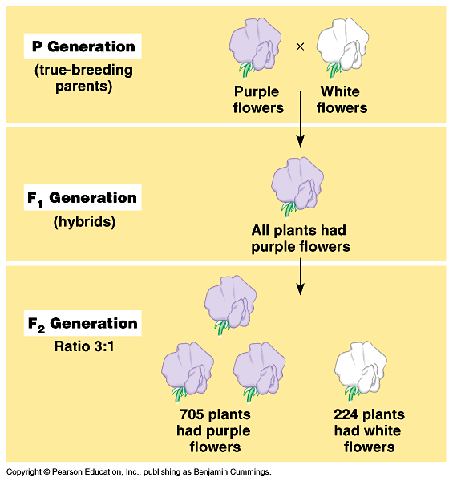
A)- Law of segregation: قانون الإنعزال)) the two alleles ﭽـينات for a character are isolated into separate gametes
Mendel expected that the F₁ hybrids from a cross تلقيح between purple-flowered and white-flowered pea plants would have pale purple flowers بنفسجي باهت.
Instead, ولكن the F₁ hybrids all have purple flowers, just a purple like their parents.
This cross produced a 3 purple to 1 white ratio of traits in the F₂ offspring,
Mendel reasoned that the heritable factor for white flowers was present in the F₁ plants, but it did not affect flower color.
Thus, purple flower is a dominant color (صفة سائدة) and white flower is a recessive color(صفة مُتنحية) .

Slide 10
Law of segregation
Focuses on only a single character via monohybrid crosses التزاوج أحادي الصفة
Mendel found similar 3 : 1 ratios of two traits among F₂ offspring when he conducted crosses for six other characters, each represented by two different varieties صفتين مختلفتين.
For example, when Mendel crossed two true-breeding varieties, one of which produced round seeds بذور مُستديرة, the other of which produced wrinkled seeds بذور مُجَعدة, all the F₁ offspring had round seeds, but among the F₂ plants, 75% of the seeds were round and 25% were wrinkled (see second law in the next lecture).
Law of segregation focused on only a single character (a monohybrid crosses التزاوج أحادي الصفة ).

Slide 11
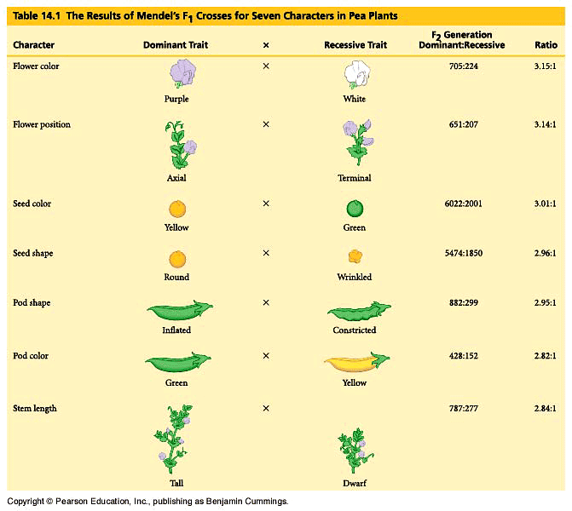

Slide 12
Mendel’s Hypothesis
Mendelian inheritance reflects rules of probability for the behaviour of genes (alleles).
  Alleles segregate تنفصل because of the distribution of homologous chromosomes to different gametes in meiosis.
For each character, an organism inherit two alleles (one from each parent).
Red colour gene (allele)
Homologous chromosomes
White colour gene (allele)
If the two alleles differ, one of them will be Dominant, and the other is Recessive.
The two alleles (genes) for a character are separated (segregated) into separate gametes (summarized as Mendel’s law of segregation) and aggregated again by fertilization.

Slide 13
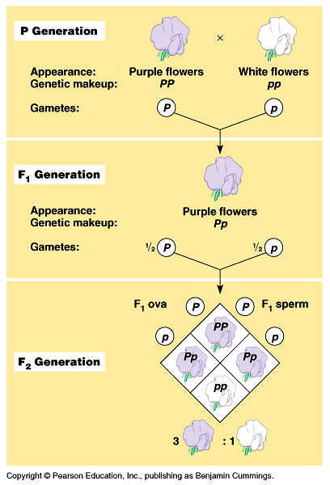
Mendel’s law of segregation accounts for the 3:1 ratio in the F₂ generation.
The F₁ hybrids will produce two classes of gametes, half with the purple-flower allele and half with the white-flower allele.
During self-pollination, the gametes of these two classes unite randomly.
This can produce four equally likely combinations of sperm and ovum.
A Punnett square predicts the results of a genetic cross between individuals of known genotype الطرز الـﭽيني.
A Punnett square analysis of the flower-color example demonstrates Mendel’s model.
Mendel’s model accounts for the 3:1 ratio in the F₂ generation

Slide 14
Pea plant
Pp
Pp
PP
pp
X
X
Heterozygous
Homozygous
P
p
P
p
P
p
Pp
PP
Pp
Pp
pp
Dominant allele
Recessive allele
100% Purple
3 Purple : 1 White
F₁ generation
F₂ generation

Slide 15
Phenotype: Is the organism’s appearance الطرز المظهري.
Phenotype
(Colour)
Genotype: Is the organism’s genetic makeup الطرز الـﭽيني.
PP
متماثل الجينات
PP
Homozygous
pp
An organism having a pair of identical alleles
Genotype
Pp
متباين الجينات
Heterozygous
(Genetic make up)
An organism having a pair of two different alleles

Slide 16
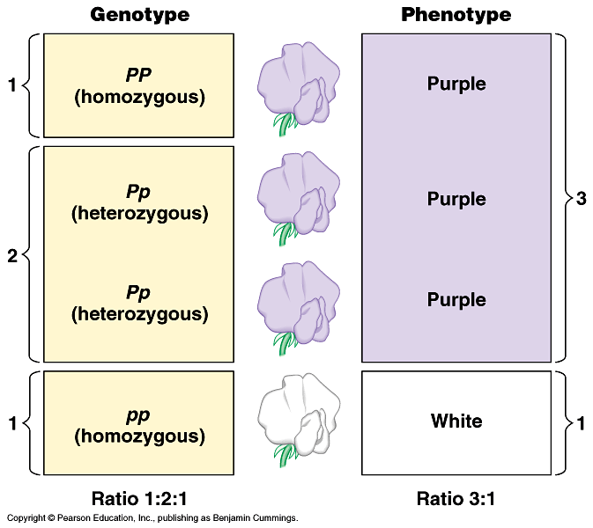
Homozygous and Heterozygous
Genotype and Phenotype
For flower color in peas, both PP and Pp plants have the same phenotype (purple) but different genotypes (homozygous and heterozygous).
The only way to
produce a white
phenotype is to
be homozygous
recessive (pp)
for the flower-
color gene.

Slide 17
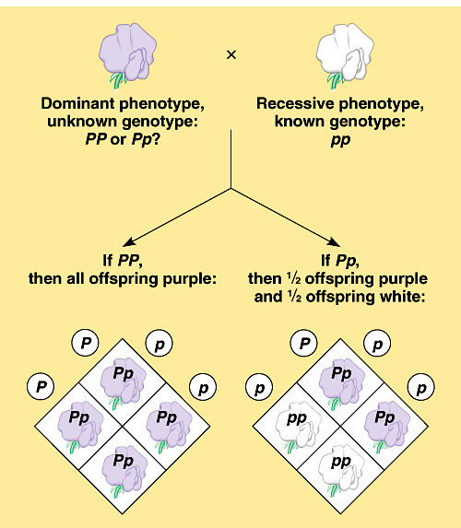
Test cross
It is not possible to predict the genotype of an organism with a dominant phenotype.
  The organism must have one dominant allele, but it could be homozygous dominant or heterozygous.
Test cross:
Is breeding of a homozygous recessive with a dominant phenotype, but unknown genotype, can determine the identity of the unknown allele.
Q: What is the result of Cross hybridization of purple X white colored flowers ?

Slide 18
Definitions
The Law of Segregation
The law of segregation states that: a pair of factors is segregated, or separated, during the formation of gametes.
Dominant character (allele) الصفة السائدة
Is fully expressed in the organism’s appearance.
Recessive character (allele) الصفة المُتنحية
Has no noticeable effect تأثير غير ملحوظ on the organism’s appearance.
Homozygous مُتماثل الجينات
An organism with two identical alleles for a character.
Heterozygous مُختلف الجينات
An organism with two different alleles for a character.
Phenotype الطرز المظهري
A description of an organism’s traits (feature مظهر).
Genotype الطرز الجيني
A description of an organism’s genetic makeup.

Slide 19


College of Science,
Zoology Department
General Animal Biology
(Zoo-109)
Zoology Department

