Slide 1




علم الأحياء
College of Science,
Zoology Department

Slide 2



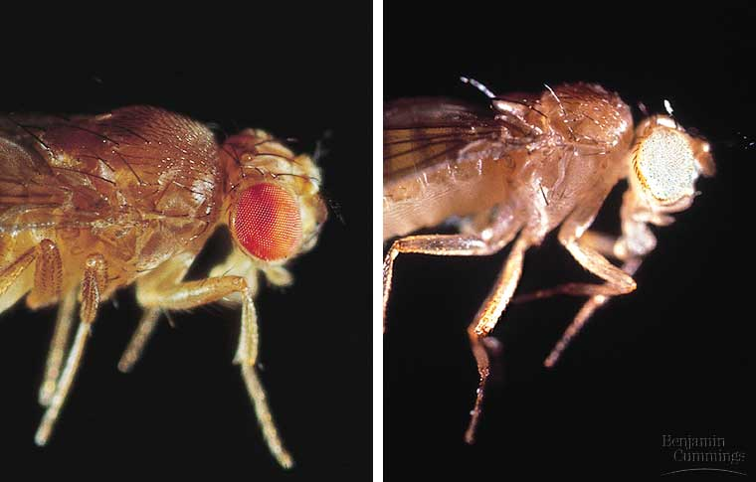
THE CHROMOSOMAL BASIS OF INHERITANCE
The chromosomal basis of sex varies with the organism
Sex-linked genes have unique patterns of inheritance
Copyright © 2002 Pearson Education, Inc., publishing as Benjamin Cummings

Slide 3


Objectives
A)- Sex Chromosomes.
  Chromosomal systems of sex determination.
  Sex-linked genes exhibit unique patterns of inheritance.
    Inheritance of Sex-Linked Genes.
    human Sex-linked disorders.
      Duchenne muscular dystrophy.
      Hemophilia.
      Color blindness.
  B)- Alterations of chromosomal number or structure cause some
  genetic disorders:
    Abnormal Chromosomal Number.
    Alterations of Chromosomal Structure.

Slide 4
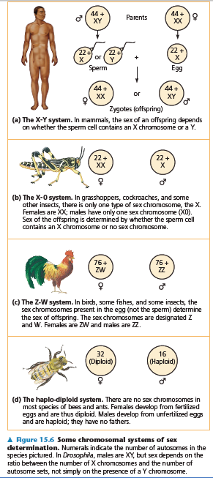
1. The chromosomal basis of sex varies with the organism
In human and other mammals, there are two varieties of sex chromosomes, X & Y.
  An individual who inherits 2 X chromosomes usually develops as a female.
  An individual who inherits an X and a Y chromosome usually develops as a male.
This X-Y system of mammals is not the only chromosomal mechanism of determining sex.
Other options include the X-0 system (in locust), the Z-W system (in birds), and the haplo-diploid system (in bees).
In Human, the SRY gene (Sex-determining Region of the Y chromosome) modifies embryonic gonads into testes.
Females lack the SRY gene, thus, the embryonic gonads develop into ovaries.

Slide 5
The chromosomal basis of sex varies with the organism
In the X-Y system, Y and X chromosomes behave as homologous chromosomes during meiosis.
  In reality, they are only partially homologous and rarely undergo crossing over
In both testes (XY) and ovaries (XX), the two sex chromosomes segregate during meiosis and each gamete receives only one of them.
  Each egg receives an X chromosome.
  50% of the sperm receive the X chromosome and the other 50% receive the Y chromosome.
Because of this, each conception has about a fifty-fifty chance of producing a particular sex.
Copyright © 2002 Pearson Education, Inc., publishing as Benjamin Cummings

Slide 6
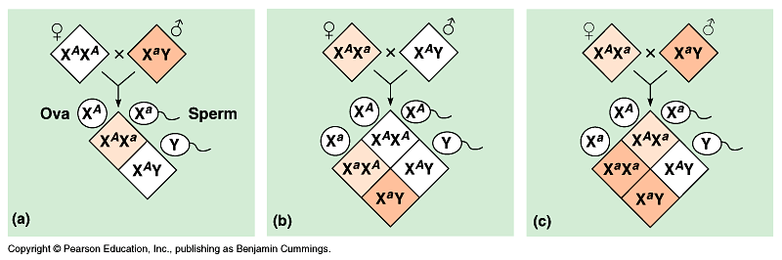
2. Sex-linked genes have unique patterns of inheritance
The sex chromosomes, especially the X chromosome, have genes for many characters unrelated to sex.
These sex-linked genes جينات مرتبطة بالجنس follow the same pattern of inheritance as the white-eye locus in Drosophila.
If a sex-linked trait is due to a recessive allele, a female have this phenotype only if homozygous.
  Heterozygous females will be carriers.

Slide 7
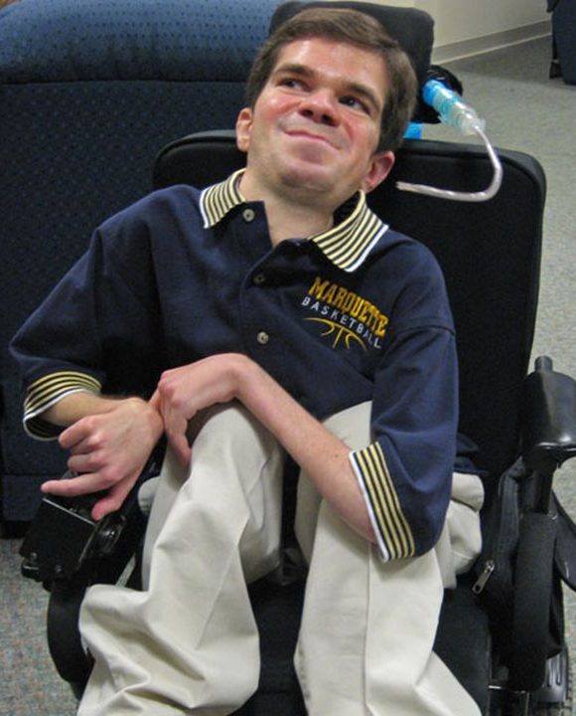

I)- Sex-linked disorders in human الأمراض المرتبطة بالجنس
Duchenne muscular dystrophy: وَهَن العضلات A recessive disorder affects one in 3,500 males born in the United States.
  Affected individuals rarely live past their early 20s.
  This disorder is due to the absence of an X-linked gene for a key muscle protein, called dystrophin.
  The disease is characterized by a weakening ضعف of the muscles and loss of coordination فـقـْد التوازن.
Hemophilia: النزيف الدمويA recessive trait defined by the absence of one or more clotting factors عوامل تجلط.
  These proteins normally slow and then stop bleeding.
  Individuals with hemophilia have prolonged bleeding نزيف مستمر because a firm clot تجلط forms slowly.
  Individuals can be treated with intravenous injections of the missing protein.
  This gene is transmitted to offspring via the mothers.
  Thus, sons borne from hemophilic woman should be exempted يُستثنى from circumcision الختان.

Slide 8
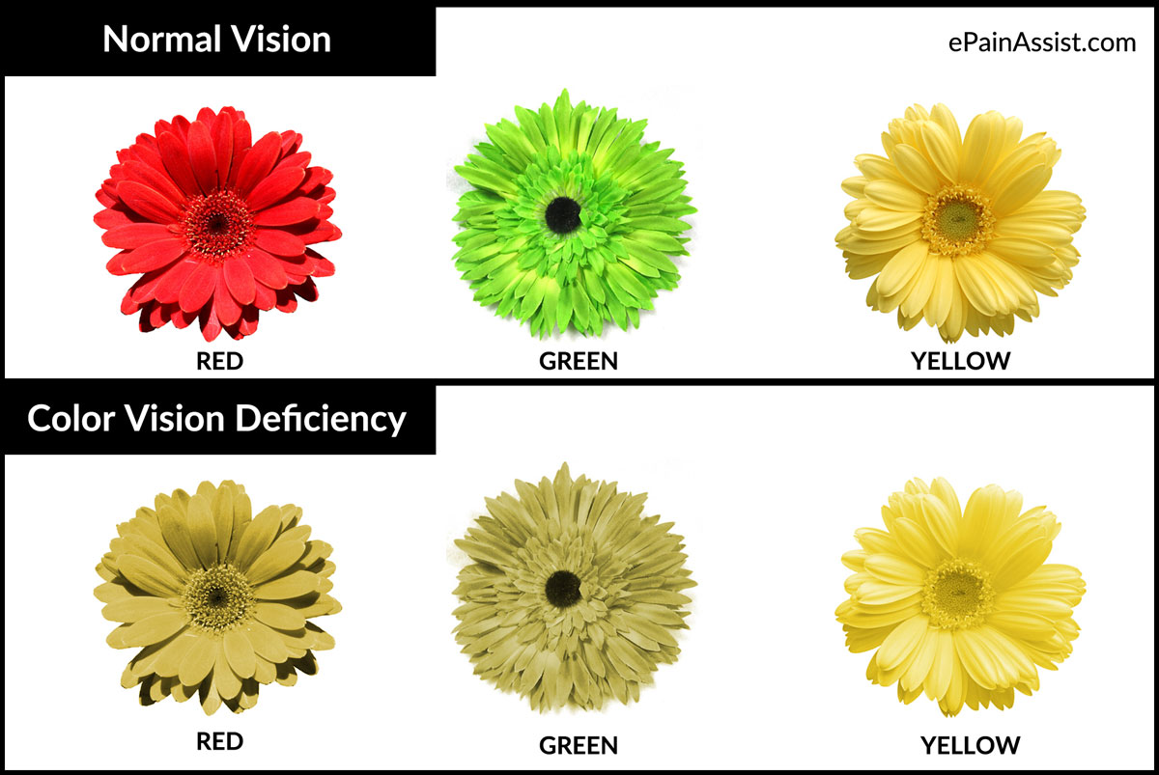
I)- Sex-linked disorders in human الأمراض المرتبطة بالجنس
Color blindness: عمى الألوان is a recessive disorder inherited as sex-linked character and affect both males and females.
  A color blind female (XªXª) may be born to a color blind father (XªY) and a carrier mother (X^{A}Xª)

Slide 9
I)- Sex-linked disorders in human الأمراض المرتبطة بالجنس
Because males have only one X chromosome (hemizygous), any male receiving the recessive allele from his mother will express the trait.
Therefore, males are far more likely to inherit sex-linked recessive disorders مرض than are females.
الصفات المرتبطة بالجنس تورث للأبناء الذكور من الأم فقط لأنهم يرثون منها الكروموسوم X الحامل لهذا النوع من الـﭼـينات، حيث إن Y لا يحمل شىء

Slide 10
II)- Alterations of chromosomes number or structure: can cause some genetic disorders
Physical and chemical disturbances, as well as errors during meiosis, can damage chromosomes in major ways or alter their number in a cell.
  Abnormal Chromosomal Number (Aneuploidy) الشذوذ العددي للكروموسومات
    Result from non-disjunction of homologous chromosomes during gametes production in one parent.
    An abnormal number of a particular chromosome, is a condition known as “Aneuploidy”.
  Alterations of Chromosomal Structure
    Homologous chromatids may break and rejoin at incorrect places, thus, one chromatid will loose more genes than it receives.

Slide 11
A)- Abnormal Chromosomal Number (Aneuploidy)
Some organisms have more than two complete chromosomal sets in all somatic cells.
The general term for this chromosomal alteration is polyploidy التعدد الكروموسومي : It is a type of Aneuploidy
Examples: triploidy (3n) or tetraploidy (4n) are specific terms indicate three or four chromosomal sets, respectively.
Polyploidy is fairly common in the plant kingdom

Slide 12
A)- Abnormal Chromosomal Number (Aneuploidy)
Aneuploidy: results from the fertilization of gametes in which non-disjunction occurred
Offspring with this condition have an abnormal number of a particular chromosome
Polyploidy: is a condition in which an organism has more than two complete sets of chromosomes:
  Triploidy (3n) is three sets of chromosomes
  Tetraploidy (4n) is four sets of chromosomes

Slide 13
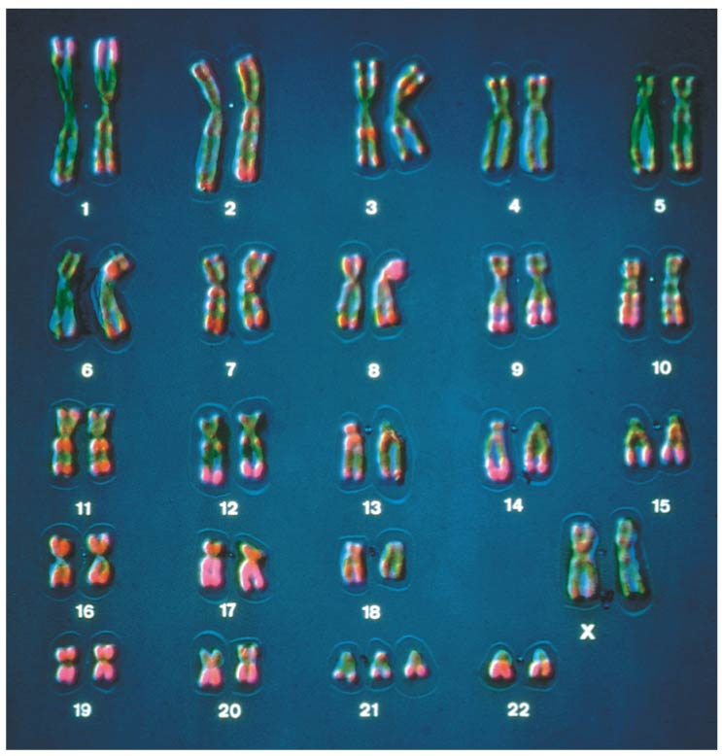
Chromosomal Duplication (Polyploidy)
A)- Polyploidy in autosomes (التعدد في الكروموسومات الذاتية)
Down syndrome trisomy in autosomes (3n)
Is due to three copies of chromosome 21 (2n + 1).
Although chromosome 21 is the smallest human chromosome, it severely alters يُغير an individual’s phenotype in specific ways.

Slide 14
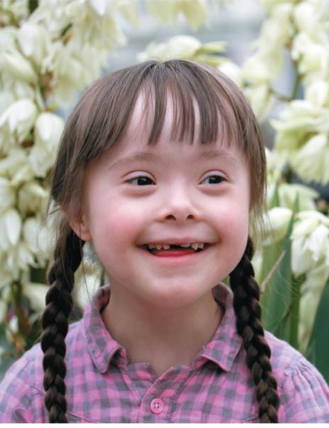
Symptoms of Down Syndrome
Chromosomal Duplication (Polyploidy)
Upward slant to eyes.
Small ears that fold over at the top.
Small, flattened nose.
Small mouth, making tongue appear large.
Short neck.
Small hands with short fingers.
In addition, down syndrome always involves some degree of mental retardation, from mild to severe. In most cases, the mental retardation is mild to moderate.
The frequency of Down syndrome increases with the age of the mother.

Slide 15
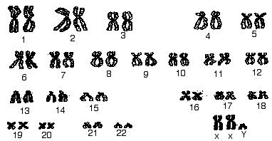
Chromosomal Duplication (Polyploidy)
B)- Polyploidy : in Sex Chromosomes)
(التعدد في الكروموسومات الجنسية)
1)- Klinefelter’s syndrome: trisomy (3n) in sex chromosomes (2n + 1).
Disorder occurring due to nondisjunction of the X chromosome.
The Sperm containing both X and Y combines with an egg containing the X, results in a male child.
The egg may contribute the extra X chromosome.
An XXY male karyotype: occurs once in every 2000 live births.
These individuals have male sex organs,
but are sterile.
There may be feminine characteristics صفات أنثوية,
but their intelligence is normal.
Males with some development of breast tissue normally seen in females.
Little body hair is present, and such person are typically tall, have small testes.
Infertility results from absent sperm.
Evidence of mental retardation may or may not be present.
2)- Jacob’s syndrome: (discovered by Patricia Ann Jacobs).
An XYY male karyotype: tend to somewhat taller than average, and is fertile man.

Slide 16
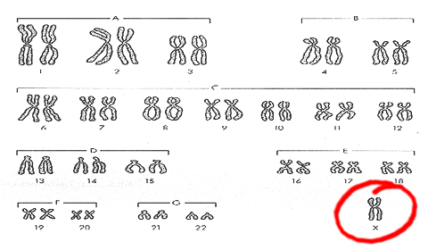
Chromosomal Duplication (Polyploidy)
3)- Triple X syndrome: a trisomy female (XXX karyotype), which occurs once in every 2000 live births, produces healthy females.
4)- Turner’s syndrome, a monosomy female (X0 karyotype),
Occurs once in every 5000 births, produces phenotypic, but immature females غير ناضجة جنسيا.
Turner syndrome is associated with underdeveloped ovaries, short stature.
Bull neck, and broad chest. Individuals are sterile, and lack expected secondary sexual characteristics.
Mental retardation typically not evident.

Slide 17
Chromosomal Duplication (Polyploidy)
Abnormal Chromosomal Number (Aneuploidy)
Polyploidy
Autosomes
Sex Chromosomes
Down syndrome
Klinefelter’s syndromes
Jacob’s syndrome
Triple-X syndrome
Turner’s syndrome
(XXY)
(XYY)
Trisomy (XXX)
Monosomy(X0)
Males
Females

Slide 18
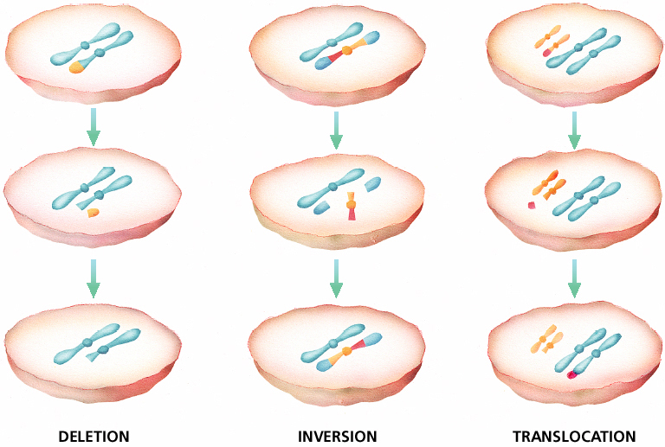
Chapter 12
B)- Alterations of chromosomal structure: (deletions, inversion, and translocations)

Slide 19
B)- Alterations of chromosomal structure, deletions, and translocations
Breakage of a chromosome can lead to three types of changes in chromosome structure:
  Deletion: removes a chromosomal fragment
  Inversion: reverses orientation of a segment within a chromosome
  Translocation: moves a segment from one chromosome to another

Slide 20
B)- Alterations of chromosomal structure
It can also cause human disorders.
Deletions حزف, even in a heterozygous state, cause severe physical and mental problems.
Cri-du-chat عارض مواء القط, (“cry of the cat”) results from a specific deletion in chromosome 5.
- Is due to a missing part of chromosome 5
  These individuals are mentally retarded, have a small head with unusual facial features, and a cry like the mewing of a distressed cat.
  This syndrome is fatal in infancy الطفوية or early childhood.

Slide 21
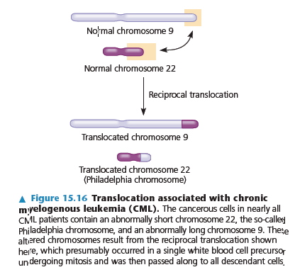
B)- Alterations of chromosomal structure
Myelogenous, [leukemia (CML)]. Caused by chromosomal translocations since a fragment of chromosome 22 switches places with a small fragment from the tip of chromosome 9.

Slide 22


College of Science,
Zoology Department
General Animal Biology
(Zoo-109)
Prof. Ashraf M. Ahmed
aalii@ksu.edu.sa

