Slide 1
Principles of Information Systems, Thirteenth Edition
Chapter 4
Software and Mobile Applications
Notes:
Principles of Information Systems, Thirteenth Edition
Chapter 4
Software and Mobile Applications

Slide 2
Objectives
After completing this chapter, you will be able to:
Define the term “sphere of influence,” and describe how it can be used to classify software
Define the basic functions performed by the operating system
Identify current operating systems that are used for personal, workgroup, and enterprise computing
Discuss how application software can support personal, workgroup, and enterprise business objectives
Identify programming languages in use today
Identify key software issues and trends that have an impact onseveral organizations and individuals
Notes:
Objectives
After completing this chapter, you will be able to:
Identify and briefly describe the functions of two basic kinds of software
Define the term “sphere of influence,” and describe how it can be used to classify software
Define the basic functions performed by the operating system
Identify current operating systems that are used for personal, workgroup, and enterprise computing
Discuss the role of the OS in embedded systems

Slide 3
An Overview of Software
Software
Consists of computer programs that control the workings of computer hardware
Software can be divided into two types:
System software – includes operating system (OS), utilities, and middleware that coordinate the activities and functions of the hardware and other programs
Application software – programs that help users solve particular computing problems
Notes:
An Overview of Software
Software
Consists of computer programs that control the workings of computer hardware
Software can be divided into two types:
System software – includes operating system (OS), utilities, and middleware that coordinate the activities and functions of the hardware and other programs
Application software – programs that help users solve particular computing problems

Slide 4
Software Sphere of Influence
Sphere of influence: the scope of problems and opportunities addressed by a particular organization
Personal sphere of influence
Serves the needs of an individual user
Personal productivity software
Enables users to improve their personal effectiveness
Notes:
Software Sphere of Influence
Sphere of influence: the scope of problems and opportunities addressed by a particular organization
Personal sphere of influence
Serves the needs of an individual user
Personal productivity software
Enables users to improve their personal effectiveness

Slide 5
Software Sphere of Influence
Workgroup: two or more people working together to achieve a common goal
Workgroup sphere of influence
Helps workgroup members attain their common goals
Enterprise sphere of influence
Serves the needs of the firm in its interaction with its environment
Notes:
Software Sphere of Influence
Workgroup: two or more people working together to achieve a common goal
Workgroup sphere of influence
Helps workgroup members attain their common goals
Enterprise sphere of influence
Serves the needs of the firm in its interaction with its environment

Slide 6
Systems Software
Controls the operations of computer hardware
Supports the application programs’ problem-solving capabilities
Types of systems software
Operating systems
Utility programs
Middleware
Notes:
Systems Software
Controls the operations of computer hardware
Supports the application programs’ problem-solving capabilities
Types of systems software
Operating systems
Utility programs
Middleware

Slide 7
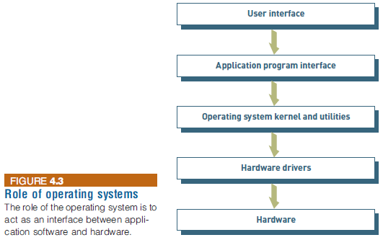
Operating Systems
A set of programs that controls computer hardware and acts as an interface with application programs
Combinations of OSs, computers, and users:
Single computer with a single user
Examples: Microsoft Windows, Google Android
Single computer with multiple simultaneous users
Used in larger server or mainframe computers that
support hundreds or thousands of people.
Examples: UNIX, z/OS, and HP-UX.
Multiple computers with multiple users
Special-purpose computers
Notes:
Operating Systems
A set of programs that controls computer hardware and acts as an interface with application programs
Combinations of OSs, computers, and users:
Single computer with a single user
Single computer with multiple simultaneous users
Multiple computers with multiple users
Special-purpose computers

Slide 8
Operating Systems
Combinations of OSs, computers, and users:
Multiple computers with multiple users
Used in computer networks, such as large computer networks with hundreds of computers attached that support many users, who may be located around the world.
Examples: Red Hat Enterprise Linux Server, Windows Server, and Mac OS X Server.
Special-purpose computers:
Controls computers with specialized functions such as sophisticated military aircraft, digital cameras, or home appliances.
Examples: Windows Embedded, and Symbian.
Notes:
Operating Systems
A set of programs that controls computer hardware and acts as an interface with application programs
Combinations of OSs, computers, and users:
Single computer with a single user
Single computer with multiple simultaneous users
Multiple computers with multiple users
Special-purpose computers

Slide 9
Operating Systems
Kernel
The heart of the operating system
Controls the most critical processes of the OS
Ties all of the OS components together and regulates other programs
Rescue disk
A storage device that contains some or all of the OS and can be used to start the computer if having trouble with the primary hard disk
Notes:
Operating Systems
Kernel
The heart of the operating system
Controls the most critical processes of the OS
Ties all of the OS components together and regulates other programs
Rescue disk
A storage device that contains some or all of the OS and can be used to start the computer if having trouble with the primary hard disk

Slide 10
Operating Systems
Functions performed by the OS
Control common computer hardware functions
Provide a user interface and input/output management
Provide a degree of hardware independence
Manage system memory
Manage processing tasks
Provide networking capability
Control access to system resources
Manage files
Notes:
Operating Systems
Functions performed by the OS
Control common computer hardware functions
Provide a user interface and input/output management
Provide a degree of hardware independence
Manage system memory
Manage processing tasks
Provide networking capability
Control access to system resources
Manage files

Slide 11
Operating Systems
Common Hardware Functions
Get input from keyboard or another input device
Retrieve data from disks
Store data on disks
Display information on a monitor or printer
User Interface and Input/Output Management
A user interface allows individuals to access and interact with the computer system
A command-based user interface requires text commands
A graphical user interface (GUI)
The user interacts with icons and menus to send commands to the computer system
Notes:
Menu bar, start menu, pointer, drop-down menu
Operating Systems
Common Hardware Functions
Get input from keyboard or another input device
Retrieve data from disks
Store data on disks
Display information on a monitor or printer
User Interface and Input/Output Management
A user interface allows individuals to access and interact with the computer system
A command-based user interface requires text commands
A graphical user interface (GUI)
The user interacts with icons and menus to send commands to the computer system

Slide 12
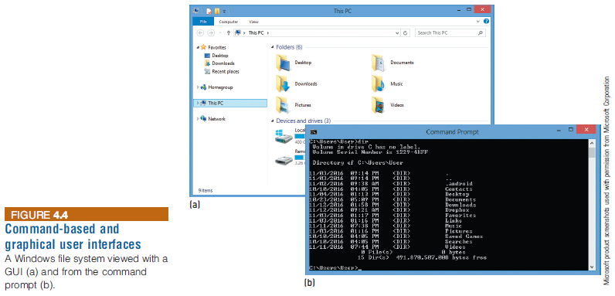
Operating Systems
Notes:
Operating Systems

Slide 13
Why Should You Learn the Command-based Interface
https://www.youtube.com/watch?v=lZ7Kix9bjPI
There is a saying, “graphical user interfaces make easy tasks easier, while command line interfaces make difficult tasks possible.”
Some other advantages:
No GUI overhead
You can script tasks and series of procedures
Notes:
https://www.youtube.com/watch?v=wLPHac99K5M

Slide 14
Operating Systems
Other user interfaces:
Voice User Interface
To interact with computers and devices using spoken language
Virtual assistants like Siri, Amazon's Alexa, and Google Assistant are prominent examples
Natural User Interface (NUI)
Seamlessly integrates gestures (as seen in Xbox Kinect), voice commands (like Siri), and touch to create an intuitive and natural way of interacting with computers
Brain-Computer Interfaces (BCI)
For people with disabilities: https://twitter.com/i/status/1694700935115919536
Hardware Independence
Application program interface (API): a set of programming instructions and standards for one software program to access and use the services of another software program
An API provides a software-to-software interface, not a user interface.
The API also provides software developers tools that allow them to build application software without needing to understand the inner workings of the OS and hardware.
Notes:
https://www.ucsf.edu/news/2023/08/425986/how-artificial-intelligence-gave-paralyzed-woman-her-voice-back
https://www.youtube.com/watch?v=9oka8hqsOzg
Operating Systems
Other user interfaces:
A natural user interface (NUI) or multitouch interface
Speech recognition
Sight interfaces
Brain interfaces
Hardware Independence
Application program interface (API): a set of programming instructions and standards for one software program to access and use the services of another software program
Hardware independence allows software development without concern for the specific underlying hardware

Slide 15
Operating Systems
Memory Management
Allows the computer to execute program instructions effectively and to speed processing
Virtual memory: hard disk space is allocated to supplement the immediate, functional memory capacity of RAM
Virtual memory works by swapping programs or parts of programs between memory and one or more disk devices—a concept called paging.
Paging reduces CPU idle time and increases the number of jobs that can run in a given time span.
Notes:
Operating Systems
Memory Management
Allows the computer to execute program instructions effectively and to speed processing
Virtual memory: hard disk space is allocated to supplement the immediate, functional memory capacity of RAM
Paging

Slide 16
Operating Systems
Processing Tasks: Five basic task management techniques
Multiuser: allows two or more users to run programs at the same time on one computer
Consider operating systems designed for server environments, like Microsoft's Windows Server,
Multiprocessing: supports running a program on more than one CPU (or core)
Multitasking: allows more than one program to run concurrently
Multithreading: allows different threads of a single program to run concurrently
A thread is a set of instructions within an application that is independent of other threads.
For example, in a spreadsheet program, the thread to open the workbook is separate from the thread to sum a column of figures.
Real time: responds to input instantly
Real-time operating systems are used to control the operation of jet engines, the deployment of air bags, and the operation of antilock braking systems—among other uses.
Notes:
Operating Systems
Memory Management
Allows the computer to execute program instructions effectively and to speed processing
Virtual memory: hard disk space is allocated to supplement the immediate, functional memory capacity of RAM
Paging

Slide 17
Operating Systems
Not all operating systems employ all these approaches to task management. For example, the general-purpose operating systems (e.g., Windows, Mac OS, and Linux) cannot support real-time processing.
Notes:
Operating Systems
Memory Management
Allows the computer to execute program instructions effectively and to speed processing
Virtual memory: hard disk space is allocated to supplement the immediate, functional memory capacity of RAM
Paging

Slide 18
Operating Systems
Networking Capability
Allows computers in a network to send and receive data and share computing resources
Access to System Resources and Security
Provides protection against unauthorized access to the users’ data and programs
Establishes a logon procedure
May control access to specific system resources
Tracks who is using the system, length of use, and attempted security breaches
Notes:
Operating Systems
Networking Capability
Allows computers in a network to send and receive data and share computing resources
Access to System Resources and Security
Provides protection against unauthorized access to the users’ data and programs
Establishes a logon procedure
May control access to specific system resources
Tracks who is using the system, length of use, and attempted security breaches

Slide 19
Operating Systems
File Management
Ensures that files in secondary storage are available when needed
Protects files from access by unauthorized users
Notes:
Operating Systems
File Management
Ensures that files in secondary storage are available when needed
Protects files from access by unauthorized users

Slide 20
Current Operating Systems
Notes:
Current Operating Systems

Slide 21
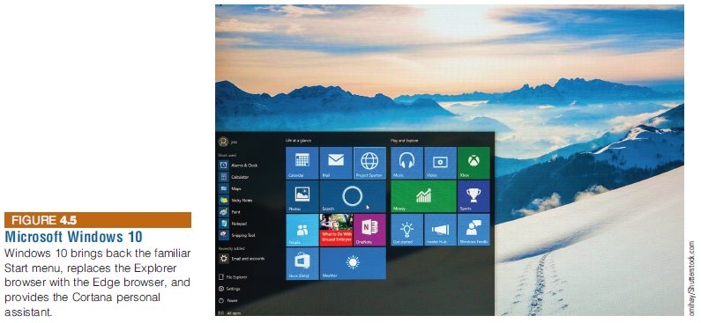
Personal Computing Operating Systems
Microsoft PC OS
As of Windows 10, Microsoft is moving away from releasing major new versions, but will provide ongoing, incremental upgrades and improvements
Notes:
Personal Computing Operating Systems
Microsoft PC OS
As of Windows 10, Microsoft is moving away from releasing major new versions, but will provide ongoing, incremental upgrades and improvements

Slide 22
Personal Computing Operating Systems
Apple Computer OS
Mac OS X has been upgraded multiple times
First eight versions were named after big cats
Latest versions are named after places in California
Notes:
Personal Computing Operating Systems
Apple Computer OS
Mac OS X has been upgraded multiple times
First eight versions were named after big cats
Latest versions are named after places in California
Mac OS X 10.11 El Capitan is the latest version
Mac users can set up their computers to run both Windows and Mac OS X

Slide 23
Personal Computing Operating Systems
Notes:
Personal Computing Operating Systems

Slide 24
Personal Computing Operating Systems
Linux
Open-source operating system, developed in 1991 by Linus Torvalds as a student in Finland
Linux is just a kernel
Enhanced over time through collaborative efforts from the community
Individuals and organizations can use the open-source Linux code to create their own distribution (flavour) of Linux
A distribution is a complete operating system that consists of:
The Linux kernel (the core of the operating system)—which controls the hardware, manages files, separates processes, and performs other basic functions—along with other software
Other software such as the terminal interface and available commands, the graphical user interface (GUI), and other useful utility programs.
Notes:
Personal Computing Operating Systems
Linux
Open-source operating system
Three of the most widely used distributions come from software companies:
Red Hat
SUSE
Canonical
openSUSE is the distribution sponsored by SUSE

Slide 25
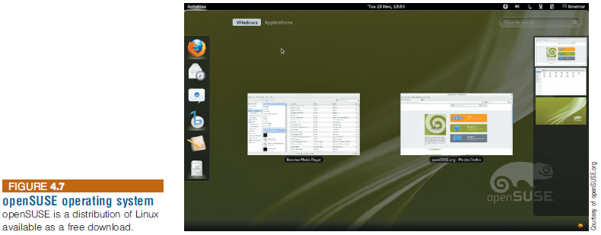
Personal Computing Operating Systems
Two of the most widely used distributions come from software companies:
Red Hat
SUSE
openSUSE is the distribution sponsored by SUSE
Notes:
Personal Computing Operating Systems
Linux
Open-source operating system
Three of the most widely used distributions come from software companies:
Red Hat
SUSE
Canonical
openSUSE is the distribution sponsored by SUSE

Slide 26
Personal Computing Operating Systems
Google: Android and Chrome
Chrome OS
Linux-based operating system designed for netbooks and nettops
Designed to run on inexpensive low-power computers
Chromium OS: an open-source version of Chrome OS
Android: an operating system for mobile devices
The majorly of mobile phones worldwide use Android
Notes:
Personal Computing Operating Systems
Google: Android and Chrome
Chrome OS
Linux-based operating system designed for netbooks and nettops
Designed to run on inexpensive low-power computers
Chromium OS: an open-source version of Chrome OS
Android: an operating system for mobile devices
80 percent of mobile phones worldwide use Android

Slide 27
Workgroup Operating Systems
Windows Server provides:
A powerful Web server management system
Virtualization tools that allow various operating systems to run on a single server
Advanced security features
Robust administrative support
UNIX
There are many variants of UNIX, including HP-UX from Hewlett-Packard, AIX from IBM, and Solaris from Oracle
Therefore, it’s a family of UNIX-based operating systems
Notes:
Workgroup Operating Systems
Windows Server provides:
A powerful Web server management system
Virtualization tools that allow various operating systems to run on a single server
Advanced security features
Robust administrative support
UNIX
Can be used on many computer system types and platforms

Slide 28
Workgroup Operating Systems
Red Hat Enterprise Linux Server can manage a cluster of several servers
Mac OS X Server
First modern server OS from Apple
Based on the UNIX OS
Makes it easy to collaborate, develop software, host Web sites and wikis, configure Mac and iOS devices, and remotely access a network
Notes:
Workgroup Operating Systems
Red Hat Enterprise Linux Server can manage a cluster of several servers
Mac OS X Server
First modern server OS from Apple
Based on the UNIX OS
Makes it easy to collaborate, develop software, host Web sites and wikis, configure Mac and iOS devices, and remotely access a network

Slide 29
Enterprise Operating Systems
Examples of mainframe OSs
z/OS: IBM’s first 64-bit enterprise OS
HP-UX from Hewlett-Packard
Linux
Notes:
Enterprise Operating Systems
Examples of mainframe OSs
z/OS: IBM’s first 64-bit enterprise OS
HP-UX from Hewlett-Packard
Linux

Slide 30
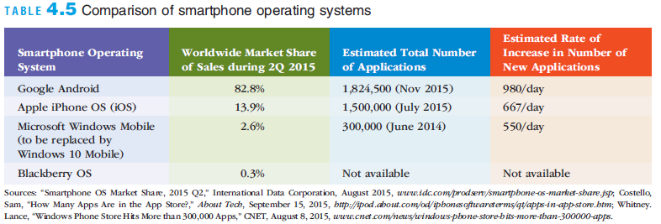
Mobile Operating Systems
Smartphones employ full-fledged computer OSs
Google Android
Apple iOS
Microsoft Windows Phone
Notes:
Mobile Operating Systems
Smartphones employ full-fledged computer OSs
Google Android
Apple iOS
Microsoft Windows Phone

Slide 31
Embedded Operating Systems
Embedded system: a computer system (including a processor) implanted in and dedicated to the control of another device
Popular OSs for embedded systems
Windows Embedded
Because embedded systems are usually designed for a specific purpose in a specific device, they are usually proprietary or custom-created and owned by the manufacturer. Examples: OSs in e-book readers, ATMs, networking devices, GPS devices, and media players
The typical car contains many embedded systems, including:
Those that control antilock brakes, air bag deployment, fuel injection, active suspension devices, transmission control, and cruise control
Notes:
but they can range from having no user interface (UI) -- for example, on devices in which the system is designed to perform a single task -- to complex graphical user interfaces (GUIs), such as in mobile devices. User interfaces can include buttons, LEDs, touchscreen sensing and more. Some systems use remote user interfaces as well.
It is embedded as part of a complete device often including electrical or electronic hardware and mechanical parts.

Slide 32
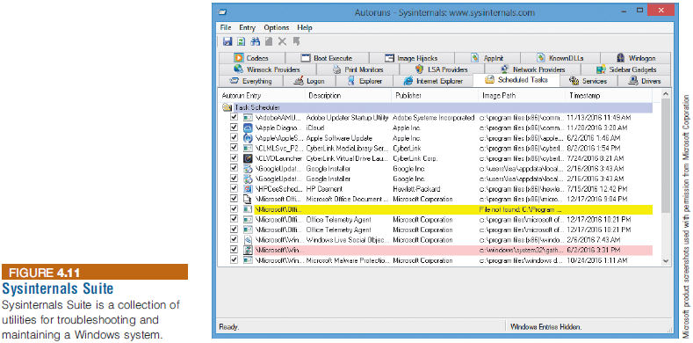
Utility Programs
Utility program: a program that helps to perform maintenance or correct problems with a system
Notes:
Utility Programs
Utility program: a program that helps to perform maintenance or correct problems with a system

Slide 33
Utility Programs
Hardware utilities
Such as disk utilities, which can
check the hard disk’s boot sector, file allocation tables, and directories and analyze them to ensure that the hard disk is not damaged
optimize the placement of files on a crowded disk
Security utilities
Antivirus and anti-malware utilities
Fire-wall software: filters incoming and outgoing packets, making sure that neither hackers nor their tools are attacking the system
File-compression utilities
File-compression programs can reduce the amount of disk space required to store a file or reduce the time it takes to transfer a file over the Internet
A Zip file has a .zip extension, and its contents can be unzipped to the original size
MP3 is a popular file-compression format used to store, transfer, and play music and audio files, such as podcasts
Notes:
Utility Programs
Hardware utilities
Security utilities
File-compression utilities
Spam-filtering utilities
Network and Internet utilities
Server and mainframe utilities
Other utilities: mobile device management (MDM), defraggers, system cleaners, etc.

Slide 34
Utility Programs
Network and Internet utilities
Network utility software can help you to keep track of network components, traffic flows, and network performance.
Server and mainframe utilities
Software that allows the creation of virtual servers, which separate a physical computing device into one or more “virtual” servers,
Companies using virtual servers can save millions of dollars in capital and operating expenses (including energy costs) per year by dramatically reducing the number of actual physical servers in use.
Other utilities: defraggers, system cleaners, uninstallers, etc.
Notes:
Utility Programs
Hardware utilities
Security utilities
File-compression utilities
Spam-filtering utilities
Network and Internet utilities
Server and mainframe utilities
Other utilities: mobile device management (MDM), defraggers, system cleaners, etc.

Slide 35
File Defragmentation
Based on class discussion, you must be able to address the following questions:
What causes file fragmentation?
Why is it necessary to occasionally defragment files?
Does file fragmentation matter when using an SSD as a permanent storage device? Why?
Visualization of the process of fragmentation and defragmentation
https://commons.wikimedia.org/wiki/File:FragmentationDefragmentation.gif#/media/File:Defragmenting_disk.gif

Slide 36
Middleware
Middleware is software that allows different systems to communicate and exchange data
A key example:
Enterprise application integration (EAI): tying together of disparate applications
It is implemented to address situations in which a company acquires different types of information systems—often through mergers, acquisitions, or expansion
Can also be used as an interface between the Internet and private corporate systems
Service-oriented architecture (SOA): a software design approach using modules to provide specific functions as services to other applications
Notes:
Middleware
Middleware
Software that allows different systems to communicate and exchange data
Can also be used as an interface between the Internet and private corporate systems
Enterprise application integration (EAI): tying together of disparate applications
Service-oriented architecture (SOA): a software design approach using modules to provide specific functions as services to other applications

Slide 37
Application Software
Application programs’ primary function
To apply the power of the computer to enable people, workgroups, and the entire enterprise to solve problems and perform specific tasks
Many software options are available
Software can be selected that best meets the needs of the individual, workgroup, or enterprise
Notes:
Application Software
Application programs’ primary function
To apply the power of the computer to enable people, workgroups, and the entire enterprise to solve problems and perform specific tasks
Many software options are available
Software can be selected that best meets the needs of the individual, workgroup, or enterprise

Slide 38
Overview of Application Software
Proprietary software: a one-of-a-kind program for a specific application
Owned by the company, organization, or person that uses it
Off-the-shelf software: software mass-produced by software vendors
Addresses needs that are common across businesses, organizations, or individuals
Notes:
Overview of Application Software
Proprietary software: a one-of-a-kind program for a specific application
Owned by the company, organization, or person that uses it
Off-the-shelf software: software mass-produced by software vendors
Addresses needs that are common across businesses, organizations, or individuals

Slide 39
Overview of Application Software
Notes:
Overview of Application Software

Slide 40
Overview of Application Software
Cloud service providers
Companies that provide software, data storage, and other services via the Internet
Software as a service (SaaS)
Businesses subscribe to Web-delivered business application software
Vendors include Oracle, SAP, NetSuite, Salesforce, and Google
Amazon is considered one of the leading public cloud service providers because of Amazon Web Services (AWS) platform
Notes:
Overview of Application Software
Cloud service providers
Companies that provide software, data storage, and other services via the Internet
Software as a service (SaaS)
Businesses subscribe to Web-delivered business application software
Vendors include Oracle, SAP, NetSuite, Salesforce, and Google
Amazon is considered one of the leading public cloud service providers because of Amazon Web Services (AWS) platform

Slide 41
Personal Application Software
Word Processing
Create, edit, and print text documents
Spreadsheet Analysis
Perform statistical, financial, logical, database, graphics, and date and time calculations using a wide range of built-in functions
Database Applications
Store, manipulate, and retrieve data
Notes:
Personal Application Software
Word Processing
Create, edit, and print text documents
Spreadsheet Analysis
Perform statistical, financial, logical, database, graphics, and date and time calculations using a wide range of built-in functions
Database Applications
Store, manipulate, and retrieve data

Slide 42
Personal Application Software
Presentation Graphics Program
Develop graphs, illustrations, drawings, and presentations
Personal Information Managers
Helps people, groups, and organizations store useful information, such as a list of tasks to complete or a set of names and addresses
Notes:
Personal Application Software
Presentation Graphics Program
Develop graphs, illustrations, drawings, and presentations
Personal Information Managers
Helps people, groups, and organizations store useful information, such as a list of tasks to complete or a set of names and addresses

Slide 43
Personal Application Software
Software Suites and Integrated Software Packages
A collection of single programs packaged together in a bundle
Suites can include: word processor, spreadsheet, database management, graphics, communications tools, and organizers
Programs are designed to work similarly
Bundled suite is cost effective
Notes:
Personal Application Software
Software Suites and Integrated Software Packages
A collection of single programs packaged together in a bundle
Suites can include: word processor, spreadsheet, database management, graphics, communications tools, and organizers
Programs are designed to work similarly
Bundled suite is cost effective

Slide 44
Personal Application Software
Other Personal Application Software
TurboTax: tax-preparation program
Software for creating Web pages and sites, composing music, and editing photos and videos
Educational and reference
Entertainment, games, and leisure
Computer-assisted design (CAD)
Statistical software: SPSS and SAS
Notes:
Personal Application Software
Other Personal Application Software
TurboTax: tax-preparation program
Software for creating Web pages and sites, composing music, and editing photos and videos
Educational and reference
Entertainment, games, and leisure
Computer-assisted design (CAD)
Statistical software: SPSS and SAS

Slide 45
Personal Application Software
Mobile Application Software
Number of apps has exploded
According to statista.com:
Google Play has 3.5 million apps
Apple App Store has 1.6 million apps
Other app stores
F-Droid
Free and open-source android apps
Has around 4,000 apps
Huawei AppGallery
Amazon Appstore
Notes:
Personal Application Software
Mobile Application Software
Number of apps has exploded
Hundreds of thousands of applications have been developed by third parties
Thousands of applications are available for iPhones from the Apple App Store
Over one million apps are available in the Android market on Google’s Play Store
Microsoft and other software companies are investing in mobile app software

Slide 46
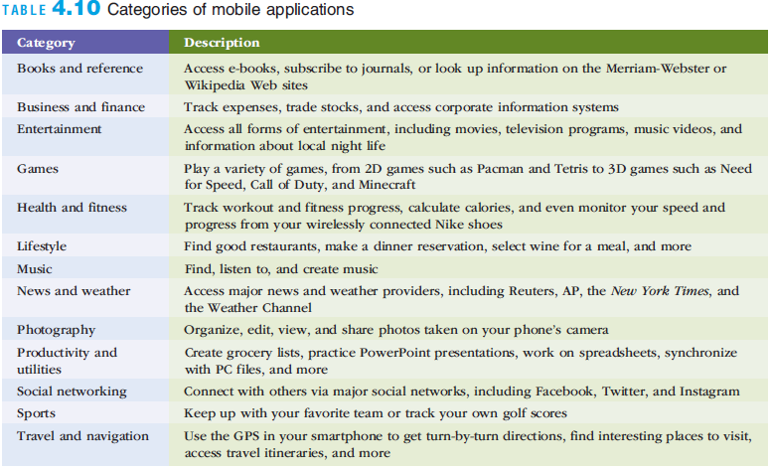
Personal Application Software
Notes:
Personal Application Software

Slide 47
Workgroup Application Software
Workgroup application software
Designed to support teamwork with people in the same location or dispersed around the world
Groupware helps groups of people work together more effectively
Also called collaborative software
Notes:
Workgroup Application Software
Workgroup application software
Designed to support teamwork with people in the same location or dispersed around the world
Groupware helps groups of people work together more effectively
Also called collaborative software

Slide 48
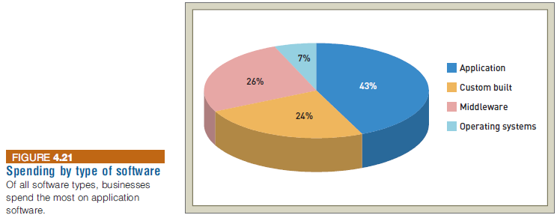
Enterprise Application Software
Enterprise application software
Software that benefits an entire organization
Helps managers and workers stay connected
Cost, installation and ability to integrate with other software are major considerations in selecting this software
Usability on smartphones and mobile devices is also an important factor
Notes:
Enterprise Application Software
Enterprise application software
Software that benefits an entire organization
Helps managers and workers stay connected
Cost, installation and ability to integrate with other software are major considerations in selecting this software
Usability on smartphones and mobile devices is also an important factor

Slide 49
Programming Languages
Programming languages
Sets of keywords, commands, symbols, and a system of rules for constructing statements
Allows humans to communicate instructions to a computer
Syntax: a set of rules associated with a programming language
Compiler: a special software program that converts the programmer’s source code into the machine-language instructions
Notes:
Programming Languages
Programming languages
Sets of keywords, commands, symbols, and a system of rules for constructing statements
Allows humans to communicate instructions to a computer
Syntax: a set of rules associated with a programming language

Slide 50
Programming Languages
Notes:
Programming Languages

Slide 51
Programming Languages
Notes:
Programming Languages

Slide 52
Programming Languages
Integrated Development Environments (IDEs):
IDE combines all the tools required for software engineering into one package
Code editor
Compiler
Debugger
Version control integration (with Git, for example)
Etc
Examples of IDEs: Xcode, Visual Studio, and Eclipse
Mobile IDEs usually offer a simulator/emulator:
For instance, the Android Studio emulator enables developers to test their applications on virtual Android devices.
The Xcode Simulator for iOS allows developers to simulate and evaluate their apps on virtual iOS devices.
Notes:
Programming Languages
Programming languages
Sets of keywords, commands, symbols, and a system of rules for constructing statements
Allows humans to communicate instructions to a computer
Syntax: a set of rules associated with a programming language

Slide 53
Programming Languages
Notes:
Programming Languages
Programming languages
Sets of keywords, commands, symbols, and a system of rules for constructing statements
Allows humans to communicate instructions to a computer
Syntax: a set of rules associated with a programming language

Slide 54
Programming Languages
Software Development Kit (SDK): a set of tools, libraries, and documentation that helps developers create applications for specific platforms (e.g., hardware platforms, OS, etc)
Examples of SDKs for Java:
Java Development Kit (JDK)
Android SDK
Apache Tomcat
Hosting Java-based web applications
AWS SDK for Java
Google Cloud SDK for Java
MLlib
is an Apache Spark's scalable machine learning library
Microsoft Azure SDK for Java

Slide 55
Programming Languages
The following show the relationship between programming languages, IDEs, and SDKs:
Apple provides the following to develop applications using objective-c and swift programming languages:
IDE: Xcode
SDKs: macOS SDK, iOS SDK, watchOS SDK, and more
In 2013, Google transitioned from providing an SDK that could be imported into Eclipse (for example) to offering a comprehensive integrated development environment (IDE) known as Android Studio for Android development.
Programming language: Java

Slide 56
Programming Languages
Programming libraries: collections of prewritten code that provide reusable functions, classes, and data structures to simplify the development of new software applications.
Common libraries in Java
Stanford CoreNLP: Natural (human) language processing
WEKA: Machine learning
Deeplearning4L (DL4J): Deep learning
JUnit: Testing
Log4J: Logging
JDBC: relational database

Slide 57
Stanford CoreNLP

Slide 58
Software Issues and Trends
Software issues:
Software bugs
Copyrights and licensing
Freeware and open-source software
Upgrades
Global software support
Notes:
Software Issues and Trends
Software issues:
Software bugs
Copyrights and licensing
Freeware and open-source software
Upgrades
Global software support

Slide 59
Software Bugs
Software bug: a defect in a program that keeps it from performing as it should
Tips for reducing the impact of software bugs
Register all software
Check read-me files for solutions to known problems
Access the support area of the manufacturer’s Web site for patches
Install the latest software updates
Make sure you can recreate the bug and then call the manufacturer’s tech support line
Notes:
Software Bugs
Software bug: a defect in a program that keeps it from performing as it should
Tips for reducing the impact of software bugs
Register all software
Check read-me files for solutions to known problems
Access the support area of the manufacturer’s Web site for patches
Install the latest software updates
Make sure you can recreate the bug and then call the manufacturer’s tech support line

Slide 60
Copyrights and Licenses
Most software products are protected by law using copyright or licensing provisions
Some software now requires that you register or activate it before it can be fully used
Notes:
Copyrights and Licenses
Most software products are protected by law using copyright or licensing provisions:
In some cases, you are given unlimited use of software on one or two computers
In other cases, you pay for your usage; if you use the software more, you pay more
Some software now requires that you register or activate it before it can be fully used
Single-user license
Permits you to install the software on one or more computers, used by one person

Slide 61
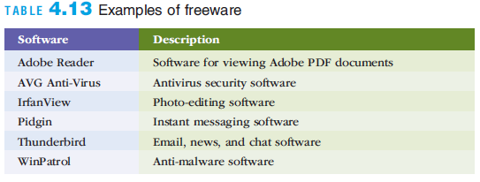
Freeware and Open-Source Software
Freeware: software that is made available to the public for free
Open-source software: distributed, typically for free, with the source code
Notes:
Freeware and Open-Source Software
Freeware: software that is made available to the public for free
Open-source software: distributed, typically for free, with the source code

Slide 62
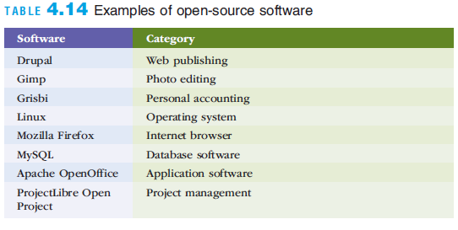
Freeware and Open-Source Software
Notes:
Freeware and Open-Source Software

Slide 63
Freeware and Open-Source Software
Software licenses:
Permissive Style
Carries minimum restrictions (permits reuse within proprietary software)
Includes disclaimer
Examples: MIT, BSD, and Apache 2.0 Licenses
Software that uses this type: Ruby on Rails, and tensorflow
Copyleft Style
The same rights have to be maintained in derivative works
Examples: GNU GPL
Software that uses this type: Linux kernel, and Git
Proprietary Licenses
Restrict the use, modification, and distribution of the software
Notes:
Freeware and Open-Source Software
GNU General Public License (GPL) grants you the right to:
Run the program for any purpose
Study how the program works and adapt it to your needs
Redistribute copies so you can help others
Improve the program and release improvements to the public

Slide 64
Software Upgrades
Software companies revise their programs and sell new versions periodically
Software upgrades vary widely in the benefits that they provide
Developing an upgrading strategy is important for many businesses
Helps to ensure that updated software is more stable with fewer errors and problems
Notes:
Software Upgrades
Software companies revise their programs and sell new versions periodically
Software upgrades vary widely in the benefits that they provide
Developing an upgrading strategy is important for many businesses
Helps to ensure that updated software is more stable with fewer errors and problems

Slide 65
Global Software Support
Supporting local operations is one of the biggest challenges IS teams face when putting together standardized, company-wide systems
Outsourcing global support to one or more third-party distributors is gaining acceptance
Notes:
Global Software Support
Supporting local operations is one of the biggest challenges IS teams face when putting together standardized, company-wide systems
Outsourcing global support to one or more third-party distributors is gaining acceptance

Slide 66
Summary
The OS is called the “soul of the computer” because it controls how you enter data into your computer, perform meaningful work, and display results
Organizations typically use off-the-shelf software to meet common business needs and proprietary software to meet unique business needs
Notes:
Summary
Software is valuable in helping individuals, workgroups, and entire enterprises achieve their goals
The OS is called the “soul of the computer” because it controls how you enter data into your computer, perform meaningful work, and display results
Organizations typically use off-the-shelf software to meet common business needs and proprietary software to meet unique business needs
The software industry continues to undergo constant change; computer users need to be aware of recent trends and issues in the software industry to be effective in their business and personal life

