Slide 1




علم الأحياء
College of Science,
Zoology Department

Slide 2


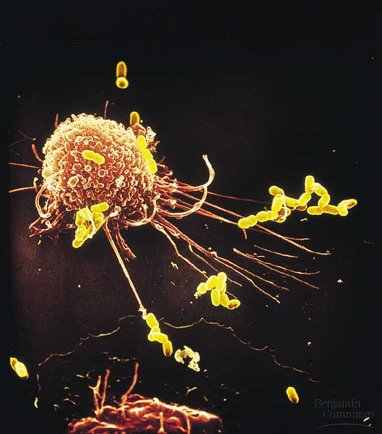
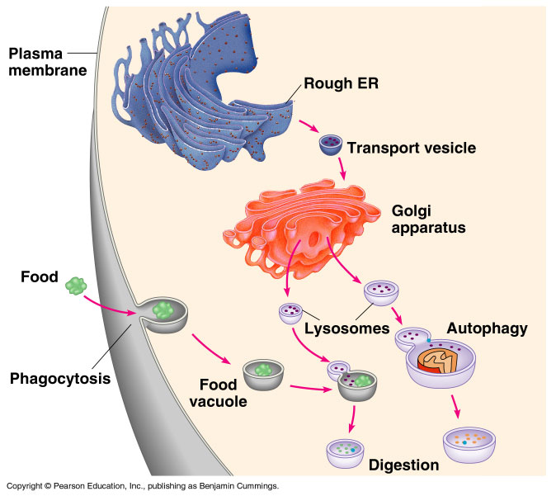
B- Eukaryotic Cell
Copyright © 2002 Pearson Education, Inc., publishing as Benjamin Cummings

Slide 3


Objectives
  3)- The Endomembrane System
  The endoplasmic reticulum (ER)
    Smooth ER.
    Rough ER .
  Golgi apparatus.
  Lysosomes.
  Vacuoles.
  4)- Other membranous organelles
  Peroxisome.
  Mitochondria.

Slide 4
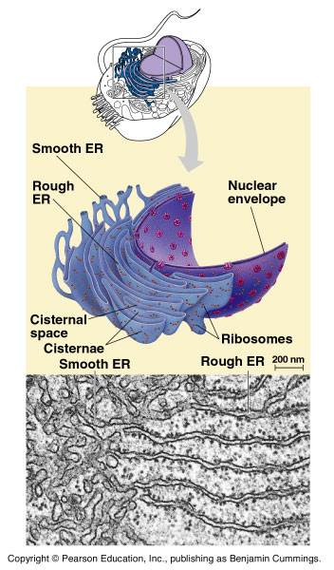
A)- The endoplasmic reticulum (ER) (The intracellular highway)
3- The Endomembrane System
It is the largest internal membrane, composed of lipid bilayer
It serves as a system of channels from the nucleus.
It functions in storage and secretion

Slide 5
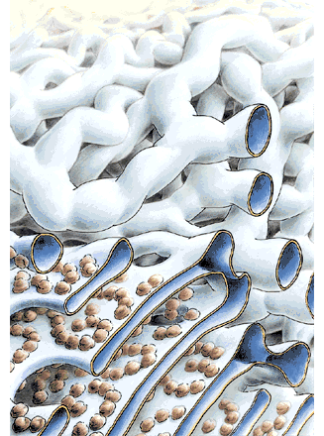
3- The Endomembrane System
Types of endoplasmic reticula
The smooth ER:
It is smooth as it lacks the associated ribosomes.
It is rich in enzymes and plays a role in metabolism.
Its enzymes synthesize lipids (oils, phospholipids and steroids), including the (sex hormones).
Extensive in the liver, as it helps in detoxifying drugs and poisons.
The rough ER:
It is “rough” because of the associated ribosomes (bound ribosomes)
It is abundant in those cells that secrete proteins such as digestive glands and antibody-producing cells.
Rough
Smooth

Slide 6
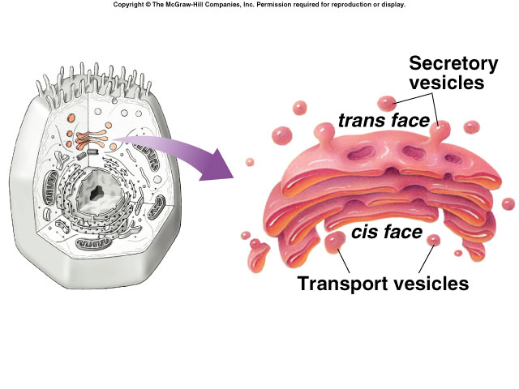
B)- Golgi apparatus: (finishes, sorts, packages and ships cell products)
3- The Endomembrane System
    Many transport products from the ER travel to the Golgi apparatus for modification of their contents.
Thus, Golgi body’s function is manufacturing, warehousing, sorting (Packaging), and shipping materials to outside the cell.
The Golgi also manufactures polysaccharides.
It correctly send proteins to their respective address.
If the Golgi makes a mistake in shipping the proteins to the right address, certain functions in the cell may stop.
The Golgi apparatus is more abundant in secretory cells.

Slide 7
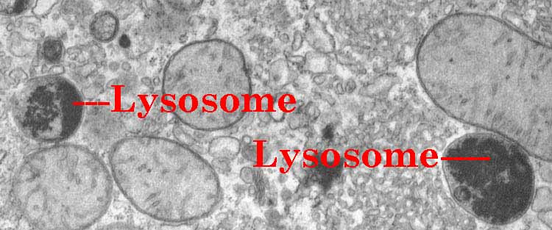
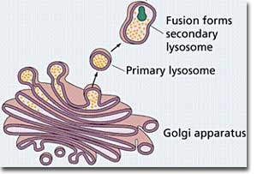
C)- Lysosomes: They are digestive components
3- The Endomembrane System
Lysosome is a membrane-bounded sac contains enzymes that digest macromolecules
Lysosomal enzymes work best at pH = 5 (acidic).
Lysosomal enzymes are synthesized by rough ER and then transferred to the Golgi then to lysosomes.

Slide 8
3- The Endomembrane System
Functions of Lysosomes
They have enzymes that hydrolyse proteins, fats, polysaccharides, and nucleic acids.
Can destroy the cell by auto-digestion (autophagy).
Can also fuse with and digest another organelle or part of the cytosol. This process is called recycling which renews the organelle and/or the cell.
Can fuse with food vacuoles to digest food, (when a food item is brought into the cell by Phagocytosis).
They digest unwanted particles.
They help white blood cells to destroy bacteria.

Slide 9
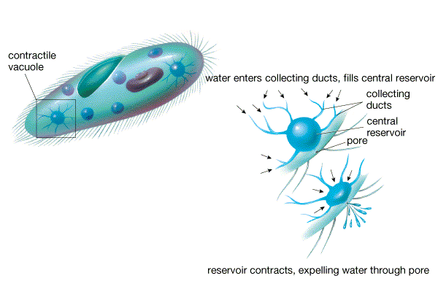
D)- Vacuoles: They have diverse functions in cell maintenance
3- The Endomembrane System
They are membrane-bound sacs with varied functions such as storage, digestion, and waste removal.
Contain water solution and help plants maintain shape.
There are different types of vacuoles including:
  Food vacuoles, from phagocytosis, fuse with lysosomes for digestion.
  Contractile vacuoles, فجوة متقبضة found in freshwater protists (e.g. Paramecium) to maintain water balance (osmoregulation) by pumping excess water out of the cell.
  Central vacuoles (in mature plants) store wastes, maintain the cell shape.

Slide 10
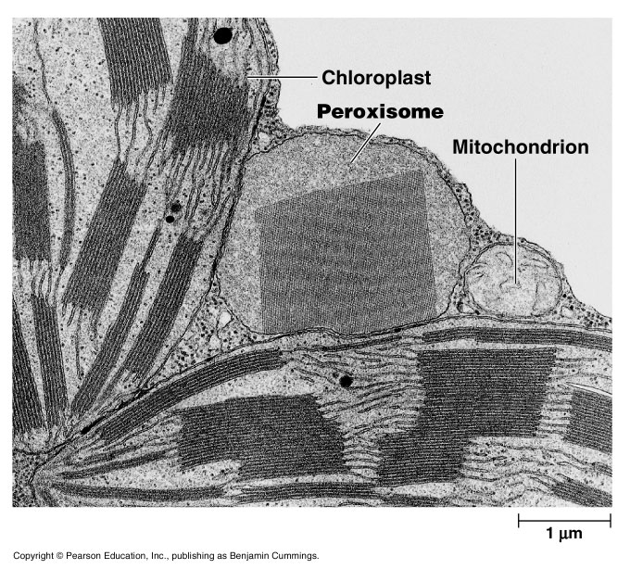
4- Other Membranous Organelles
1)- Peroxisomes
Are similar in appearance to lysosomes, but the two have different origins:
Lysosomes are generally formed in the Golgi complex,
Whereas peroxisomes are self-replicating themselves.
  Contain enzymes for degrading amino acids and fatty acids, resulting in production of the toxic hydrogen peroxide; (H₂O₂) as a byproduct of cellular metabolism.

Slide 11
Other Membranous Organelles
Functions of peroxisomes:
  1- They have enzymes that converts the toxic H₂O₂ to water (H₂O).
  2- They break fatty acids down to smaller molecules that are transported to mitochondria as fuel (for cellular respiration).
  3- They detoxify alcohols and other harmful compounds. Thus, it exists extensively in the liver cells.
4- They initiate the production of phospholipids, which are the major component of cellular membranes.

Slide 12
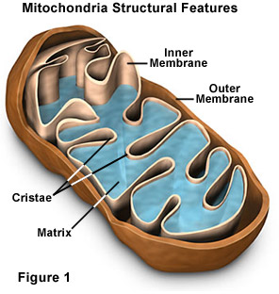
Other Membranous Organelles
2)- Mitochondria:
They are rod-shaped organelles that convert oxygen and nutrients into ATP (adenosine triphosphate) during aerobic respiration.
Mitochondria are the sites of cellular respiration,
Generating ATP from the catabolism (هدم/حرق) of sugars, fats, and other fuels in the presence of oxygen.
Almost all eukaryotic cells have mitochondria except red blood cells.
Mitochondria are mobile and moving around inside the cell along tracks in the cytoskeleton.
The number of mitochondria present in a cell depends upon the metabolic requirements of that cell, and may range from a single large mitochondrion to thousands.

Slide 13
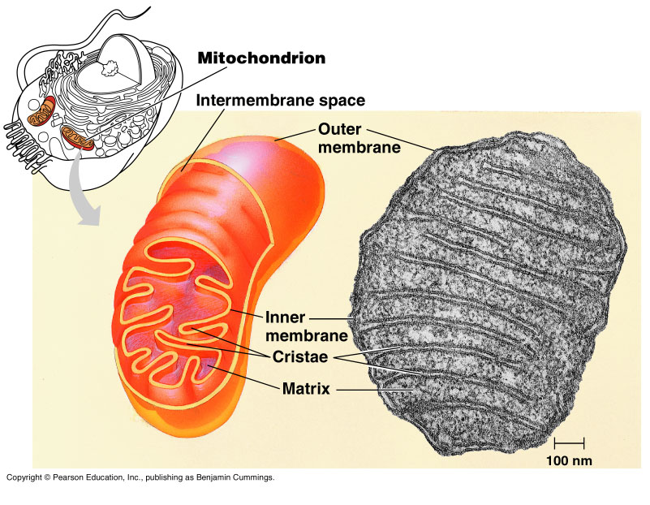
Other Membranous Organelles
Structure of mitochondrion:
Mitochondria have a smooth outer membrane and a highly folded inner membrane forming the cristae.
The inner membrane encloses the mitochondrial matrix, a fluid-filled space with the mitochondrial DNA, ribosomes, and enzymes.
The mitochondrion is different from the most other organelles because:
It has its own DNA ,ribosomes, and enzymes.
It reproduces independently of the cell.

Slide 14


College of Science,
Zoology Department
General Animal Biology
(Zoo-109)
Zoology Department

