Slide 1
AN INTRODUCTION TO METABOLISM
Enzymes
1. Enzymes speed up metabolic reactions by lowering energy barriers.
2. Enzymes are substrate specific.
3. The active site is an enzyme’s catalytic center.
4. A cell’s physical and chemical environment affects enzyme activity.
ENZYMES: A protein with catalytic properties due to its power of specific activation
Pages 96 - 103

Slide 2
Hydrolysis of sucrose (table sugar)
Dehydration
Glucose + Fructose
Sucrose
Hydration (H₂O)
Glucose + Fructose
Sucrase
Hydrolysis of sucrose in the presence of Sucrase results in its two monosaccharide components.
This process include:
1- Breaking the bond between Glucose and Fructose;
2- Then, forming new bonds with H⁺ and OH⁻ from water
This process consumes energy (Activation Energy; E_{A})

Slide 3
Enzymes speed up metabolic reactions by lowering energy barriers
A catalyst is a chemical agent that changes the rate of a reaction without being consumed by the reaction.
An enzyme is a catalytic protein.
Chemical reactions between molecules involve both bond breaking and bond forming.
To hydrolyze (hydration) sucrose, the bond between glucose and fructose must be broken via hydrolysis in the presence of sucrase (the catalyst).
Sucrase

Slide 4
Enzymes and Activation Energy
Activation Energy:
It is the minimum amount of energy needed to start a reaction. It is the amount of energy needed for the reaction (between enzyme & substrate) to complete (to break the bonds).
Raising the temperature for these reactions to complete will either denature the compounds or kill the cell.
Thus, organisms must therefore use a catalyst.
Catalyst:
It is a chemical agent that accelerate the reaction without being consumed by the reaction.
Enzyme is a catalytic protein
Enzyme is a specific catalyst for specific reactants at any time in the cell (e.g. Sucrase for only Sucrose).

Slide 5
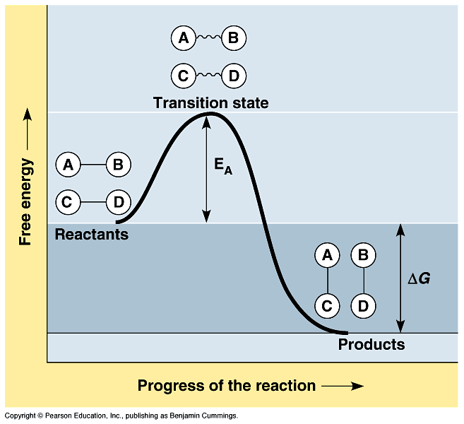
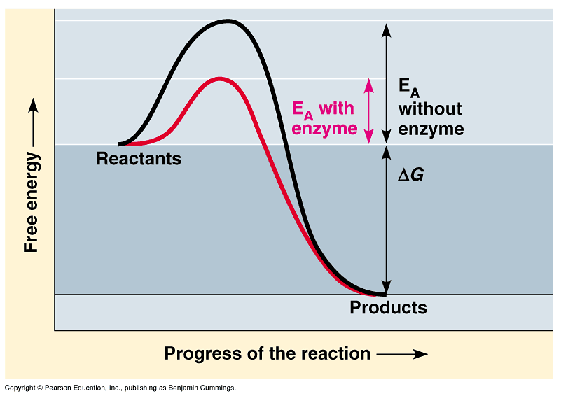
Activation energy: is the amount of energy necessary to push the reactants over an energy barrier.
At the transition state, the molecules are at an unstable point.
The difference between free energy of the products and the free energy of the reactants is the delta G.
Enzyme can increase the rate of reactions by lowering E_{A}.
The transition state can then be reached even at moderate temperatures.

Slide 6
Enzymes are substrate specific
The substrate is a reactant which binds to an enzyme.
When a substrate binds to an enzyme, the enzyme catalyzes the conversion of the substrate to the product.
Sucrase (catalyst) is an enzyme that binds to sucrose (substrate) and breaks the disaccharide into fructose and glucose (products).
Enzyme (a catalyst)
Substrate
Product (s)
Sucrase
Sucrose + H₂O
Glucose + Fructose
Specificity of enzyme refers to the shape of its Active Site into which fits the surface of the substrate.

Slide 7
The active site is an enzyme’s catalytic center
The active site of an enzymes is the groove on the surface of the enzyme into which the substrate fits.
The specificity of an enzyme is due to the fit between the active site and that of the substrate.
As the substrate binds, the enzyme changes shape to fit the substrate, bringing chemical groups in position to catalyze the reaction.

Slide 8
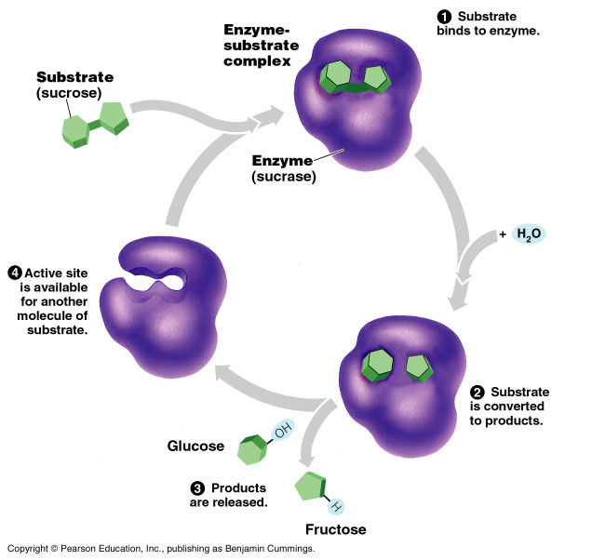
Catalytic Cycle of Enzyme

Slide 9
Active site of enzyme and Catalytic Cycle
Sucrase
Sucrose
Glucose
H₂O
Fructose

Slide 10
Catalytic Cycle of Enzyme
1- The substrate binds to the active site of enzyme.
2- This forms an Enzyme-Substrate complex (via weak hydrogen bonds).
3- The active site catalyses the conversion of the substrate to final products (original components) by breaking bonds.
4- The resulting products release from the enzyme.
5- The enzyme starts another reaction over and over again.
6- Thus, the enzyme can have a huge metabolic effect in the catalytic cycle.

Slide 11
A single enzyme molecule can catalyze thousands or more reactions a second.
Enzymes are unaffected by the reaction and are reusable.
Most metabolic enzymes can catalyze a reaction in both the forward and reverse direction.
The actual direction depends on the relative concentrations of products and reactants.
Enzymes catalyze reactions in the direction of equilibrium.
Enzymes lower activation energy and speed a reaction.
The rate that a specific number of enzymes converts substrates to products depends in part on substrate concentrations.
At some substrate concentrations, the active sites on all enzymes are engaged, called enzyme saturation.

Slide 12
A)- Cellular factors affecting enzyme activity
Changes in shape of the enzyme molecule influence the reaction rate.
Some conditions lead to the most active conformation and lead to optimal rate of reaction. These factors are:-
Temperature: has a major impact on reaction rate.
As temperature increases, reaction between substrate and active sites occur faster.
However, at some point thermal increase begins to denature the enzyme.
Each enzyme has an optimal temperature.

Slide 13
2. pH also influences the reaction rate, each enzyme has an optimal pH falls between pH 6 - 8 for most enzymes.
However, digestive enzymes in the stomach are designed to work best at pH 2 while those in the intestine are optimal at pH 8, both matching their working environments.
3. Cofactors :
A non-protein helpers for catalytic activity of enzymes. They bind permanently to the enzyme and include two types:-
a)- Inorganic cofactors, include zinc, iron, and copper.
b)- Organic cofactors, include vitamins or molecules derived from vitamins.(coenzymes)

Slide 14
B)- Enzyme inhibitors
Inhibitors are chemicals that reduce the rate of enzymic reactions.
The are usually specific and they work at low concentrations.
They block the enzyme but they do not usually destroy it.
Many drugs and poisons are inhibitors of enzymes in the nervous system.
Competitive inhibition : the inhibitor binds to the same site as the substrate, thus prevent the enzymatic reactions.
Non-competitive inhibition:
the inhibitor binds somewhere other than the active site, resulting in changing enzyme shape. Finally, deactivate the active site

Slide 15
Some benefits of enzyme inhibitors
The insecticide DDT is inhibitor for key enzymes of nervous system in insects results in death.
Many antibiotics (e.g. Penicillin) inhibits enzymes that help bacteria to make their cell walls.

Slide 16
Section C: The Control of Metabolism
Metabolic control often depends on allosteric regulation.
2. The localization of enzymes within a cell helps order metabolism.

Slide 17
A)- Metabolic control
In many cases, the molecules that naturally regulate enzyme activity behave like reversible noncompetitive inhibitors.
These molecules often bind weakly to an allosteric site which is a specific receptor on the enzyme that is not the active site.
These molecules can either inhibit or stimulate enzyme activity.
Allosteric site
1)- Allosteric Regulation:
Most allosterically regulated enzymes are constructed of two or more polypeptide chains.
Each subunit has its own active site. The allosteric sites are often located where subunits are joined.
The whole protein exists in two conformational shapes, The active form, and the inactive form.

Slide 18
i)- Allosteric activators:
It stabilizes the conformation that has a functional active site.
ii)- Allosteric inhibitors:
It stabilizes the conformation that lacks an active site.
In many cases, both inhibitors and activators are similar enough in shape that they compete for the same allosteric sites.
These molecules may be products and substrates of a metabolic pathway.
For example, some catabolic pathways have allosteric sites that are inhibited when ATP binds, but activated when AMP (adenosine monophosphate) binds.
When ATP levels are low, AMP levels are high, and the pathway is turned on until ATP levels rise, AMP levels fall and inhibition by ATP occurs.

Slide 19
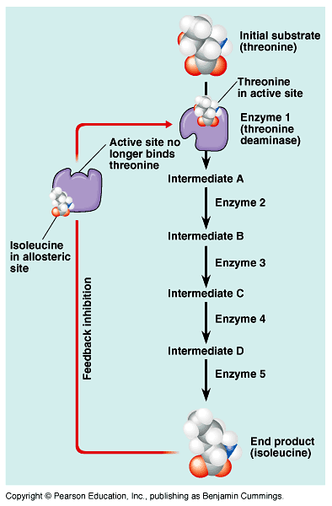
iii)- Feedback inhibition
It is one of the common methods of metabolic control in which a metabolic pathway is turned off by its end product.
Example:
The production of Isoleucine from Thereonine by Thereonine deaminase:-
The end product acts as an inhibitor of an enzyme in the pathway.
When the product is abundant, the pathway is turned off, when rare the pathway is active.

Slide 20
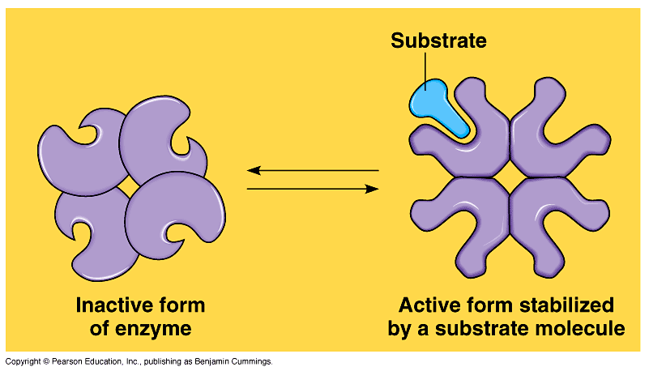
B)- Cooperativity regulation
It occurs in enzymes with multiple catalytic subunits. Lending a substrate to one active site stabilizes favorable conformational changes at all other subunits, a process called cooperativity.
This mechanism amplifies the response of enzymes to substrates, making the enzymes accept additional substrates.

Slide 21
Summary of metabolic control (i.e. enzyme activity)
The cell is controlling its metabolism by regulating enzyme activity:
1)- Allosteric Regulation:
Regulatory molecules that bind weakly to an Alosteric site of the enzyme (Allosteric Enzymes) in order to inhibit or stimulate the enzyme activity (see Fig 6.18 carefully).
A)- Allosteric activator.
B)- Allosteric inhibitor
C)- Feedback inhibition.
2- Cooperativity.
Stabilizes favorable conformational changes at all other subunits to make the enzyme more efficient.
http://www.northland.cc.mn.us/biology/Biology1111/animations/enzyme.html

