Slide 1
Shortness of Breath
Abdulrahman Al Frayh
Professor of Pediatrics Consultant Pediatric Pulmonologist
King Saud University

Slide 2
Airway Differences Between Adults and Children
Small airways are more easily blocked. Child's tongue is larger.
Infants are nose-breathers.
– Suctioning nasopharynx improves breathing significantly.

Slide 3
Chest and Abdomen
Increased elasticity of chest
Primarily abdominal breathers (infants primarily nose-breathers)
Less protection than adults for internal organs

Slide 4
QUALITIES OF DYSPNEA
Arise through cortical motor command
Work/effort
Stimulation of airway receptors
Tightness
Hunger for air
Imbalance when ventilation increases
Am Respir Crit Care Med. Vol 185,2012

Slide 5
CAUSES OF DYSPNEA
Increased ventilatory demand | Impaired mechanical response
Increased physiologic dead space Pulmonary embolism Pulmonary artery compression emphysema | Airway obstruction Chronic bronchitis tumor
Metabolic Exercise Altered CO2 Metabolic asidosis | Decreased chest wall compliance Post-thoracotomy Obesity
Neurohumoral or humoral Pain Anxiety Depression | Decreased parenchymal elasticity Pulmonary fibrosis Congestion
 | Inspiratory muscle weakness Neuromuscular disease Cachexia due to malnutrition/malignancy Myopathy Electrolyte imbalance

Slide 6
ASSESMENT OF DYSPNEA
History
Work/effort
Acute dyspnea
Chronic dyspnea
Associated symptoms
Positional dyspnea

Slide 7
CHARACTERISTICS OF HISTORY
Intermittent dyspnea
Reversibl causes
Acute bronchoconstriction Congestive heart failure Acute pulmonary embolism Pleural effusion
Persistent dyspnea
Irreversibl causes
COPD
Interstitial
Chronic pulmonary embolism PAH
Diaphragmatic dysfunction
/anomalies
Chest wall disorders

Slide 8
Cardiovascular Disease
Acute dyspnea can be caused by disturbances of the heart rhythm, failure of the left ventricle, mitral valve dysfunction, congenital heart disease or an embolus.

Slide 9
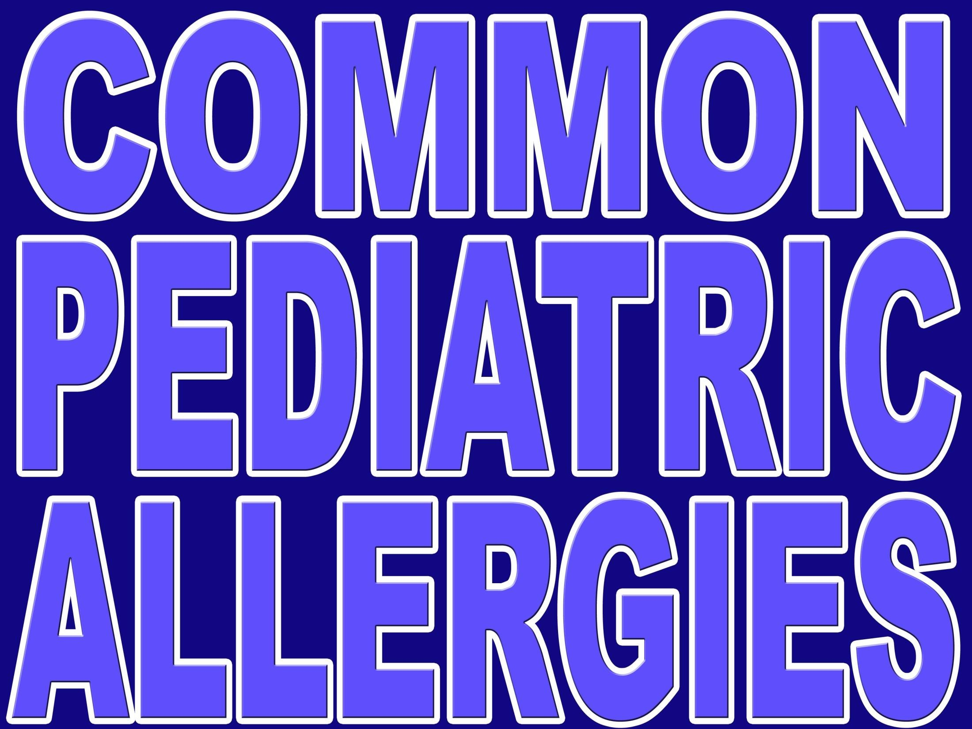

Slide 10
PREVALENCE OF ATOPY AND ASTHMA IN PRIMARY SCHOOL CHILDREN IN AUSTRALIA
Asthma diagnosed | 31.0%
Hay Fever | 38.4%
Eczema | 24.8%

Slide 11
Prevalence of Asthma, Rhinitis and Eczema in Saudi Arabia
50
40
30
20
10
0
45
Percentage
25
25
23
22
20
13
12
8
Asthma Rhinitis Eczema
1986: n=2123, 1995: n=1008, 2001:n=1014
Middle Bar indicates Physicians’ diagnosed Asthma
Red Bar indicates highly suspected asthma

Slide 12
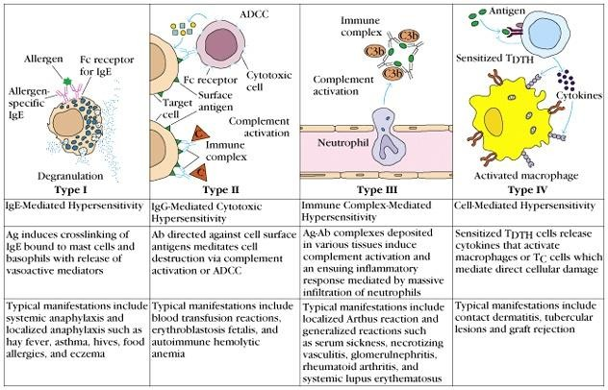
GeLL and Coombs classification of hypersensitivities.
Type II | Type III | Type IV
IgG/IgM Mediated | IgG Mediated | T cell
rbc lysis | Immune complex Disease | Delayed Type Hypersensitivity
AllergyType I
IgE Mediated
Classic

Slide 13
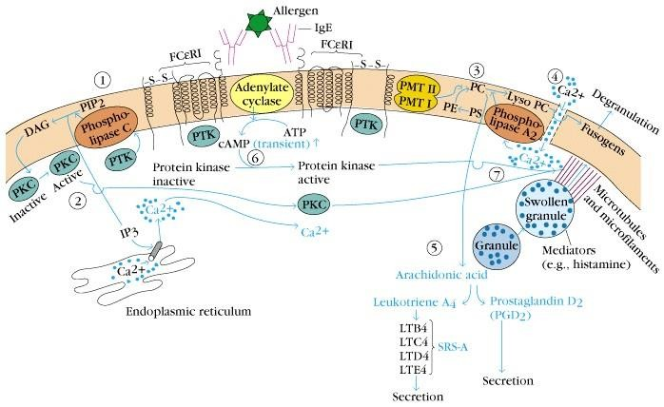
FcεRI Triggers Release of Mediators
Early mediators
cause immediate symptoms
e.g. histamine (preformed in granules) leukotriene C4 and prostaglandin D2
are quickly made 2' mediators

Slide 14
Type IV DTH Contact dermatitis
▶ The response to poison oak is a classic Type IV.
▶ Small molecules act as haptens and complex with skin proteins to be taken up by APCs and presented to Th1 cells to get sensitization.
▶ During secondary exposure Th1 memory cells become activated to cause DTH.

Slide 15
The history is the most important element in the evaluation of allergy. Key features of the history are:
Worsening of symptoms on exposure to aeroallergens
Seasonal variation in symptoms related to pollination of
trees, grasses, and weeds
A family history of atopic disease
An environmental history assessing exposure to indoor and outdoor allegens
and the presence of associated allergic conditions

Slide 16
The most important ancillary test to confirm the diagnosis of allergy is the skin test, which is the gold standard in this regard. The skin test results must be interpreted in light of the history to determine the importance of a positive test.

Slide 17
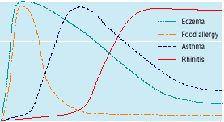
THE “ATOPIC MARCH”
5 Age (years)
IgE levels in blood
→ AD is in most cases the first manifestation of the atopic disposition
Modified from Barnetson & Rogers. BMJ 2002, 324:1376–9
0
10 15

Slide 18
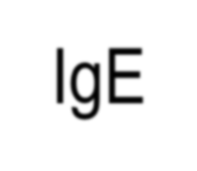
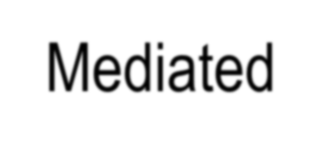
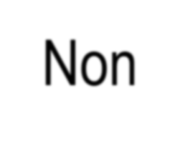
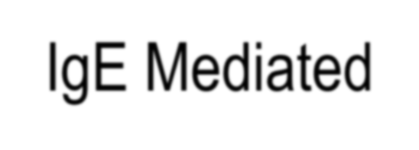
Adverse Reactions to Food
IgE-Mediated
▶ Oral
Allergy Syndrom e
▶ Anaphyla xis
▶ Urticaria
Non-IgE Mediated
Eosinophilic esophagitis
Eosinophilic gastritis
Eosinophilic gastroenteritis
Atopic dermatitis
Protein-Induced Enterocolitis
Protein-Induced Enteropathy
Eosinophilic proctitis
Dermatitis herpetiformis

Slide 19
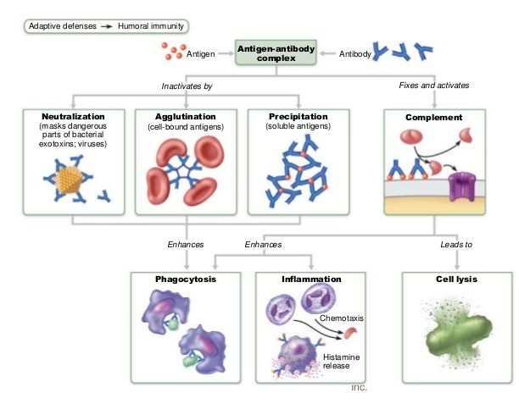
Antigen-Antibody Complex Functions

Slide 20
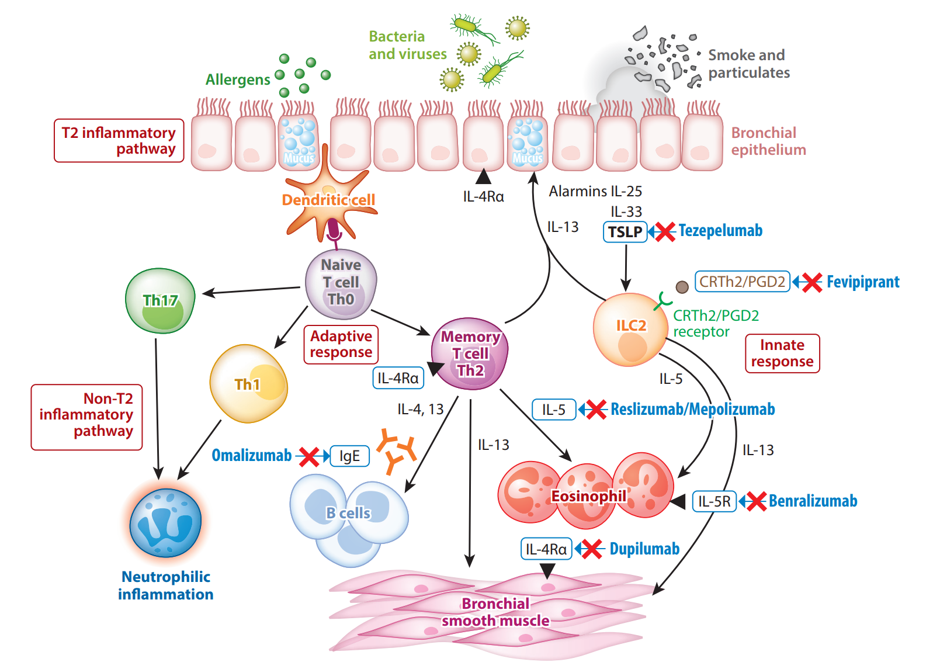

Slide 21
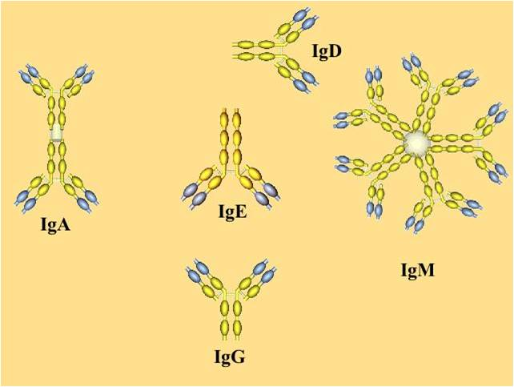
Classes of Antibodies

Slide 22
Classes of Antibodies
IgA | Antibodies are dimmers – contain two Y shaped structures. Found in mucosal areas, such as the gut, respiratory tract and urogenital tract. Also found in saliva, tears, and breast milk. They attack microbes and prevents colonization by pathogens before they reach the blood stream so it is most important antibody in local immunity
IgD | Functions mainly as an antigen receptor on B cells that have not been exposed to antigens. It has been shown to activate basophils and mast cells to produce antimicrobial factors.
IgG | In its four forms, provides the majority of antibody-based immunity against invading pathogens. It makes up about 75 % of all human antibodies and is the body’s major defense against bacteria. The only antibody capable of crossing the placenta to give passive immunity to fetus. It is the most versatile of antibodies because it carries out functions of the other antibodies as well.
IgE | Binds to allergens and triggers histamine release from mast cells and basophils, and is involved in allergy. Also protects against parasitic worms.
IgM | Expressed on the surface of B cells and in a secreted form with very high avidity. Eliminates pathogens in the early stages of B cell mediated (humoral) immunity before there is sufficient IgG.

